Slide 1
Fundamentals of Microelectronics
CH1 Why Microelectronics?
CH2 Basic Physics of Semiconductors
CH3 Diode Circuits
CH4 Physics of Bipolar Transistors
CH5 Bipolar Amplifiers
CH6 Physics of MOS Transistors
CH7 CMOS Amplifiers
CH8 Operational Amplifier As A Black Box

Slide 2
Chapter 1 Why Microelectronics?
1.1 Electronics versus Microelectronics
1.2 Example of Electronic System: Cellular Telephone
1.3 Analog versus Digital

Slide 3
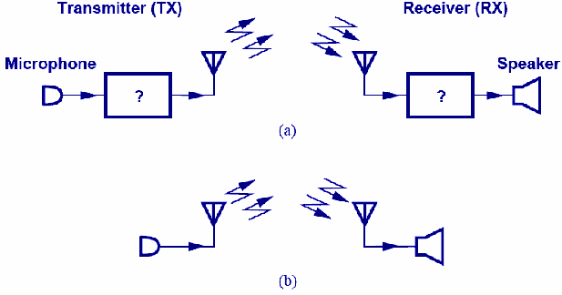
Cellular Technology
An important example of microelectronics.
Microelectronics exist in black boxes that process the received and transmitted voice signals.
CH1 Why Microelectronics?

Slide 4
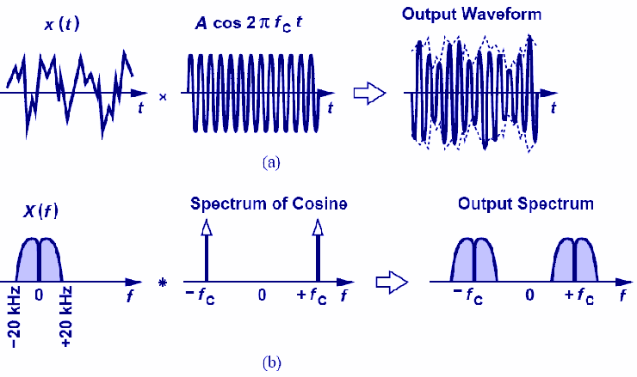
Frequency Up-conversion
Voice is “up-converted” by multiplying two sinusoids.
When multiplying two sinusoids in time domain, their spectra are convolved in frequency domain.
CH1 Why Microelectronics?

Slide 5
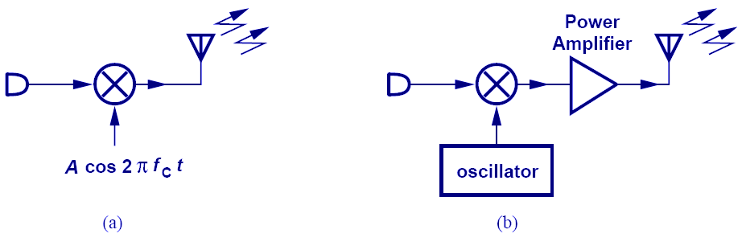
Transmitter
Two frequencies are multiplied and radiated by an antenna in (a).
A power amplifier is added in (b) to boost the signal.
CH1 Why Microelectronics?

Slide 6
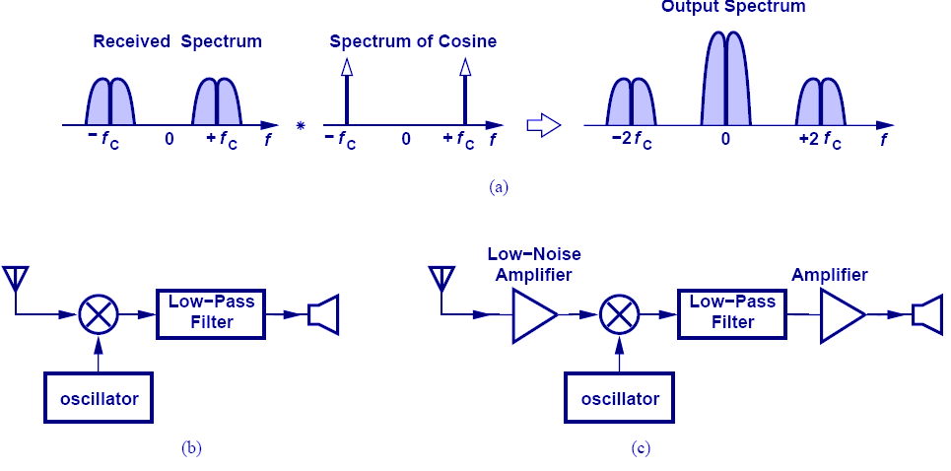
Receiver
High frequency is translated to DC by multiplying by f_{C}.
A low-noise amplifier is needed for signal boosting without excessive noise.
CH1 Why Microelectronics?

Slide 7
Chapter 2 Basic Physics of Semiconductors
Objectives
  Semiconductor materials and their properties
  PN-junction diodes
  Reverse Breakdown

Slide 8
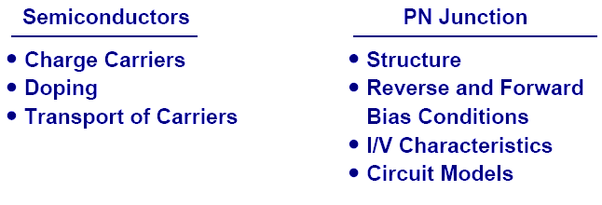
Semiconductor Physics
Semiconductor devices serve as heart of microelectronics.
PN junction is the most fundamental semiconductor device.
CH2 Basic Physics of Semiconductors

Slide 9
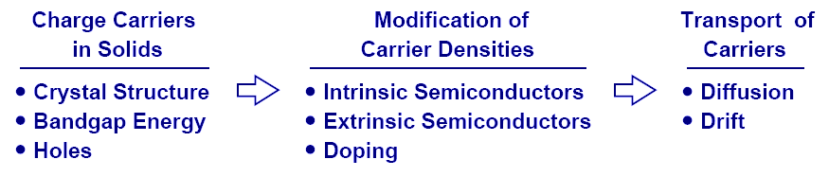
Charge Carriers in Semiconductor
To understand PN junction’s IV characteristics, it is important to understand charge carriers’ behavior in solids, how to modify carrier densities, and different mechanisms of charge flow.
CH2 Basic Physics of Semiconductors

Slide 10
Chapter 2 Basic Physics of Semiconductors
Semiconductor materials can imitate the classical glass tubes based diodes and triodes
Silicon atomic density ≈ 5 × 10²² atoms/cm³
In intrinsic silicon, only about 1 electron per 10¹² atoms is free, giving approximately 10¹⁰ electrons/cm³.
For practical conduction, semiconductors are doped to increase carrier concentration to 10¹⁵–10¹⁸ cm⁻³.
We can create n-type (cathode) and p-type(cathode)

Slide 11
Classification of materials: conductivity
  Conductor (unipolar) “metals”
  Insulator Eg=2.5eV
  Semiconductor (bipolar)
    Eg=1.12 Si and 0.72 Ge
E_{g}, or bandgap energy: min energy required to dislodge electron from its covalent bond.

Slide 12
Atom’s chemical activity
  Neon: 8 valence electrons (10)
  Sodium: one “ready to give away” (11)
  Chloride: seven “eager to receive” (17)
  Materials with 4 valence electrons fall b/w
  Inert and highly active :semiconductors
  (3 to 5 valence electrons)

Slide 13
Silicon (Z=14)?
Abundance
Stable with temperature
Stable crystalline structure
Easy manufacturing process: physical and chemical properties
Moderate band gap of 1.12eV

Slide 14
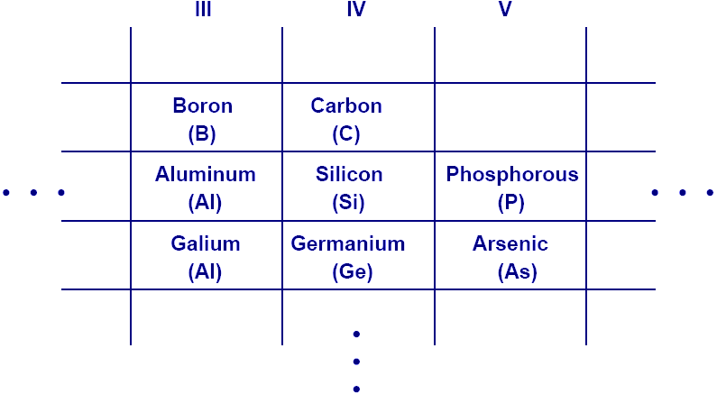
Periodic Table
This abridged table contains elements with three to five valence electrons, with Si being the most important.
CH2 Basic Physics of Semiconductors

Slide 15
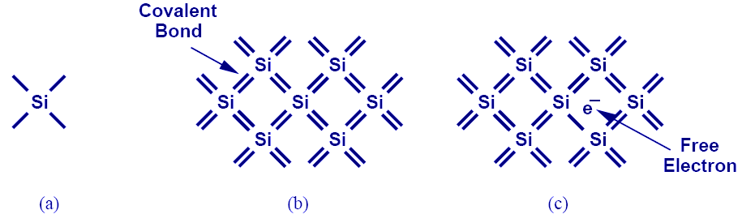
Silicon
Si has four valence electrons. Therefore, it can form covalent bonds with four of its neighbors.
When temperature goes up, electrons in the covalent bond can become free.
CH2 Basic Physics of Semiconductors

Slide 16
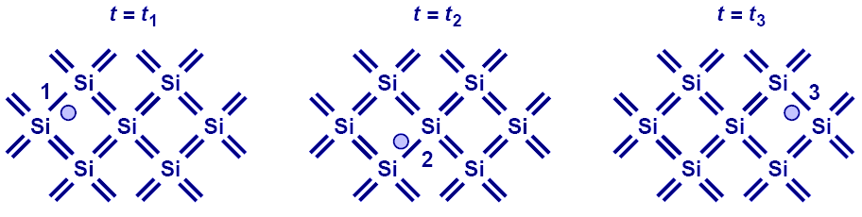
Electron-Hole Pair Interaction
With free electrons breaking off covalent bonds, holes are generated.
Holes can be filled by absorbing other free electrons, so effectively there is a flow of charge carriers.
CH2 Basic Physics of Semiconductors

Slide 17
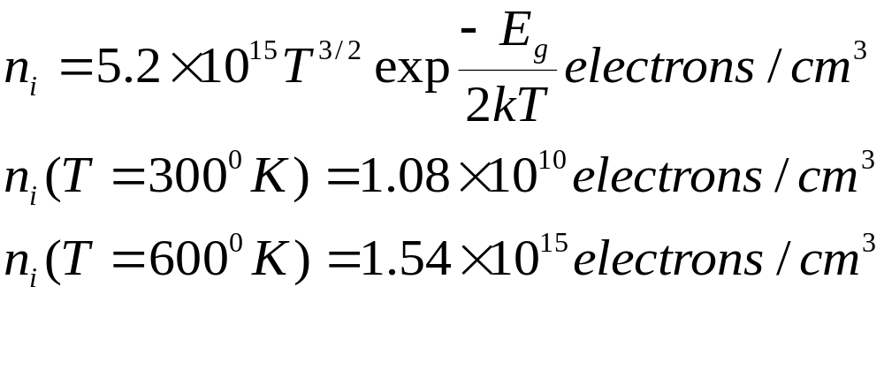
Free Electron Density at a Given Temperature
E_{g}, or bandgap energy determines how much effort is needed to break off an electron from its covalent bond.
There exists an exponential relationship between the free-electron density and bandgap energy.
CH2 Basic Physics of Semiconductors

Slide 18
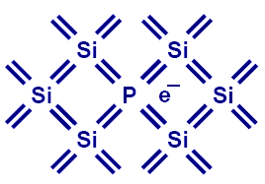
Doping (N type)
Pure Si can be doped with other elements to change its electrical properties.
For example, if Si is doped with P (phosphorous), then it has more electrons, or becomes type N (electron).
CH2 Basic Physics of Semiconductors

Slide 19
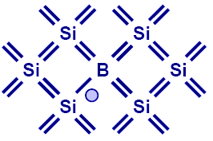
Doping (P type)
If Si is doped with B (boron), then it has more holes, or becomes type P.
CH2 Basic Physics of Semiconductors

Slide 20
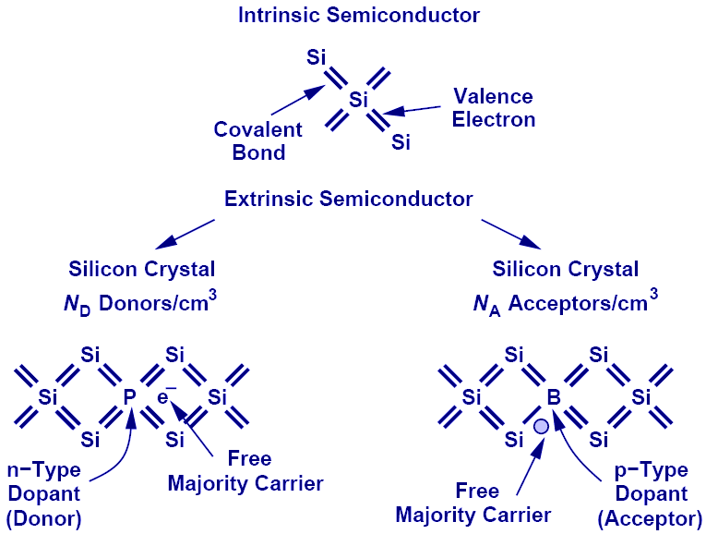
Summary of Charge Carriers
CH2 Basic Physics of Semiconductors

Slide 21

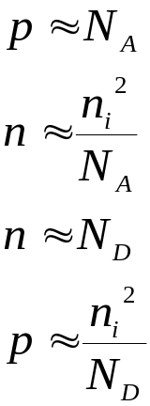

Electron and Hole Densities
Majority Carriers :
Minority Carriers :
Majority Carriers :
Minority Carriers :
The product of electron and hole densities is ALWAYS equal to the square of intrinsic electron density regardless of doping levels. Law of mass action
Conservation of charge:
CH2 Basic Physics of Semiconductors

Slide 22
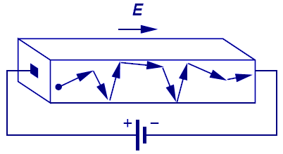
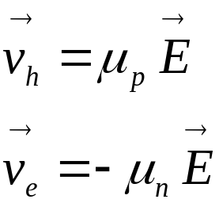
First Charge Transportation Mechanism: Drift
The process in which charge particles move because of an electric field is called drift.
Charge particles will move at a velocity that is proportional to the electric field.
CH2 Basic Physics of Semiconductors

Slide 23
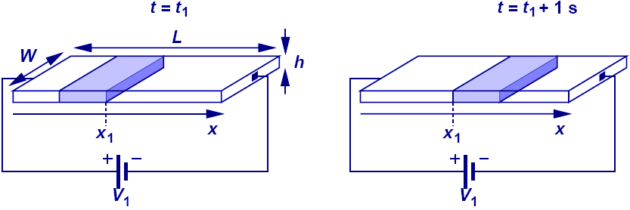

Current Flow: General Case
Electric current is calculated as the amount of charge in v meters that passes thru a cross-section if the charge travel with a velocity of v m/s.
CH2 Basic Physics of Semiconductors

Slide 24
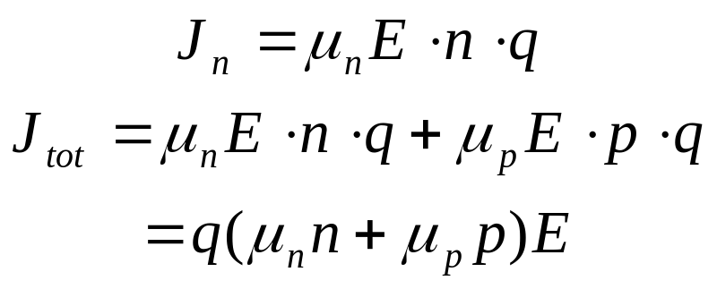
Current Flow: Drift
Since velocity is equal to μE, drift characteristic is obtained by substituting V with μE in the general current equation.
The total current density consists of both electrons and holes.
CH2 Basic Physics of Semiconductors

Slide 25
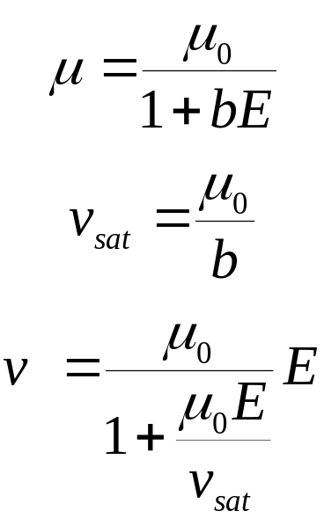
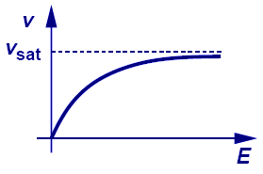
Velocity Saturation
A topic treated in more advanced courses is velocity saturation.
In reality, velocity does not increase linearly with electric field. It will eventually saturate to a critical value.
CH2 Basic Physics of Semiconductors

Slide 26
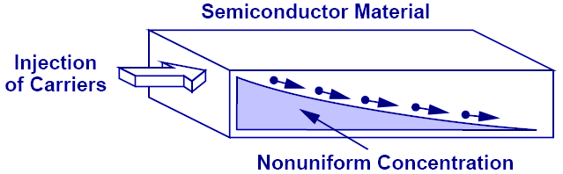
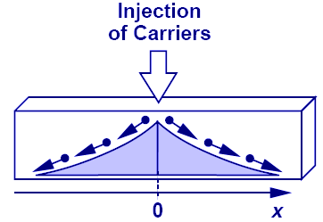
Second Charge Transportation Mechanism: Diffusion
Charge particles move from a region of high concentration to a region of low concentration. It is analogous to an every day example of an ink droplet in water.
CH2 Basic Physics of Semiconductors

Slide 27
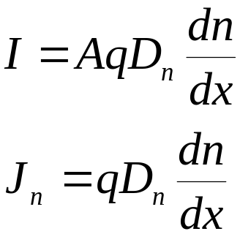
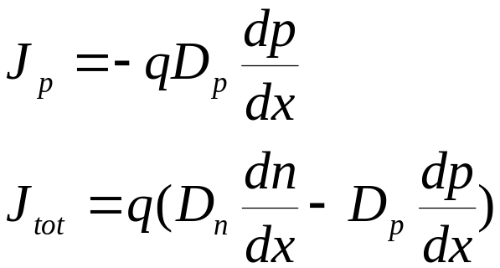
Current Flow: Diffusion
Diffusion current is proportional to the gradient of charge (dn/dx) along the direction of current flow.
Its total current density consists of both electrons and holes.
CH2 Basic Physics of Semiconductors

Slide 28
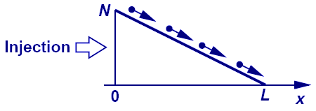
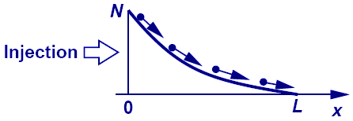
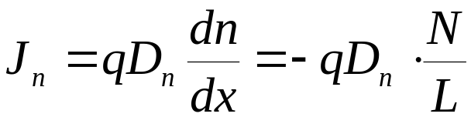
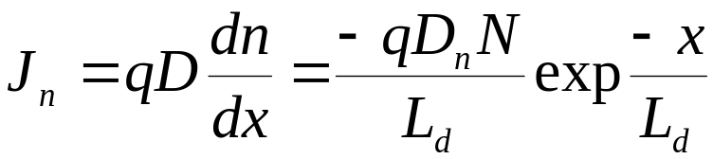
Example: Linear vs. Nonlinear Charge Density Profile
Linear charge density profile means constant diffusion current, whereas nonlinear charge density profile means varying diffusion current.
CH2 Basic Physics of Semiconductors

Slide 29
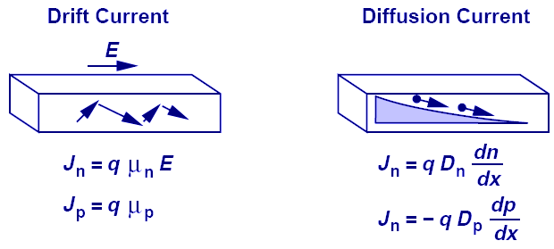
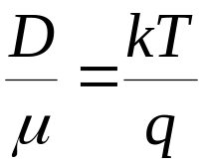
Einstein's Relation
While the underlying physics behind drift and diffusion currents are totally different, Einstein’s relation provides a mysterious link between the two.
CH2 Basic Physics of Semiconductors

Slide 30
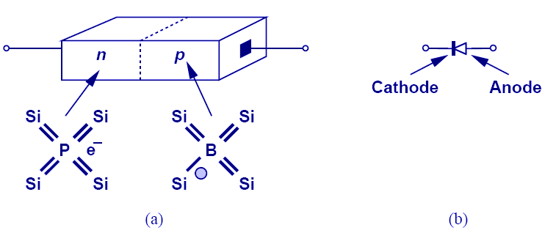
PN Junction (Diode)
When N-type and P-type dopants are introduced side-by-side in a semiconductor, a PN junction or a diode is formed.
CH2 Basic Physics of Semiconductors

Slide 31
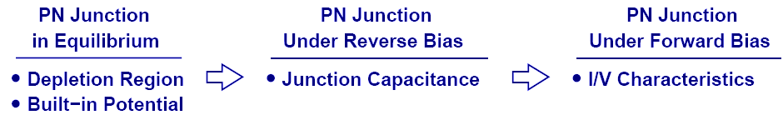
Diode’s Three Operation Regions
In order to understand the operation of a diode, it is necessary to study its three operation regions: equilibrium, reverse bias, and forward bias.
CH2 Basic Physics of Semiconductors

Slide 32
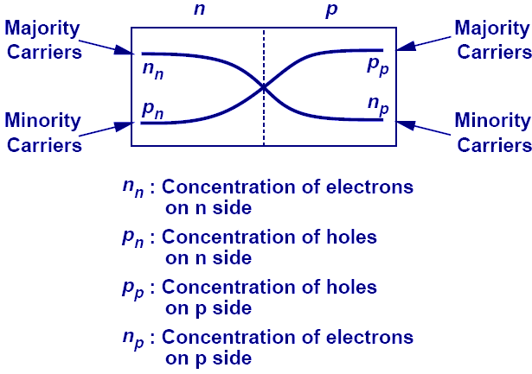
Current Flow Across Junction: Diffusion
Because each side of the junction contains an excess of holes or electrons compared to the other side, there exists a large concentration gradient. Therefore, a diffusion current flows across the junction from each side.
CH2 Basic Physics of Semiconductors

Slide 33
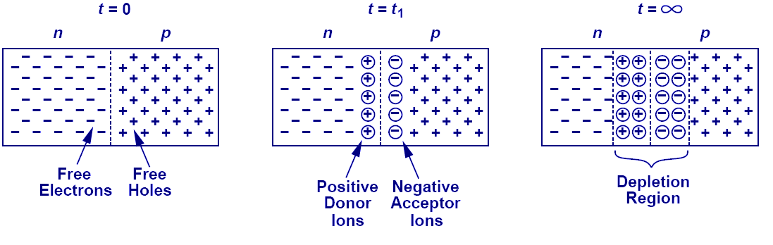
Depletion Region
As free electrons and holes diffuse across the junction, a region of fixed ions is left behind. This region is known as the “depletion region.”
CH2 Basic Physics of Semiconductors

Slide 34
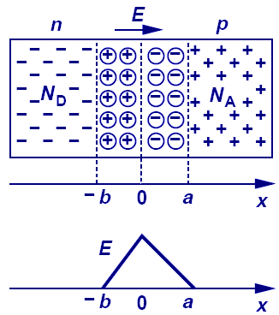
Current Flow Across Junction: Drift
The fixed ions in depletion region create an electric field that results in a drift current.
CH2 Basic Physics of Semiconductors

Slide 35
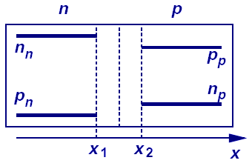
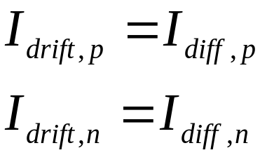
Current Flow Across Junction: Equilibrium
At equilibrium, the drift current flowing in one direction cancels out the diffusion current flowing in the opposite direction, creating a net current of zero.
The figure shows the charge profile of the PN junction.
CH2 Basic Physics of Semiconductors

Slide 36
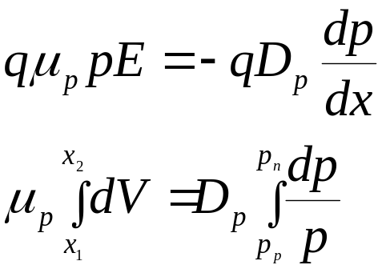
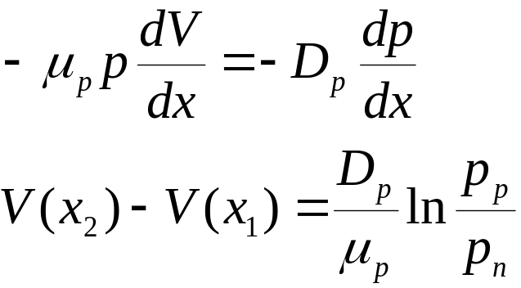
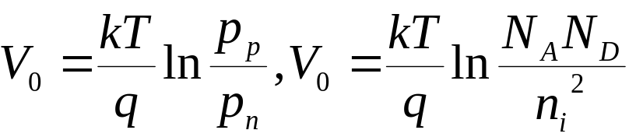
Built-in Potential
Because of the electric field across the junction, there exists a built-in potential. Its derivation is shown above.
CH2 Basic Physics of Semiconductors

Slide 37
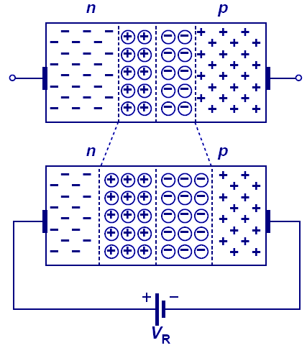
Diode in Reverse Bias
When the N-type region of a diode is connected to a higher potential than the P-type region, the diode is under reverse bias, which results in wider depletion region and larger built-in electric field across the junction.
CH2 Basic Physics of Semiconductors

Slide 38
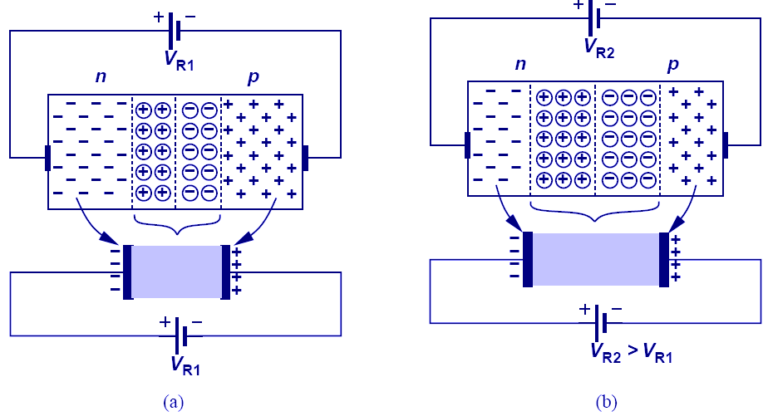
Reverse Biased Diode’s Application: Voltage-Dependent Capacitor
The PN junction can be viewed as a capacitor. By varying V_{R}, the depletion width changes, changing its capacitance value; therefore, the PN junction is actually a voltage-dependent capacitor.
CH2 Basic Physics of Semiconductors

Slide 39
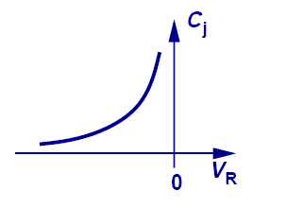
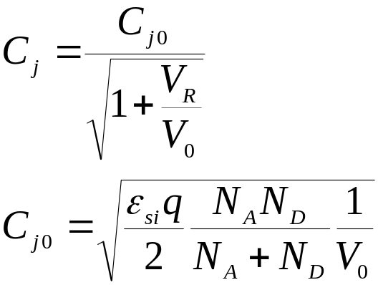
Voltage-Dependent Capacitance
The equations that describe the voltage-dependent capacitance are shown above.
CH2 Basic Physics of Semiconductors

Slide 40
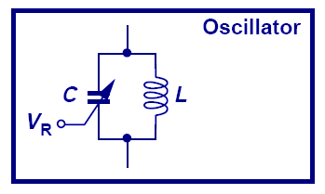
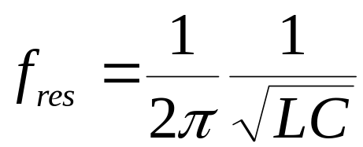
Voltage-Controlled Oscillator
A very important application of a reverse-biased PN junction is VCO, in which an LC tank is used in an oscillator. By changing V_{R}, we can change C, which also changes the oscillation frequency.
CH2 Basic Physics of Semiconductors

Slide 41
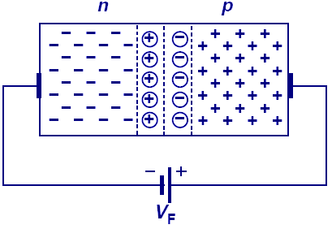
Diode in Forward Bias
When the N-type region of a diode is at a lower potential than the P-type region, the diode is in forward bias.
The depletion width is shortened and the built-in electric field decreased.
CH2 Basic Physics of Semiconductors

Slide 42
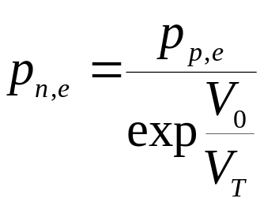
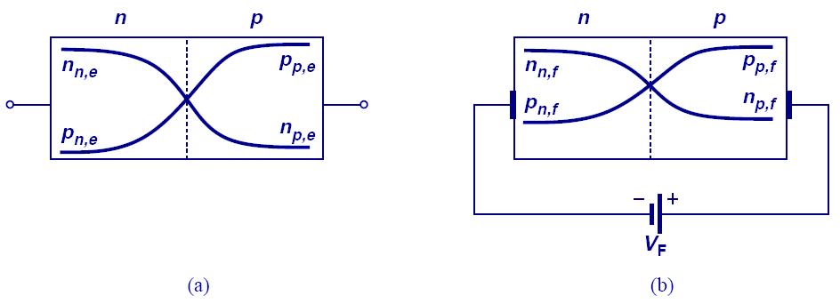
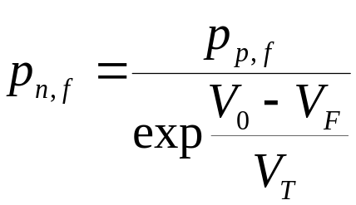
Minority Carrier Profile in Forward Bias
Under forward bias, minority carriers in each region increase due to the lowering of built-in field/potential. Therefore, diffusion currents increase to supply these minority carriers.
CH2 Basic Physics of Semiconductors

Slide 43


Diffusion Current in Forward Bias
Change in electron conc. in p side and hole conc. In n side.
CH2 Basic Physics of Semiconductors

Slide 44





Diffusion Current in Forward Bias
Diffusion current will increase in order to supply the increase in minority carriers. The mathematics are shown above.
CH2 Basic Physics of Semiconductors

Slide 45

Minority Charge Gradient
Minority charge profile should not be constant along the x-axis; otherwise, there is no concentration gradient and no diffusion current.
Recombination of the minority carriers with the majority carriers accounts for the dropping of minority carriers as they go deep into the P or N region.
CH2 Basic Physics of Semiconductors

Slide 46


IV Characteristic of PN Junction
The current and voltage relationship of a PN junction is exponential in forward bias region, and relatively constant in reverse bias region.
CH2 Basic Physics of Semiconductors

Slide 47

Constant-Voltage Diode Model
Diode operates as an open circuit if V_{D}< V_{D,on} and a constant voltage source of V_{D,on} if V_{D} tends to exceed V_{D,on.}
CH2 Basic Physics of Semiconductors

Slide 48




Example: Diode Calculations
for
for
This example shows the simplicity provided by a constant-voltage model over an exponential model.
For an exponential model, iterative method is needed to solve for current, whereas constant-voltage model requires only linear equations.
CH2 Basic Physics of Semiconductors

Slide 49

Reverse Breakdown
When a large reverse bias voltage is applied, breakdown occurs and an enormous current flows through the diode.
CH2 Basic Physics of Semiconductors

Slide 50

Zener vs. Avalanche Breakdown
Zener breakdown is a result of the large electric field inside the depletion region that breaks electrons or holes off their covalent bonds.
Avalanche breakdown is a result of electrons or holes colliding with the fixed ions inside the depletion region.
CH2 Basic Physics of Semiconductors

Slide 51
Chapter 3 Diode Circuits
3.1 Ideal Diode
3.2 PN Junction as a Diode
3.3 Applications of Diodes

Slide 52

Diode Circuits
After we have studied in detail the physics of a diode, it is time to study its behavior as a circuit element and its many applications.
CH3 Diode Circuits

Slide 53

Diode’s Application: Cell Phone Charger
An important application of diode is chargers.
Diode acts as the black box (after transformer) that passes only the positive half of the stepped-down sinusoid.
CH3 Diode Circuits

Slide 54

Diode’s Action in The Black Box (Ideal Diode)
The diode behaves as a short circuit during the positive half cycle (voltage across it tends to exceed zero), and an open circuit during the negative half cycle (voltage across it is less than zero).
CH3 Diode Circuits

Slide 55

Ideal Diode
In an ideal diode, if the voltage across it tends to exceed zero, current flows.
It is analogous to a water pipe that allows water to flow in only one direction.
CH3 Diode Circuits

Slide 56

Diodes in Series
Diodes cannot be connected in series randomly. For the circuits above, only a) can conduct current from A to C.
CH3 Diode Circuits

Slide 57



IV Characteristics of an Ideal Diode
If the voltage across anode and cathode is greater than zero, the resistance of an ideal diode is zero and current becomes infinite. However, if the voltage is less than zero, the resistance becomes infinite and current is zero.
CH3 Diode Circuits

Slide 58

Anti-Parallel Ideal Diodes
If two diodes are connected in anti-parallel, it acts as a short for all voltages.
CH3 Diode Circuits

Slide 59

Diode-Resistor Combination
The IV characteristic of this diode-resistor combination is zero for negative voltages and Ohm’s law for positive voltages.
CH3 Diode Circuits

Slide 60

Diode Implementation of OR Gate
The circuit above shows an example of diode-implemented OR gate.
V_{out} can only be either V_{A} or V_{B}, not both.
CH3 Diode Circuits

Slide 61

Input/Output Characteristics
When V_{in} is less than zero, the diode opens, so V_{out} = V_{in}.
When V_{in} is greater than zero, the diode shorts, so V_{out} = 0.
CH3 Diode Circuits

Slide 62

Diode’s Application: Rectifier
A rectifier is a device that passes positive-half cycle of a sinusoid and blocks the negative half-cycle or vice versa.
When V_{in} is greater than 0, diode shorts, so V_{out} = V_{in}; however, when V_{in} is less than 0, diode opens, no current flows thru R₁, Vout = I_{R1}R₁ = 0.
CH3 Diode Circuits

Slide 63




Signal Strength Indicator
for
for
The averaged value of a rectifier output can be used as a signal strength indicator for the input, since V_{out,avg} is proportional to V_{p}, the input signal’s amplitude.
CH3 Diode Circuits

Slide 64

Diode’s application: Limiter
The purpose of a limiter is to force the output to remain below certain value.
In a), the addition of a 1 V battery forces the diode to turn on after V₁ has become greater than 1 V.
CH3 Diode Circuits

Slide 65

Limiter: When Battery Varies
An interesting case occurs when V_{B} (battery) varies.
Rectification fails if V_{B} is greater than the input amplitude.
CH3 Diode Circuits

Slide 66

Different Models for Diode
So far we have studied the ideal model of diode. However, there are still the exponential and constant voltage models.
CH3 Diode Circuits

Slide 67

Input/Output Characteristics with Ideal and Constant-Voltage Models
The circuit above shows the difference between the ideal and constant-voltage model; the two models yield two different break points of slope.
CH3 Diode Circuits

Slide 68

Input/Output Characteristics with a Constant-Voltage Model
When using a constant-voltage model, the voltage drop across the diode is no longer zero but V_{d,on} when it conducts.
CH3 Diode Circuits

Slide 69

Another Constant-Voltage Model Example
In this example, since Vin is connected to the cathode, the diode conducts when Vin is very negative.
The break point where the slope changes is when the current across R1 is equal to the current across R2.
CH3 Diode Circuits

Slide 70

Another Constant-Voltage Model Example
This example shows the importance of good initial guess and careful confirmation.
CH3 Diode Circuits

Slide 71


Small-Signal Analysis
Small-signal analysis is performed around a bias point by perturbing the voltage by a small amount and observing the resulting linear current perturbation.
CH3 Diode Circuits

Slide 72


Small-Signal Analysis in Detail
If two points on the IV curve of a diode are close enough, the trajectory connecting the first to the second point is like a line, with the slope being the proportionality factor between change in voltage and change in current.
CH3 Diode Circuits

Slide 73


Small-Signal Incremental Resistance
Since there’s a linear relationship between the small signal current and voltage of a diode, the diode can be viewed as a linear resistor when only small changes are of interest.
CH3 Diode Circuits

Slide 74



Small Sinusoidal Analysis
If a sinusoidal voltage with small amplitude is applied, the resulting current is also a small sinusoid around a DC value.
CH3 Diode Circuits

Slide 75

Cause and Effect
In (a), voltage is the cause and current is the effect. In (b), the other way around.
CH3 Diode Circuits

Slide 76
Applications of Diode
CH3 Diode Circuits

Slide 77


Half-Wave Rectifier
A very common application of diodes is half-wave rectification, where either the positive or negative half of the input is blocked.
But, how do we generate a constant output?
CH3 Diode Circuits

Slide 78

Diode-Capacitor Circuit: Constant Voltage Model
If the resistor in half-wave rectifier is replaced by a capacitor, a fixed voltage output is obtained since the capacitor (assumed ideal) has no path to discharge.
CH3 Diode Circuits

Slide 79


Diode-Capacitor Circuit: Ideal Model
Note that (b) is just like V_{in,} only shifted down.
CH3 Diode Circuits

Slide 80

Diode-Capacitor With Load Resistor
A path is available for capacitor to discharge. Therefore, V_{out} will not be constant and a ripple exists.
CH3 Diode Circuits

Slide 81


Behavior for Different Capacitor Values
For large C₁, V_{out} has small ripple.
CH3 Diode Circuits

Slide 82


Peak to Peak amplitude of Ripple
The ripple amplitude is the decaying part of the exponential.
Ripple voltage becomes a problem if it goes above 5 to 10% of the output voltage.
CH3 Diode Circuits

Slide 83


Maximum Diode Current
The diode has its maximum current at t₁, since that’s when the slope of V_{out} is the greatest.
This current has to be carefully controlled so it does not damage the device.
CH3 Diode Circuits

Slide 84

Full-Wave Rectifier
A full-wave rectifier passes both the negative and positive half cycles of the input, while inverting the negative half of the input.
As proved later, a full-wave rectifier reduces the ripple by a factor of two.
CH3 Diode Circuits

Slide 85

The Evolution of Full-Wave Rectifier
Figures (e) and (f) show the topology that inverts the negative half cycle of the input.
CH3 Diode Circuits

Slide 86

Full-Wave Rectifier: Bridge Rectifier
The figure above shows a full-wave rectifier, where D₁ and D₂ pass/invert the negative half cycle of input and D₃ and D₄ pass the positive half cycle.
CH3 Diode Circuits

Slide 87

Input/Output Characteristics of a Full-Wave Rectifier (Constant-Voltage Model)
The dead-zone around V_{in} arises because V_{in} must exceed 2 V_{D,ON} to turn on the bridge.
CH3 Diode Circuits

Slide 88

Complete Full-Wave Rectifier
Since C₁ only gets ½ of period to discharge, ripple voltage is decreased by a factor of 2. Also (b) shows that each diode is subjected to approximately one V_{p} reverse bias drop (versus 2V_{p} in half-wave rectifier).
CH3 Diode Circuits

Slide 89

Current Carried by Each Diode in the Full-Wave Rectifier
CH3 Diode Circuits

Slide 90

Summary of Half and Full-Wave Rectifiers
Full-wave rectifier is more suited to adapter and charger applications.
CH3 Diode Circuits

Slide 91

Voltage Regulator
The ripple created by the rectifier can be unacceptable to sensitive load; therefore, a regulator is required to obtain a very stable output.
Three diodes operate as a primitive regulator.
CH3 Diode Circuits

Slide 92


Voltage Regulation With Zener Diode
Voltage regulation can be accomplished with Zener diode. Since r_{d} is small, large change in the input will not be reflected at the output.
CH3 Diode Circuits

Slide 93



Line Regulation VS. Load Regulation
Line regulation is the suppression of change in V_{out} due to change in V_{in} (b).
Load regulation is the suppression of change in V_{out} due to change in load current (c).
CH3 Diode Circuits

Slide 94

Evolution of AC-DC Converter
CH3 Diode Circuits

Slide 95

Limiting Circuits
The motivation of having limiting circuits is to keep the signal below a threshold so it will not saturate the entire circuitry.
When a receiver is close to a base station, signals are large and limiting circuits may be required.
CH3 Diode Circuits

Slide 96

Input/Output Characteristics
Note the clipping of the output voltage.
CH3 Diode Circuits

Slide 97

Limiting Circuit Using a Diode:
Positive Cycle Clipping
As was studied in the past, the combination of resistor-diode creates limiting effect.
CH3 Diode Circuits

Slide 98

Limiting Circuit Using a Diode:
Negative Cycle Clipping
CH3 Diode Circuits

Slide 99

Limiting Circuit Using a Diode:
Positive and Negative Cycle Clipping
CH3 Diode Circuits

Slide 100

General Voltage Limiting Circuit
Two batteries in series with the antiparalle diodes control the limiting voltages.
CH3 Diode Circuits

Slide 101



Capacitive Divider
CH3 Diode Circuits

Slide 102

Waveform Shifter: Peak at -2Vp
As V_{in} increases, D₁ turns on and V_{out} is zero.
As V_{in} decreases, D₁ turns off, and V_{out} drops with V_{in} from zero. The lowest V_{out} can go is -2V_{p}, doubling the voltage.
CH3 Diode Circuits

Slide 103

Waveform Shifter: Peak at 2Vp
Similarly, when the terminals of the diode are switched, a voltage doubler with peak value at 2V_{p} can be conceived.
CH3 Diode Circuits

Slide 104


Voltage Doubler
The output increases by V_{p,} V_{p/2,} V_{p/4,} etc in each input cycle, eventually settling to 2 V_{p.}
CH3 Diode Circuits

Slide 105

Current thru D₁ in Voltage Doubler
CH3 Diode Circuits
Notes:
After t1, D1 stops conducting…doesn’t that mean the current running thru it is zero?

Slide 106

Another Application: Voltage Shifter
CH3 Diode Circuits

Slide 107

Voltage Shifter (2V_{D,ON})
CH3 Diode Circuits

Slide 108

Diode as Electronic Switch
Diode as a switch finds application in logic circuits and data converters.
CH3 Diode Circuits

