Slide 1
Business Letters
SALES letter, order letter, inquiry letter and memo

Slide 2
Business Letters
Business letters are formal written means of communication used in professional and commercial contexts. They help convey information clearly, maintain records, and build professional relationships. Effective business letters follow a structured format and use precise, courteous language.

Slide 3
LAYOUT OF BUSINESS LETTER
Suitable and correct layout enhances the overall effectiveness of any letter.
The layout helps to arrange all the elements of a formal letter in an organized manner.
Although the basic parts of a letter have remained the same for centuries, the layouts have changed to quite an extent.
Sometimes an organization adopts a certain format as its policy; sometimes the individual letter writer is allowed to choose the format most appropriate for a given letter or to settle on a personal preference. In general, two major letter layouts are widely used.

Slide 4
Block layout
The block layout, also known as the complete block layout is extremely popular as it makes the letter look attractive, elegant, and efficient.
The main characteristic of this layout is that all elements except the letterhead heading are aligned to the left margin

Slide 5
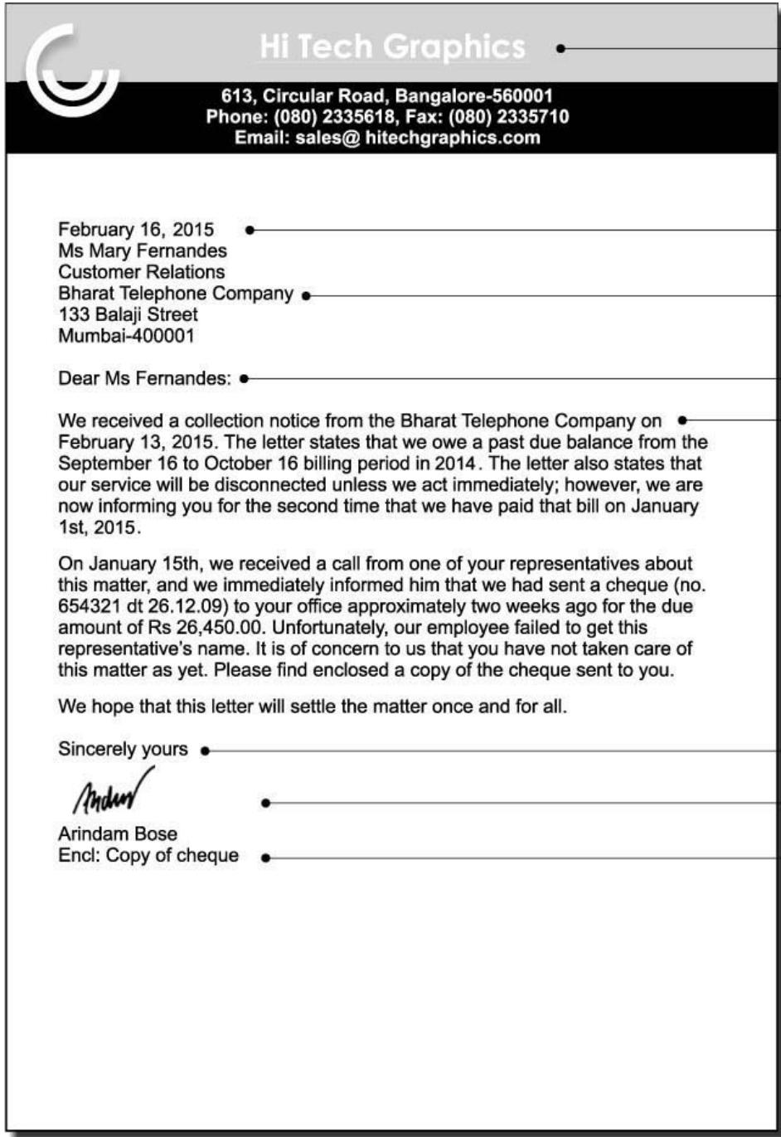

Slide 6
Modified Block layout
The modified block format differs from the block format in the positioning of certain elements:
The heading is center aligned whereas the dateline, complimentary close, and signature block are right-aligned.
Although organizations seem to prefer the full block format, the modified block is also acceptable. The modified block’s appearance is often considered to be more balanced and traditional.

Slide 7
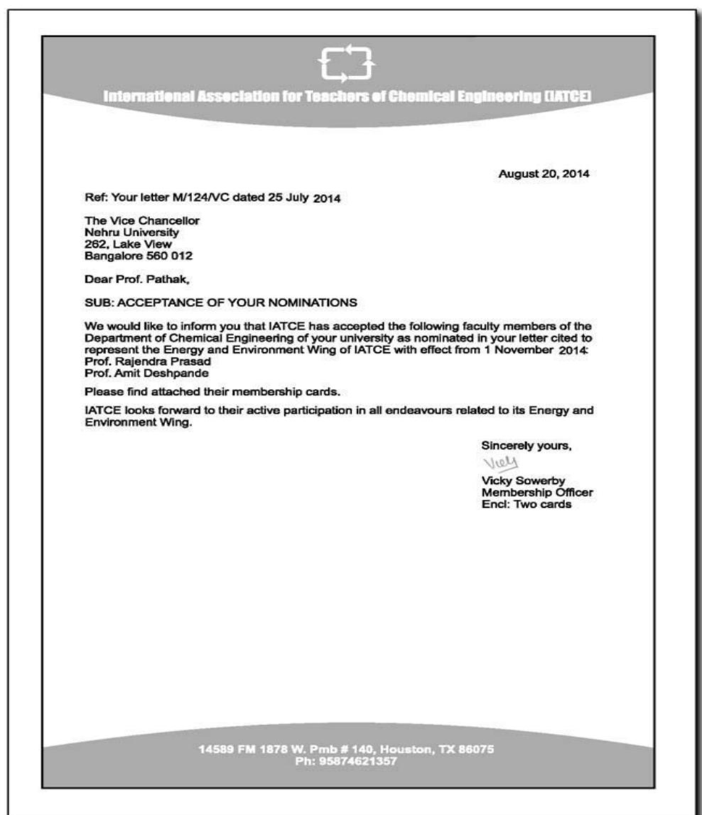

Slide 8
Sales Letter
These letters are meant to present a new product or service to the company’s client or customer.
Sales personnel use these letters to contact prospective buyers and also to strengthen their terms with long-term clients.
It:
tells about a product or service
explains why it is useful
asks the reader to take action (like buy or contact)
In short: it is a letter used to sell something.

Slide 9
ABC Electronics Pvt. Ltd. MG Road, Panaji, Goa – 40300
Date: 13 April 2026
To, The Purchase Manager XYZ Enterprises Margao, Goa – 403601
Subject: Introduction of Our New Smart Home Devices
Dear Sir/Madam,
We are pleased to introduce our new range of smart home devices, including lighting systems, security cameras, and voice-controlled assistants. These products are user-friendly, efficient, and competitively priced.
We are offering a 15% discount on bulk orders placed before 30 April 2026. We would be happy to share more details or arrange a demonstration.
We look forward to your response.
Yours sincerely,
Rahul Mehta Sales Manager ABC Electronics Pvt. Ltd. Contact: +91 XXXXX XXXXX

Slide 10
Inquiry Letter
Generally, a client or customer writes this letter and sends it to the organization to ask for details or seek clarifications about the goods.
This will include their quality, quantity, rates, size, delivery charges, discount rates, packing, time of delivery and other terms and conditions.

Slide 11
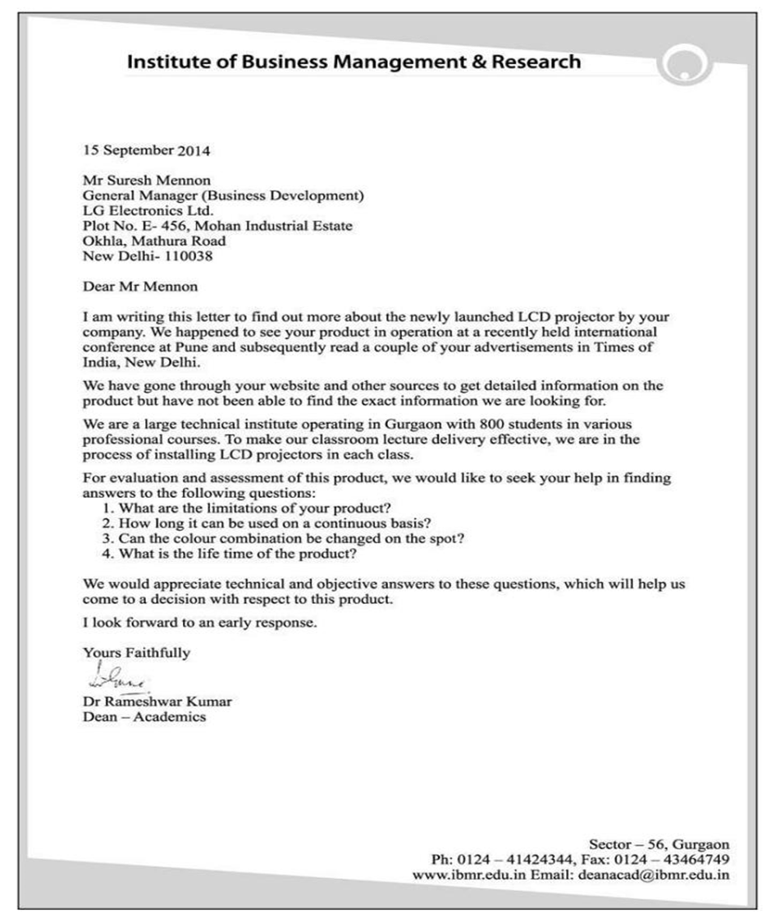

Slide 12
Order letter
An order letter is a letter written to request or place an order for goods or services.
It:
tells what you want to buy
mentions quantity and details
may include delivery and payment instructions
In short: it is a letter used to order something.

Slide 13
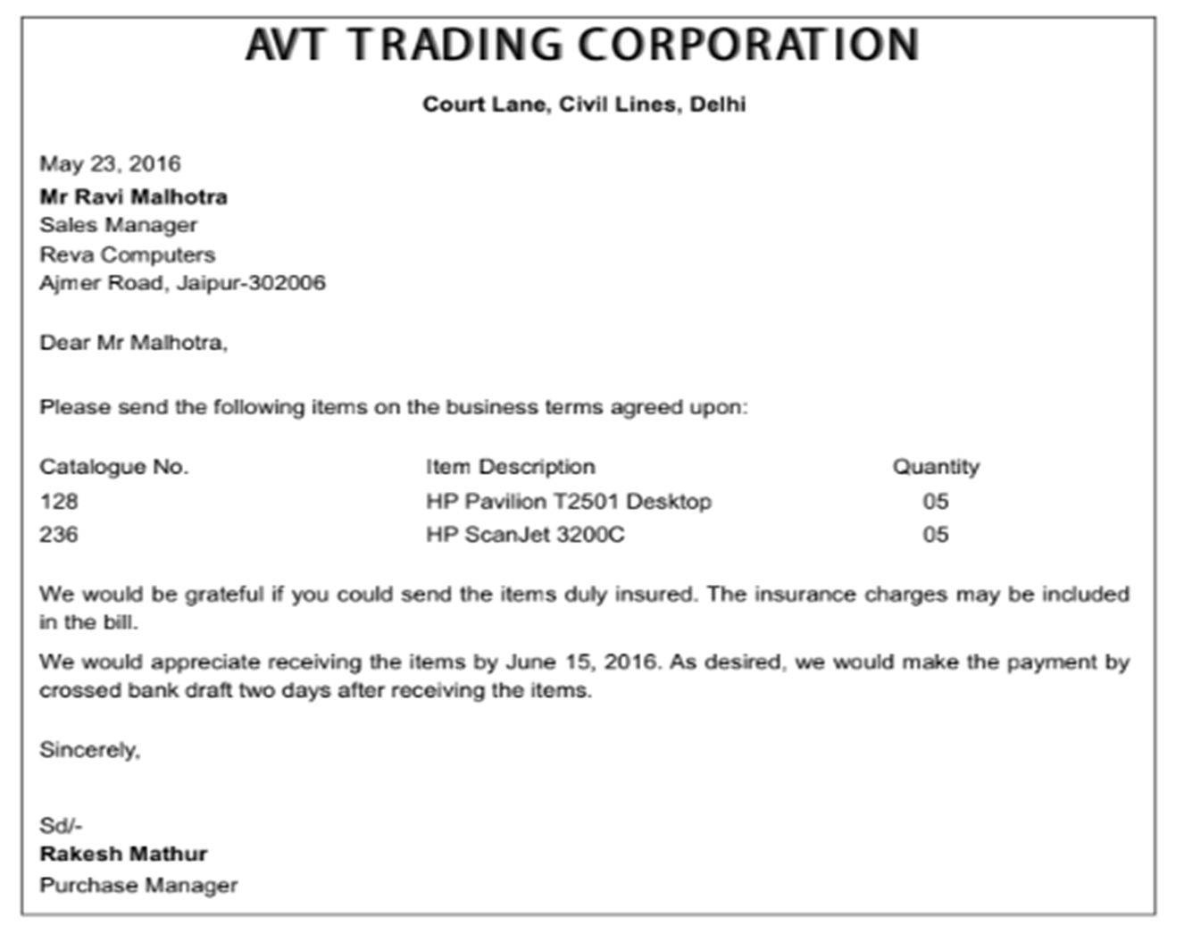

Slide 14
Memo
There are many types and tools for official communication each suited to specific situations. One such popular form of communication is a memo.
A memo is actually short for Memorandum.
It is one of the most used means of official communication in the business world. Its main purpose is to serve as a reminder or to give some instructions.

Slide 15
Letters Versus Memos
Unlike letters, which are used as a means to reach out to people outside an organisation, memos are used to send information inside an organisation.
A memo is written in a specific format, which is different from the letter format.
Memos are less formal than letters.
Memos are less structured than letters.
The tone of memo is more conversational than that of a letter.
Memos contain less background explanation and information than letters.

Slide 16
MEMORANDUM
To: All Employees of the Accounting Department
From: Mr. XYZ, Head of Accounts
CC: Ms. ABC, HR Department
Date: 25 October 2018
Subject: Compulsory Training about the New Software
As you are all aware, we have recently adopted new accounting software at the company. The decision was taken to improve our accounting procedure and make it more time and cost efficient. A training seminar will be held on 5th November 2018 at 9 am to familiarize the staff with the new software. This is done to make the transition between the software as easy as possible. All employees of the department are required to attend.

