Slide 1
Notice, Circular, Agenda and Minutes
Module-4

Slide 2
Introduction
Written communication within an organisation should be drafted with utmost care.
Intra- or inter-departmental written communication can be in the form of circulars or notices that are either circulated to all employees or displayed on a board for all to read.
Communication within organisations can also be in the form of meetings that need to be properly planned.
For this, it becomes imperative for the agenda to be properly drawn up and the minutes of the meeting to be prepared early for maximum benefit to all concerned.

Slide 3
Notice
A notice is a short, formal message used to give important information to a group of people.
It:
informs people about events, rules, or announcements
is usually displayed on notice boards or shared officially
is clear and brief
In short: a notice is a formal way to inform many people about something important.

Slide 4
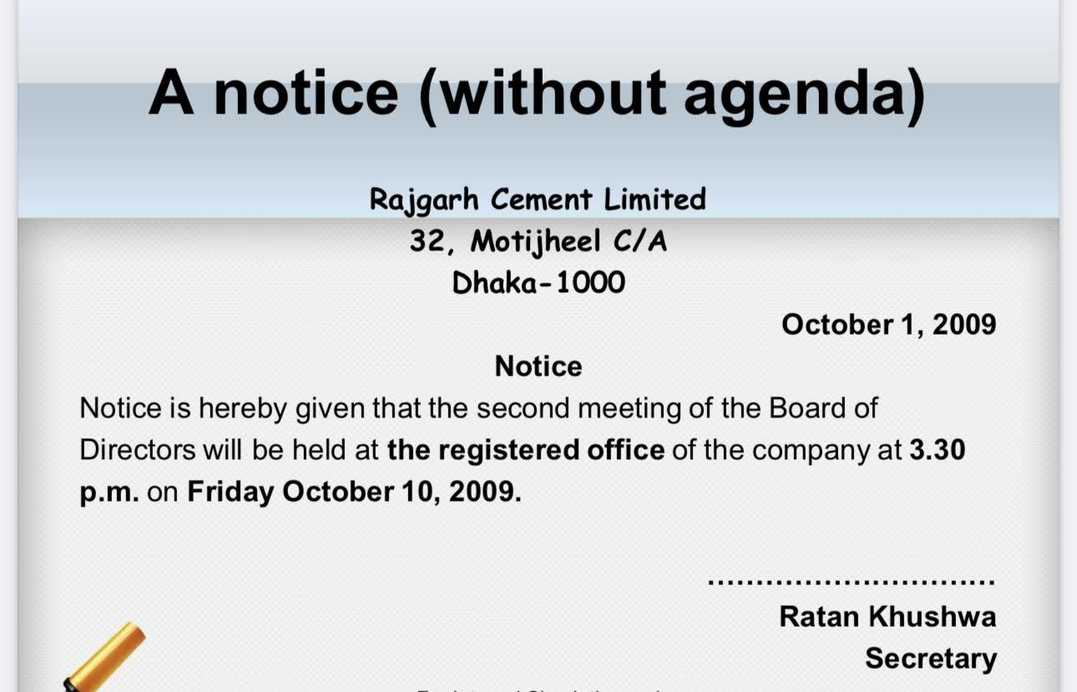
Notice

Slide 5
Circular
A formal communication to communicate some message to a large number of customers, people concerned in an organization, and suppliers.

Slide 6
Circular
Malibu Industries
Bijwasan, New Delhi
Dated: 30 oct 2014
Circular No.423/56
The wives of five Kargil martyrs would be visiting the organization on November 2, 2014 to familiarize us their problems and grievances. Hence, employees are requested to be present and to extend their cooperation for this noble cause.
Sd/-
Mahesh Gidwani
Manager

Slide 7
Difference between Notice and circular
Very few copies of a notice (possibly only one), thousands of copies of a circular are printed
A notice is usually posted on a wall or similar fixed structure, a circular is designed to be distributed in various locations, or mailed
A notice is generally intended to be read by many people; each circular is likely to be read by one person

Slide 8
Continue…
A circular goes to people, but people come to a notice.
Since a notice is designed to be read by groups of people, it is likely to be printed in a larger typeface so that it can be read at a distance; a circular can be printed in small type, since it will be hand! held by individuals.
A notice is more likely to have legal standing than a circular, since it is difficult to prove that circulars have reached their target audience, while a notice that is prominently posted may be assumed to have been read by the public.

Slide 9
Agenda
Agenda is a document that outlines the contents of a forthcoming meeting. It is usually sent along with the notice of the meeting. Basically agenda is a statement of business or assignment to be discussed in the meeting on which minutes and decisions are taken thereafter.
Agenda should be specific and clear to all authorized person.

Slide 10
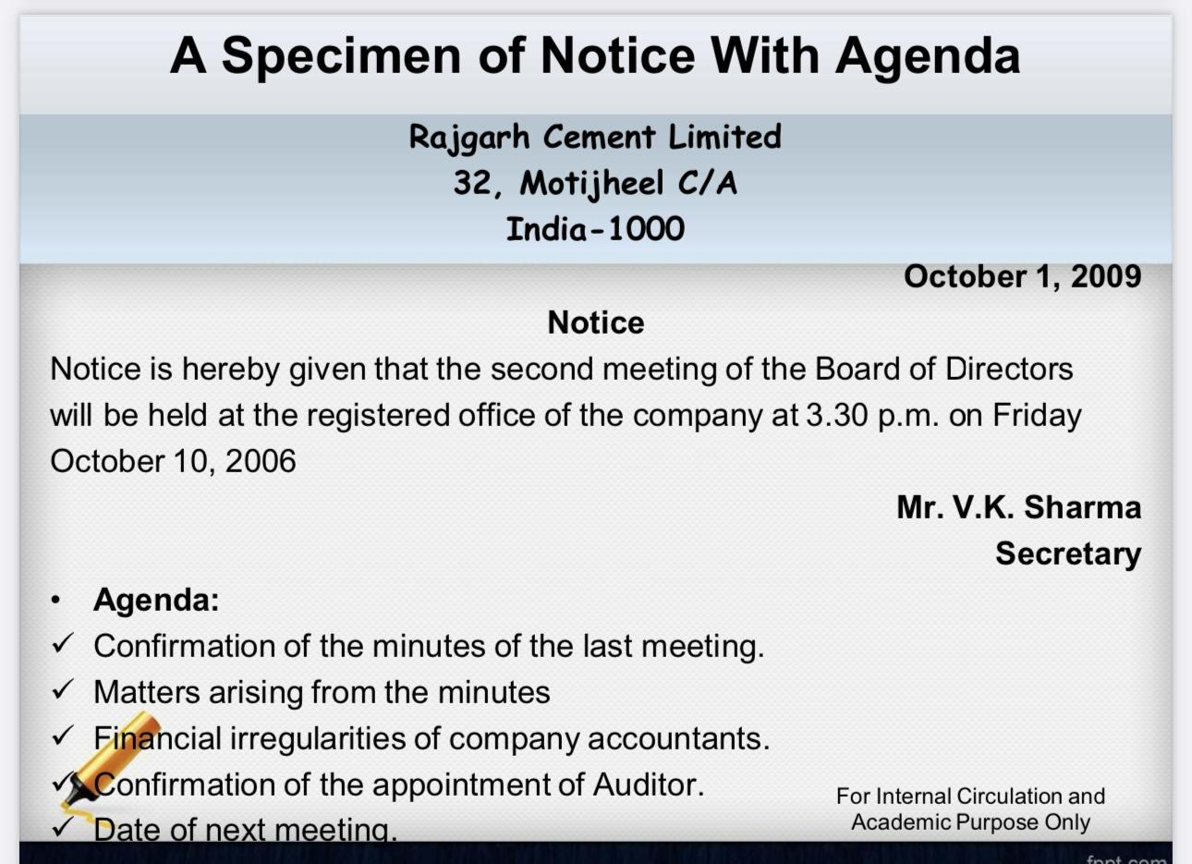
Agenda

Slide 11
Minutes
Minutes are the official record of the proceedings or a meeting. It usually show a concise and accurate record of decisions and resolutions.
Minutes is a chronological written statement of resolutions taken in meeting. It is taken on the elaborate discussion of the agenda.
It is a list of actions and resolutions adopted after detailed discussion of persons attended in the meeting, preserved it for decision making and policy implementation.

Slide 12
What needs to be included?
Date, time and location of the meeting.
The purpose of the meeting.
Names of attendees and those who were unable to attend.
Agenda items.
Decisions that were made.
Actions that need to be done. Include the deadline and who it was assigned to.
Follow up meeting.

Slide 13
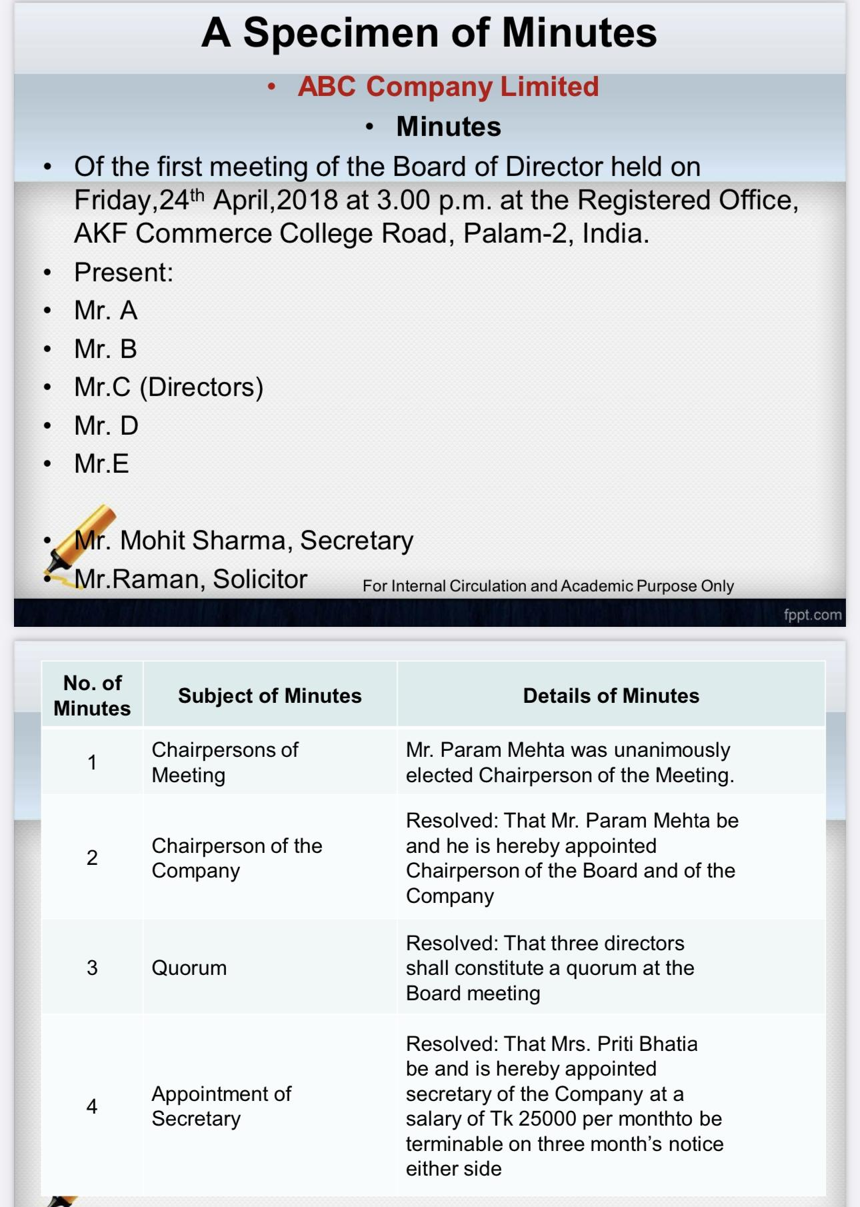

Slide 14
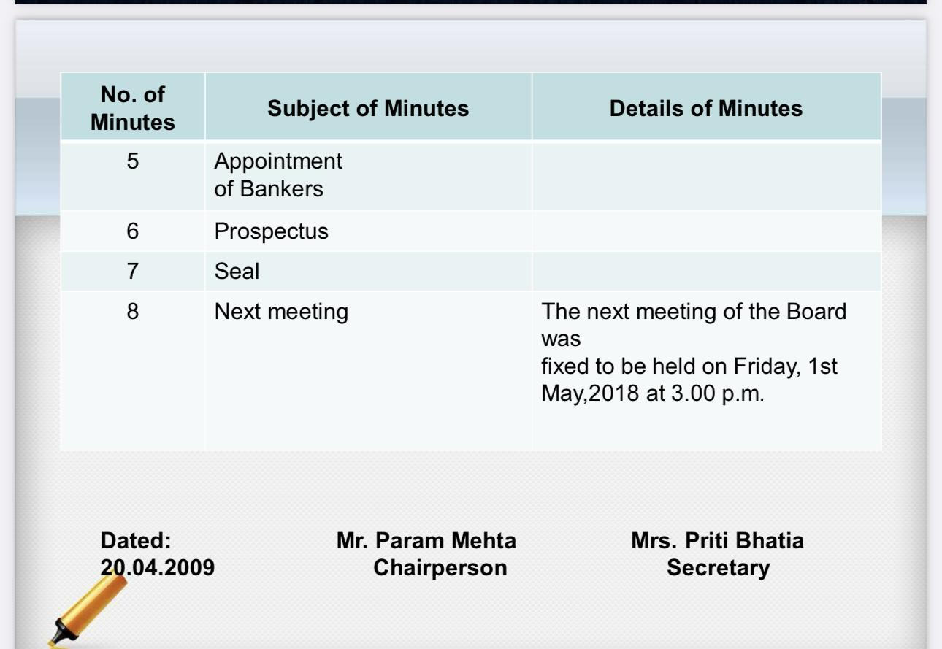

Slide 15
Thank You

