Slide 1

Halting Problem
Pradeep Dahal
017BSCIT029

Slide 2
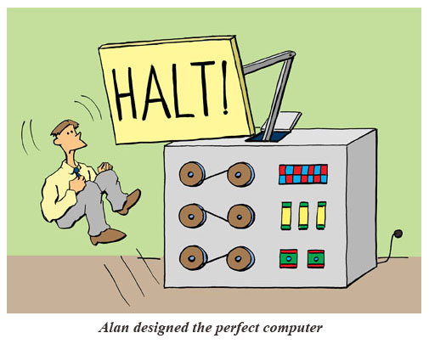
Halting Problem
There doesn't exist no machine which can tell if a machine halts or not.

Slide 3
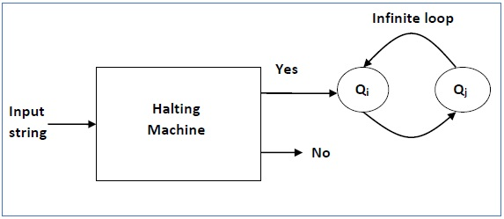
Proof of Halting problem
https://www.youtube.com/watch?v=92WHN-pAFCs

Slide 4
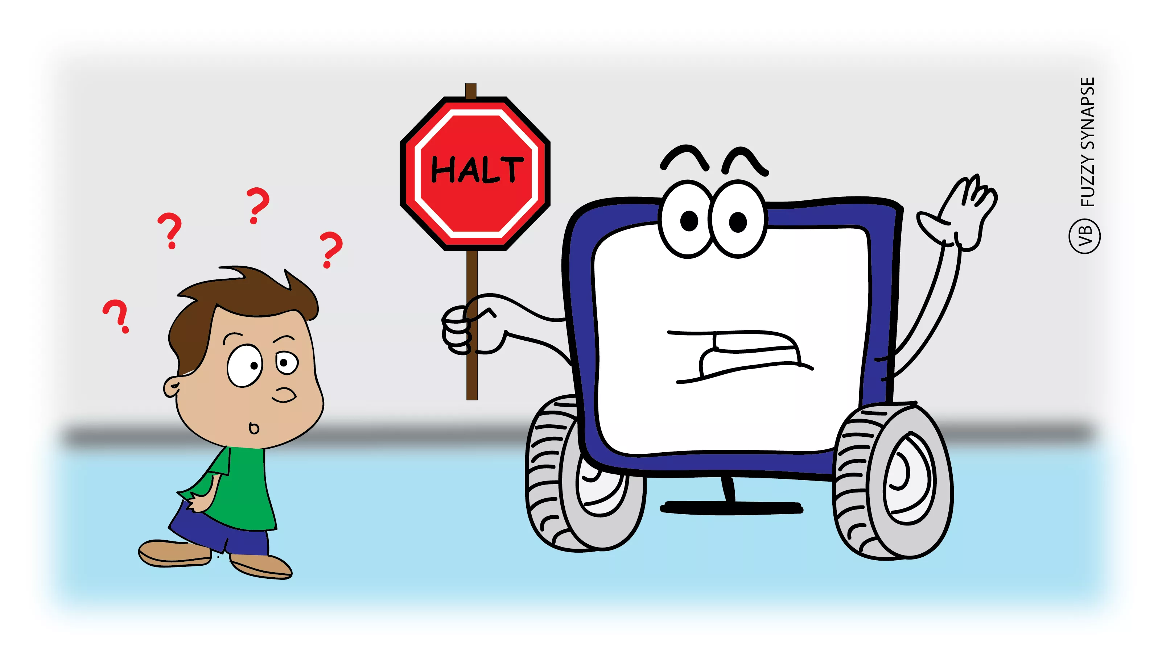
Decidable Language in Turing Machine
A language L is decidable if a Turing machine halts not matter the input string is in that language or not.

Slide 5

Undecidable Language
A language L is undecidable if a turning machine halts for some input and may go in a loop for other inputs.

Slide 6


Slide 7


