Slide 1

Seminar On
“Leveraging Recurrent Neural Network (RNN) and Long-short Term Memory (LSTM) for emoji prediction”
MSc.CSIT| 1st Semester | CSC -542 | CDCSIT
November 2025
Supervised by:
Dr. Dhiraj Kedar Pandey
Presented by:
Priya Shrestha
Roll no: 24

Slide 2
TABLE OF CONTENTS
Introduction
Objective
Problem Statement
Background
Methodology
Implementation
Results
Conclusion
References

Slide 3
INTRODUCTION
An emoji is a small digital icons used to express emotions, ideas, or concepts in text.
Emoji offer a unique and succinct way to convey emotions that can be challenging to express through text alone.
Over 80% of social media users worldwide use emojis on major messaging platforms in 2024. This highlights the growing need for a tool that can predict the right emoji for the right context.

Slide 4
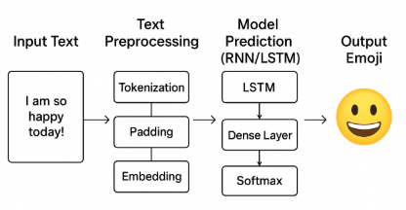
INTRODUCTION cont.….
Both Recurrent Neural Network(RNN) and Long Short-Term Memory(LSTM) are deep learning models designed to process sequential data like text
Figure : Emoji Prediction Process

Slide 5
Objective
To predict the most appropriate emoji for a given text.
Evaluate RNN and LSTM performance.

Slide 6
Problem Statement
Struggles with emotional and contextual understanding.
Class imbalance in labeled emoji datasets.
Lack of personalization and user-specific context.

Slide 7
Background
Emoji first introduced in Japan(1999) by Shigetaka kurita(NTT DoCoMo)
Keyword-based or Rule-based methods: High precision, low recall, poor adaptability.
Probabilistic Models : Estimate the likelihood of emoji
RNN → Sequence modeling.
LSTM → preserves long term context and emotional nuances.

Slide 8
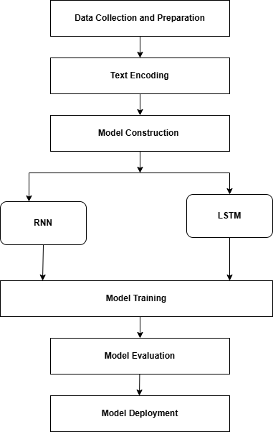
Conceptual Framework
Figure 1: Conceptual Framework for Emoji prediction

Slide 9
Methodology
Data Collection and Preprocessing : Collect text from public sources (e.g., Kaggle), then cleaned, normalized and tokenized.
Text Encoding :The tokenized text is converted into numeric sequences, padded for uniform length, and represented using pre-trained embeddings (e.g., GloVe).
Model Construction : Build RNN and LSTM architectures with layers like Embedding, LSTM, Dense, and Dropout to process sequential text data.
Model Training : Train on labeled data, optimize with Adam, and tune hyperparameters.
Model Evaluation : Evaluate models using Accuracy, Precision, Recall, and F1-score; analyze confusion matrices to assess performance across emoji categories.
Model Deployment : Deploy the best-performing model for real-time emoji prediction.

Slide 10
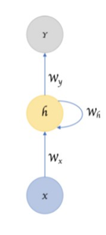

Recurrent Neural Network(RNN) model – Sequence Processing and prediction
Input Representation (Convert text → word embeddings)
For each input text sequence $X=\left[x_{1} , x_{2} , . , ..x_{T}\right]$:
Each word $x_{t}$ is converted into a dense embedding vector
The sequence of embeddings is fed to the RNN one time step at a time.
Hidden State Update (Recurrent Processing)
At each time step $t$:
h_{t}​=tanh(W_{x}X_{t} +W_{h}h_{t-1} + b_{h})
Output Prediction (Emoji Classification) : $\hat{y}=\text{softmax}(W_{y}h_{t}+b_{y})$

Slide 11

Long Short-Term Memory(LSTM) model -Long-Term Context Handling & Prediction
Input Representation (Convert text → word embeddings)
  For each input text sequence $X=\left[x_{1} , x_{2} , . , ..x_{T}\right]$:
  Each word $x_{t}$is converted into a dense embedding vector
  LSTM processes each embedding sequentially while maintaining long-term memory
Cell State and Hidden State Update (Memory-Controlled Processing)
At each time step $t$:
Forget gate : F_{t}= σ(X_{t} W_{f} + H_{t-1} U_{f})
Input gate : I_{t}= σ (X_{t} W_{i} + H_{t-1} U_{i})
H’_{t} = tanh(X_{t} W_{c} + H_{t-1} U_{c}) [New candidate information]
C_{t =} σ (C_{t-1} F_{t}+ I_{t} H’_{t}) [New cell state]
Output gate : O_{t}= σ (X_{t} W_{o} + H_{t-1} U_{o})
H_{t} = tanh(C_{t *} O_{t}) [New information]
Output Prediction (Emoji Classification) : $\hat{y}=\text{softmax}(W_{y}h_{t}+b_{y})$
Goal: Maximize margin between classes → better generalization for unseen data.

Slide 12
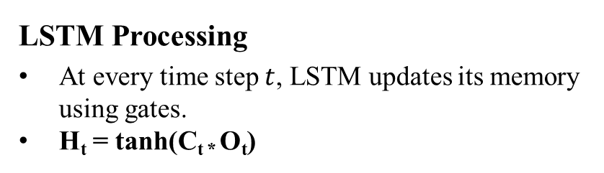
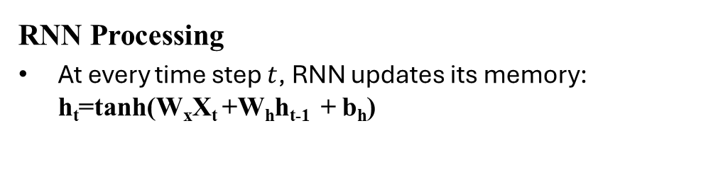
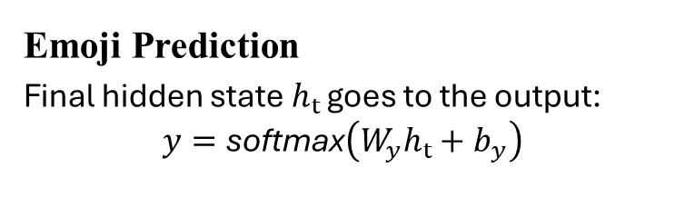
How RNN and LSTM works for Emoji Prediction?
Example:
Input Sentence: “I am presenting my seminar”
“I”→X1,“am”→X​2,“presenting”→X3,“my”→X4,“seminar”→X5​Text Preprocessing :
  Tokenize +Pad Sequences
  Tokenize → [12, 7, 45, 98, 23] (ex: token IDs)
  Pad sequences → [12, 7, 45, 98, 23, 0, 0, 0]
  Embedding (GloVe 100d) :
  Each token → 100-dimensional vector
  12 → [0.11, -0.02, ..., 0.05]
  7 → [0.04, 0.21, ..., -0.12]
RNN Processing
At every time step $t$, RNN updates its memory: h_{t}​=tanh(W_{x}X_{t} +W_{h}h_{t-1} + b_{h})
LSTM Processing
At every time step $t$, LSTM updates its memory using gates.
H_{t} = tanh(C_{t *} O_{t})
Emoji Prediction
Final hidden state $h_{t }$goes to the output:
$$y=\text{softmax}\left(W_{y}h_{t}+b_{y}\right)$$

Slide 13
Implementation
Python : Primary Programming language for NLP
Keras(TensorFlow) : Building and Training RNN/LSTM models.
NumPy & Pandas : Data preprocessing and feature vectors.
Matplotlib / Seaborn :Visualizing results.
Emoji Library : Handling emoji characters and Label Mapping
Evaluation: Accuracy, Precision, Recall, F1-score.

Slide 14
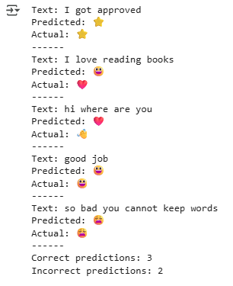
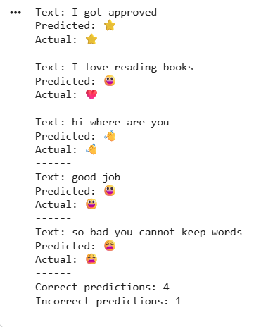
Results
Figure a. RNN
Figure b. LSTM

Slide 15
Results
Metric | Model 1 (RNN) | Model 2 (LSTM)
Accuracy | 0.60 | 0.80
Precision(Macro) | 0.50 | 0.70
Recall(Macro) | 0.30 | 0.80
F1-Score(Macro) | 0.533 | 0.733
Figure : Performance Metrics

Slide 16
Conclusion
LSTM outperforms RNN in capturing long term dependencies, context and sentiments.
RNN still is faster but struggles with long sequences and achieves lower accuracy and unstable validation.
LSTM is superior for emoji prediction and proves to be the better choice.
Future Work: Use larger/balanced datasets, and advanced models.(Bi-LSTM, GRU) or Transformer based models (BERT,GPT)

Slide 17
References
[1] R. Ranjan, P. Yadav, "Emoji prediction using LSTM and Naive Bayes," in TENCON 2021-2021 IEEE Region 10 Conference (TENCON), 2021, pp. 284–288. Kone, V., et al, "Emoji prediction using bi-directional LSTM," in ITM Web of Conferences, 2023, pp. 02004.
[2] Kone, V., et al, "Emoji prediction using bi-directional LSTM," in ITM Web of Conferences, 2023, pp. 02004.
[3] Zhang, L., et al, "Emoji prediction: A transfer learning approach," in Future of Information and Communication Conference, 2020, pp. 864–872.
[4] Shaik, A., et al. "Recurrent neural network with emperor penguin-based Salp swarm (RNN-EPS2) algorithm for emoji based sentiment analysis," in Multimedia Tools and Applications, vol. 83, no. 12, pp. 35097–35116, 2024.
[5] H. Raj, S. Balachandran. "Future emoji entry prediction using neural networks," in Journal of Computer Science, vol. 16, no. 2, pp. 150–157, 2020.

Slide 18
[6] Zhou, C., et al. "A C-LSTM neural network for text classification," in arXiv preprint arXiv:1511.08630, 2015.
[7] A.Sherstinsky. "Fundamentals of recurrent neural network (RNN) and long short-term memory (LSTM) network," in Physica D: Nonlinear Phenomena, vol. 404, pp. 132306, 2020.
[8] Yu, Y., et al. "A review of recurrent neural networks: LSTM cells and network architectures," in Neural computation, vol. 31, no. 7, pp. 1235–1270, 2019.
[9] Bai, Q., et al. "A systematic review of emoji: Current research and future perspectives," in Frontiers in psychology, vol. 10, pp. 476737, 2019.
[10] Liu, C., Fang, F., Lin, X., Cai, T., Tan, X., Liu, J., & Lu, X. (2021). Improving sentiment analysis accuracy with emoji embedding. Journal of Safety Science and Resilience, 2(4), 246–252.
[11] Mittal, M., Arora, M., & Pandey, T. (2019). Emoticon prediction on textual data using stacked LSTM model. In International Conference on Communication and Intelligent Systems (pp. 259–269).

Slide 19
[12] Al-Azani, S., & El-Alfy, E.S. (2018). Emojis-based sentiment classification of Arabic microblogs using deep recurrent neural networks. In 2018 international conference on computing sciences and engineering (ICCSE) (pp. 1–6).
[13] Hussain, S., Alhussayni, K., & Obayes, H. (2024). Iraqi Dialect Emoji Prediction Based on Deep CNN-LSTM Architecture. In National Conference on New Trends in Information and Communications Technology Applications (pp. 128–141).
[14] Lou, Y., Zhang, Y., Li, F., Qian, T., & Ji, D. (2020). Emoji-based sentiment analysis using attention networks. ACM Transactions on asian and low-resource language information processing (TALLIP), 19(5), 1–13.[9] Bai, Q., et al. "A systematic review of emoji: Current research and future perspectives," in Frontiers in psychology, vol. 10, pp. 476737, 2019.
[15] Gupta, A., Bhatia, B., Chugh, D., Himabindu, G., Sethia, D., Agarwal, E., Sani, D., & Garg, S. (2021). Context-aware emoji prediction using deep learning. In International Conference on Artificial Intelligence and Speech Technology (pp. 244–254).

Slide 20

Thank you
!!
Any Queries??

