Slide 1
Project title
Optimised design of RC concrete beams using peridynamics
Preben Monteiro Ness

Slide 2
Outline
Motivation
What is peridynamics?
My research focus
Project aims
Current progress
Expected findings
Q&A

Slide 3
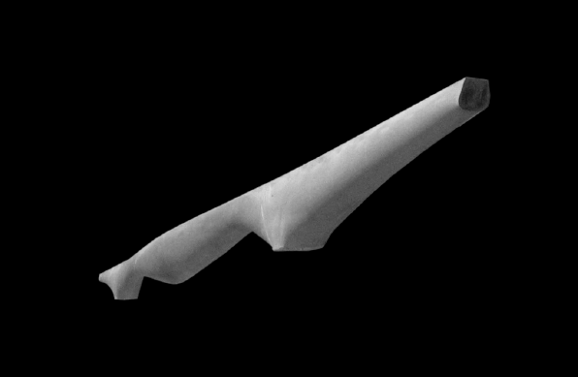
Optimised reinforced concrete (RC) beam design
Standard beam design in general wasteful
Lack reliable methods to assess non-standard designs
Assess failure load, force-displacement behaviour
Credit: Mark West, C.A.S.T.

Slide 4
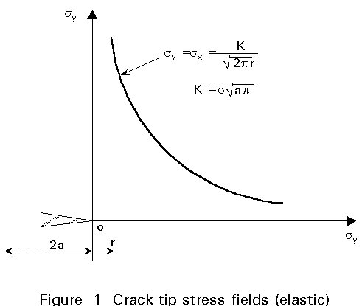

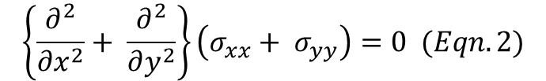
Modelling material behaviour
Significant problem is brittle fracture behaviour
Governing equations contain spatial derivatives
Breaks down on crack boundaries
$$\frac{∂σ_{xx}}{∂x}+ \frac{∂σ_{xy}}{∂y}=0 (Eqn. 1)$$
$$\left\{\frac{∂^{2}}{∂x^{2}}+ \frac{∂^{2}}{∂y^{2}}\right\}\left(σ_{xx}+ σ_{yy}\right)=0 (Eqn. 2)$$
http://fgg-web.fgg.uni-lj.si/~/pmoze/esdep/master/wg12/l1000.htm - basics of fracture mechanics | 3C7 Mechanics of Solids

Slide 5
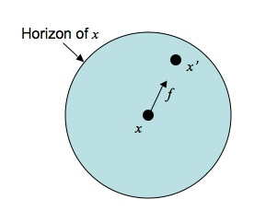
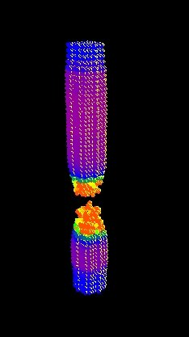
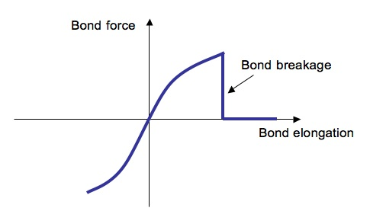
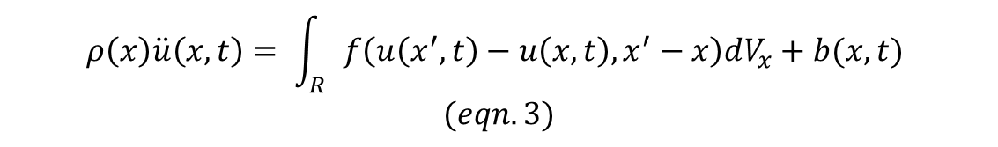
Peridynamics (PD)
Reformulate governing equations as integrals (Silling et al. 2000)
Model material as large 3D truss
Points interact with neighbouring points through a specified force density function f
Bonds break after critical elongation
$$ρ\left(x\right)\ddot{u}\left(x,t\right)= \int_{R}{f\left(u\left(x^{′},t\right)−u\left(x,t\right),x^{′}−x\right)dV_{x}+b(x,t)}$$
$$(eqn. 3)$$
https://en.wikipedia.org/wiki/Peridynamics#/media/File:Peridynamics-horizon.jpg | Silling, S. A. et al. (2000), “Reformulation of elasticity theory for discontinuities and long-range forces in journal” of physics of solids

Slide 6
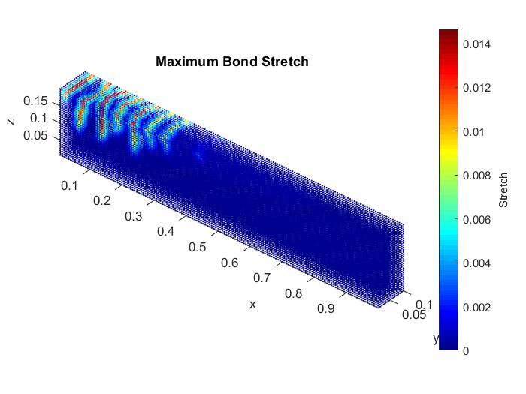
Research focus: physical validity
Majority of literature concerned with mathematical properties of PD
I want to investigate the physical validity of PD on RC concrete beams of non-standard geometry
Practical approach to make designs optimised for efficient material use?
MATLAB source code courtesy of Mark Hobbs

Slide 7
Project roadmap
[Mich.] Build bond-based PD model in C++ (currently at ~1000 lines of code)
Validate on simple geometry (completed in MATLAB)
[Mich.] Implement “arbitrary” geometry import
Validate on non-standard geometry
[Lent] Implement optimisation scheme on parameterised geometry
Parameterise geometry
Run simulations in parallel on high performance computers
[Lent] Modify model to support weak formulation of PD (Madenci et al. 2018)
Madenci, E. et al. (2018) “Weak form of peridynamics for nonlocal essential and natural boundary conditions”

Slide 8
Expected results
Expect simple geometry behaviour to be accurate for simulations times of ~ 2 hours
What node resolution is needed for non-standard geometries?
Directly translates to computational cost
Bond-based model good approximate behaviour
Hope reasonable results can be achieved with computationally feasibly coarse node discretisation

Slide 9
References
Silling, S. A. et al. (2000) Reformulation of elasticity theory for discontinuities and long-range forces
Madenci, E. et al. (2018) Weak form of peridynamics for nonlocal essential and natural boundary conditions
Questions?

