Slide 1
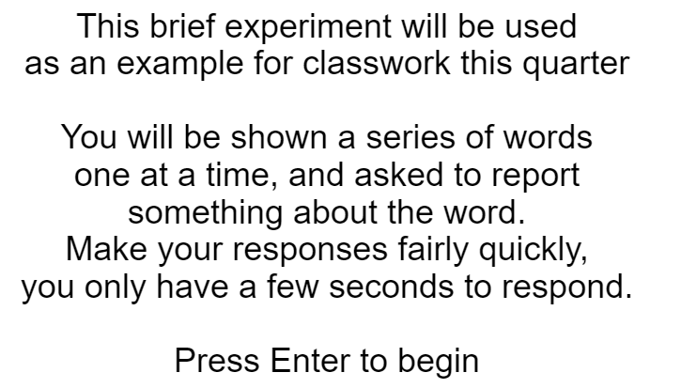

Slide 2
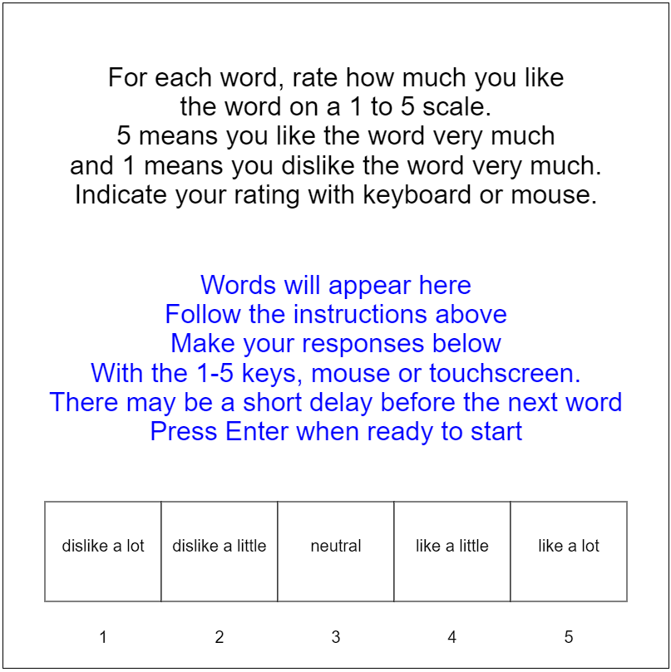
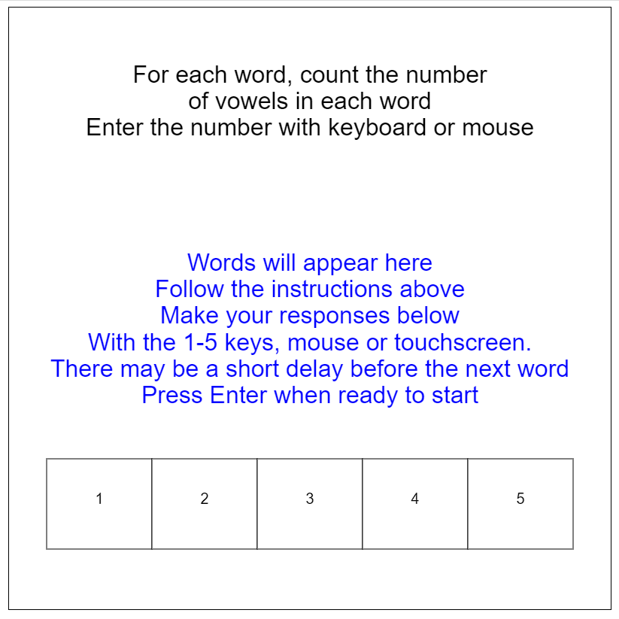

Slide 3
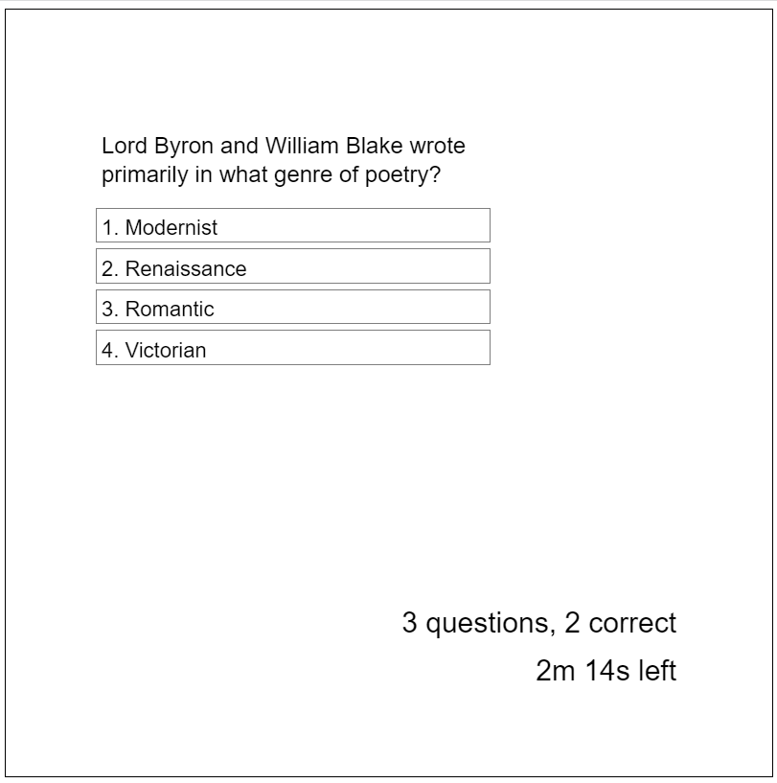
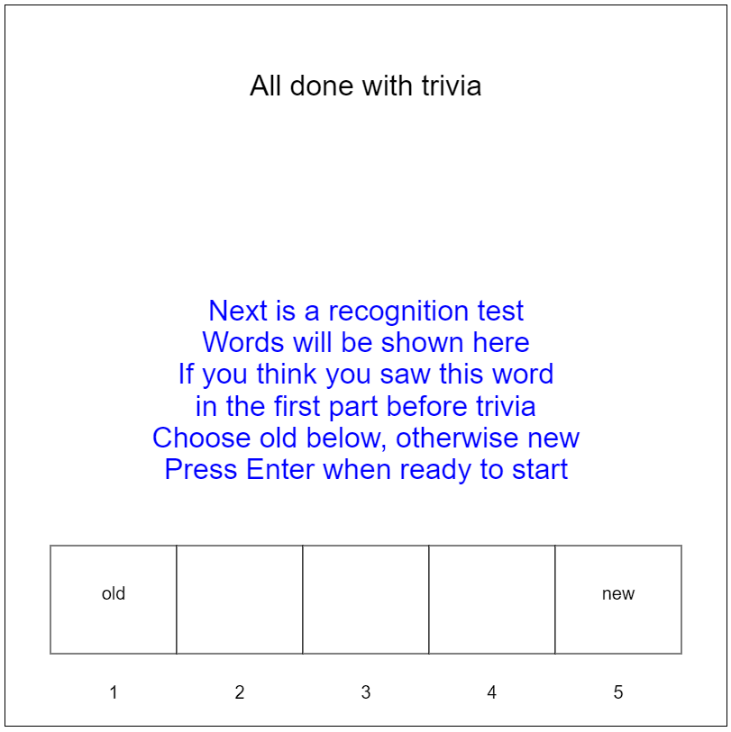

Slide 4
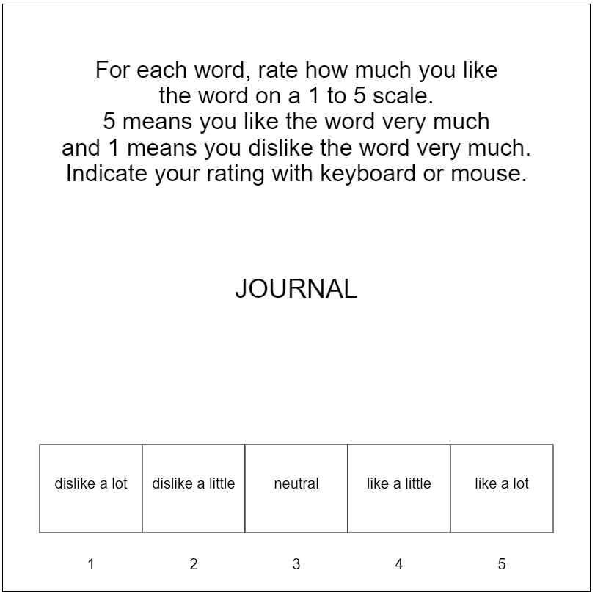
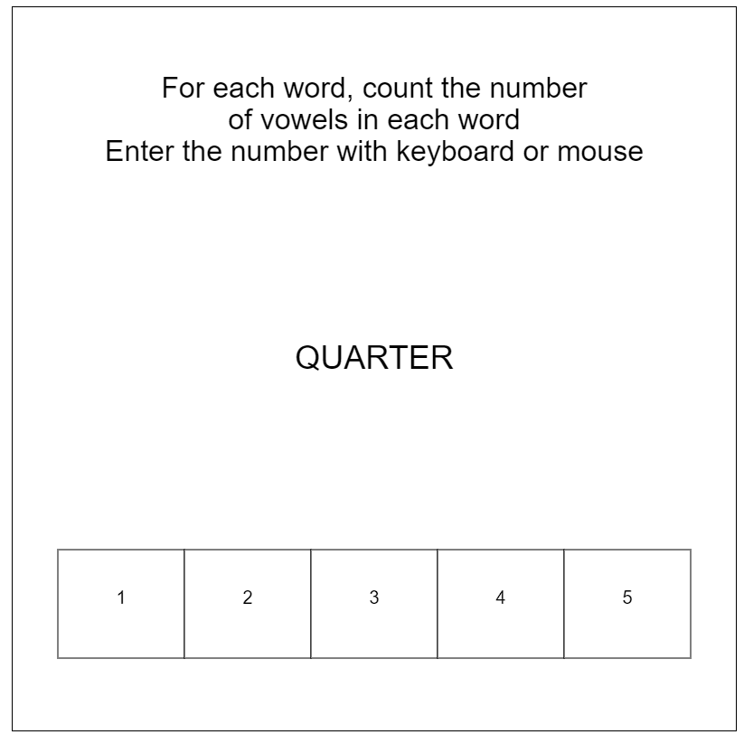

Slide 5
4s time per word to rate (automatic advance)
“For each word, rate how much you like the word on a 1 to 5 scale. 5 means you like the word very much and 1 means you dislike the word very much. Indicate your rating with keyboard or mouse.”
“For each word, count the number of vowels in each word. Enter the number with keyboard or mouse"
3m delay period completing trivia questions
A set of 60 words was used for the study and test stimuli. Words were selected to have a written frequency of 30-80 per million and to be 5-8 letters in length.

Slide 6
POCKET, PAINT, PRISON, QUARTER, CITIZEN, VEHICLE, ROUGH, BRAIN, TEMPLE, PRINCE, MEDICINE, FILLING, GUARD, JOURNAL, ENGINE, PALACE, GRAVE, BRANCH, CONCRETE, DANCER, SALARY, BASEMENT, MATCH, NATIVE, STABLE, FENCE, SWIMMING, QUEEN, OCEAN, FACTORY
CLOTH, DRIVER, LIQUID, SOLDIER, GALLERY, CHAIN, LUMBER, STEEL, MISSILE, SMOKE, AUTHOR, OWNER, PORCH, FISHING, SMELL, SHADOW, TRACK, GUEST, DISPLAY, MUSCLE, SPEAKER, WEDDING, WORKER, GUIDE, BRUSH, HIGHWAY, NAVAL, CARBON, PARTNER, PASSAGE

Slide 8
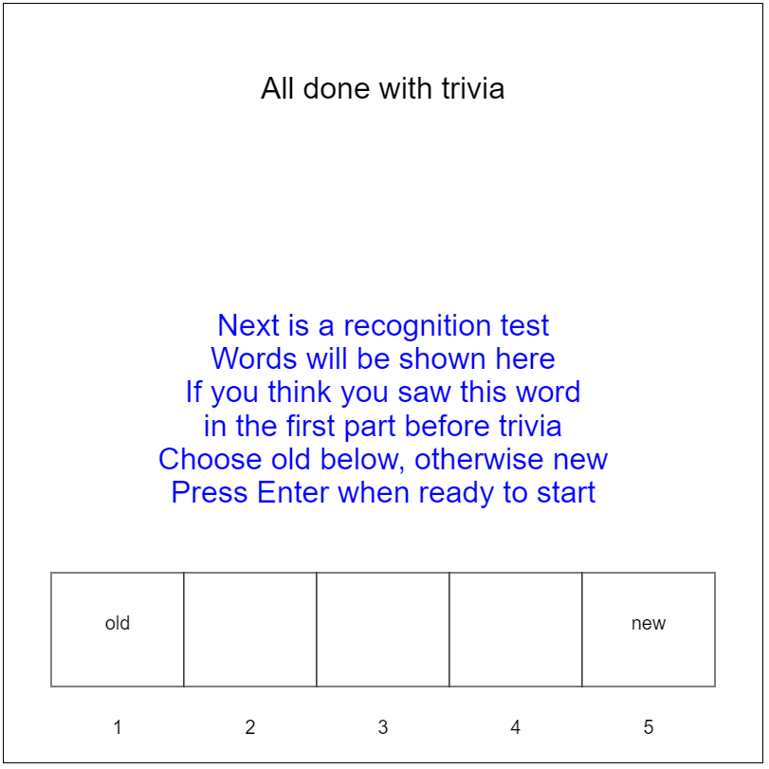

Slide 9
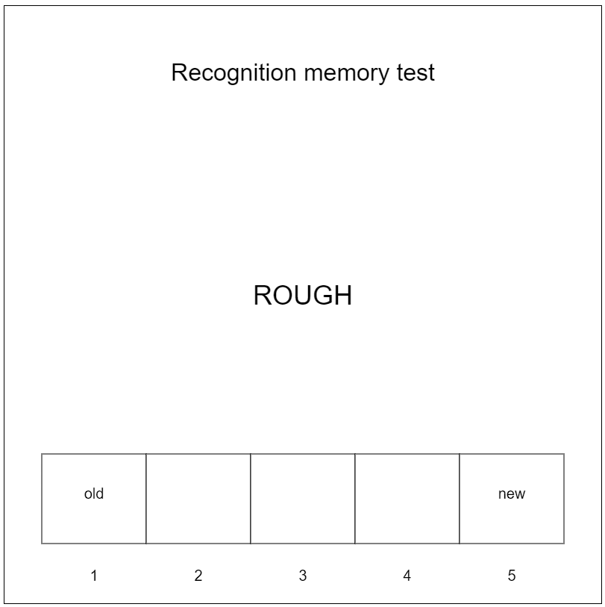
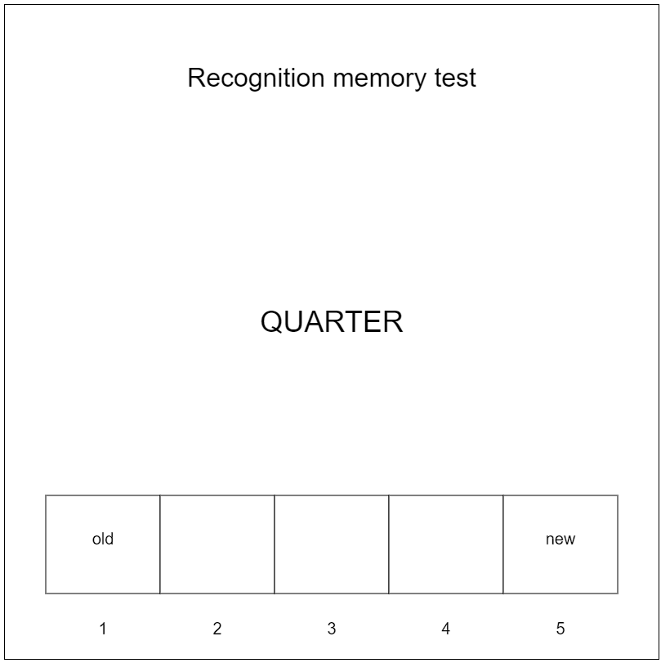

Slide 10




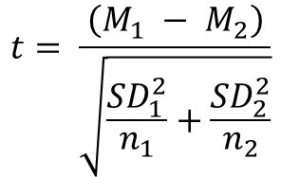
$$t= \frac{\left(M_{1} − M_{2}\right)}{\sqrt{\frac{{SD}_{1}^{2}}{n_{1}}+\frac{{SD}_{2}^{2}}{n_{2}}}}$$
$$SE=\frac{SD}{\sqrt{n}}$$
$$t= \frac{\left(M − μ_{0}\right)}{SE}$$
$$t\left(df\right)=X.xx, p<0.yy$$
$$F\left({df}_{n},{df}_{d}\right)=X.xx, p<0.yy$$

Slide 11
RED
CORAL
TURQUOISE
PURPLE
AMBER
BLUE
CRIMSON
PERIWINKLE
ORANGE
GREEN
BLUE
CRIMSON
PERIWINKLE
ORANGE
GREEN

Slide 12
 |  | Tested in Messy Room
 |  | No | Yes
Private Body Consciousness | Low | Typical moral judgments | Typical moral judgments
 | High | Typical moral judgments | Very harsh moral judgments

Slide 13
 |  | Cell Phone
 |  | No | Yes
Time of Day | Daytime
 | Nighttime
 |  | Psychotherapy Type
 |  | Cognitive |  | Behavioral
Length | Two weeks | Female Therapist | Male Therapist | Female Therapist | Male Therapist
 | Two months | Female Therapist | Male Therapist | Female Therapist | Male Therapist

Slide 14
Means Table |  | Factor 1
 |  | A | B | Mean
Factor 2 | X | 3.27 (1.51) | 7.09 (1.35) | 5.18 (2.39)
 | Y | 3.65 (1.08) | 7.44 (1.44) | 5.55 (2.28)
 | Mean | 3.46 (1.33) | 7.26 (1.41)

Slide 15
Means Table |  | Factor 1
 |  | A | B | Mean
Factor 2 | X | 3.93 (1.43) | 4.21 (1.22) | 4.07 (1.33)
 | Y | 6.98 (1.28) | 6.88 (1.37) | 6.93 (1.33)
 | Mean | 5.45 (2.04) | 5.55 (1.86)

Slide 16
Means Table |  | Factor 1
 |  | A | B | Mean
Factor 2 | X | 2.36 (1.54) | 4.70 (1.54) | 3.53 (1.93)
 | Y | 4.00 (1.08) | 6.38 (1.44) | 5.19 (1.84)
 | Mean | 3.18 (1.63) | 5.54 (1.74)

Slide 17
Means Table |  | Factor 1
 |  | A | B | Mean
Factor 2 | X | 1.43 (1.32) | 4.43 (2.00) | 2.93 (2.26)
 | Y | 3.56 (1.39) | 9.31 (1.38) | 6.43 (3.19)
 | Mean | 2.50 (1.72) | 6.87 (2.98)

Slide 18
Means Table |  | Factor 1
 |  | A | B | Mean
Factor 2 | X | 6.70 (1.76) | 4.34 (1.58) | 5.52 (2.04)
 | Y | 3.92 (1.42) | 4.51 (1.29) | 4.21 (1.39)
 | Mean | 5.31 (2.11) | 4.43 (1.45)

Slide 19
Means Table |  | Factor 1
 |  | A | B | Mean
Factor 2 | X | 3.29 (1.07) | 5.87 (1.54) | 4.58 (1.85)
 | Y | 6.59 (1.63) | 3.20 (1.31) | 4.90 (2.25)
 | Mean | 4.94 (2.15) | 4.53 (1.96)

