Slide 1
Her kan du skrive enhet/tilhørighet. Sett blank hvis dette ikke er aktuelt. Innhold i dette feltet styres her: Meny -> Sett inn (Mac=Vis) -> Topptekst og bunntekst
Universitetet i Bergen
INF319: A Variable Cost Pickup and Delivery Problem with Multiple Time Windows
By Preben Bucher-Johannessen
07.12.2018

Slide 2
Universitetet i Bergen
Agenda
Automobile Manufacturing Industry
Pickup and Delivery problems
The Inbound Manufacturer
Suppliers and Manufacturers
Carrier Vehicle Fleet
Multiple Time Windows
The Solution: A VCPDPMTW Model
Mathematical Model
References
07.12.2018
Side 1

Slide 3
Universitetet i Bergen
Agenda
Automobile Manufacturing Industry
Pickup and Delivery problems
The Inbound Manufacturer
Suppliers and Manufacturers
Carrier Vehicle Fleet
Multiple Time Windows
The Solution: A VCPDPMTW Model
Mathematical Model
References
07.12.2018
Side 1

Slide 4
Universitetet i Bergen
Automobile Manufacturing Industry
One of the most significant industries in Europe
Highly competitive global market
Increasing cost pressure
High flexibility in processes and structures
Supply chain concept and active management of outbound and inbound flow essential
Highly complex models with many variables
Optimization and pickup and delivery models key tools
07.12.2018
Side 1

Slide 5
Universitetet i Bergen
Agenda
Automobile Manufacturing Industry
Pickup and Delivery problems
The Inbound Manufacturer
Suppliers and Manufacturers
Carrier Vehicle Fleet
Multiple Time Windows
The Solution: A VCPDPMTW Model
Mathematical Model
References
07.12.2018
Side 1

Slide 6
Universitetet i Bergen
Agenda
Automobile Manufacturing Industry
Pickup and Delivery problems
The Inbound Manufacturer
Suppliers and Manufacturers
Carrier Vehicle Fleet
Multiple Time Windows
The Solution: A VCPDPMTW Model
Mathematical Model
References
07.12.2018
Side 1

Slide 7
Universitetet i Bergen
Pickup and delivery problems
Well researched problem with a long history.
Solomon (1987) described an algorithm to the general pickup and delivery problem.
Vehicle Routing with Stochastic demands Dror et al. (1989)
Multi-vehicle PDPTW, Desrosiers et al. (1995)
NP-hard problems -> heuristics, Savelsberg and Sol (1995), and Lu et al. (2004)
Parragh et al. (2006) - comprehensive survey on pickup and delivery problems and classified PDP in sub-categories.
Maritime versions of the Problem: Hybrid Cargo generating and routing heuristic in Christiansen et al. (2002), Speed optimization to reduce fuel emissions Christiansen et al. (2004), Hemmati et al. (2014), Hemmati et al. (2016)
Zhou (2013) proposed a model to reduce the inbound transportation costs for a food processing company.
PDP with multiple time windows was proposed by, Favaretto et al. (2007) and Ferreira et al. (2018)
07.12.2018
Side 1

Slide 8
Universitetet i Bergen
Agenda
Automobile Manufacturing Industry
Pickup and Delivery problems
The Inbound Manufacturer
Suppliers and Manufacturers
Carrier Vehicle Fleet
Multiple Time Windows
The Solution: A VCPDPMTW Model
Mathematical Model
References
07.12.2018
Side 1

Slide 9
Universitetet i Bergen
Agenda
Automobile Manufacturing Industry
Pickup and Delivery problems
The Inbound Manufacturer
Suppliers and Manufacturers
Carrier Vehicle Fleet
Multiple Time Windows
The Solution: A VCPDPMTW Model
Mathematical Model
References
07.12.2018
Side 1

Slide 10
Universitetet i Bergen
The Inbound manufacturer
An inbound perspective -> need for comprehensive model
Suppliers and Factories
Docking limitation
Carrier vehicle fleet
Before and after irrelevance
Carriers cost structure
Multiple time windows
Weekly planning priod
Inbound oriented thinking
07.12.2018
Side 1

Slide 11
Universitetet i Bergen
Agenda
Automobile Manufacturing Industry
Pickup and Delivery problems
The Inbound Manufacturer
Suppliers and Manufacturers
Carrier Vehicle Fleet
Multiple Time Windows
The Solution: A VCPDPMTW Model
Mathematical Model
References
07.12.2018
Side 1

Slide 12
Universitetet i Bergen
Agenda
Automobile Manufacturing Industry
Pickup and Delivery problems
The Inbound Manufacturer
Suppliers and Manufacturers
Carrier Vehicle Fleet
Multiple Time Windows
The Solution: A VCPDPMTW Model
Mathematical Model
References
07.12.2018
Side 1

Slide 13
Universitetet i Bergen
Suppliers and factories
P1
D2
P1
D1
Supplier
Factory
D3
Factory: No more than 2 stops per visit!
07.12.2018
Side 1

Slide 14
Universitetet i Bergen
Agenda
Automobile Manufacturing Industry
Pickup and Delivery problems
The Inbound Manufacturer
Suppliers and Manufacturers
Carrier Vehicle Fleet
Multiple Time Windows
The Solution: A VCPDPMTW Model
Mathematical Model
References
07.12.2018
Side 1

Slide 15
Universitetet i Bergen
Agenda
Automobile Manufacturing Industry
Pickup and Delivery problems
The Inbound Manufacturer
Suppliers and Manufacturers
Carrier Vehicle Fleet
Multiple Time Windows
The Solution: A VCPDPMTW Model
Mathematical Model
References
07.12.2018
Side 1

Slide 16


Universitetet i Bergen
Carrier vehicle fleet
Costs only relevant from pickup to delivery
Carrier determines how costs are calculated
often cost per km depending on interval
P1
Dn
First Pickup
D_{s} = Total distance
Final Delivery
Distance interval | D₁ < 100 | D₂ < 200 | D₃ > 200
C_{s} = cost per km | C₁ = 20 | C₂ = 30 | C₃ = 40
Total cost = Σ (D_{s}*C_{s})
07.12.2018
Side 1

Slide 17
Universitetet i Bergen
Agenda
Automobile Manufacturing Industry
Pickup and Delivery problems
The Inbound Manufacturer
Suppliers and Manufacturers
Carrier Vehicle Fleet
Multiple Time Windows
The Solution: A VCPDPMTW Model
Mathematical Model
References
07.12.2018
Side 1

Slide 18
Universitetet i Bergen
Agenda
Automobile Manufacturing Industry
Pickup and Delivery problems
The Inbound Manufacturer
Suppliers and Manufacturers
Carrier Vehicle Fleet
Multiple Time Windows
The Solution: A VCPDPMTW Model
Mathematical Model
References
07.12.2018
Side 1

Slide 19
Universitetet i Bergen
Multiple Time Windows
Multiple time windows
Pickup/delivery must be within one of the possible time windows
Inbound perspective
P1
D1
Pickup time windows
Delivery time windows
07.12.2018
Side 1

Slide 20
Universitetet i Bergen
Agenda
Automobile Manufacturing Industry
Pickup and Delivery problems
The Inbound Manufacturer
Suppliers and Manufacturers
Carrier Vehcile Fleet
Multiple Time Windows
The Solution: A VCPDPMTW Model
Mathematical Model
References
07.12.2018
Side 1

Slide 21
Universitetet i Bergen
Agenda
Automobile Manufacturing Industry
Pickup and Delivery problems
The Inbound Manufacturer
Suppliers and Manufacturers
Carrier Vehcile Fleet
Multiple Time Windows
The Solution: A VCPDPMTW Model
Mathematical Model
References
07.12.2018
Side 1

Slide 22
Universitetet i Bergen
Solution: A VCPDPMTW Model
Our model: A Variable Cost Pickup and Delivery Problem with Multiple Time Windows (VCPDPMTW)
Compehensive model
Not previously touched to my knowledge
Goal is to solve the demands of the inbound oriented manufacturer
07.12.2018
Side 1

Slide 23
Universitetet i Bergen
Agenda
Automobile Manufacturing Industry
Pickup and Delivery problems
The Inbound Manufacturer
Suppliers and Manufacturers
Carrier Vehicle Fleet
Multiple Time Windows
The Solution: A VCPDPMTW Model
Mathematical Model
References
07.12.2018
Side 1

Slide 24
Universitetet i Bergen
Agenda
Automobile Manufacturing Industry
Pickup and Delivery problems
The Inbound Manufacturer
Suppliers and Manufacturers
Carrier Vehicle Fleet
Multiple Time Windows
The Solution: A VCPDPMTW Model
Mathematical Model
References
07.12.2018
Side 1

Slide 25
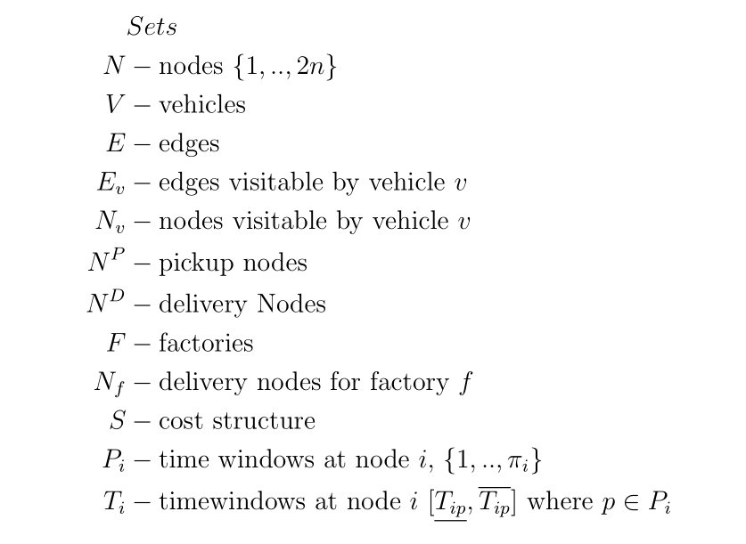
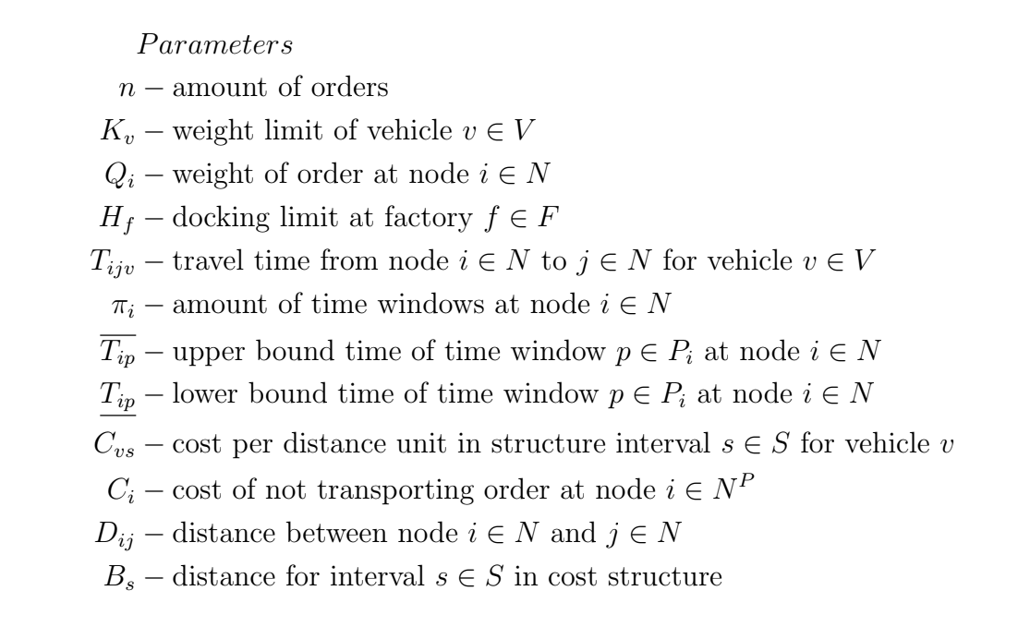
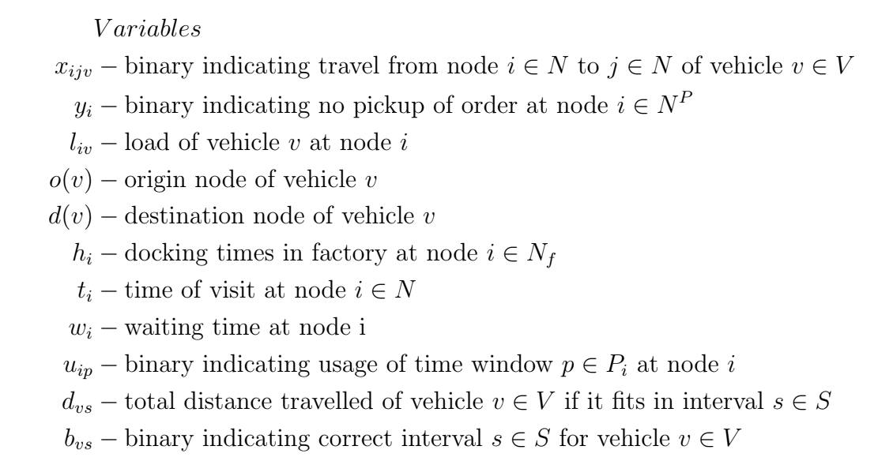
Universitetet i Bergen
Mathematical model
07.12.2018
Side 1

Slide 26
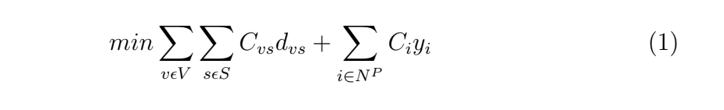
Universitetet i Bergen
Mathematical model
Objective function:
07.12.2018
Side 1

Slide 27
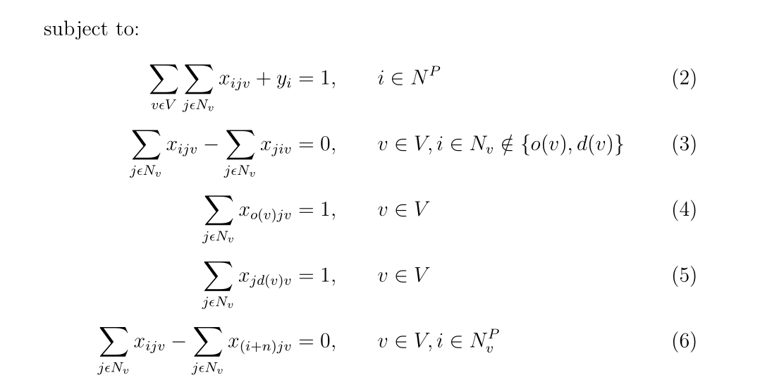
Universitetet i Bergen
Mathematical model
Travel constraints:
07.12.2018
Side 1

Slide 28
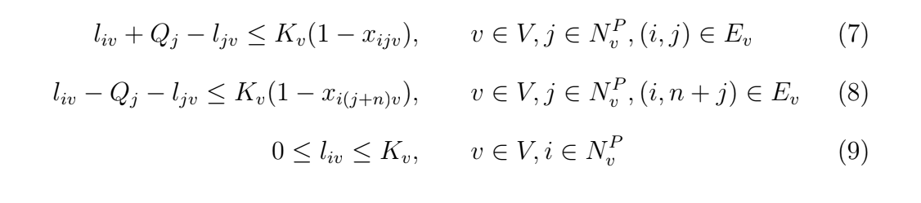
Universitetet i Bergen
Mathematical model
Weight constraints:
07.12.2018
Side 1

Slide 29
Universitetet i Bergen
Mathematical model
Weight constraints:
07.12.2018
Side 1

Slide 30
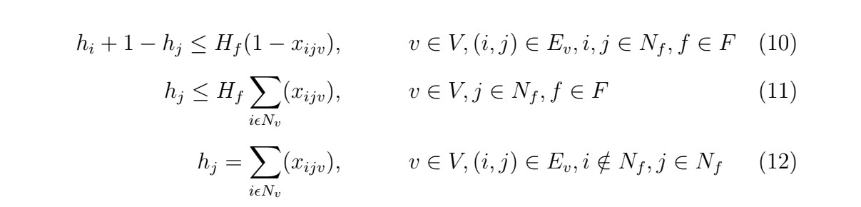
Universitetet i Bergen
Mathematical model
Docking constraints:
07.12.2018
Side 1

Slide 31
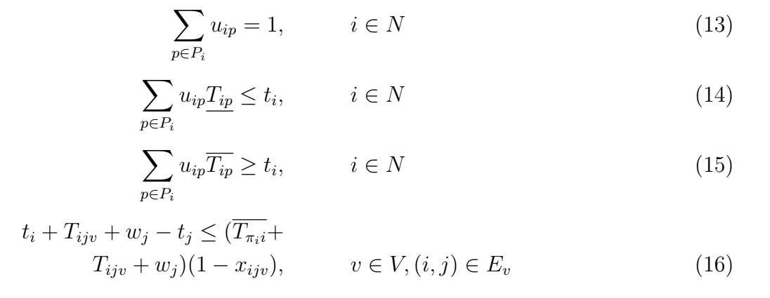
Universitetet i Bergen
Mathematical model
Multiple time window constraints:
07.12.2018
Side 1

Slide 32
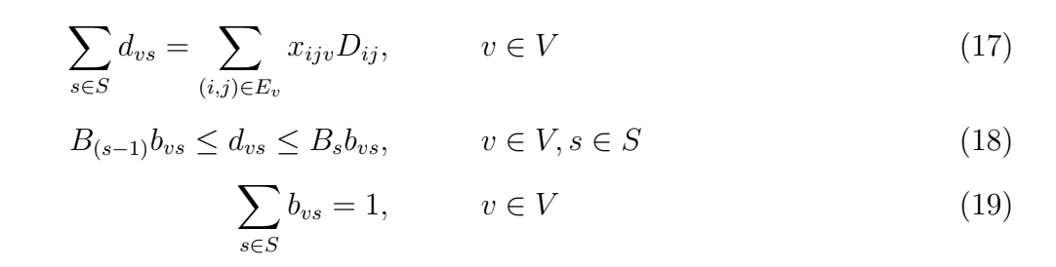
Universitetet i Bergen
Mathematical model
Cost structure constraints:
Reminder! Objective function:
07.12.2018
Side 1

Slide 33
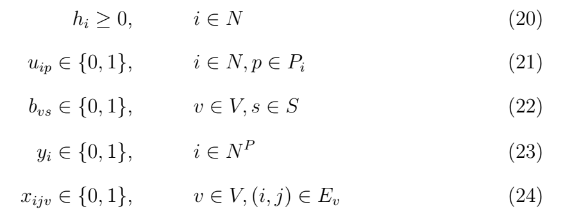
Universitetet i Bergen
Mathematical model
Final variable constraints:
07.12.2018
Side 1

Slide 34
Universitetet i Bergen
Agenda
Automobile Manufacturing Industry
Pickup and Delivery problems
The Inbound Manufacturer
Suppliers and Manufacturers
Carrier Vehicle Fleet
Multiple Time Windows
The Solution: A VCPDPMTW Model
Mathematical Model
References
07.12.2018
Side 1

Slide 35
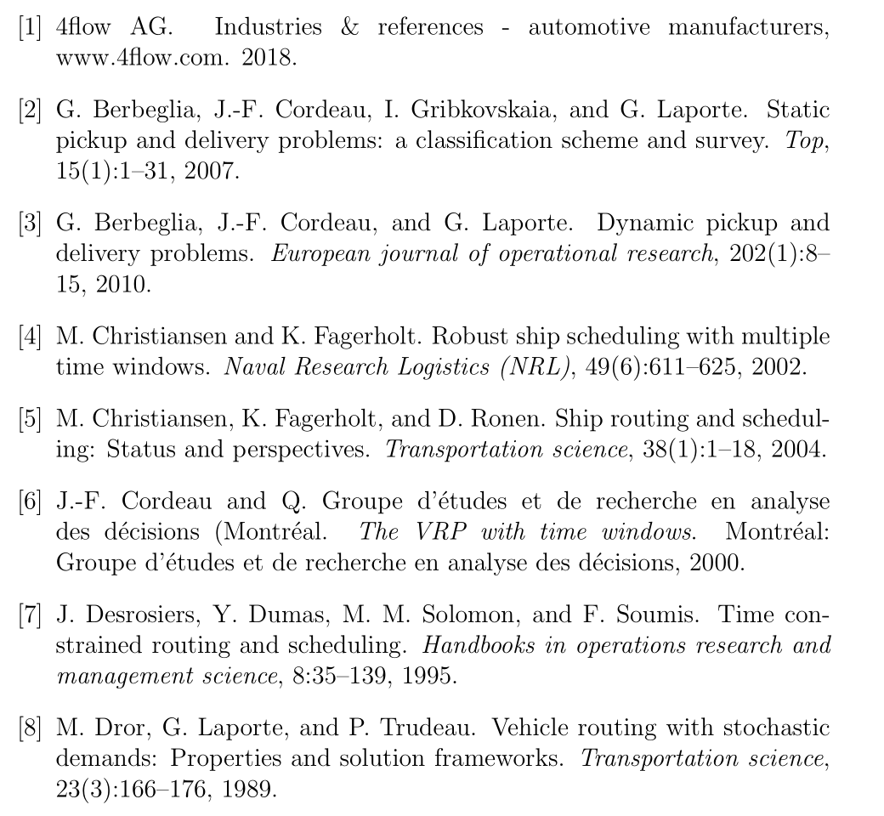
Universitetet i Bergen
References
07.12.2018
Side 1

Slide 36
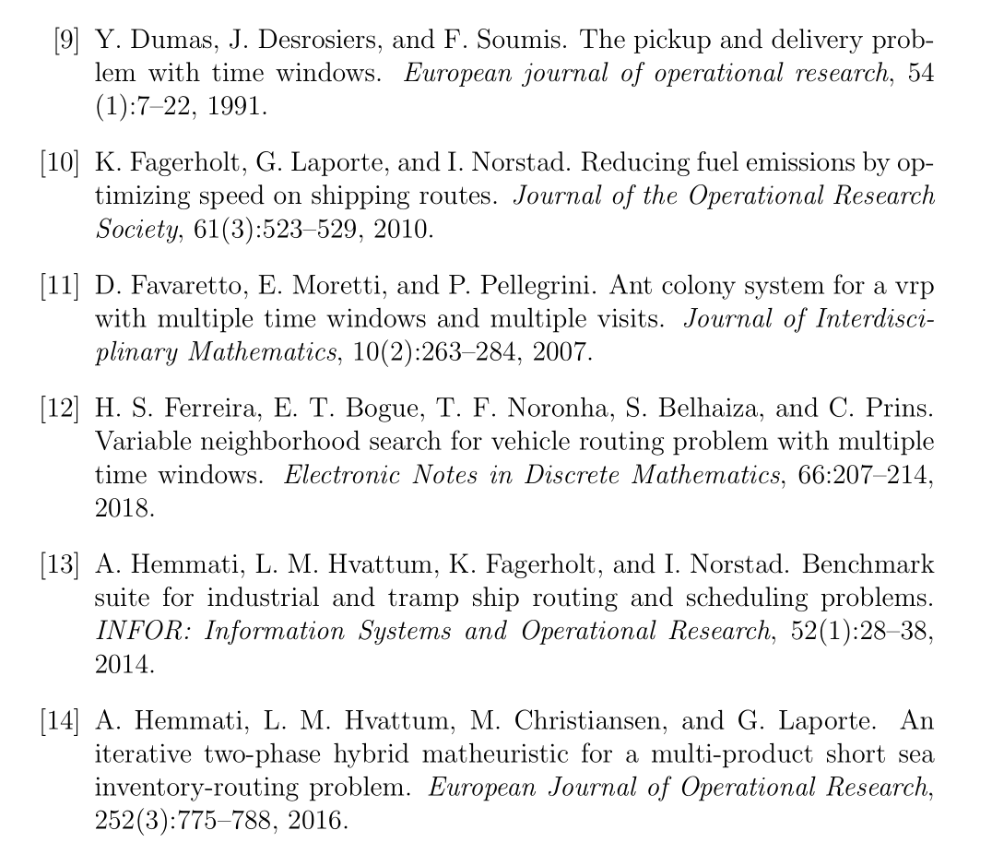
Universitetet i Bergen
References
07.12.2018
Side 1

Slide 37
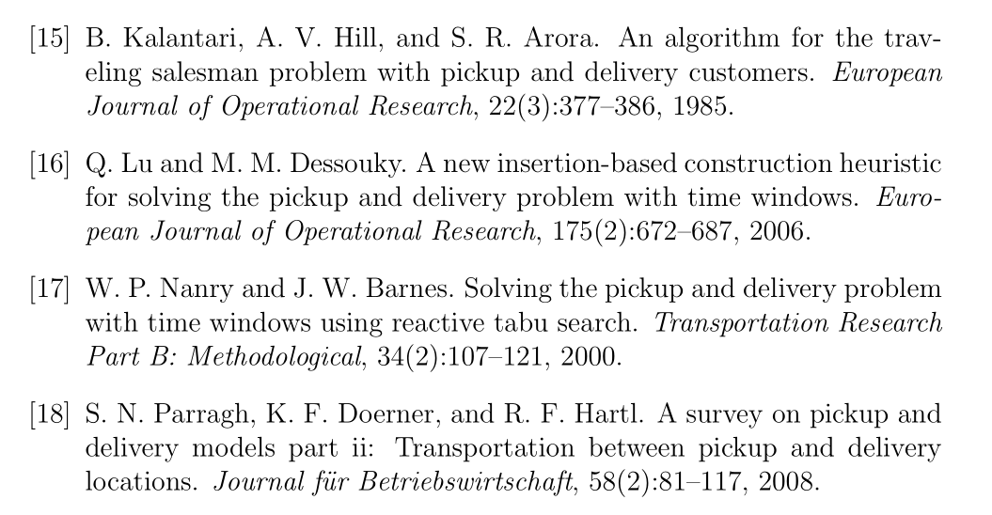
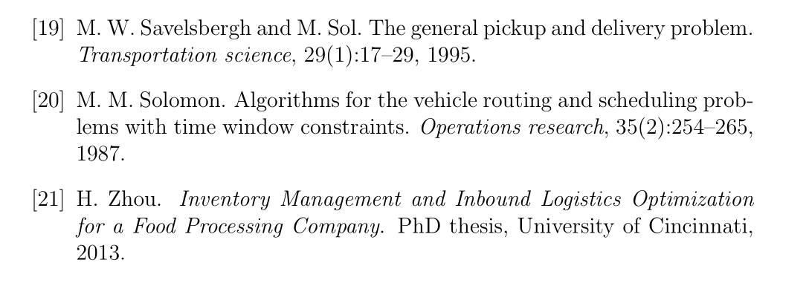
Universitetet i Bergen
References
07.12.2018
Side 1

Slide 38

Questions?
Universitetet i Bergen

