Slide 1
1_{D}
1_{D}
1_{P}
1_{P}
3_{P}
3_{D}
Swap
3_{P}
3_{D}
2_{D}
2_{D}
2_{P}
2_{P}
Vehicle schedule: ( 1 2 3 3 2 1) ( 1 3 2 2 3 1 )

Slide 2
2_{P}
2_{P}
1_{P}
1_{P}
3_{P}
3_{P}
3-exchange
1_{D}
1_{D}
3_{D}
2_{D}
3_{D}
2_{D}
Vehicle schedule: ( 1 1 2 2 3 3 ) ( 1 3 2 1 3 2 )

Slide 3
1_{P}
1_{P}
1_{P}
3_{P}
3_{P}
3_{P}
1_{D}
1_{D}
2-Opt
2_{D}
2_{P}
2_{D}
2_{P}
3_{D}
3_{D}
3_{D}
Vehicle schedule: ( 1 2 3 1 2 3 ) ( 1 1 3 2 2 3 )

Slide 4
cluster a_{i}
cluster a_{i}
cluster b
i
i

Slide 5
 | a | b | c | d
a | 0 | 9 | 6 | 7
b | 9 | 0 | 8 | 5
c | 6 | 8 | 0 | 9
d | 7 | 5 | 9 | 0
 | a | b,d | c
a | 0 | 7 | 6
b,d | 7 | 0 | 8
c | 6 | 8 | 0
 | a,c | b,d
a,c | 0 | 7
b,d | 7 | 0

Slide 6
s
5* | 3* | 3‘ | 5‘ | 0 | 0 | 4* | 4‘ | 0 | 1 | 1 | 2 | 2
S₁
S₂
S₃
S_{dummy}

Slide 7
T₁₁
T₁₁
T₁₂
T₁₂
T₁₃
T₁₃
T^{O}₁₂
T^{NO}₁₂
T^{A}₁₂
T^{A}₁₂-T^{NO}₁₂
T₂₁
T₂₁
T₂₁
T₂₁
T₂₁
T₂₁

Slide 8
diversification
Objective function
intensification
Solution space

Slide 9
Manufacturer
4PL planning company
Operation management
Software and optimization
algorithms
Consulting services
Suppliers
3PL
Transport

Slide 10
C_{ABCD}
c_{OA}
c_{AB}
c_{BC}
c_{CD}
c_{DO}
A
B
C
D
C_{AB} + C_{BC} + C_{CD} ≠ C_{ABCD}

Slide 11

T₁₁
T₁₁
T₁₂
T₁₂
T₁₃
T₁₃
V₁
A₁
A₂
A₃
A₄

Slide 12
v₁
3_{P}
3_{P}
3_{D}
3_{D}
B
B
1_{D}
1_{D}
1_{P}
1_{P}
v₂
2_{D}
2_{D}
2_{P}
2_{P}

Slide 13
C₅
C₅
C₆
C₆
C₄
C₄
C₃
C₃
C₂
C₂
C₁
C₁
B
B

Slide 14
a
9
a
8
b
ab
ac
ad
17
14
11
2
5
3
abc
abd
acb
adb
adc
4
19
18
14
14
18
c
d
7
abcda
abdca
acbda
21
23
14

Slide 15
Original Problem
Master Problem
Restricted Master Problem
Add column
to RMP
Solve LPR of RMP and generate Duals
Solve subproblem by passing duals. Found
column with negative reduced cost?
Yes
No
Branch
Solution Intergral?
No
Yes
Done

Slide 16
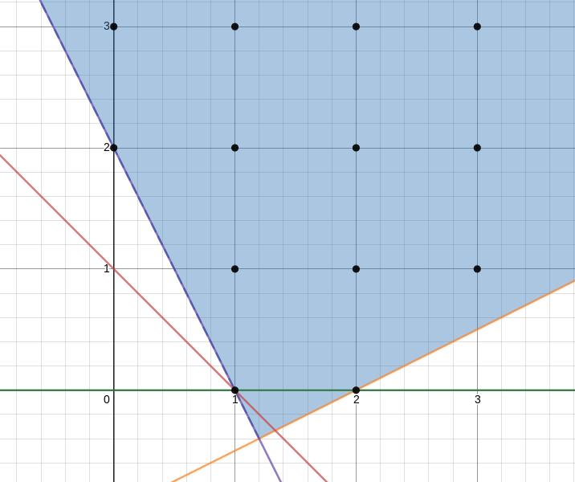
min x+y
s.t.
2x + y ≥ 2
-x + 2y ≥ -2
x,y ϵ Ζ

