Slide 1
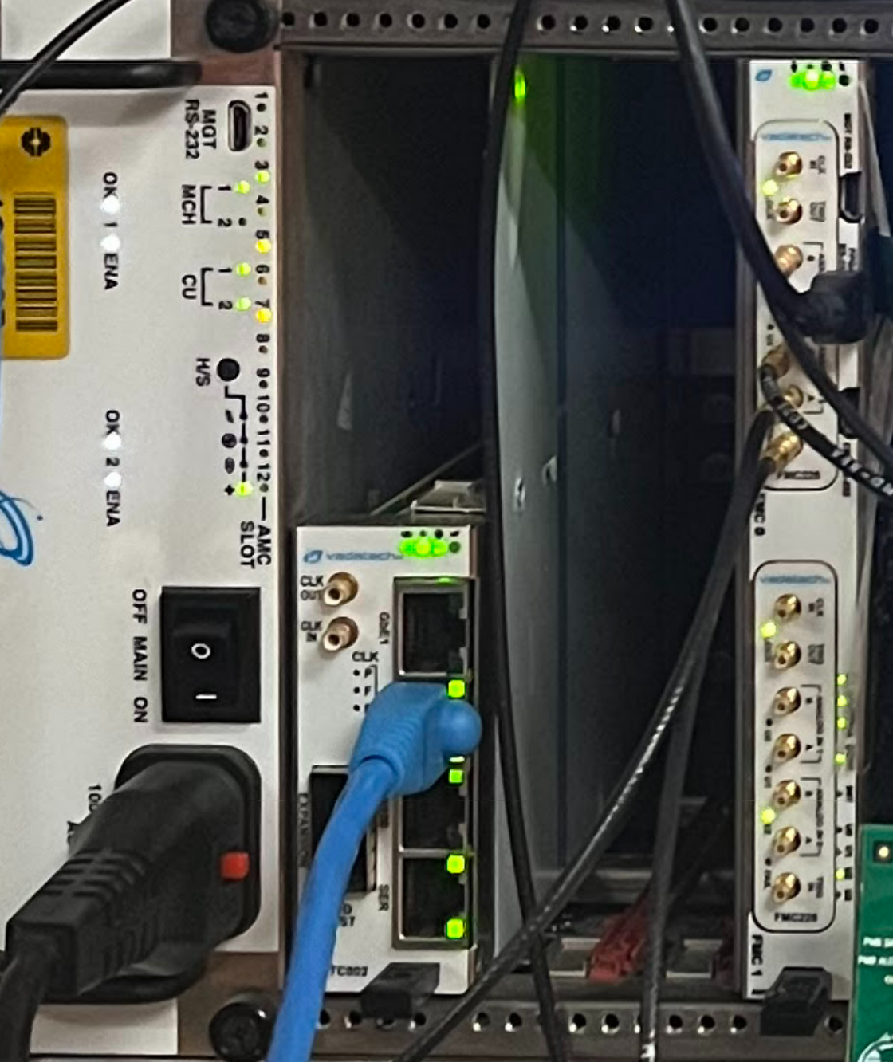
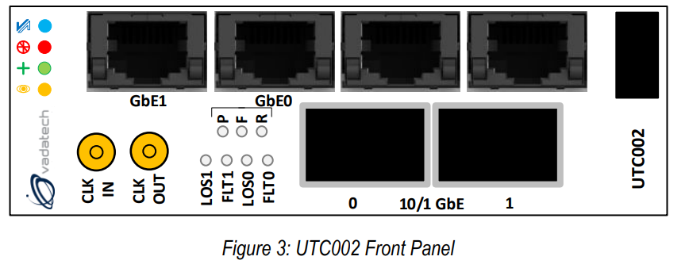
“FPGA RS-232” to PC
(this is the minicom window)
To PC secondary network card (this is the ethernet connection)
Up to four data inputs
Accelerator Trigger
Optional serial to USB connection (Jinglu should have this cable)

