Slide 1
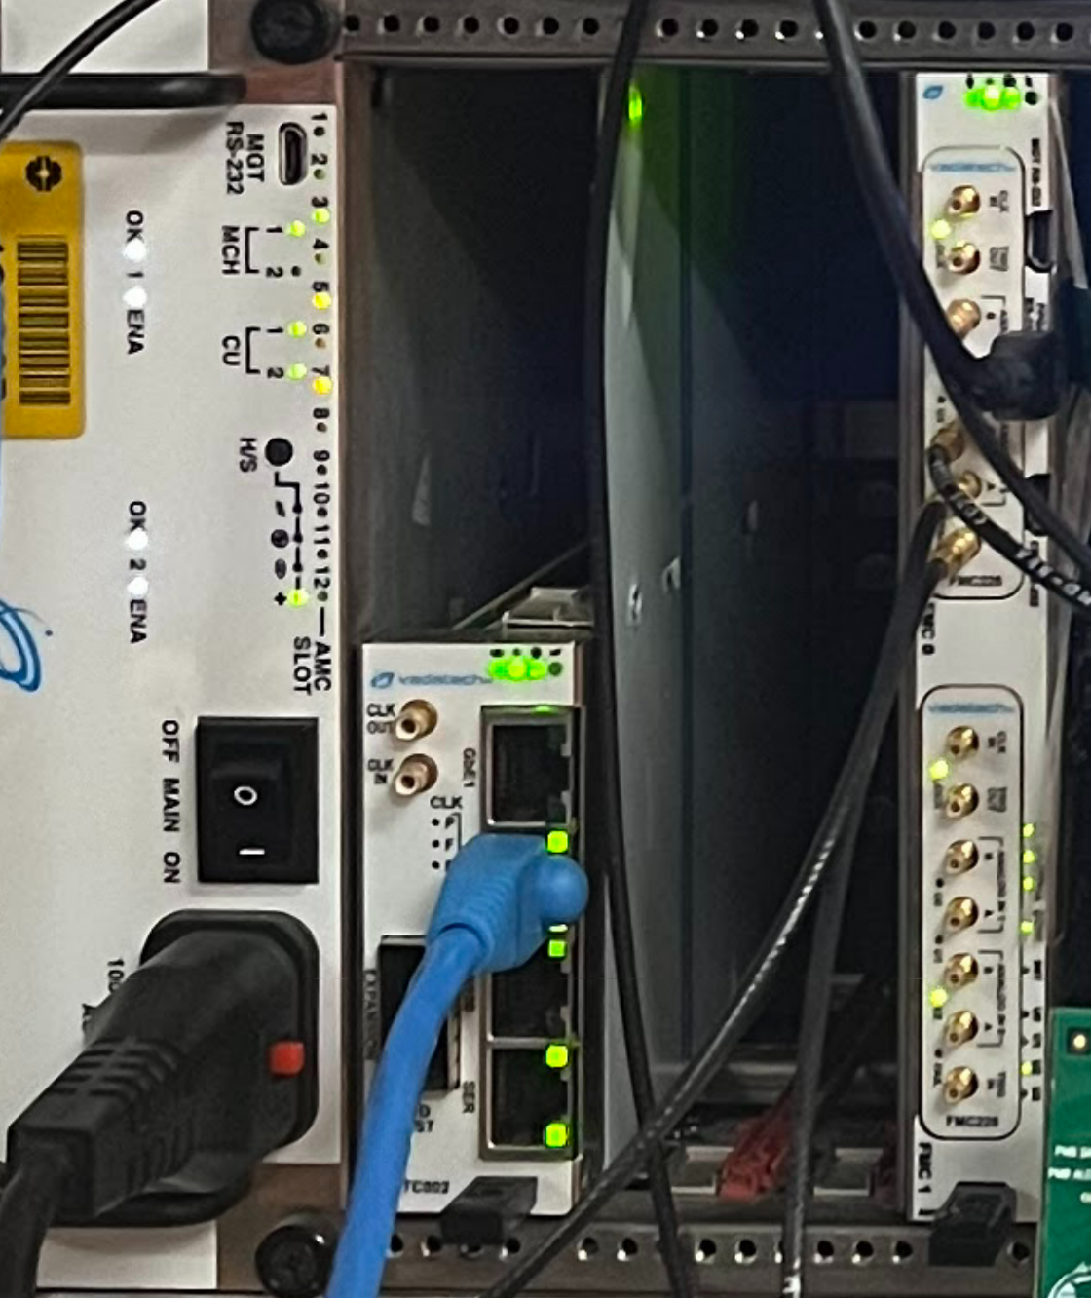
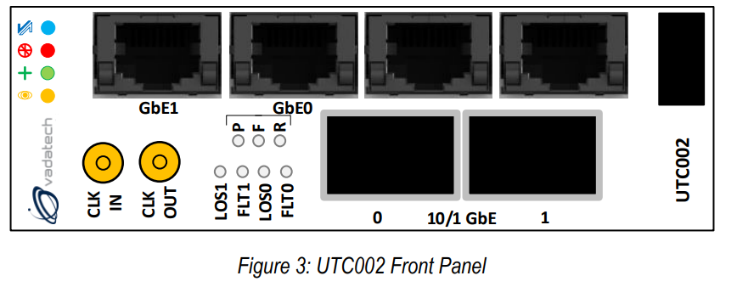
“FPGA RS-232” to PC
(this is the minicom window)
To PC secondary network card (this is the ethernet connection)
Up to four data inputs
Accelerator Trigger
Serial to USB connection (for debug)

