Slide 1
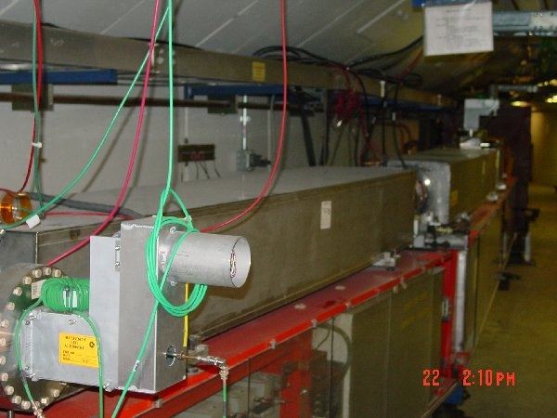
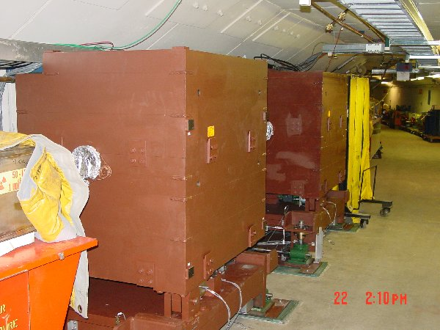
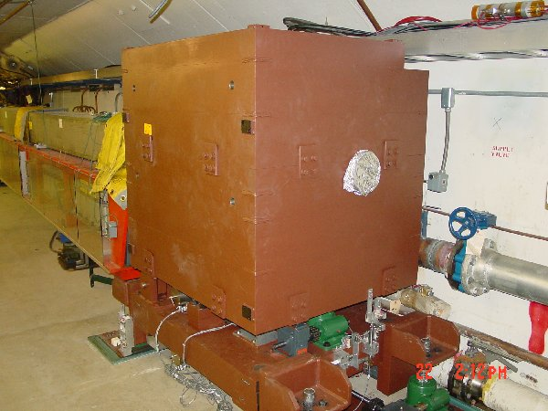
Collimation System
Primary Collimation foils (already there)
Secondary absorbers w/shielding
Tertiary absorber
  Collimators in, wired, tested, aligned (?), ready for vacuum work – on schedule.

Slide 2
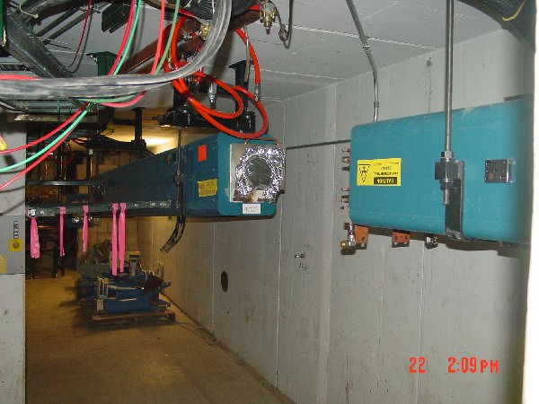
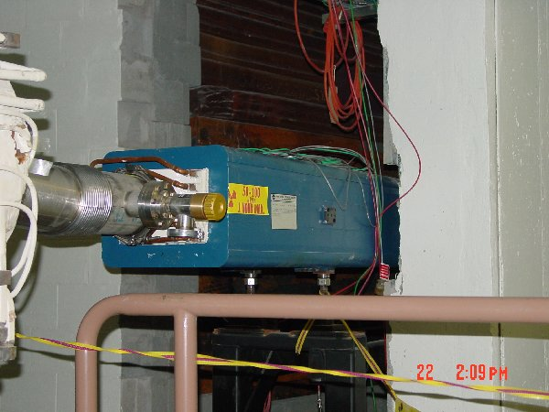
EDWA Magnets
These are all gone now – on schedule. Radiation exposures within ALARA projection
< 2 mR/hr without magnets
Still 10’s of mR/hr even without magnet

Slide 3
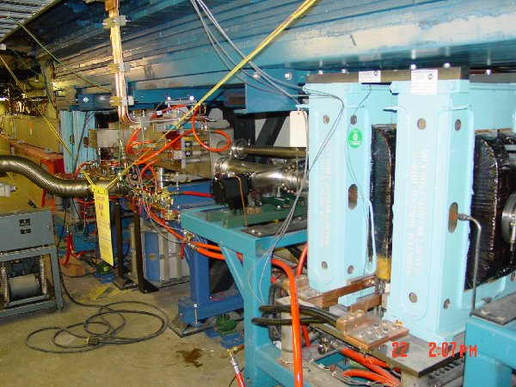
Long 3 Dogleg Work – Starts week after next
Stretch out dogleg pairs
Move Septum
  Currently 50-60 mR/hr. Plan to remove all components and bottom layer of shielding prior to starting work.

Slide 4
Booster Summary
Everything on schedule.
We’ve finished a lot of the small jobs that we thought would wait until later in the shutdown (damper, beam whacker, etc…)
Doing well with respect to radiation exposure.
Things still look good for our October 18th turn-on.
Some worry that the prototype RF cavities might not be ready (hope to get at least one in).
Need more keys!!! We ran out three times in the last two days.

