Slide 1
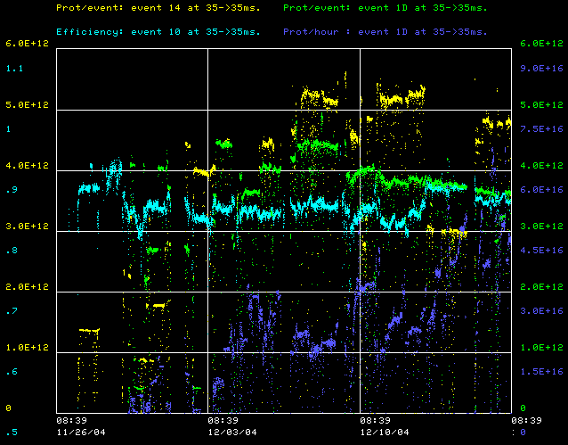
How are we doing?
This week (best)
  Stacking 5.3E12
  Eff. 87%
  MiniBooNE 6.5E16
Best:
  Stacking: 6E12
  Eff. 87%
  MiniBooNE 8E16
Also:
  Cogging more or less operational

Slide 2
Issues
High field orbit issues
  BEX bump sagging
    Add prepulses
    Working to replace power supplies
    Magnet reconfiguration
  Magnet moves?
    Waiting on alignment data
Multi-batch extraction jitter
  Debugging cogging
  Fixed notcher problems
  Wider notch being considered
Period L5 alignment problems
  Communication problem during shutdown
  Realigned yesterday
Plan
  Keep tuning
    Transition losses
    Orbit at extraction regions

