Slide 1
New Booster Injection Scheme
Eric Prebys
(for Milorad Popovic)

Slide 2
Multi-turn Ion Injection
Existing System:
4 pulsed “ORBUMP” magnets
Circulating Beam
DC “Septum”
Beam at injection
400 MeV H⁻ beam from LINAC
Stripping foil
At injection, the 40 mA Linac H- beam is injected into the Booster over several “turns” (1 turn ~5E11).
The orbit is “bumped” out, so that both the injected beam and the circulating beam pass through a stripping foil, after which they circulate together.

Slide 3
ORBUMP Problems
High rep. rate heating problems
  Operates instantaneously at 15 Hz, but…
  Magnets not cooled
    Will overheat after sustained high rate running
  Power supply not designed for high rate running
    Partially improved by water flow improvements and new capacitors
  Currently limit average rep. rate to ~7.5 Hz, including conditioning prepulses.
Not powerful enough
  Not able to bump circulating beam out far enough to properly match injected beam
  -> ~1 cm of beam motion at injection
  -> significant losses
Edge focus effects
  Strong horizontal bend results in vertical focusing
  -> vertical lattice distortion.
Current path not optimum
  Existing stripline configuration very sensitive to impedance mismatches.

Slide 4
Baseline solution (Proton Plan 1.2.2)
New magnets:
  Replace laminated magnets with drop-in replacements based on ferrite
  Cooled stripline and conductor
  Capable of sustained operation at 15 Hz w/o overheating
New power supply:
  Properly spec’ed capacitors and switch network
  Modern charging supply
  Also capable of 15Hz operation.
Combination powerful enough for proper injection matching.
On track for installation in 2005 shutdown.
  Build new girder, test and install as a unit (existing girder too hot to work on).

Slide 5
New Injection Scheme (Milorad Popovic)
Circulating Beam
DC “Septum”
400 MeV H⁻ beam from LINAC
Beam at injection
Stripping foil

Slide 6
Advantages
Eliminates DCSEP:
  Historical aperture restriction
  Hysteresis problems
  VERY hot
Less magnets:
  Now have a full complement of spares (making six).
Lower power
  50% lower current
  25% lower voltage
Reduced edge focusing:
  ~35% of original effect

Slide 7
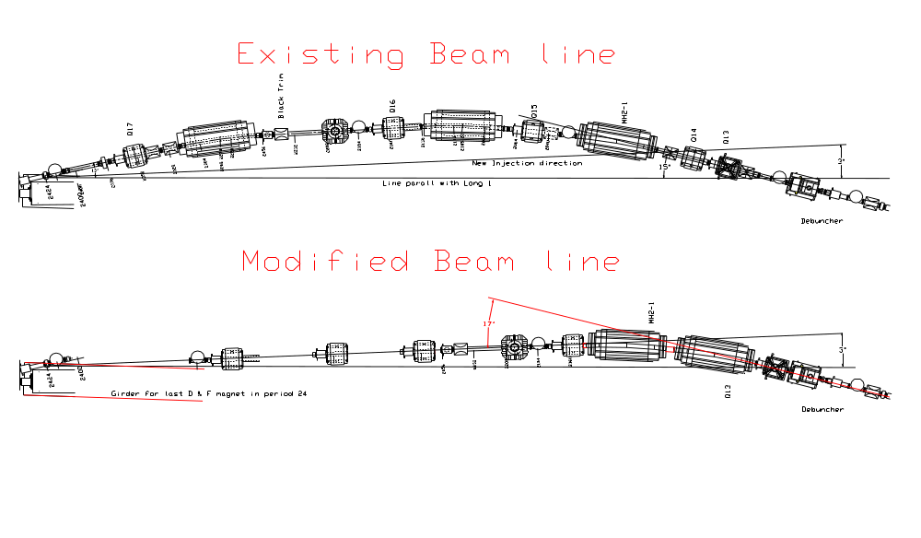
Consequences for 400 MeV line
Beam Direction
Same up to debuncher
ORBUMP
ORBUMP
No new beamline elements
  DCSEP and one HBEND removed
  Remaining elements rearranged
Minimal stand fabrication

Slide 8
Implications for Plan
ORBUMP project not significantly effected
  Only need three magnets -> now we’ll have three spares
  Girder and stripline were not yet designed anyway
    New design simpler
  Trivial mods to PFN in power supply
400 MeV line project new
  Optical model looks OK
    Working on beam sheet (F. Garcia)
  Working with mechanical support for details of line rearrangement (Rob Reilly)
    One new stand
    Misc. vacuum parts
    Had to remove many elements anyway to install new ORBUMP girder

