Slide 1
Run II DOE Review - Booster
Eric Prebys
Booster Group Leader
FNAL Beams Division

Slide 2
Primary Consumers of Protons
“stacking” (last 2 years): Proton source provides protons to Main Injector, where they are accelerated to 120 GeV for antiproton production – typically 7E15 p/hr max.
MiniBooNE (last 2 months): 8 GeV protons delivered directly to neutrino production target – typically 1.5E16 p/hr max, but baseline is 7 times that!!!
NUMI (2004?): protons delivered to Main Injector, which will accelerate them to 120 GeV for neutrino production – wants at least 5E16 p/hr while MiniBooNE and stacking are running.

Slide 3
Fundamental Change in Focus
During collider operation (“stack and store”), fairly long periods of reduced proton source performance could be tolerated with no significant impact on the physics. Recently, this has becoming less true.
Proton source has not been a limiting factor in the Fermilab physics program in a very long time.
For the new generation of neutrino experiments, physics is directly related to the total number of protons delivered.

Slide 4
One Year Ago…
The only real measure of Proton Source Performance was the delivered flux. In particular,
  No measurement of energy or phase of beam going from Linac to Booster.
  No way to measure Booster tune without dedicated study time.
  No systematic way of studying losses.
These improvements prepare us for the hard stuff ahead.

Slide 5
Proton Timelines
Everything measured in 15 Hz “clicks”
Minimum Main Injector Ramp = 22 clicks = 1.4 s
MiniBoone batches “sneak in” while the MI is ramping.
Cycle times of interest
  Min. Stack cycle: 1 inj + 22 MI ramp = 23 clicks = 1.5 s
  Min. NuMI cycle: 6 inj + 22 MI ramp = 28 clicks = 1.9 s
  Full “Slipstack” cycle (total 11 batches):
    6 inject
    + 2 capture (6 -> 3)
    + 2 inject
    + 2 capture (2 -> 1)
    + 2 inject
    + 2 capture (2 -> 1)
    + 1 inject
    + 22 M.I. Ramp
    ----------------------
    39 clicks = 2.6 s

Slide 6
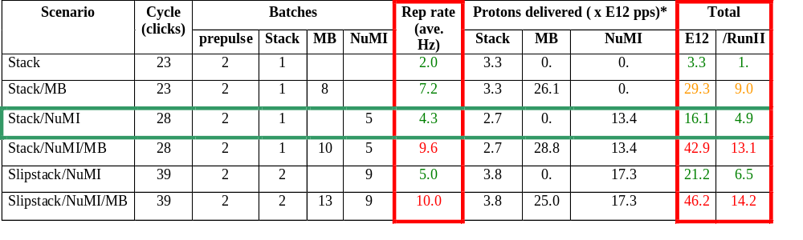
Summary of Proton Ecomomics
MiniBooNE baseline ≈ 5E20 p/year
Booster Hardware Issues
Radiation Issues
NUMI “baseline” = 13.4E12 pps x 2E7 s/year ≈ 2.7E20 p/year
*assuming 5E12 protons per batch

Slide 7
What Limits Total Proton Intensity?
Maximum number of Protons the Booster can stably accelerate: 5E12
Maximum average Booster rep. Rate: formerly 2.5Hz, currently 2 Hz, soon 7.5 Hz
(NUMI only) Maximum number of booster batches the Main Injector can hold: currently 6, possibly go to 11
(NUMI only) Minimum Main Injector ramp cycle time (NUMI only): 1.4s+loading time
Losses in the Booster:
  Above ground radiation
  Damage and/or activation of tunnel components
Our biggest worry at the moment!!!!

Slide 8

Typical Booster Cycle
Various Injected Intensities
Transition
Intensity (E12)
Energy Lost (KJ)
Time (s)

Slide 9
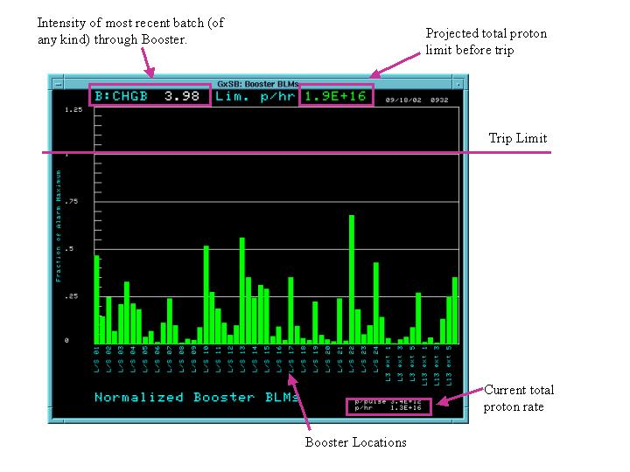
Tunnel Loss Limits

Slide 10
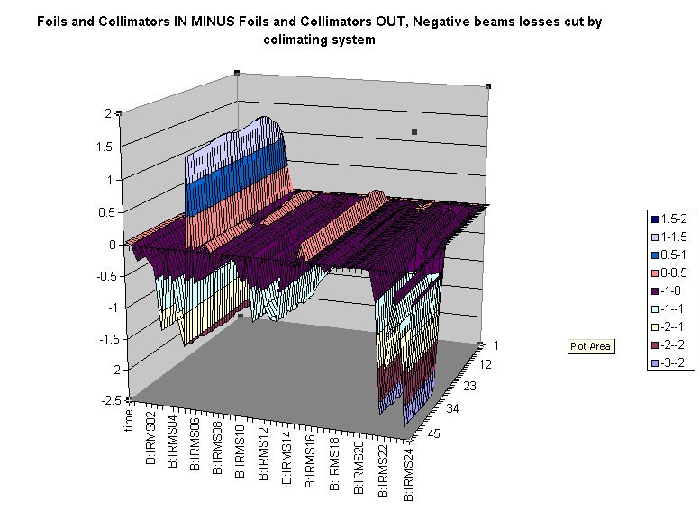
Differential Loss Monitor Example: Collimators in – Collimators Out
Collimator Position
Relative Loss
Time
Position

Slide 11
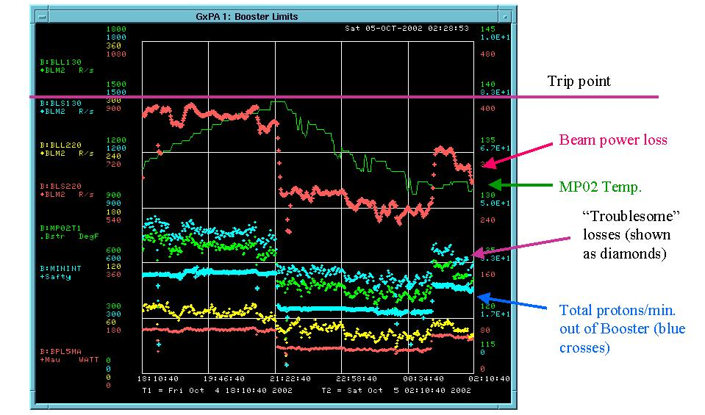
Summary of Booster Limits

Slide 12
Above Ground Radiation
Main worry are the high occupancy areas in the Booster towers.
Shielding has been added both in the tunnel and to the first floor of the Booster towers.
Offices have been moved to reclassify some worrisome areas.
Radiation is monitored by a system of “chipmunks” positioned around the Booster.
Part of the Booster permit system.

Slide 13
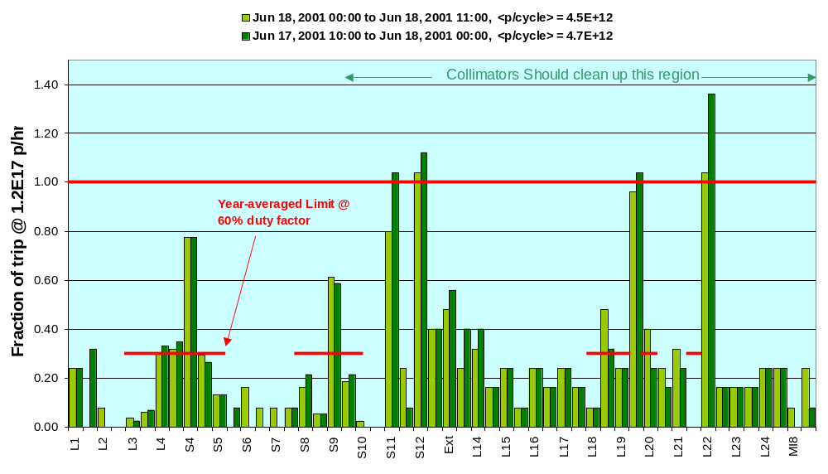
Best Performance + Shielding + BooNE Intensities
Scaled up from measurements during stacking-> looks OK

Slide 14
Problems with Fast Cycle Time
Existing Fermilab alarms and limits system works only with DC values.
There are several hundred important proton source measurements which vary over small time scales (usec to msec).
At present, the only way to monitor these is either examining them by hand or using discrete samples in the alarms and limits system.
-> Usually, problems can only be found indirectly by looking at performance. E.g. recently it took about a week to track down a low level RF problem which would have been obvious if we were looking at the right thing.
People who should be working to improve Booster performance spend all their time keeping it running.

Slide 15
Ramp Monitor Program
A dedicated task which will loop over all the ramping devices.
For each device, it will calculate a running average curve for each type of Booster cycle (pbar production, MiniBooNE, etc), and calculate an RMS.
Deviations from this curve will be logged, and possibly set alarms.
It’s envisioned that this program will greatly aid in debugging problems, and may well migrate to other parts of the accelerator.

Slide 16
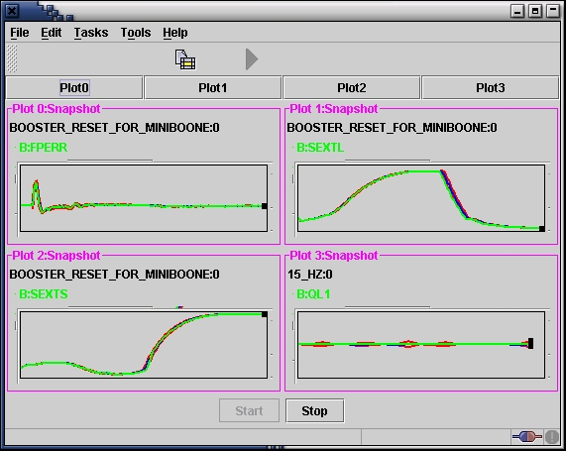
Ramp Monitor Progress
Latest Measurement
1 sigma envelope

Slide 17
Easy Question First
Do we have adequate resources??
NO

Slide 18
Minimum Staffing Needs
Crisis (needed to maintain current level of performance):
  1 Engineer III+ to take charge of low level RF system.
  1 Tech/Engineer to assist.
For any hope of improvement:
  1 Full time accelerator physicist to help orchestrate performance studies.
  1 Engineer to help oversee large projects (collimator shielding,Large aperture RF, etc.)

Slide 19
(Roughly) Prioritized Booster Project List
Fix what’s broken today!!!
Collimator shielding (first design review complete, hope to have ready for “January” shutdown, or incremental installation).
New extraction septum power supply (finished, ready to connect).
Ramped orbit correctors (being optimized for high intensity transport).
New extraction septum magnet (finished, being tested, ready for “January” shutdown).
Longitudinal Damping system upgrade (being designed).
Large aperture RF cavities (powered prototype tested, vacuum-ready new prototype ready “in the spring”, may need to redline whole system if other ideas don’t pan out).
Low Level RF upgrade (could suddenly jump up in priority if things start to fail).
This list does not include ongoing studies to understand Booster performance

Slide 20
Some of Specific Studies
Understanding fundamental machine characteristics:
  tunes
  chromaticity
Injection:
  Dependence on injected bunch width
  Dependence on injected bunch overlap
  Dependence on RF capture parameters
  Space charge: coherent tune shift, incoherent tune spread, etc.
Transition:
  Detailed study of loss mechanisms through transition and after.
  Gamma-t jump??

Slide 21
Hard Questions
Quantitative overview of tunnel loss concerns:
  Damage thresholds not understood at any level – try to keep losses within a factor of two of historical levels.
  Try to keep activation at a level where a single crew can do “typical” service operations.
Quantitative improvements from ongoing projects
  Collimators: factor of 2?
  Orbit control: factor of 2, maybe?
  Better understanding of instabilities: a bit?
  Improved monitoring/reliability: a bit?
  This does not get us to the required intensities.

Slide 22
Measured Beam Energy Loss
~ 60 “Tevatron-style” ionization monitors:
  100 second running average now our primary figure of merit for Booster performance.
  Part of Booster permit system.
Differential proton loss is measured using toroids.
  Weighted by energy to produce a “Beam Energy Lost”.
  Loss rate in Watts calculated using a 5 minute running average updated every minute. Part of Booster permit system (current limit 400 W).

Slide 23
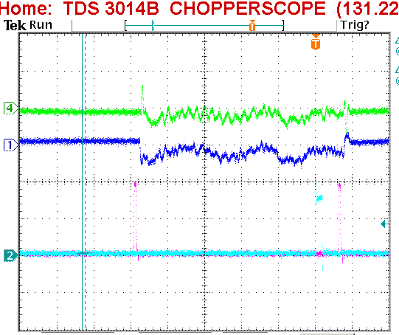
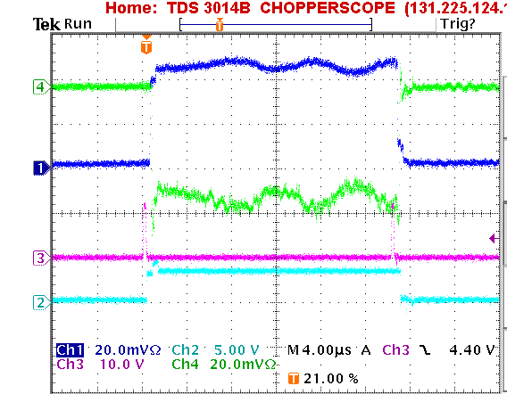
Injected Energy and Phase
Energy: Time of flight (phase difference) between end of Linac and injection debuncher cavity.
Phase: Difference between detected phase and debuncher phase at cavity
Good
Bad!!!
Injection Time
Problem: No automated alarm (yet)

Slide 24
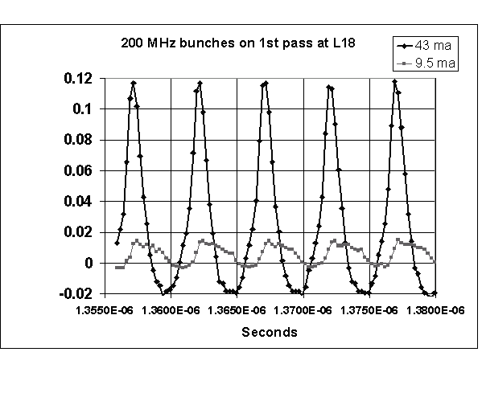
Injected Bunch Shape
Resistive Wall Monitor ¾ of the way around the ring.
Problem: not yet used in a systematic way.

Slide 25
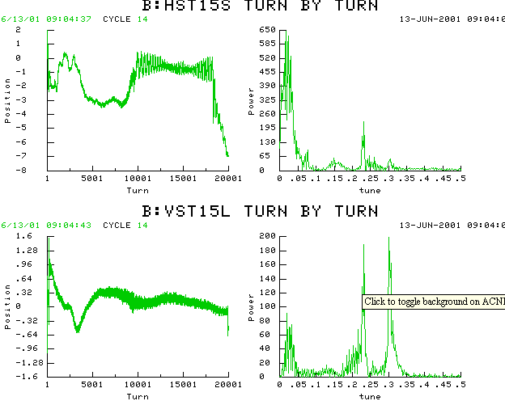
Orbit
System of 48H+48V BPM’s, which can be read out as a function of time for the whole ring each cycle.
Instability
HOR:
VERT:

Slide 26
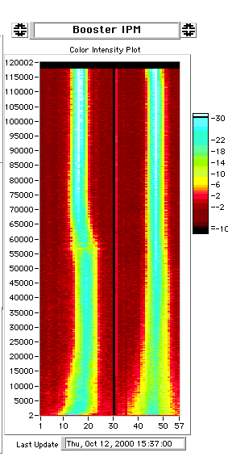
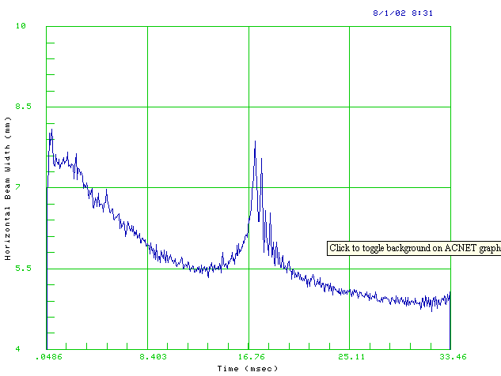
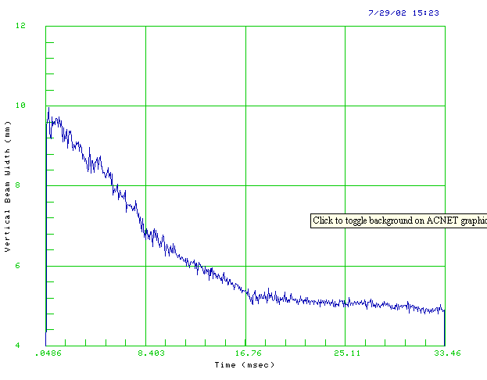
Beam Profile: Ionization Profile Monitor

Slide 27
Injected Beam Profile (“Flying Beam”)
Beam sweeps over fixed wire as it returns from injection “bump”.
Use secondary emission signal vs. time to get beam profile.
Use to calibrate IPM (in progress)

Slide 28
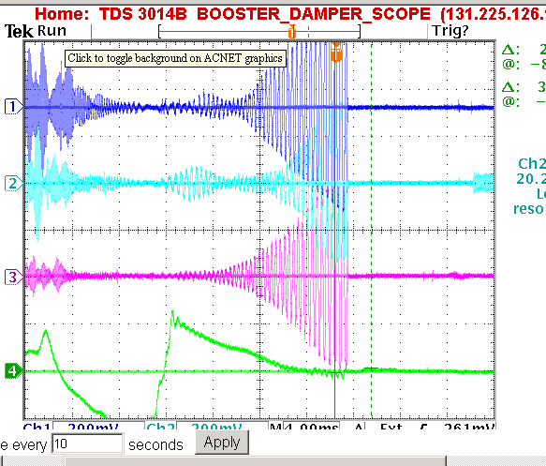
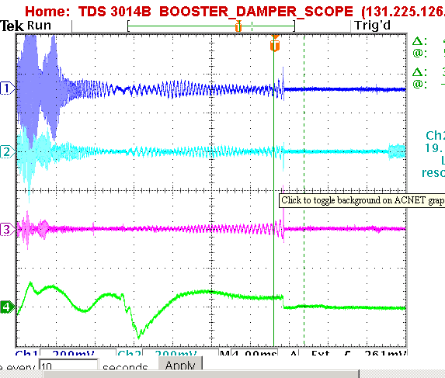
Coupled Bunch Detection
Individual Mode Lines (typically ~80 MHz) mixed down and monitored through the acceleration cycle.
Problem: No automated alarm.
System being redesigned.
Dampers Working
No Dampers

Slide 29
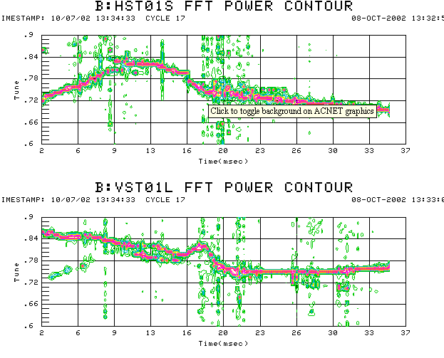
Tune Measurement (first time in many years!)
Horizontal plane pinged at 2 ms intervals.
Do FFT on one of the BPM’s
For the moment, coupling to vertical plane is sufficient to measure that too!!

