Slide 1

Proton Beam Inter-Bunch Extinction and Extinction Monitoring for the Mu2e Experiment
Eric Prebys, FNAL
HB2012, Beijing, China

Slide 2
Acknowledgments
Representing the Mu2e Collaboration
24 Institutions
~120 Collaborators
This talk has direct contributions from
Alexander Drozhdin, FNAL
Andrei Gaponenko, FNAL
Carol Johnstone, FNAL
Vladimir Kashikhin, FNAL
Peter Kasper, FNAL
Sasha Makrarov, FNAL
Bill Molzon, UCI
Igor Rakhno, FNAL
Zhengyun You, UCI

Slide 3

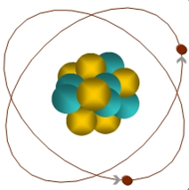

The Physics of Mu2e: μ+N → e+N
Nearly all models beyond the Standard Model predict the interaction:
If captured on the nucleus, a muon will have an enhanced probability of exchanging a virtual neutral particle
Could be a γ or heavy boson.
Two body decay➔mono-energetic electron!
Similar to μ→eγ, with important advantages:
No combinatorial background
Because the virtual particle can be a photon or heavy neutral boson, this reaction is sensitive to a broader range of BSM physics
Goal: measure with a single event sensitivity of <10⁻¹⁶
μ
105 MeV e⁻

Slide 4
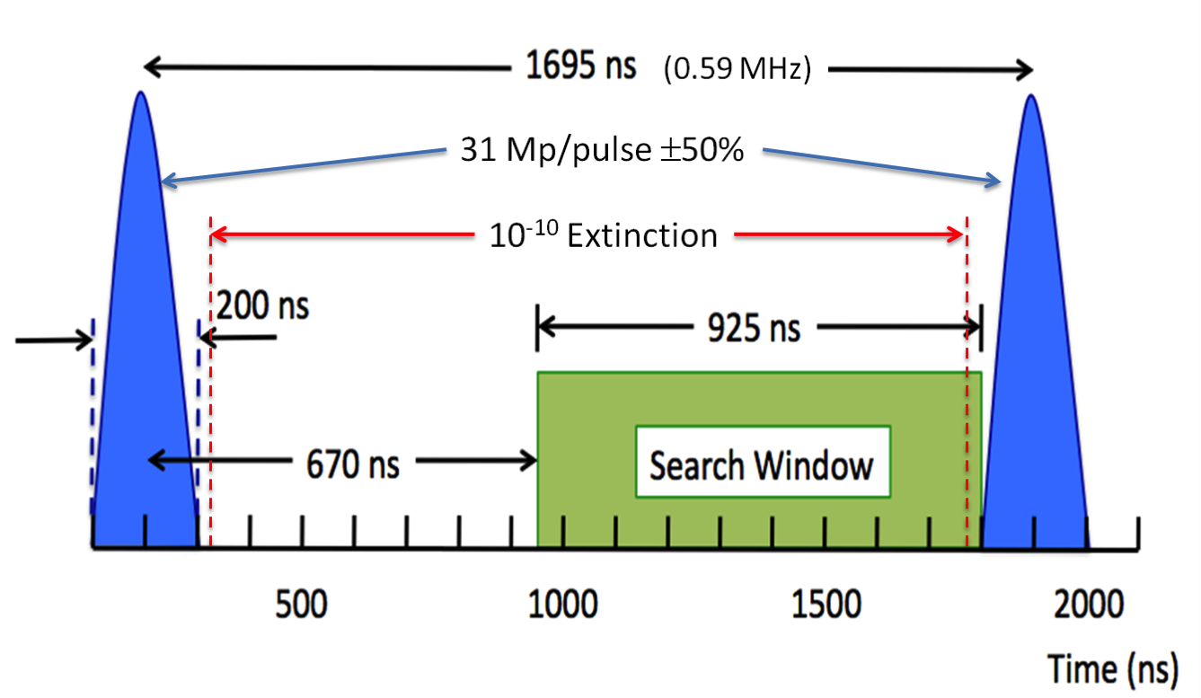
Experimental Technique and Extinction
A proton beam will be used to create muons, which will be transported and captured on an Aluminum target.
Most backgrounds are prompt with respect to the parent protons, so a pulsed beam will be used.
Detection window will be after backgrounds have died away
Out of time protons would limit sensitivity and must be suppressed at the 10⁻¹⁰ level (“Extinction”)

Slide 5
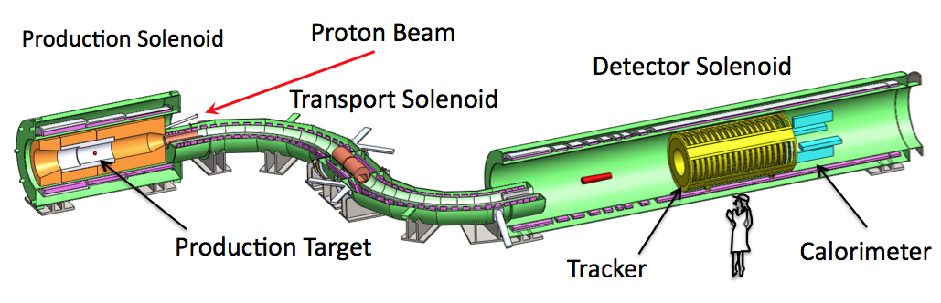
Muon Beam Line and Mu2e Detector
Production Target
Proton beam strikes target, producing mostly pions
Production Solenoid
Contains backwards pions/muons and reflects slow forward pions/muons
Transport Solenoid
Selects low momentum, negative muons
Capture Target, Detector, and Detector Solenoid
Capture muons on Aluminum target and wait for them to decay
Detector blind to ordinary (Michel) decays, with E≤½m_{μ}c²
Optimized for E~m_{μ}c²

Slide 6
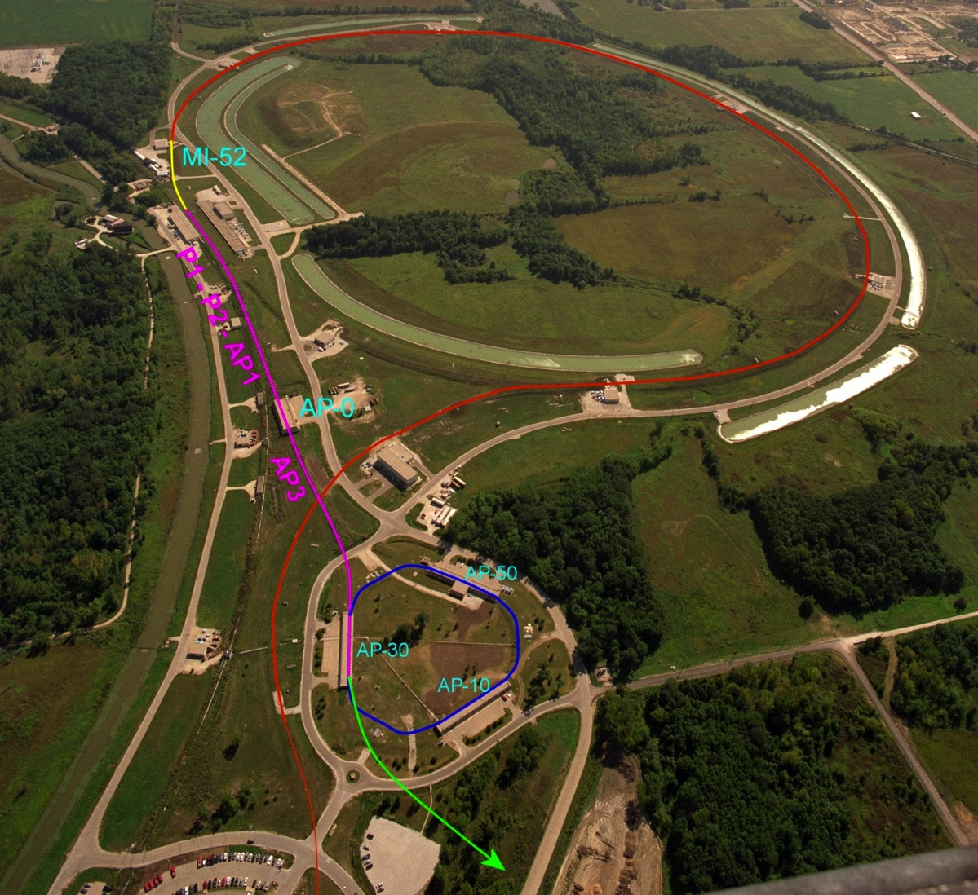
Overview: Proton Delivery at Fermilab
One Booster batch (4x10¹² protons) is injected into the Recycler.
It is divided into 4 bunches of 10¹² each
These are extracted one at a time to the Delivery Ring
Period = 1.7 μsec
As a bunch circulates, it is resonantly extracted to produce the desired beam structure.
Bunches of ~3x10⁷ protons each
Separated by 1.7 μsec
Main Injector/Recycler
Delivery Ring (formerly pBar Debuncher)
Mu2e
Booster

Slide 7
Extinction Systems
Extinction will be achieved in two phases:
In ring
Beam delivery technique automatically gives good extinction < 10⁻⁵ going into the Delivery Ring
May degrade to 10⁻⁴ during the spill
In beam line
System of AC dipoles and collimators
Factor of 10⁻⁷ should be possible
Monitoring
Need to show that 10⁻¹⁰ has been achieved

Slide 8
Delivery Ring
Start with < 10⁻⁵ level of extinction going into the Delivery Ring, so the issue is how will it grow during the spill.
Effects considered
RF noise
Intrabeam scattering
Beam loading
Beam-gas interaction
Scattering off of extraction septum
Simulation still ongoing, but it looks like it should be possible to maintain a 10⁻⁵ level of extinction.

Slide 9
Extinction on the Proton Beam Line
The proton delivery beam line will contain a system of resonant dipoles (“AC dipoles”) and collimators to eliminate out of time beam
Delivery Ring
Mu2e Experiment
Proton Beam Line

Slide 10
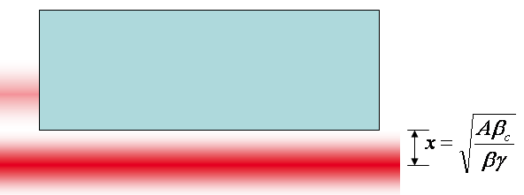
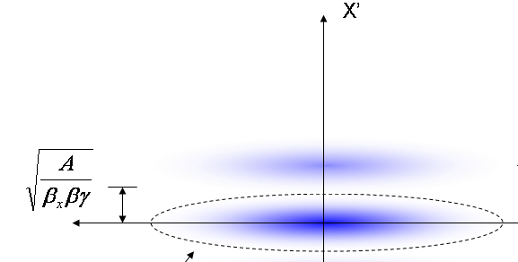
Generic Beamline Extinction Analysis
Assumptions:
Beam occupies entire admittance
Beam line admittance is equal to the collimation channel’s admittance
Resonant dipole that deflects out-of-time beam into a collimation system
At collimator:
Beam fully extinguished when deflection equals twice full admittance (A) amplitude
Angle to extinguish beam:
At dipole:

Slide 11
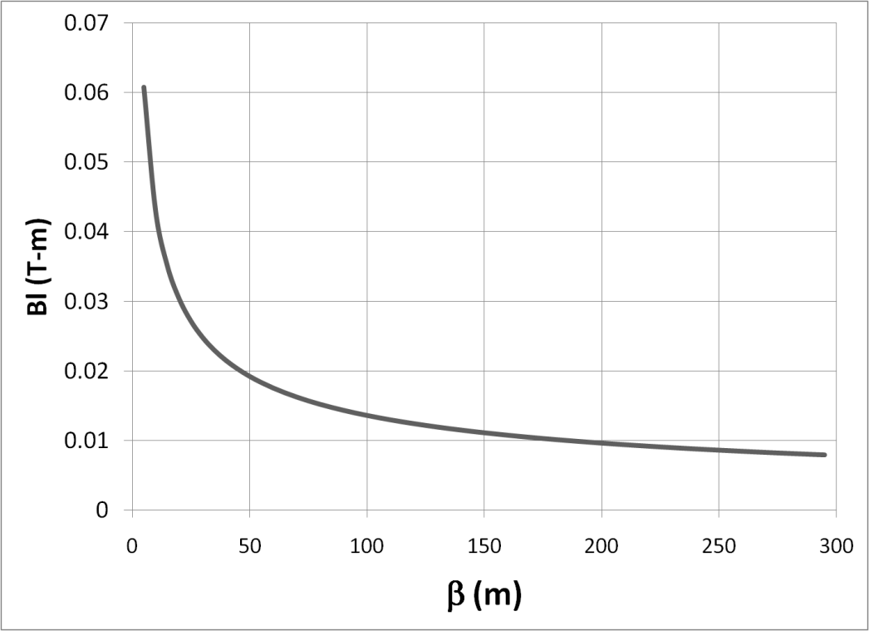
Magnet Considerations
Bend strength to extinguish:
Stored Energy:
⇒Large β_{x}, long weak magnets
- Assume β_{x}=250m, L=6m
- Factor of 4 better than β_{x}=50m, L=2m

Slide 12
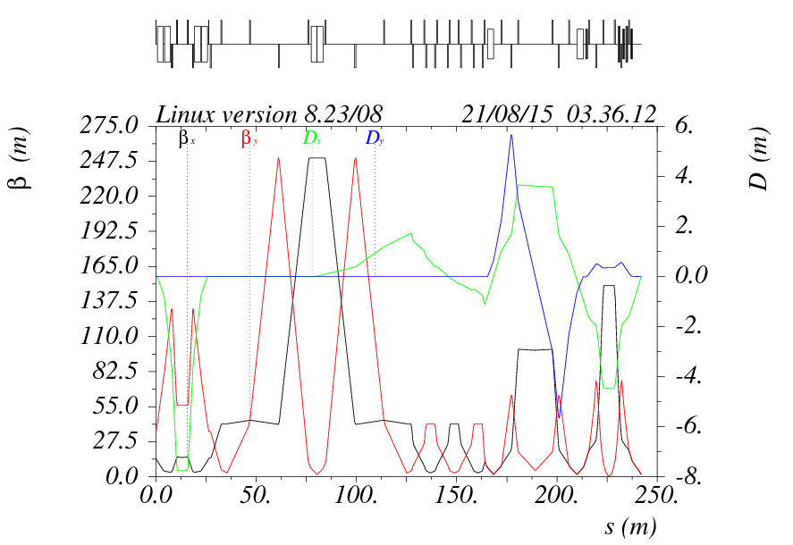
Features of the Extinction Beam Line
Upstream of extinction dipole
Collimation to define beam line admittance to 50 π-mm-mr
AC dipole region
Bend plane: β=250m
Non-bend plane: waist
Extinction collimation
Minimize transmission of scraping particles
Post-extinction
High dispersion region for momentum collimation.

Slide 13
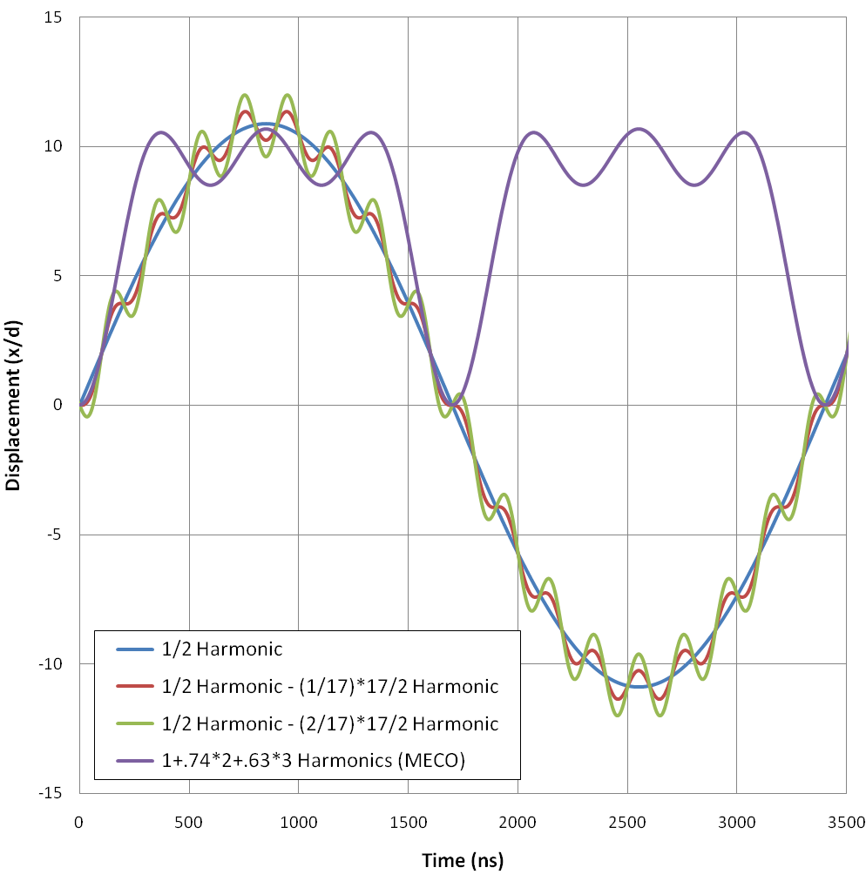
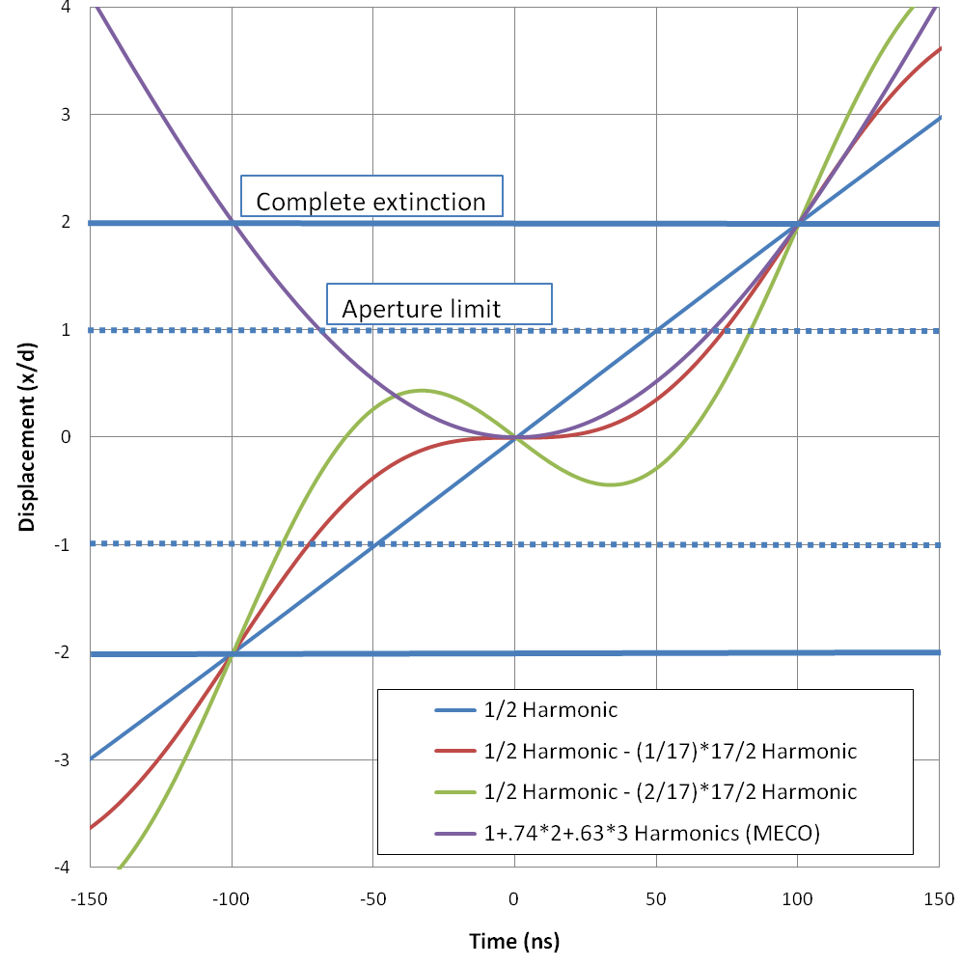
Wave Forms Analyzed
Bunch length
Transmission window
Of the options considered:
½ harmonic – (2/17) * 17/2 harmonic seems most promising

Slide 14
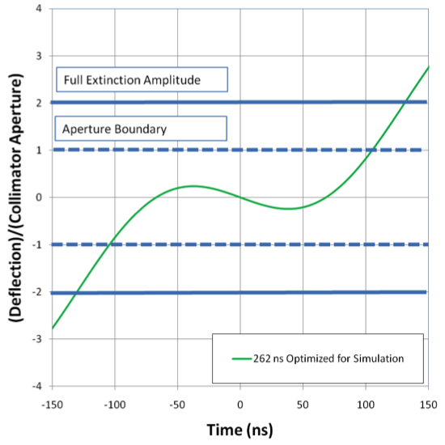
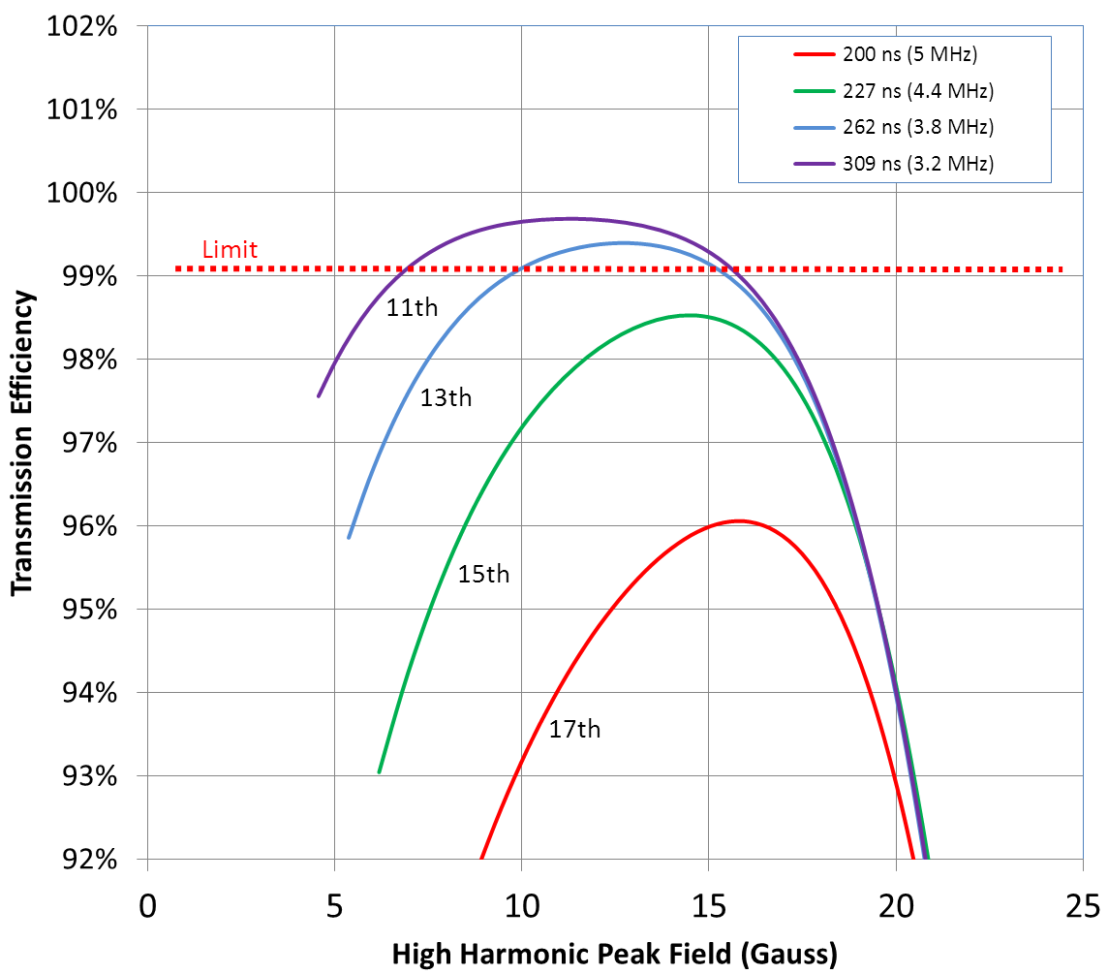
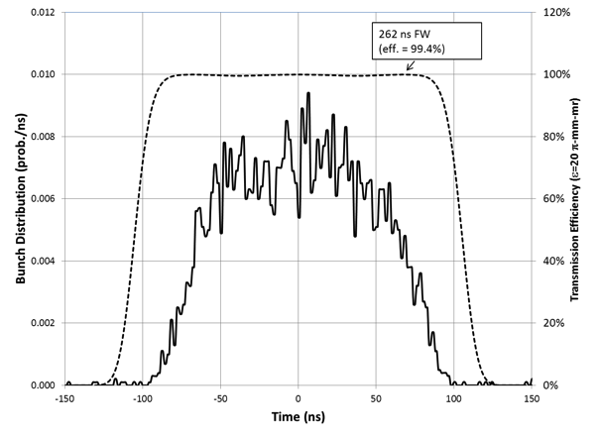

Wave Form Optimization
This study produced in the final parameters for the two harmonic system
Transmission efficiency was simulated with more realistic bunch shapes
Harmonic number and amplitude of high frequency component was varied
Beam motion in Collimator
Transmission Window
Bunch

Slide 15
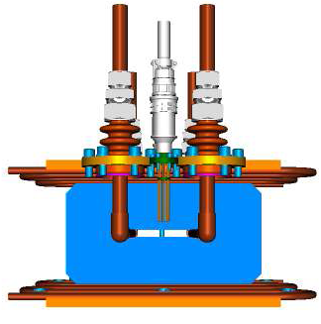
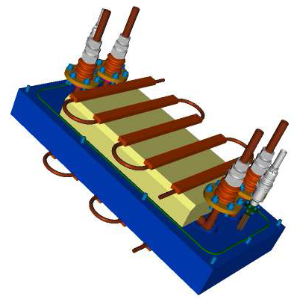
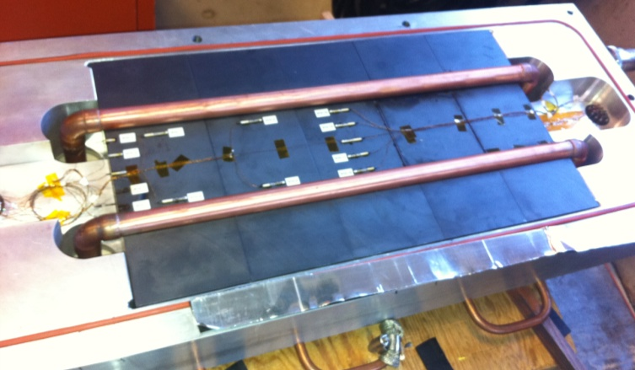
AC Dipole Prototype*
1 .5m prototype has built and tested
Successfully operated at both frequencies
Plan is to build final system out of identical 1m segments
Conductor
Cooling channel
Gap
Ferrite
*Design by Sasha Makarov and Vladimir Kashikhin

Slide 16
Extinction Simulation
The extinction beam line was simulated using STRUCT and MARS*
Collimator Material:
Extinction Region
Extinction < 5x10⁻⁸ over range of interest for optimized collimators
This is multiplied by the Delivery Ring factor to produce a total extinction of < 5x10⁻¹²
Time (ns)
*I. Rakhno

Slide 17
Monitor Requirements
Demonstrate 10⁻¹⁰ extinction
Assume ≈ 3 x 10⁷ protons/bunch
Not possible measure 10⁻¹⁰ with a single bunch
⇒ Integrate over many bunches
Integration time should be < ≈ 1 hour
Only protons hitting the target can cause backgrounds
Monitoring beam itself will lead to a potentially large over estimate of the background to the experiment
⇒ Monitor target interaction product and integrate a statistical profile of out of time beam.

Slide 18
Statistical Filter + Detector Strategy
Filter
Selects a sample of suitable secondaries and delivers them to the detector
Sets the per proton detector signal rate
Shields the detector from unwanted interaction products
Detector
Measure “in-time” and “out-of-time” signal rates with equal or known relative efficiency
Must have LOW “out-of-time” backgrounds compared to signal rate

Slide 19
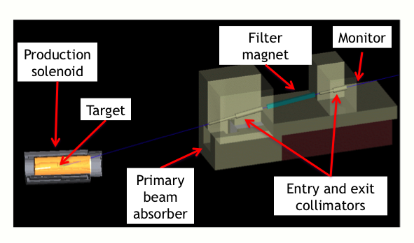
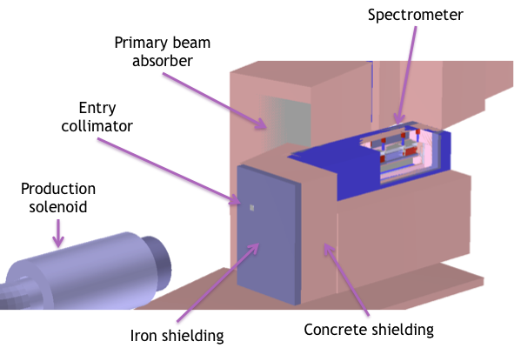
Precision Monitor Options
Pixel Tracker
Located above and behind the proton absorber
Samples 3 to 4 GeV/c positive charged secondaries
Pixel detectors reconstruct and count straight tracks with a well defined direction in 25ns time bins
Mini Spectrometer
Located beside the proton absorber
Samples ~ 1 GeV/c positive charged secondaries
Magnetic spectrometer with 4 scintillator stations measures dE/dx, time of flight, and momentum of identified particle tracks

Slide 20
Requirements
Signal Rate
Determined from beam intensity
3 x 10⁷ protons/bunch
Bunch rate: 0.6 MHz @ 33% duty factor
⇒ 2 x 10¹⁶ in-time p.o.t./hr
10⁻¹⁰ extinction ⇒ 2 x 10⁶ out-of-time p.o.t./hr
To set a 90% C.L.
Need 2.3 expected out-of-time signal/hr
⇒ 1.2 x 10⁻⁶ signal events per p.o.t.
Background
<< 1 event/hr
Both approaches seem to satisfy these requirements
Down selection committee formed.
Recommendation in November

Slide 21
What’s Next
In ring extinction
Complete calculations and simulations to determine the likely level of out of time beam.
Work in mitigation, such as in ring momentum collimation, if it’s insufficient.
Beam line extinction
Magnet design appears sound
Continue modeling effort to optimize collimation design.
Monitoring
Down select between two precision monitor options
Develop fast monitor to measure extinction at the 10⁻⁵ level monitor beam coming out of the ring before the AC dipole
Hope to combine with precision intensity measurement for slow extraction feedback.

Slide 22
Mu2e Schedule

Slide 23
Conclusions
Extinction and extinction monitoring are a critical part of the Mu2e schedule
We have developed a plan for beam line extinction and have two apparently viable options for precision monitoring
More analysis is required to determine what, if any, further mitigation will be required in Delivery Ring to achieve the required 10⁻⁵ level of extinction.

