Slide 1
Beam/Booster Status and Plan
Eric Prebys
Booster Group Leader
FNAL Beams Division

Slide 2
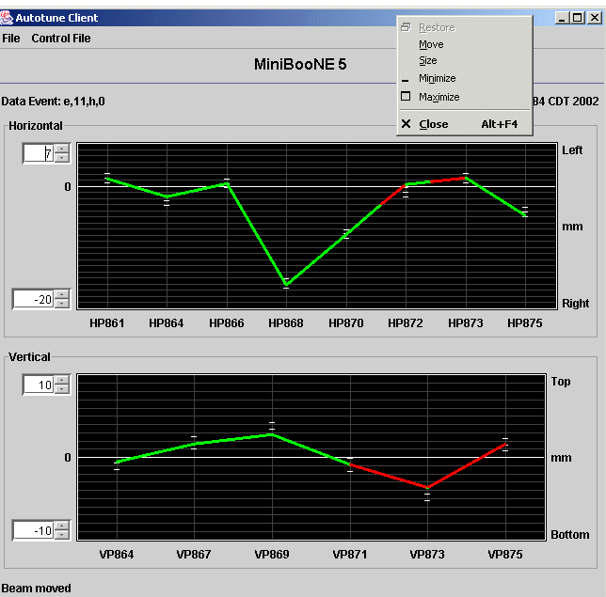
Autotune Now Working!!!
Now stable and working.
Typically left running for long periods.
Training operators to use.
Should be able to handle small changes due to Main Injector injection closure.

Slide 3
870 Aperture Problem
Moved multiwire from 871 to 870 to look at beam size.
Guess what? It was big.
All quads (powered and permanent) now checked – OK.
Not well understood.
Not a big issue (except to the extent it means we don’t understand our beam).

Slide 4
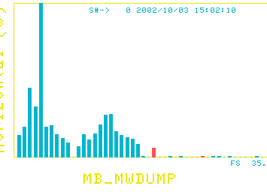
Beam Angle Problem
Center
Center
Dead channel
H
V
Looks like beam off by ~10 mr horizontally.
Is this possible? (Could also be bad loss monitor gains).
How big a problem is this.

Slide 5
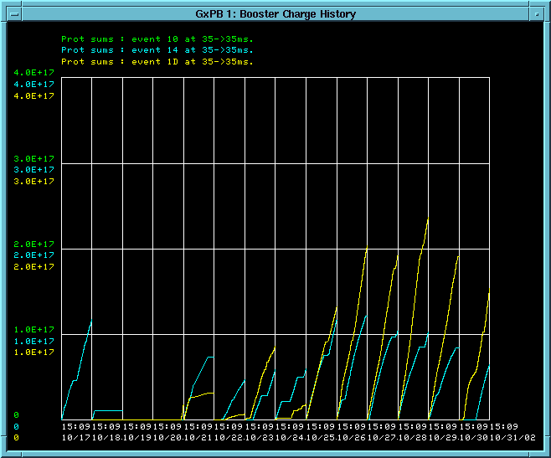
How are we Doing
Still seem to be stuck at the E16/hr limit
Wrong Magnet Move
Right Magnet Move

Slide 6
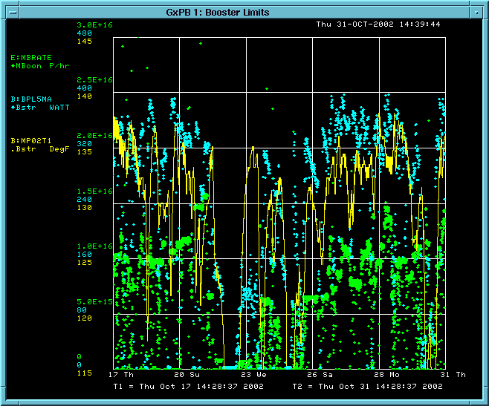
Limiting Factors (Last Two Weeks)
Limit
Booster Power Loss (will raise limit next week)
MP02 Temp
MiniBooNE rate (p/hr)
Wrong Magnet Move
Right Magnet Move

Slide 7
Change of Management
Proton Source Dept.
Head: Bob Webber
Booster Group
Leader: Jim Lackey
MiniBooNE Beam Line
Mach. Coor.: Craig Moore
Deputy: Eric Prebys
Linac Group
Leader: Elliot McCrory
Proton Source Dept.
Head: Elliot McCrory
Booster Group
Leader: Eric Prebys
MiniBooNE Beam Line
Mach. Coor.: Craig Moore
Deputy: ???
Linac Group
Leader: Elliot McCrory

Slide 8
Division of Responsibilities
Me:
  Achieving maximum number of protons out of the Booster.
  Addressing Booster beam quality issues (e.g. longitudinal damping).
  Address Time Line Issues
Craig + ??:
  MiniBooNE beam line issues.
  Access coordination.
  Optimized MiniBooNE running.

Slide 9
Problems During Shot Setup/Study Periods
Problem during final proton loading:
  Final protons use short batches (7/84 bunches).
  These follow a slightly different path (or are at least measured to).
  Injection closing for these protons starts upstream of the switch magnets, so it affects our beam line
  Autotune might be able to correct for this, but the loss monitors trip before it has a chance to.
  Bruce Brown and Dave Capista is working with data from Tom Kobilarcik to automatically bump magnets in our line to compensate for MI-8 changes.
Long super cycle problem
  When the TeV is ramping, they switch from a 60 sec to a 220 second super cycle.
  When a lot of MiniBooNE pulses are put into this, the Main Injector ramp shifts one tick too early on stacking pulses, causing the Booster to lose beam a phase lock time.
  Not fully understood. Linden Carmichael (back from vacation) is working on it.

Slide 10
Problems During Shot Setup/Study Periods (cont’d)
Sparse time line problem
  To save Booster pre-pulses, MiniBooNE “trailer-hitches” to existing cycles.
  During shot setup, there aren’t many of these, so we end up with very long (2 prepulse+1 M.I. + 10 MiniBooNE = 13) pulse trains.
  This can instantaneously exceed the limiting rate counters (which average over 16 seconds).
  Facility to automatically build new, dedicated MiniBooNE modules is very inefficient (2 prepulses for every MiniBooNE pulse).
  Linden Carmichael is also working on this.
Operator attention problem
  Need more oversight from the experiment
  Revive “beam liason” idea???

Slide 11
Minimum Staffing Needs (as told to DOE)
Crisis (needed to maintain current level of performance):
  1 Engineer III+ to take charge of low level RF system.
  1 Tech/Engineer to assist.
For any hope of improvement:
  1 Full time accelerator physicist to help orchestrate performance studies. (Need at least 50% FTE of someone who knows accelerator physics or 25% FTE of someone who knows accelerator physics+controls). Maybe from BP.
  1 Engineer to help oversee large projects (collimator shielding,Large aperture RF, etc.)

Slide 12
(Roughly) Prioritized Booster Project List
Fix what’s broken today!!! (everybody)
Collimator shielding (first design review complete, hope to have ready for “January” shutdown, or incremental installation). (Alex Chen, Jim Lackey)
New extraction septum power supply (finished, ready to connect). (Chez Jach)
Ramped orbit correctors (high intensity transport demonstrated, being optimized). (Eric Prebys, Linda Coney)
New extraction septum magnet (finished, being tested, ready for “January” shutdown). (Jim Lackey + MF)
Automated Ramp Monitor Program (J. Guglielmo [CD]).
Longitudinal Damping system upgrade (being designed). (Bill Pellico)
Large aperture RF cavities (powered prototype tested, vacuum-ready new prototype ready “in the spring”, may need to redline whole system if other ideas don’t pan out). (John Reid).
Low Level RF upgrade (could suddenly jump up in priority if things start to fail). (????)
This list does not include ongoing studies to understand Booster performance

Slide 13
Some of Specific Studies
Understanding fundamental machine characteristics:
  tunes
  chromaticity
Injection:
  Dependence on injected bunch width
  Dependence on injected bunch overlap
  Dependence on RF capture parameters
  Space charge: coherent tune shift, incoherent tune spread, etc.
Transition:
  Detailed study of loss mechanisms through transition and after.
  Gamma-t jump??

Slide 14
List of Projects for “January” Shutdown
Install new MP02 magnet
Install collimator shielding
Install new MI-8 bend (EDWA) magnets (reduce losses in MI-8).
Install new Lambertson at end of Linac (reduced fringe fields will improve significance of dump Linac dump studies).

Slide 15
Good News from DOE Review
Even though it was a collider review, DOE made some specific recommendations wrt. proton source
  Increase support and staffing for proton source.
  Encourage more involvement from Beam Physics.

Slide 16
Hard Questions
Quantitative overview of tunnel loss concerns:
  Damage thresholds not understood at any level – try to keep losses within a factor of two of historical levels. (reviewers suggested installing dose monitors in the tunnel)
  Try to keep activation at a level where a single crew can do “typical” service operations.
Quantitative improvements from ongoing projects
  Collimators: factor of 2?
  Orbit control: factor of 2, maybe?
  Better understanding of instabilities: a bit?
  Improved monitoring/reliability: a bit?
  This does not get us to the required intensities.
  In the ensuing conversation, I agreed that a factor of 3-5 over present performance was a “reasonable” goal.

Slide 17
Impact of MiniBooNE on Collider
No direct impact by definition
  Pbar and collider get whatever protons they want.
  MiniBooNE gets whatever it can after that.
Indirect impacts
  Negative
    Increased Booster loss trips
    Increased failure rate of pulsed components (not seen yet)
    Increased cooldown time due to activation.
  Positive
    More consistent Booster performance because of closer attention.
    Better understanding of Booster will lead to superior performance for the collider.
Bottom Line:
  Collider luminosity (peak and integrated) have gone up about 50% since MiniBooNE started running.
  It is unlikely that MiniBooNE will ever have a significant effect on collider operation.

