Slide 1
Presented ongoing activities in LARP
  Magnet Systems
  Accelerator Systems
  Program Management
Also presented plan for “spinning off” construction project for Phase I (then called “LAUC”)
  Keep under LARP for FY09, budgeting planning out of LARP budget
    Would take ~$1M out of $13M scenario
  Set up separate project structure in FY10
  Elements
    NiTi separation dipoles for Phase I based on RHIC dipoles
    HTSC feedboxes
    “Magnet Systems Engineering”
    5 rotatable collimators
    Laser wire profile monitor for Linac 4
Only piece from LARP
E. Prebys – Fermilab LARP meeting
7/30/08

Slide 2
Generally positive reviews on accelerator and magnet effort
  All talks including closeout available at “LARP+LAUC Review”
  https://larpdocs.fnal.gov/LARP-public/DocDB/DisplayMeeting?conferenceid=52
  Recommended proceeding more or less as planned with magnets
  Closer interaction with CERN on some accelerator projects
A bit more rocky on the construction project
  Unclear how projects were chosen and prioritized
  No comfortable operating program under LARP, even for one year
  Nevertheless, praised effort to mesh CERN Phase-I schedule with US CD-0,1,2 process.
  Recommended setting up a separate structure ASAP
  Also strongly recommended a new name.
E. Prebys – Fermilab LARP meeting
7/30/08

Slide 3
Kovar very supportive of LARP
Recommended setting up a separately funded project office for construction project (LAUC-> APL), ie
  Still plan for $13M for LARP in FY09
  ~$2.5M additional for APL planning
  Scale ~$9M/year for three years
    Not out of line with our estimates
    Third year might impact LARP
  Accordingly, we are currently seeking a project manager
    Timescale ~1/09
    Steve Peggs will serve in the interim
E. Prebys – Fermilab LARP meeting
7/30/08

Slide 4
Mostly to assure Lyn Evans and Enrico Previn about state of Lumi
  Embarrassing that delay was discovered at a CERN MAC meeting, rather than being discovered withing LARP
  LHC no longer planning on Lumi for 08 run, but rather will use scintillator.
  Still depending on Lumi for ’09 because scintillator not rad hard.
Met with Ralph Assmann about collimation
  In spite of uncertainty about details of collimation, confident rotating collimators will play some role.
Took part in Lumi beam test at NA
  Good news: new preamp worked
  Bad news: significant cross-talk from new air-core cable system
E. Prebys – Fermilab LARP meeting
7/30/08

Slide 5
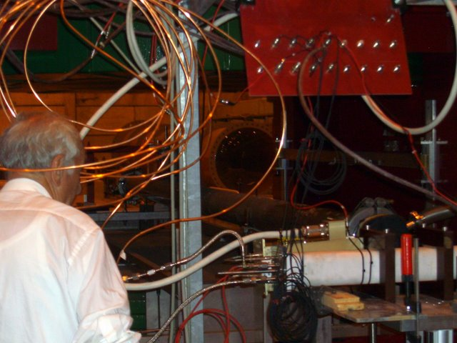
Detector
E. Prebys – Fermilab LARP meeting
7/30/08

Slide 6
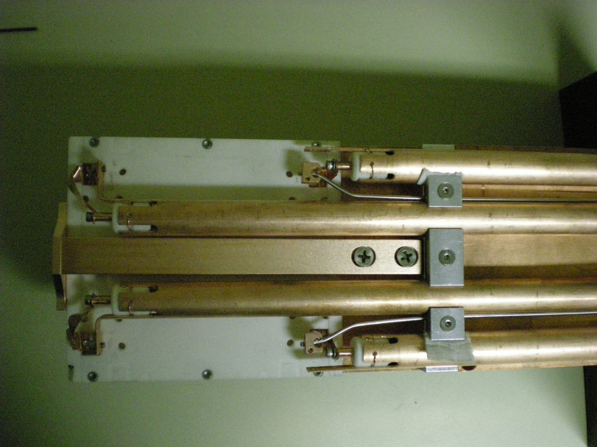
Replaced lossy dielectric with air (actually gas)-core cable.
Ionization in cable induces cross-talk from outer to inner quadrants.
E. Prebys – Fermilab LARP meeting
7/30/08

Slide 7
Lumi hardware being finalized at LBNL
Plan to install all tunnel hardware before beam this year, using existing lumi design
  Develop algorithm to correct for cross-talk
Redesign retrofit for cable to eliminate ionization problem
  Install before 09 run
  Should not be activated during 08 run.
E. Prebys – Fermilab LARP meeting
7/30/08

