Slide 1


Eric Prebys, Program Director
US LHC Accelerator Research Program (LARP)
Ultimate tribute
Sept 10, 2008
*
10/31/2008

Slide 2
LHC Status
  Commissioning
  Sept. 19 Incident
Future upgrade plans
  Phase I
  Phase II, including injector chain
US Contributions
  LHC Accelerator Research Program (LARP)
  Accelerator Projects for the LHC (APL)
E. Prebys, LARP Presentation to JOG
10/31/2008

Slide 3
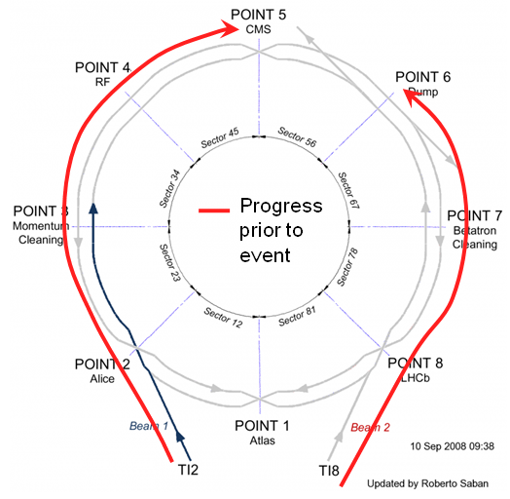
The LHC startup on September 10 was the most elaborate media event in the history of physics (history of science?)
Fermilab staged a simultaneous event in the LHC@FNAL Remote Operations Center (ROC)
  Over 400 staff, reporters, and
  members of the public attended
  the 1:30 AM (CDT) “Pajama Party”
Local monitoring
  Generic “synoptic display”
  Access to LHC eLogBook
  Full CMS event displays
  Selected LHC accelerator
  processes
E. Prebys, LARP Presentation to JOG
10/31/2008

Slide 4
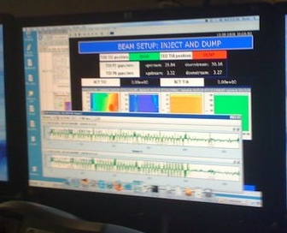
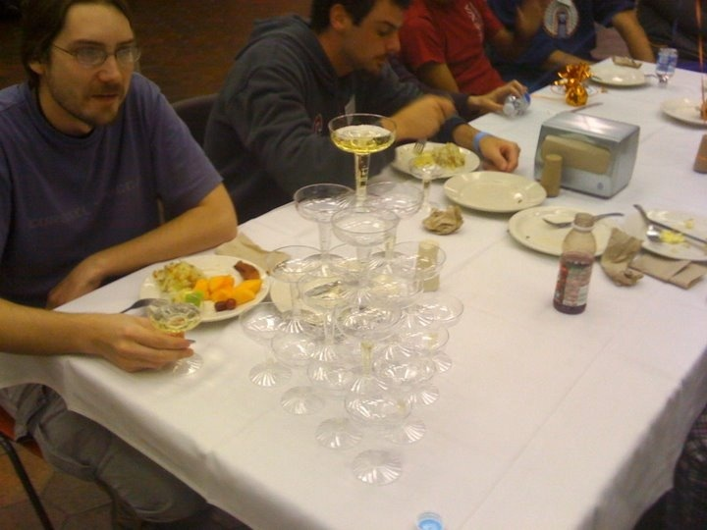
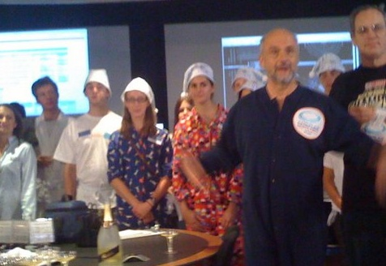
9:35 – First beam injected
9:58 – beam past CMS to point 6 dump
10:15 – beam to point 1 (ATLAS)
10:26 – First turn!
…and there was much rejoicing
E. Prebys, LARP Presentation to JOG
10/31/2008

Slide 5
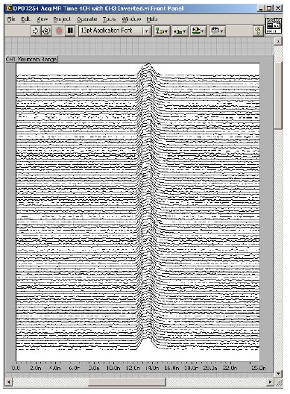
Beam 2 was circulated in 2 ½ hours
After a few days, beam had been captured with RF and achieved several hour lifetimes.
Optics measurements showed some small polarity problems, but no major problems
Switching to beam 1 when a tranformer problem held beam off for a few days
E. Prebys, LARP Presentation to JOG
10/31/2008

Slide 6
On September 19th, sector 3-4 was being ramped to 9.3 kA, the equivalent of 5.5 TeV
  All other sectors had already been ramped to this level
  Sector 3-4 had previously only been ramped to 7 kA (4.1 TeV)
At 11:18AM, a quench developed in the splice between dipole C24 and quadrupole Q24
  Not initially detected by quench protection circuit
  Power supply tripped at .46 sec
  Discharge switches activated at .86 sec
Within the first second, and arc formed at the site of the quench
  Helium pressure rose beyond .13 MPa and ruptured into the insulation vacuum.
Vacuum also degraded in the beam pipe
*Taken from Oct. 15 “Interim Report” https://edms.cern.ch/file/973073/1/Report_on_080919_incident_at_LHC__2_.pdf
and private communications
E. Prebys, LARP Presentation to JOG
10/31/2008

Slide 7
Electrical noise triggered quench detection in other subsectors.
Helium escaped into the insulation vacuum
  Most subsectors remained below the limit of 2.1 MPa except 19-21, which triggered the relief valves and vented into the tunnel.
Pressure differential at the vaccum barriers between vacuum subsectors resulted in large forces
  Short straight sections moved significantly on their stands, sometimes breaking loose from the concrete anchors.
  The motion broke several He jumpers, resulting in more Helium loss.
  In the end, approximately 6 out of 15 tonnes of Helium were lost from the sector (~3 x Macy’s Thanksgiving Parade)
E. Prebys, LARP Presentation to JOG
10/31/2008

Slide 8
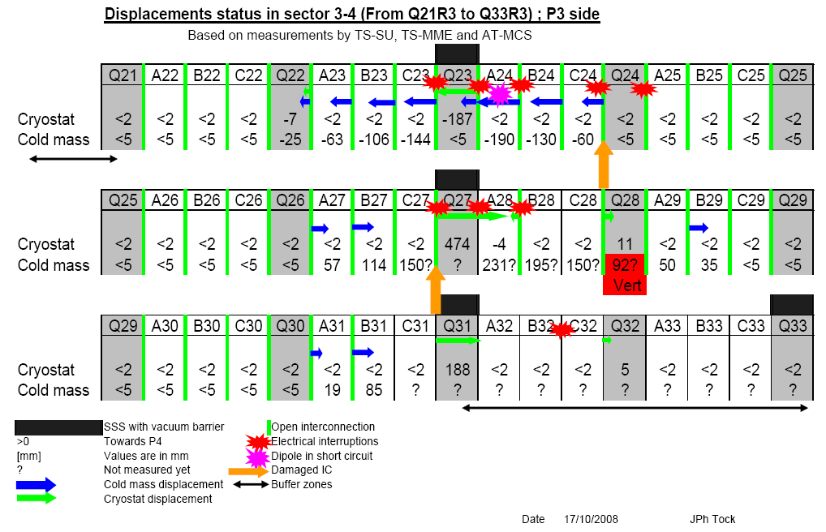
E. Prebys, LARP Presentation to JOG
10/31/2008

Slide 9
CERN is working to address the problem efficiently and effectively.
  Detailed scope and schedule still being determined.
At most 24 dipoles and 5 quadrupoles will have to be replaced
  Damage primarily to the superinsulation
  Cold mass probably OK in most cases
  Most can be repaired outside of the tunnel
Studying contamination of vacuum pipe
  Both vacuum pipes compromised
  Endoscope shows soot and MLI “not as bad as expected”
    Investigating course of action
Investigating
  Improvements in detection
    Indirect: Joule-Thompson valves
    Direct: Improvements to quench detection
  Improvements to mitigation
    Pressure relief system needs to be improved
E. Prebys, LARP Presentation to JOG
10/31/2008

Slide 10
2008 run lost
  LARP planned to use this run to help commission instrumentation
  -> some tasks will be carried over into FY10
Start date nominally May 1, but official schedule not formalized yet
  Mitigation could push it later
  Nevertheless, US accelerator programs take it as gospel until we hear differently.
Had planned to use Winter shutdown to train magnets to 7 TeV
  Although it’s not official yet, extremely likely that entire 2009 run will be at 5 TeV.
  Rolf Heuer (DG designate) wisely puts utmost consideration on integrity of machine.
Unclear how incident will affect long term upgrade path
  Heuer has stated that preparations will proceed assuming earliest date (currently end of 2012 for Phase I), but that upgrade will not occur until it makes sense from a physics standpoint.
Need and scope of US assistance in addressing the incident still being discussed.
  Will of course render assistance if needed, but could draw money away from other activities.
E. Prebys, LARP Presentation to JOG
10/31/2008

Slide 11
Initial operation
  Ramp up to 1x10³⁴ cm⁻²s⁻¹
Phase I upgrade (inner triplets only)
  After ~2 years of operation (~2012)
  Details approaching base line
  Replace 70 mm triplet quads with 120 mm quads
  β* goes from 50->25 cm
  Luminosity goes to 2.5x10³⁴ cm⁻²s⁻¹
Phase II upgrade
  Second half of next decade (nominally 2016)
  Luminosity goal: 1x10³⁵
  Details still under study
    New technology for larger aperture quads (Nb₃Sn)
    crab cavities?
    Improved injector chain (SPL+PS2)
E. Prebys, LARP Presentation to JOG
10/31/2008

Slide 12
Proton flux / Beam power
50 MeV
Linac2
Linac4
160 MeV
1.4 GeV
PSB
SPL’
RCPSB
SPL
~ 5 GeV
26 GeV
PS
PS2 (PS2+)
Linac4: PSB injector (160 MeV)
SPL: Superconducting Proton Linac (~ 5 GeV)
SPL’: RCPSB injector
(0.16 to 0.4-1 GeV)
RCPSB: Rapid Cycling PSB
(0.4-1 to ~ 5 GeV)
PS2: High Energy PS
(~ 5 to 50 GeV – 0.3 Hz)
PS2+: Superconducting PS
(~ 5 to 50 GeV – 0.3 Hz)
SPS+: Superconducting SPS
(50 to1000 GeV)
DLHC: “Double energy” LHC
(1 to ~14 TeV)
40 – 60 GeV
Output energy
450 GeV
SPS
SPS+
1 TeV
LHC
DLHC
7 TeV
~ 14 TeV
M. Benedikt, R. Garoby, CERN DG
E. Prebys, LARP Presentation to JOG
10/31/2008

Slide 13
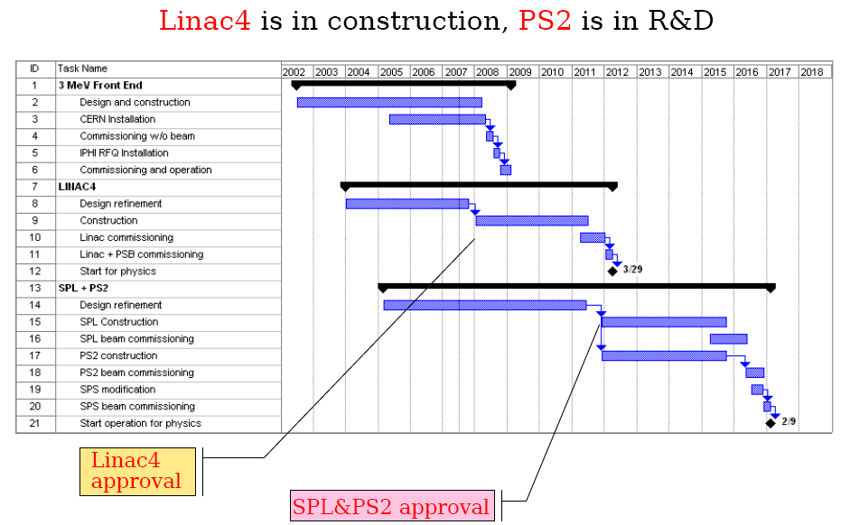
E. Prebys, LARP Presentation to JOG
10/31/2008

Slide 14
Inner triplets and feed boxes at CMS and ATLAS IP’s
  Fermilab-KEK collaboration
  In spite of some commissioning problems, triplets installed and have been ramped to full 7 TeV
US LHC Accelerator Research Program (LARP)
  Coordinates US R&D for the LHC
    FNAL, BNL, LBNL, SLAC, and some UT Austin
  Some instrumentation deliverables for initial operation
  R&D for future luminosity upgrades
  Major effort to develop Nb3Sn magnets for Phase II upgrades
LHC Accelerator-Fermilab Software
  Group formed to address gaps in LARP program
  Has developed close relationship with CERN controls group (Elliott McCrory resident at CERN)
  Now working with LARP to integrate instrumentation into operations.
Accelerator Projects for the LHC (APL)
  New program to coordinate larger scale construction projects for the LHC
  Currently being organized around several phase-I activities
  Exact scope and nature being determined
Focus of this talk
New
E. Prebys, LARP Presentation to JOG
10/31/2008

Slide 15
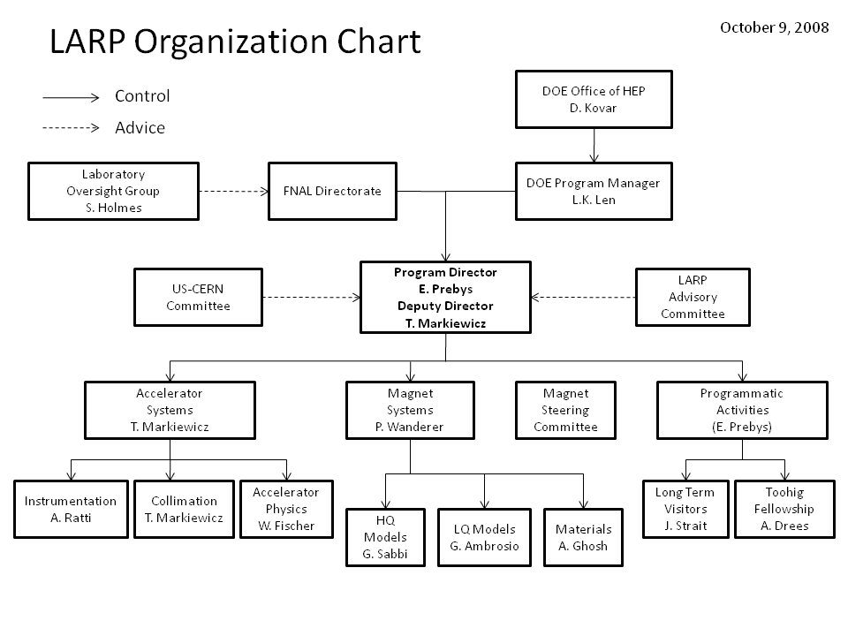
E. Prebys, LARP Presentation to JOG
10/31/2008

Slide 16
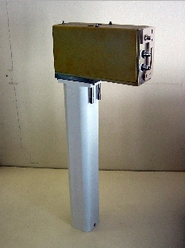
Schottky detector
  Used for non-perturbative tune measurements (+chromaticities, momentum spread and transverse emmitances)
Tune tracking
  Implement a PLL with pick-ups and quads to lock LHC tune
  Investigating generalization to chromaticity tracking
AC dipole
  Use AC dipole to drive beam
  Measure both linear and non-linear
  beam optics
  Done with UT Austin in conjunction with
  Fermilab accelerator PhD program
Luminosity monitor
  High radiation ionization detector
  integrated with the LHC neutral beam
  absorber (TAN) at IP 1 and 5.
Not finished
E. Prebys, LARP Presentation to JOG
10/31/2008

Slide 17
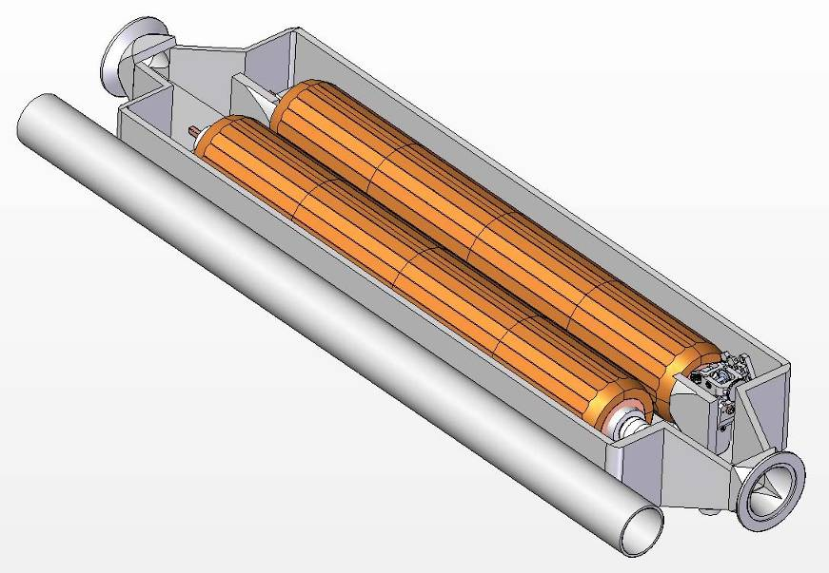
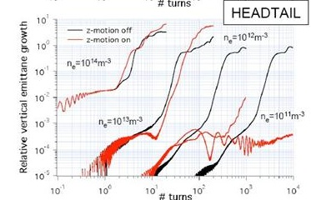
Rotating collimators
  Can rotate different facets into
  place after catastrophic beam
  incidents
  Aim for prototype in FY09
Crystal Collimation
  CRYSTAL Collaboration
  T980
Beam-beam studies
  General simulation
  Electron lens
  Wire compensation
Electron cloud studies
  Study effects of electron cloud in
  LHC and injector chain
E. Prebys, LARP Presentation to JOG
10/31/2008

Slide 18
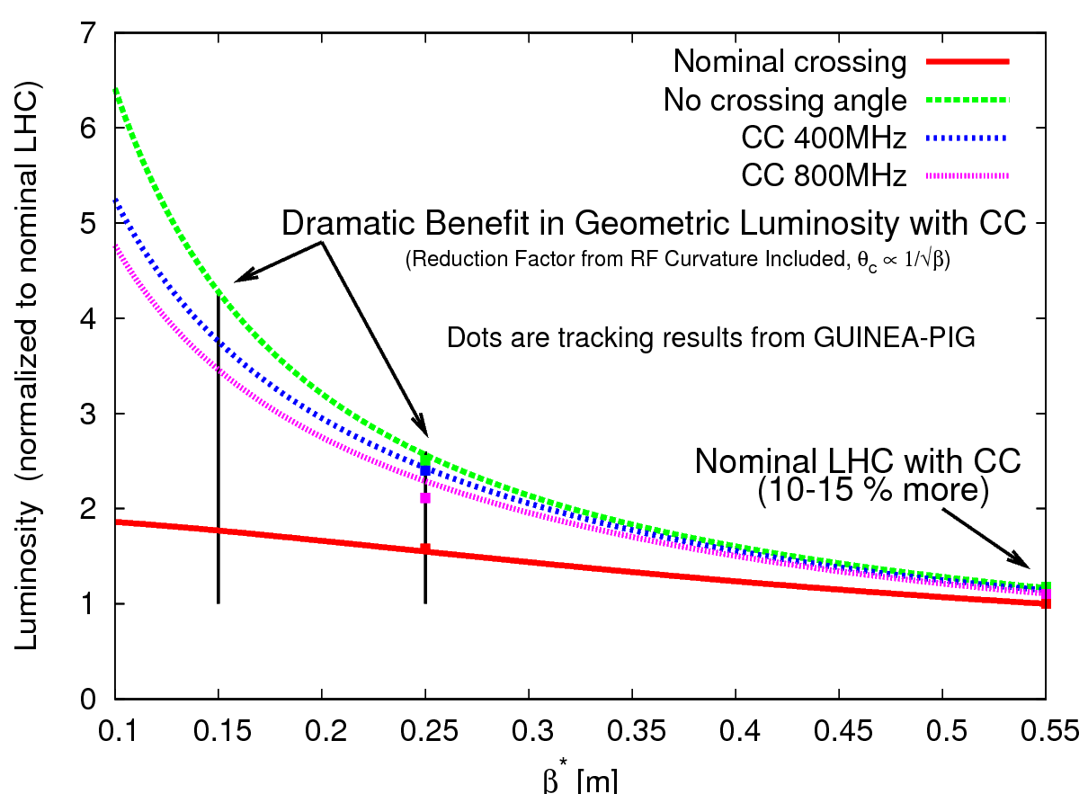
Crab cavities
  Transverse fields rotate bunches to
  compensate for crossing angle in
  final upgrade
  Goal: one cavity in Phase I upgrade,
  2 (global) or 4 (local) in Phase II
  Significant opportunity
  Collaboration with KEK, CERN, and
  Daresbury
  But big job, lots of $$
PS2 opportunities
  Significant synergy with Project X
  Ecloud
  Injection, collective instabilities
  Laser stripping
  RF
E. Prebys, LARP Presentation to JOG
10/31/2008

Slide 19
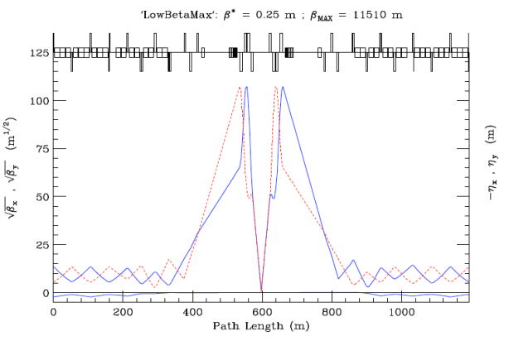
Decreasing spot size at interaction region requires larger apertures and higher gradients at focusing quads
High gradient/large aperture means higher fields at the coil than are possible with Traditional NbTi
A major part of LARP (half budget) is focused on developing accererator grade quads based on Nb₃Sn
Success of magnet program ~success of LARP
E. Prebys, LARP Presentation to JOG
10/31/2008

Slide 20
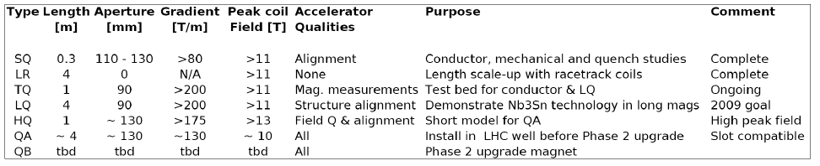
Magnet groups at FNAL, BNL, and LBNL working to develop 4m Nb3Sn magnet appropriate for use in the LHC Phase II upgrade.
Currently pushing all parameters
  Long Quad (LQ): 4m quad with 90 mm aperture
  High field Quad (HQ): 1m quad with 130 mm aperture
Plan first accelerator quality prototype (QA) to be plug compatible with Phase I NbTi magnets
  Nb₃Sn would give larger termperature margin
Parameters of final prototype (QB) will be determined by Phase II optics decisions
E. Prebys, LARP Presentation to JOG
10/31/2008

Slide 21
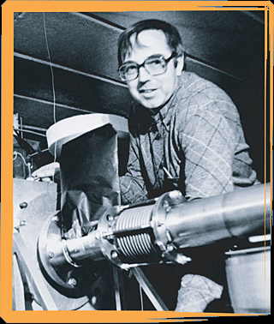
Long Term Visitors program
  Pay transportations and living expenses for US scientists working at CERN for extended periods (at least 6 months/year)
  Interested parties coordinate with a CERN sponsor and apply to the program (Jim Strait)
  Plan to support 4 in FY09
Toohig Fellowship
  Named for Tim Toohig
  Open to recent PhD’s
  Successful candidates divide their
  time between CERN and one of
  the four host labs.
  Currently 4 Toohig Fellows in
  program
E. Prebys, LARP Presentation to JOG
10/31/2008

Slide 22
Long Term Visitors
  At CERN (decoupled of LHC operation)
    Jim Strait, FNAL, working with Rüdiger Schmidt on machine protection
    Steve Peggs, BNL, working with Rogelio Tomas Garcia and Frank Schmidt on beta beating and coupling in LHC (currently studying SPS data)
  Pending (need LHC machine time)
    Eliana Gianfelice-Wendt, FNAL, working with Brennan Goddard on injection and abort gap commissioning (was at CERN, now called back)
    Alan Fisher, SLAC, to work with Berndt Dehning on BLM system
Toohig Fellows
  Helene Felice, LBNL, magnets
  Ricardo DeMaria, BNL, PS2 studies
  Ryoichi Miyamoto, BNL, instrumentation
  Daruisz Bocian, FNAL, magnets
Toohig alum
  Rama Calaga, BNL postdoc, LHC commissioning and crab cavity development
Important to have focus for collaboration
  Given up idea of “generic commissioners”
In general, integration of LARP personnel very successful
  Good words from both sides
*only includes people directly supported by LARP
E. Prebys, LARP Presentation to JOG
10/31/2008

Slide 23
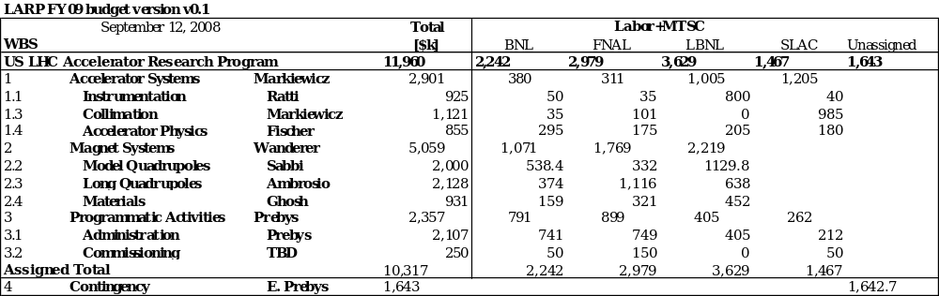
E. Prebys, LARP Presentation to JOG
10/31/2008

Slide 24
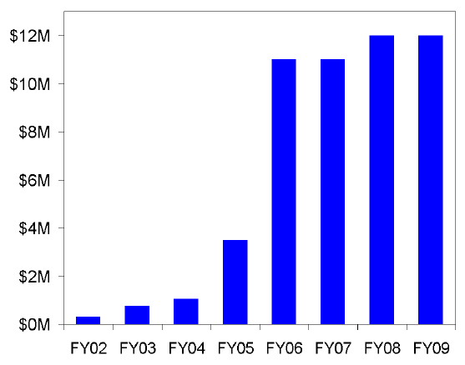
The current LARP came into being in a period of strong growth
Even with lumi and rotating collimators ramping down, it is impossible to support everything on the plate at a reasonable level
New opportunities very exciting
  Crab cavities
  PS2
This year is only possible because of scientific labor contributed in accordance with core competencies of the labs
  Order ~5 FTE total (=$1.5M)
  General agreement this is “seed money” and cannot continue
Have to make some difficult decisions for FY10 and beyond
E. Prebys, LARP Presentation to JOG
10/31/2008

Slide 25
Starting the FY10 budget process now
  Significant discussion at our CM11 collaboration meeting at FNAL
Working with L1 and L2 managers to determine a 5 year plan for existing and proposed programs
Priorities
  Lumi monitor must work! LARP credibility depends on it
  Magnet program must deliver a prototype on a time scale appropriate to the Phase II upgrade
  We must deliver a rotating collimator on a time scale appropriate for consideration of installation (~Phase I)
  Must continue to support Fellows and Visitors, at least at some level
Beyond that, everything fair game
Give priority to
  Well identified goal (e.g. crab cavity design, ecloud feedback specification)
  Multi-lab interest
Continue process throughout year with the goal of determining the cut list at our April collaboration meeting.
…unless of course we get a lot more money ☺
E. Prebys, LARP Presentation to JOG
10/31/2008

Slide 26
LARP is not really equipped to deal with large deliverables
  Primarily an R&D organization
  Insufficient contingency
  This was highlighted by the problems with the luminosity monitor.
APL is being developed to handle larger projects with hard deliverables.
Initially comprises projects for the Phase I upgrade.
Considering an ongoing relationship where LARP R&D feeds into APL projects.
E. Prebys, LARP Presentation to JOG
10/31/2008

Slide 27
Priority 1:
  NbTi separator dipoles based on RHIC design
  Feedboxes
Priority 2:
  Laser “wire” profile monitor for LINAC4
  LLRF for LINAC4
Priority 3:
  5 Rotatable collimators (asynchronous to Phase I)
E. Prebys, LARP Presentation to JOG
10/31/2008

Slide 28
Steve Peggs acting program manager
Searching for permanent program manager
Establishing DOE project office
Schedule
  CD-0: “very soon”
  CD-1: Q2 FY09
  CD-2: Q4 FY09
  CD-3: Q2 FY10
  CD-4: Q4 FY12
E. Prebys, LARP Presentation to JOG
10/31/2008

Slide 29
The turn on of the LHC was truly incredible.
Recent events are unfortunate, but these things happen, and CERN is dealing with the problem as efficiently as possible.
The US has made significant contributions to the accelerator effort, and will continue to do so through the LARP, LAFS and APL programs.
  Limited only by resources
E. Prebys, LARP Presentation to JOG
10/31/2008

