Slide 1

Baseline Plan
2010-2012: complete technology demonstration (original goal)
LQ to address all length-related issues (& fully reproduce TQ results):
  2010-2011: 2-3 additional tests using 54/61 coil series
  2010-2011: Fabricate 4-6 additional coils using 108/127
  2011(2012): ~2 tests with 108/127 coil series
HQ to address field/energy limits and accelerator quality
  2010-2011: 3-4 tests with 1 m models
  Progressively push performance
  2011-2012: Extend to 1.5 or 2 m length
  Use Phase 1 specifications as reference
2012-2014: fabricate and test IR Quad prototype
2015-2020: IR quad production for Phase 2 upgrade

Slide 2
Current status
New scenario emerging from Chamonix and post-Chamonix discussion:
  LHC design energy and luminosity is reached around 2014
  First upgrade around ~2018?
  1-year shutdown required for installation
  Additional time is required for achieving the 2-3 luminosity gain
  Experiments like integrated luminosity w/o long shutdowns
A single upgrade based on Nb₃Sn IR Quads may be the best strategy
The Nb₃Sn Quad development plan should be revised accordingly:
  Feasibility of installing Nb₃Sn IR Quads in LHC in ~2018
  Implications on technical plan, resources, schedule, cost
  Milestones/decision points, infrastructure requirements etc.

Slide 3
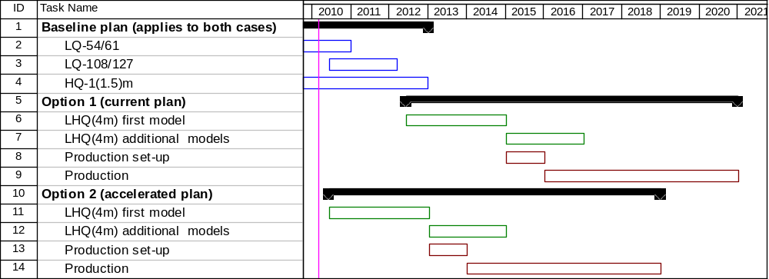
Schedule options
Option 2 makes sense in the context of:
  A determination that 120 mm aperture is a good choice for the upgrade
  A magnet R&D budget increase of ~6 M$ over 2010-12
  Additional resources for LARP in 2010-12 (from APUL)
Note: 1+5 years production schedule is just for illustration, could vary
considerably depending on specs, infrastructure, resources etc.

Slide 4
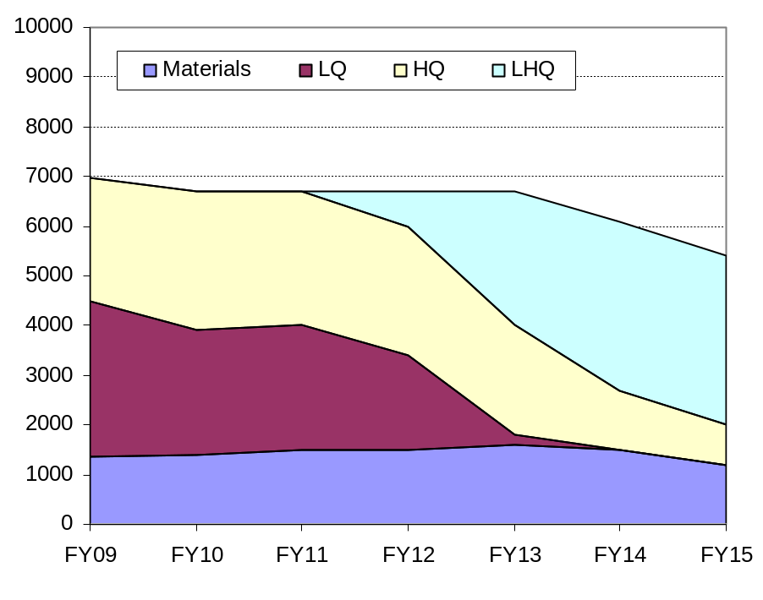
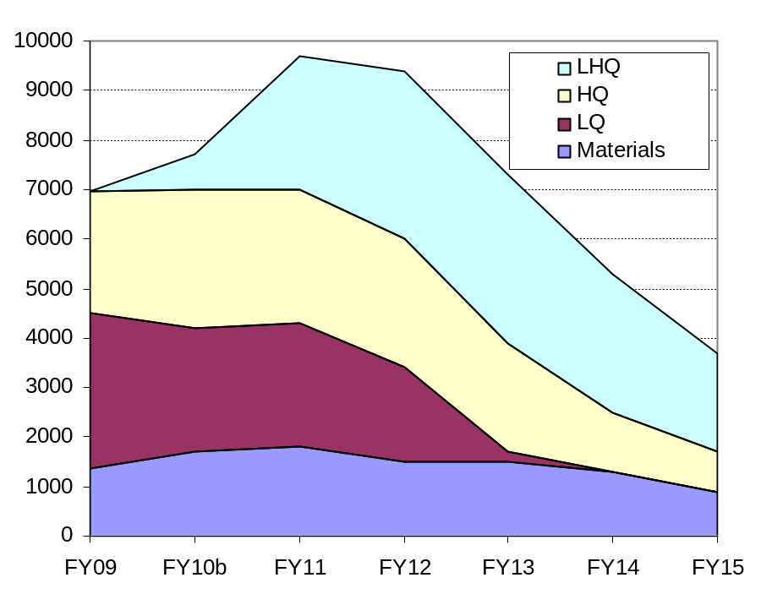
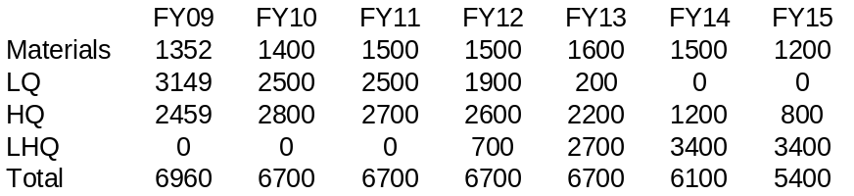
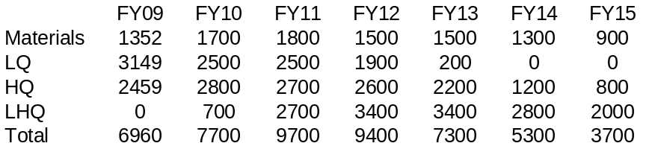
Magnet R&D Budget Profiles
Baseline (option 1)
Accelerated (option 2)

