Slide 1
Booster Issues for NuMI
Eric Prebys
FNAL Beams Division

Slide 2
The Basics
One of two electrostatic pre-accs accelerates H- ions to 750 keV.
The linac accelerates these ions to 400 MeV
The ions are injected over several (up to 12) turns into the booster, and passed through a foil to strip off the electrons.
The booster accelerates the protons from 400 MeV to 8 GeV.
The booster lattice is in an offset 15 Hz (line/4) resonant circuit. This sets an overall quantum of time for the whole accelerator (“tick”, “click”, “clink”).
Instantaneous 15 Hz rep rate routinely achieved.
Average rep rate limited by
  Power dissipation of ramped elements
  Above ground radiation (safety issues)
  Below ground radiation (activation issues)
Some numbers:
  Historical high*: 3E12 ppp @2.5 Hz (3E16 pph)
  Run II needs: 5E12 ppp @.7 Hz (1.3E16 pph)
  BooNE+Run II: 5E12 ppp @5.7 Hz (1E17 pph)
  NuMI + Run II: 5E12 ppp @3.2 Hz (6E16 pph)
Factor 8!
*MR fixed target, back when life was cheap

Slide 3
Ramped element limits
Linac chopper: 15 Hz
ORBUMP Magnets: 7.5 Hz (lots of work to go to 15Hz)
Booster RF: 7.5 Hz (Maybe go to 15 if we use existing cooling lines).
BEXBMP: 15 Hz
Extraction kickers: 15 Hz
MP02 extraction septum: 2.5 Hz (New PS -> 5 Hz, New magnet + PS -> 7.5Hz, + more cables -> 15 Hz. ~6/2002)
-> We currently take 7.5 Hz as a practical limit for BooNE and beyond.

Slide 4
Radiation Issues
Radiation Limitations
  Above ground (want to avoid turning towers into controlled access area).
    Shielding
    Reduce beam losses
  Below ground (must avoid making booster elements too hot to handle).
    Reduce beam losses

Slide 5
The “Notch”
The Booster uses multi-turn injection, resulting in a continuous beam around the ring.
If beam is passing through the extraction septum while it is ramping, some of it will be steered into beam elements.
This is the single largest source of radiation resulting from the booster.
Solution: Early in the cycle, the old extraction kicker is pulsed, blowing a “notch” in the beam. Extraction is timed to coincide with the notch.
Problem: although it’s a factor of 20 better to lose the beam early in the cycle, it’s still not negligible (more in a minute)

Slide 6
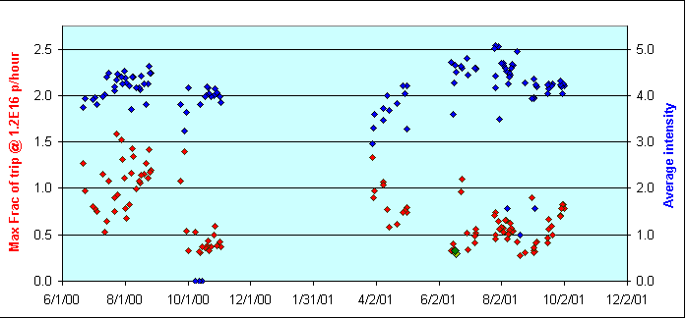
Above Ground Rad. Trip Monitors (courtesy P. Kasper)
Notch Off!
Run II Needs
MiniBoone+RunII
NuMI+RunII
Almost there!

Slide 7
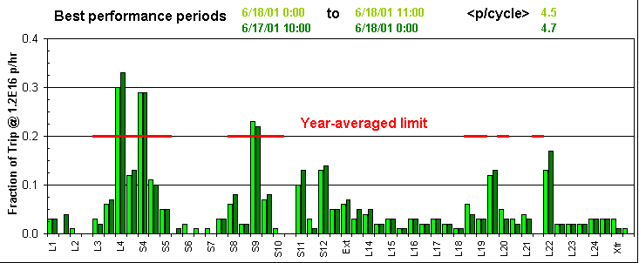
Integrated Dose Trips (factor 5 lower)
Extraction
Notch!!
NuMI
BooNE
Shielding currently being installed in critical areas (first floor of East and West Booster Towers)

Slide 8
Bottom Line for Above Ground Radiation
It looks like with a combination of shielding and careful beam handling, we should be able to keep above ground radiation to acceptable levels, even at BooNE+Run II intensities.

Slide 9
Collimators
In order to reduce the uncontrolled beam loss when creating the notch, the idea is to excite a resonant instability and then scrape the beam away at a well-positioned collimator.
Collimators have been commissioned, but unfortunately didn’t make it in time for this shutdown.
Most of the prep work has been done, so installing the collimators should be able to be done in about a day, and will probably get done before BooNE.

Slide 10
Ramped Closed Orbit Corrections
The main beam elements ramp with the momentum, but up until now, the corrector elements have been operated DC
  Beam can “wander” by up to a few cm’s during ramp.
Ramping control cards were installed during the shutdown.
Closure control program almost ready. Still needs to be tested.
Correctors not powerful enough to steer the beam all the way through the cycle. Still, should help.

Slide 11
Better Beam Characterization
Injection Line diagnostics upgraded substantially during shutdown.
Space charge studies underway.
Transition revisited?

Slide 12
Loading The Main Injector
The main injector circumference is exactly 7 times the booster circumference, so there’s room for 7 booster batches.
BUT, one slot must remain empty to allow the injection kicker to ramp down. -> max 6 booster batches/M.I. Cycle (unless we do slipstacking…)

Slide 13
Proton Timelines
Everything measured in 15 Hz “clicks”
Minimum M.I. Ramp = 22 clicks = 1.4 s
MiniBoone batches “don’t count”.
Cycle times of interest
  Stack cycle: 1 inj + 22 MI ramp = 23 clicks = 1.5 s
  NuMI cycle: 6 inj + 22 MI ramp = 28 clicks = 1.9 s
  Full Slipstack cycle (total 11 batches):
    6 inject
    + 2 capture (6 -> 3)
    + 2 inject
    + 2 capture (2 -> 1)
    + 2 inject
    + 2 capture (2 -> 1)
    + 1 inject
    + 22 M.I. Ramp
    ----------------------
    39 clicks = 2.6 s

Slide 14
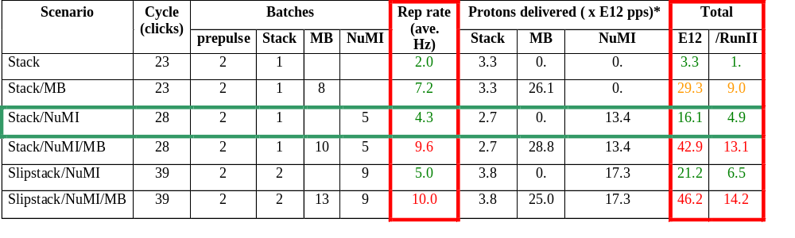
Summary of Proton Ecomomics
Booster Hardware Issues
Radiation Issues
NUMI “baseline” = 13.4E12 pps x 2E7 s/year ≈ 2.7E20 p/year
*assuming 5E12 protons per batch

Slide 15
Timing: The One NuMI Specific Booster Problem
In order to Reduce radiation, a “notch” is made in the beam early in the booster cycle.
Currently, the extraction time is based on the counted number of revolutions (RF buckets) of the Booster. This ensures that the notch is in the right place.
The actual time can vary by > 5 usec!
This is not a problem if booster sets the timing, but it’s incompatible with multi-bunch running.
We must be able to fix this total time so we can synchronize to the M.I. orbit.
This is called “beam cogging”.

Slide 16
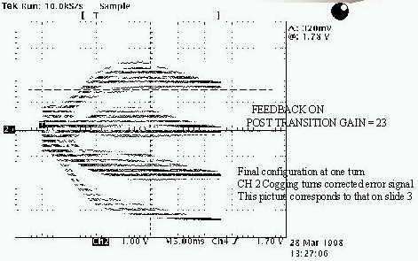
Active cogging
Detect slippage of notch relative to nominal and adjust radius of beam to compensate.
Allow to slip by integer turns, maintaining the same total time.
Does not currently work at high intensities.
Still do not really understand the problem. Suspect TCLK drift relative to magnet phase, but no correlation seen.

Slide 17
> 5E12 ppp ????
Early losses are extremely non-linear with number of turns of injection.
Space charge effects are typically blamed, but the details are not well understood.
A study group is working on this.
Too late for BooNE, by maybe NuMI?
Increasing the ppp would allow you to almost double your total protons before hitting the BooNE rad limits!!

Slide 18
Summary
Reasonable booster assumptions:
  5E12 ppp
  Ave 7.5 Hz rep rate
  Up to 1E17 pph w/o tripping rad alarm (BooNE needs)
Assuming BooNE runs as planned, the one NuMI-specific booster issue is that of beam cogging!
With those limits, NuMI can expect 2.7E20 p/year
Slipstacking (if it worked perfectly!) would increase this by about 30%.
Increasing the ppp could increase NuMI’s delivered protons.

