Slide 1
Booster Issues for NuMI
Eric Prebys
FNAL Beams Division

Slide 2
The Basics
One of two electrostatic pre-accs accelerates H- ions to 750 keV.
The linac accelerates these ions to 400 MeV
The ions are injected over several (up to 15) turns into the booster, and passed through a foil to strip off the electrons.
The booster accelerates the protons from 400 MeV to 8 GeV.
The booster lattice is in an offset 15 Hz (line/4) resonant circuit. This sets an overall quantum of time for the whole accelerator (“tick”, “click”, “clink”).
Instantaneous 15 Hz rep rate routinely achieved.
Average rep rate limited by
  Power dissipation of ramped elements
  Above ground radiation (safety issues)
  Below ground radiation (activation issues)
Some numbers:
  Historical high*: 3E12 ppp @2.5 Hz (3E16 pph)
  Run II needs: 5E12 ppp @.7 Hz (1.3E16 pph)
  BooNE+Run II: 5E12 ppp @5.7 Hz (1.1E17 pph)
  NuMI + Run II: 5E12 ppp @3.2 Hz (6E16 pph)
  NuMI + Run II+BooNE: 5E12 ppp@8.9Hz (1.7E17 pph)
Factor 8!
*MR fixed target, back when life was cheap

Slide 3
Pulsed element limits
Linac chopper: 15 Hz
ORBUMP Magnets: 7.5 Hz (lots of work to go to 15Hz)
Booster RF: 7.5 Hz (Maybe go to 15 if we use existing cooling lines).
BEXBMP: 15 Hz
Extraction kickers: 15 Hz
MP02 extraction septum: 2.5 Hz (New PS -> 4.5 Hz ~9/02, New magnet + PS -> 7.5Hz ~1/03, + more cables -> 15 Hz)
-> We currently take 7.5 Hz as a practical limit for BooNE and beyond.

Slide 4
Radiation Issues
Radiation Limitations
  Above ground (want to avoid turning towers into controlled access area).
    Shielding
    Reduce beam losses
  Below ground (must avoid making booster elements too hot to handle).
    Reduce beam losses

Slide 5
Proton Timelines
Everything measured in 15 Hz “clicks”
Minimum M.I. Ramp = 22 clicks = 1.4 s
MiniBoone batches “don’t count”.
Cycle times of interest
  Stack cycle: 1 inj + 22 MI ramp = 23 clicks = 1.5 s
  NuMI cycle: 6 inj + 22 MI ramp = 28 clicks = 1.9 s
  Full Slipstack cycle (total 11 batches):
    6 inject
    + 2 capture (6 -> 3)
    + 2 inject
    + 2 capture (2 -> 1)
    + 2 inject
    + 2 capture (2 -> 1)
    + 1 inject
    + 22 M.I. Ramp
    ----------------------
    39 clicks = 2.6 s

Slide 6
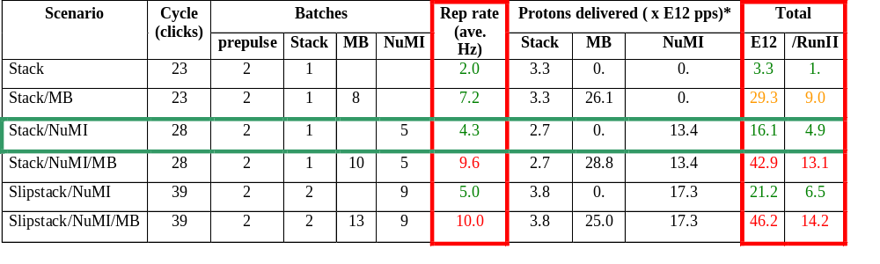
Summary of Proton Ecomomics
Booster Hardware Issues
Radiation Issues
NUMI “baseline” = 13.4E12 pps x 2E7 s/year ≈ 2.7E20 p/year
*assuming 5E12 protons per batch

Slide 7
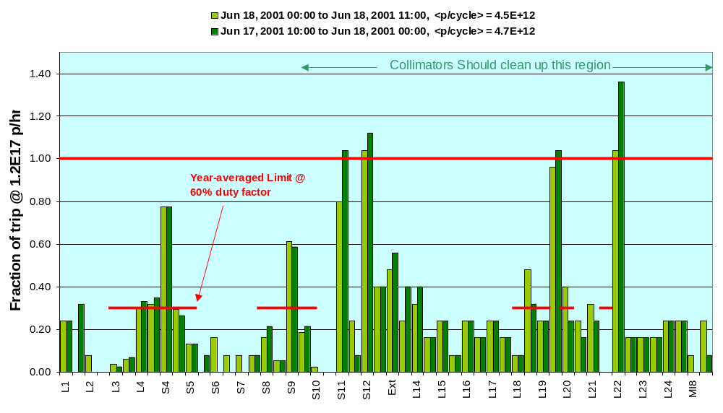
Best Performance + Shielding + BooNE Intensities

Slide 8
Bottom Line for Above Ground Radiation
It looks like with a combination of shielding and careful beam handling, we should be able to keep above ground radiation to acceptable levels, even at BooNE+Run II intensities.

Slide 9
Below Ground Radiation Issues
Harder to quantify (no hard limits)
Worry about high service components becoming so activated that they can’t be worked on (e.g. RF cavities).
Some are already disturbingly hot (~200-300 mRem @ 1 foot)
More about this in a minute…

Slide 10
Collimators
Basic Idea…
A scraping foil deflects the orbit of halo particles…
…and they are absorbed by thick copper collimators.
All are moveable, and the Copper collimators are located in areas (period 6&7) where radiation is less of an issue. Once their operation has been established, these areas will be heavily shielded.
It is hoped that this collimation could reduce important losses by up to a factor of two.
Status: All collimators are in and have been exercised. We are learning how to use them. They cannot be regularly used until the shielding is in place (by the shutdown).

Slide 11
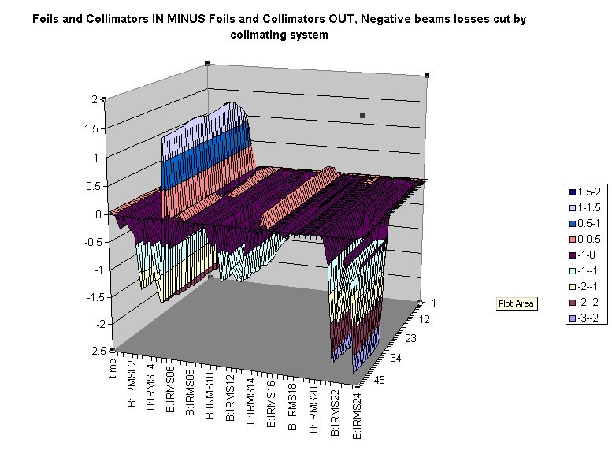
Collimator Performance
Relative Loss
Time
Position

Slide 12
Ramped Closed Orbit Corrections
The main beam elements ramp with the momentum, but up until now, the corrector elements have been operated DC
  Beam can “wander” by up to a few cm’s during ramp.
Ramping control cards were installed during the shutdown.
Closure control program almost ready. Still needs to be tested.
Correctors not powerful enough to steer the beam all the way through the cycle. Still, should help.

Slide 13
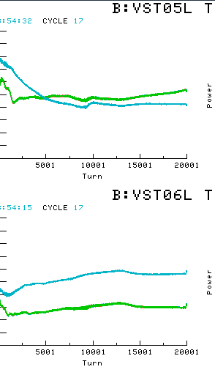
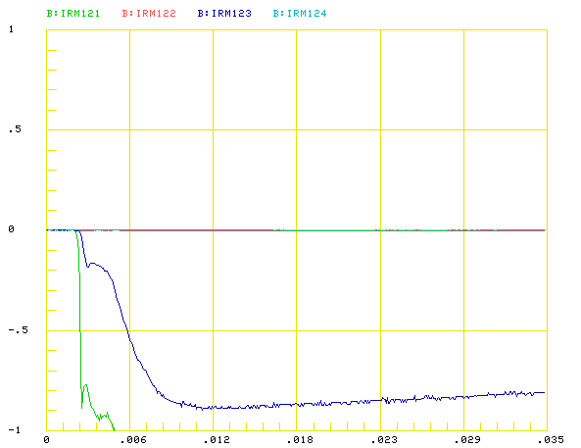
Steered (flattened) Beam with Collimators
Steered
unsteered
Relative Losses near extraction septum. Overall performance improved over unsteered collimation
Position

Slide 14
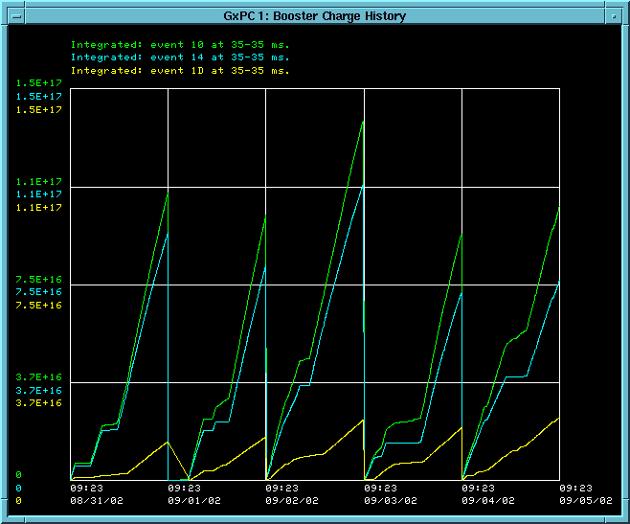
MiniBooNE Comes on Line
Total
Stacking
MiniBooNE
Want Relative Sizes of MB and Stacking to Reverse!

Slide 15
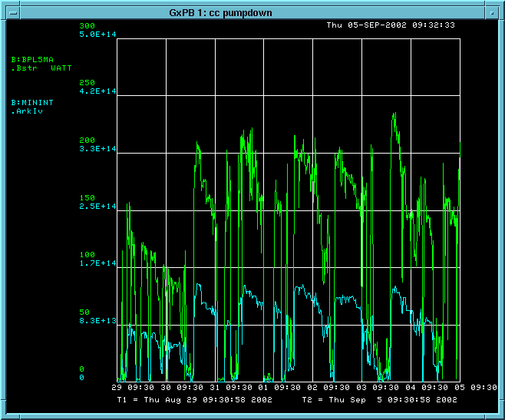
Beam Power Loss (Beam Losses)
Present Limit (will at least be doubled)
5 min. Beam Power Loss
Protons delivered per minute (~ 1/10 of full MiniBooNE).

Slide 16
Bottom Line
We have a LONG way to go to reduce losses to the level where MiniBooNE can run, let alone NUMI.

Slide 17
The “Notch”
The Booster uses multi-turn injection, resulting in a continuous beam around the ring.
If beam is passing through the extraction septum while it is ramping, some of it will be steered into beam elements.
This is the single largest source of radiation resulting from the booster.
Solution: Early in the cycle, the old extraction kicker is pulsed, blowing a “notch” in the beam. Extraction is timed to coincide with the notch.
Problem: although it’s a factor of 20 better to lose the beam early in the cycle, it’s still not negligible (more in a minute)
The notch raises serious complications in timing the booster relative to the main injector (beam cogging)

Slide 18
Timing: The One NuMI Specific Booster Problem
In order to Reduce radiation, a “notch” is made in the beam early in the booster cycle.
Currently, the extraction time is based on the counted number of revolutions (RF buckets) of the Booster. This ensures that the notch is in the right place.
The actual time can vary by > 5 usec!
This is not a problem if booster sets the timing, but it’s incompatible with multi-bunch running.
We must be able to fix this total time so we can synchronize to the M.I. orbit.
This is called “beam cogging”.

Slide 19
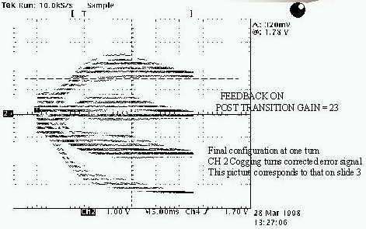
Active cogging
Detect slippage of notch relative to nominal and adjust radius of beam to compensate.
Allow to slip by integer turns, maintaining the same total time.
Does not currently work at high intensities.
Still do not really understand the problem. Suspect TCLK drift relative to magnet phase, but no correlation seen.

Slide 20
> 5E12 ppp ????
Early losses are extremely non-linear with number of turns of injection.
Space charge effects are typically blamed, but the details are not well understood.
A study group is working on this.
Too late for BooNE, by maybe NuMI?
Increasing the ppp would allow you to almost double your total protons before hitting the BooNE rad limits!!

Slide 21
Improved Beam Characterization
We now have the ability to measure the Booster tune for the first time in many years.
A number of improved monitoring tools have been added over the last year (e.g. linac energy meter), and have dramatically improved consistency.

Slide 22
Some Good News
In spite of some recent disturbing comments…
“If it’s not Run II, I don’t want to talk about it”
-Sign on Steve Holmes’ Door
… we have just been promised “substantial” support from the Computing Division for proton source (Booster+Linac) projects.
It is envisioned that these people work on building and improving tools to monitor machine machine performance.
“Proton Source” = “MiniBooNE+NUMI”

