Slide 1
Near Term* Plans for the Fermilab Proton Source
Eric Prebys
FNAL Accelerator Division
*Near term = “prior to proton driver”

Slide 2
Outline
Finley Report
Background
  Linac
  Booster
  Main Injector
  Proton Limitations
Projected Proton Demands
  Experimental Requests
  Proton Economics
Operational Issues and Current Performance
Recent Improvements
The Plan
  The process
  Near term
  Issues for the next year
  Longer term decisions

Slide 3
Proton Team (“Finley Report”)
Group formed in early 2003 to study proton demands and needs for the “near” future (through ~2012 or so), in the absence of a proton driver.
Work culminated in a report to the director, available at www.fnal.gov/directorate/program_planning/studies/ProtonReport.pdf
This work will form the basis of “The Proton Plan”.
No big surprises [see P. Kasper “Getting Protons to NuMI (It’s a worry)”, 2001].

Slide 4
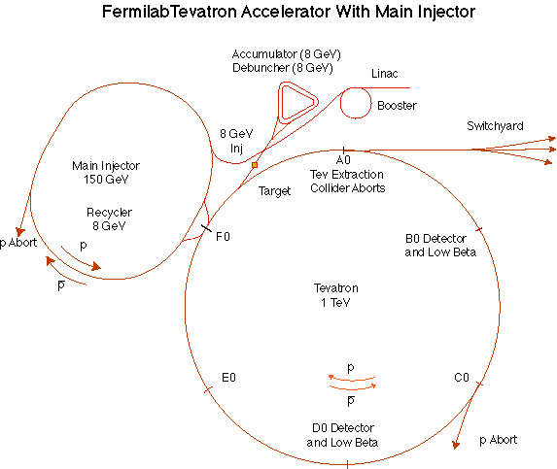
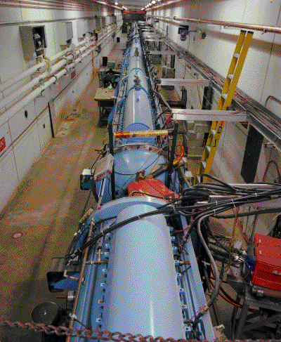
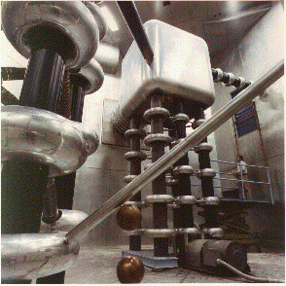
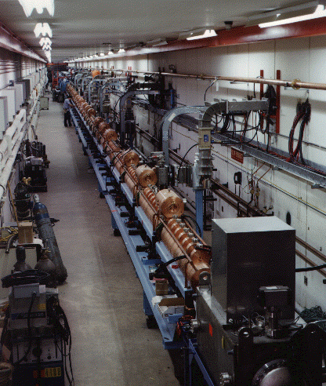
Preac(cellerator) and Linac
“New linac”- 800 MHz “π cavities” accelerate H- ions from 116 MeV to 400 MeV
“Preac” - Static Cockroft-Walton generator accelerates H- ions from 0 to 750 KeV.
“Old linac”- 200 MHz “Alvarez tubes” accelerate H- ions from 750 keV to 116 MeV
Preac/Linac can deliver about 45 mA of current for about 40 usec at a 15 Hz repetition rate (not a bottleneck)

Slide 5
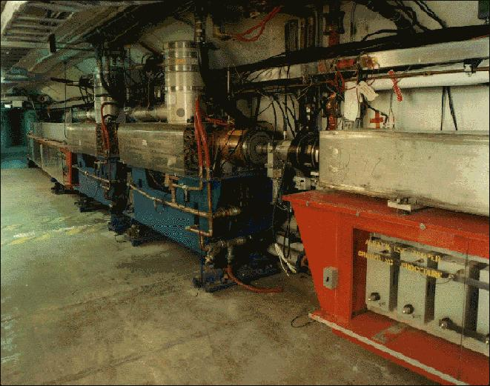
Booster
400 MeV Linac H- beam is injected into booster.
The lattice magnets in the Booster form a 15 Hz resonant circuit, setting the instantaneous cycle rate, but ramped elements limit the average repetition rate to somewhat lower.
From the Booster, beam can be directed to
  The Main Injector
  MiniBooNE
  The Radiation Damage Facility (RDF)
  A dump.
The 15 Hz cycle sets a fundamental clock rate for the entire complex.
One full booster “batch” sets a fundamental unit of protons throughout the accelerator complex (max 5E12).

Slide 6
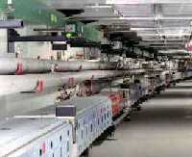
Main Injector
The Main Injector can accept 8 GeV protons OR antiprotons from
  Booster
  The anti-proton accumulator
  The Recycler (which shares the same tunnel)
It can accelerate protons to 120 GeV (in a minimum of 1.4 s) and deliver them to
  The antiproton production target.
  The fixed target area.
  (soon) The NUMI beamline.
It can accelerate protons OR antiprotons to 150 GeV and inject them into the Tevatron.
The Main Injector holds six booster batches, in the absence of exotic loading schemes (slip stacking, RF barrier, etc).
It’s envisioned that two slipstacked batches will be used for stacking and the rest for NUMI and/or switchyard 120.

Slide 7
What Limits Total Proton Intensity?
Maximum number of Protons the Booster can stably accelerate: 5E12
Maximum average Booster rep. Rate: currently 7.5 Hz, may have to go to 10 Hz for NuMI+ (full) MiniBooNE
(NUMI only) Maximum number of booster batches the Main Injector can hold: currently 6 in principle, possibly go to 11 with fancy loading schemes in the future
(NUMI only) Minimum Main Injector ramp cycle time (NUMI only): 1.4s+loading time (at least 1/15s*nbatches)
Losses in the Booster:
  Above ground radiation
  Damage and/or activation of tunnel components
Our biggest worry at the moment!!!!

Slide 8
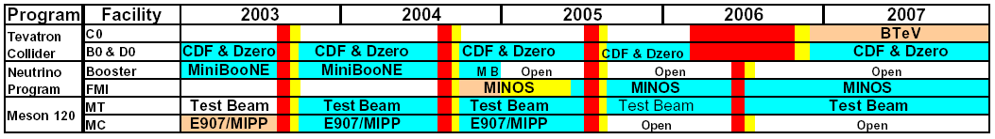
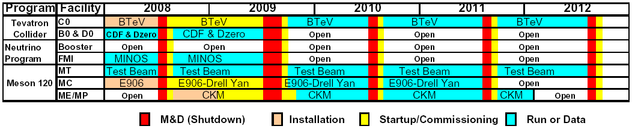
Fermilab Program
Interest in Continuing MiniBooNE (or other 8 GeV line exp.)
Major proton consumers (in order of demand):
  MiniBooNE
  NuMI (starting 2005)
  Pbar production
  Switchyard 120

Slide 9
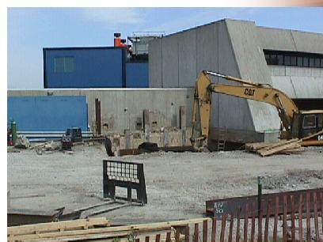
Preparing for the Neutrino Program
Shielding and new radiation assessment
Vastly improved loss monitoring.
Numerous hardware improvements
  e.g new extraction septum and power supply
New tuning strategies.

Slide 10
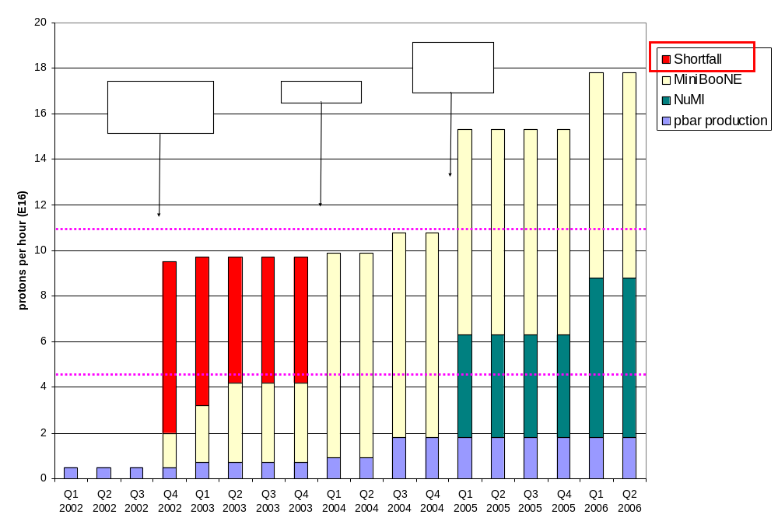
Proton Demand

Slide 11
Demand: Summary
Pbar production
  current: 0.9E16 p/hr
  Max (slipstacking): 1.8E16 p/hr
MiniBooNE
  current: ~3.5E16 p/hr
  Request: 9E16 p/hr [5E20 p/yr]
NuMI
  Baseline: 4.5E16 p/hr [2-2.5 p/yr]
  Exotic loading schemes (~2006): ~7E16 p/hr [4E20 p/yr]
  Occasionally claim: 14E16 p/hr [8E20 p/yr]
2005
  Max pbar + MiniBooNE + baseline NuMI:
  ~16E16 p/hr (~4 times current limit!)
What MINOS believes they are getting

Slide 12
Understanding Proton Economics: Proton Timelines
Everything measured in 15 Hz “clicks”
Minimum Main Injector Ramp = 22 clicks = 1.4 s
MiniBoone batches “sneak in” while the MI is ramping.
Some Booster elements require 2 null prepulses before each 15 Hz batch train.
Cycle times of interest
  Min. Stack cycle: 1 inj + 22 MI ramp = 23 clicks = 1.5 s
  Min. NuMI cycle: 6 inj + 22 MI ramp = 28 clicks = 1.9 s
  Full “Slipstack” cycle (one, scenario, total 11 batches):
    6 inject
    + 2 capture (6 -> 3)
    + 2 inject
    + 2 capture (2 -> 1)
    + 2 inject
    + 2 capture (2 -> 1)
    + 1 inject
    + 22 M.I. Ramp
    ----------------------
    39 clicks = 2.6 s
(More protons but longer cycle time)

Slide 13
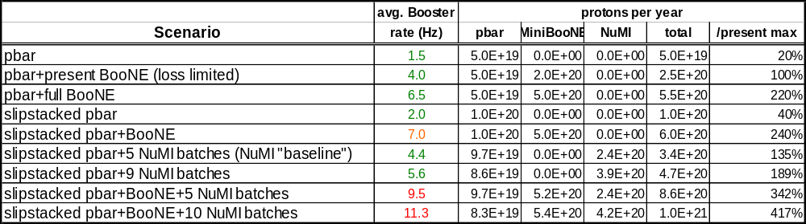
Proton Scenarios
Booster Hardware Issues
Booster Activation Issues
Maximum we can imagine delivering without major Main injector Upgrades

Slide 14
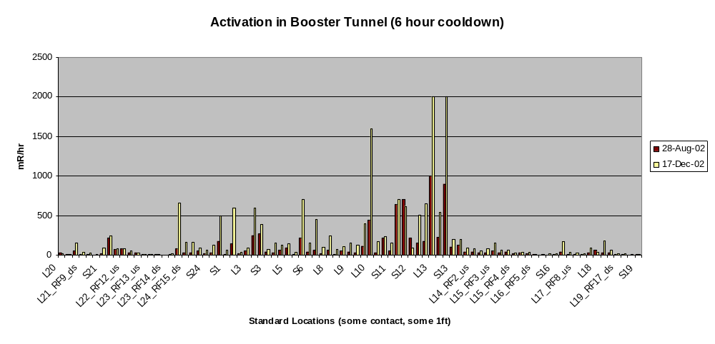
The Bad News: Booster Tunnel Radiation Levels
Any further increase in protons must come without increasing losses.

Slide 15
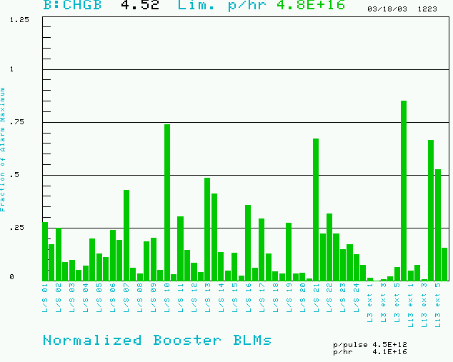
Operational Issues: Limiting Booster Losses
Maximum based on trip point
100 second running loss sums (normalized to trip point)
Also limit total booster average power loss (B:BPL5MA) to 400W.
Present rate

Slide 16
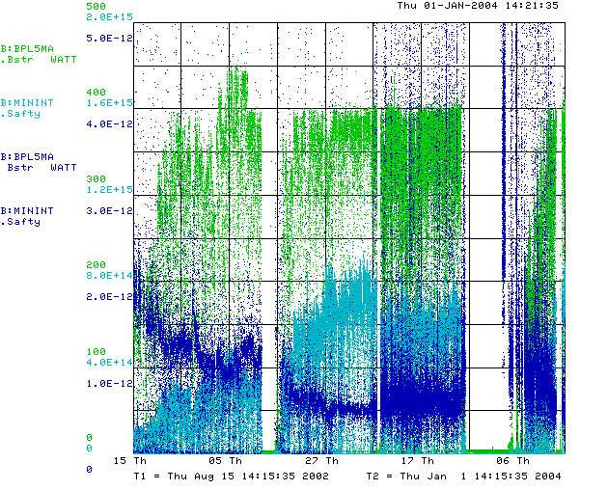
Historic Performance (through last week)
Power loss (W)
Protons (p/min)
Energy Lost (W-min/p)
BooNE turn-on (Sept. 2002)
After Shutdown
Best running

Slide 17

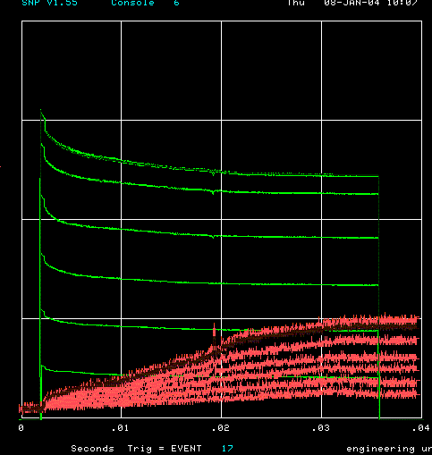
How far have we come?
Before MiniBooNE
Now (same scale!!)
Charge through Booster cycle
Time (s)
Energy Lost
Note less pronounced injection and transition losses

Slide 18
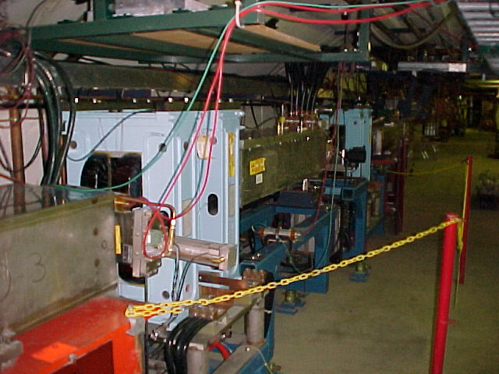
Solving Problems: Extraction Doglegs
Each of the two Booster extraction septa has a set of vertical dogleg magnets to steer the beam around it during acceleration.
These magnets have an edge focusing effect which distorts the horizontal injection lattice:
  50% increase in maximum β
  100% increase in maximum dispersion.
  Harmonic contributions.
This discovery was a direct result of increased Beam Physic involvement.
Effect goes like I². Now tune to minimize.
Modified one of the two extraction regions during the recent shutdown to reduce problem (40% total reduction in lattice deviations)
Will do second next year
In then end, close to an 80% reduction in distortions
Septum
Dogleg Magnets

Slide 19
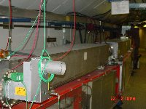
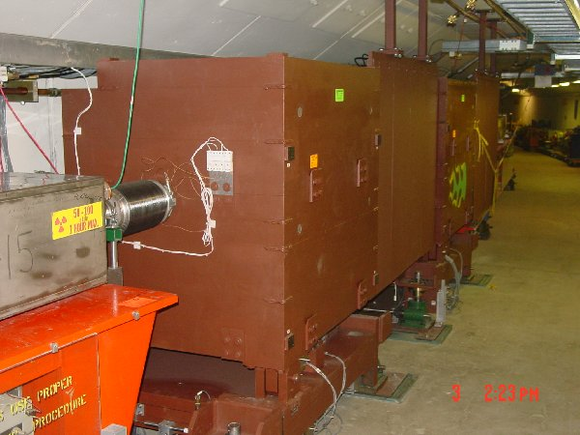
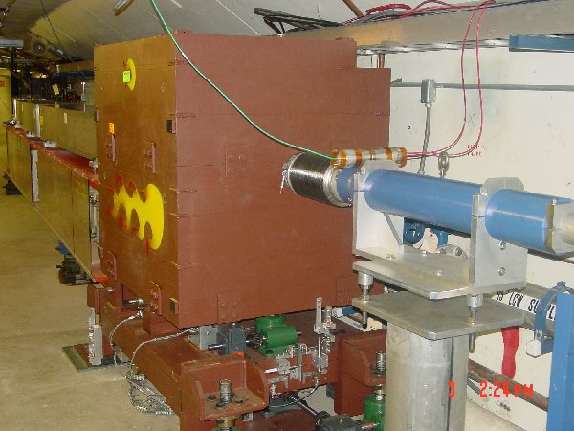
Solving Problems: New Collimator System
Basic Idea…
A scraping foil deflects the orbit of halo particles…
…and they are absorbed by thick collimators in the next periods.
Should dramatically reduce uncontrolled losses

Slide 20
Other Major Shutdown Work
New Linac Lambertson
  Should improve 400 MeV line optics
  Simplifies linac tuning
  Reduce losses
Four Large aperture Booster extraction magnets (EDWA)
  Should reduce losses at extraction.
Complete vertical alignment network of Booster
  First in ??? Years
  Will be used to align entire machine
New power supply for second extraction region
  Part of overall upgrade project
Linac water system upgrade
Booster vacuum system upgrade
Numerous other jobs

Slide 21
Formulating a Plan
The lab has recognized that the proton demands of the experimental program are significant, if not daunting, and will require substantial efforts to meet.
As the financial burden of Run II begins to ease, it’s envisioned that financial resources on the order of $20M will be diverted to these efforts over the next few years.
We are in the process of putting together a plan with the maximum likelihood of reaching these goals.
Ultimate goal is to generate a project similar to Run II
However, because the future (MiniBooNE) is already here, such a plan will necessarily have near and long term components.

Slide 22
Near Term Priorities
Optimizing Booster for improved lattice:
  Tuning and characterizing 400 MeV line (Linac to Booster).
  Tuning Booster orbit to minimize losses.
Commission Collimators:
  Once we have Booster optimized to the new lattice, we will begin to exercise the collimator system.
  Estimate about 2 months to bring into standard operation.
Aperture Improvments:
  Alignment
    Complete (magnet) vertical network done over shutdown
    Will analyze and effect moves when opportunities arise
    Working on a systematic method for aligning straight sections.
    Formulating a plan for a complete, modern, network by next summer
  Orbit control
    Ramped orbit control program has been written.
    Will be commissioned soon (new personnel)
    Important now that collimator is in place.
  Prototype RF Cavities
    Two large aperture prototype cavities have been built, thanks to the help of MiniBooNE and NuMI universities.
    We will install these as soon as they are ready to replace existing cavities which are highly activated.
It’s hoped this work will allow us to reach the MiniBooNE baseline this year.

Slide 23
Issues over the Next Year
Linac Characterization and Reliability
  Increase instrumentation of old linac to study instabilities.
  Develop set of performance parameters.
Booster improvements.
  Prepare for modification of second extraction region
    New septum
    Modified dogleg magnets
    On track for next year’s shutdown.
  Injection Bump (ORBUMP) Power Supply
    Existing supply a reliability worry.
    Limited to 7.5 Hz
    Building new supply, capable of 15 Hz.
    Aiming for next year’s shutdown.
  Under consideration: New ORBUMP Magnets
    Existing magnets limited by heating to 7.5 Hz
    Working on a design for cooled versions.
    These, with a new power supply, will make the Booster capable of sustained 15 Hz operation.
    Biggest decision for the near future.

Slide 24
Multibatch Timing
In order to Reduce radiation, a “notch” is made in the beam early in the booster cycle.
Currently, the extraction time is based on the counted number of revolutions (RF buckets) of the Booster. This ensures that the notch is in the right place.
The actual time can vary by > 5 usec!
This is not a problem if booster sets the timing, but it’s incompatible with multi-batch running (e.g. Slipstacking or NuMI)
We must be able to fix this total time so we can synchronize to the M.I. orbit.
This is called “beam cogging”.

Slide 25
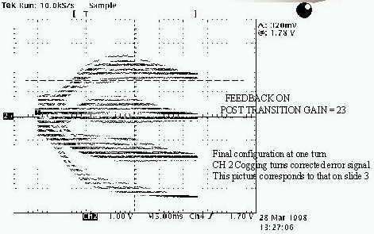
Active cogging
Detect slippage of notch relative to nominal and adjust radius of beam to compensate.
Allow to slip by integer turns, maintaining the same total time.
Efforts in this area have been recently increased, with the help of a Minos graduate student (R. Zwaska).
Aim to get working in the next few months

Slide 26
Long Term, Big $$ Ideas Under Consideration
New Booster RF system:
  Larger aperture cavities (two prototypes will be installed soon).
  New solid state preamps and modulators (would pay for itself in a few years).
New Linac front end:
  Replace Preac and 200 MHz linac with RFQ feeding 400 MHz klystron-driven linac.
  Addresses 7835 Amplifier Tube Problem
  Possible part of proton driver?
Reduce Main Injector ramp time:
  Still needs time to load protons
  Needs to fit in with stacking.
  Necessary to get the kind of protons that off-axis is talking about.

Slide 27
Longevity Issues
Linac
  200 MHz Power Amplifier tubes
    5 sockets. Replace about 3/year
    One vendor, in danger of going out of business
    Quality control problems
    Currently 3 spares (most in several years)
    No drop-in replacement
  800 MHz klystrons
    7 sockets
    Installed in 1992
    One failure in 1997 -> replaced, no problem
    One failure in early December -> replaced, no problem
    One faiulre at Christmas -> THREE BAD SPARES
    Now we’re a bit worried!
Booster
  Old, but will probably last with care.

Slide 28
Summary
We have a good understanding of the proton demands over the next few years in the context of the limitations of the Fermilab accelerator complex.
We have made remarkable progress toward meeting these demands, but are still falling well short.
We are pursuing an ambitious plan to attempt to meet these demands, but cannot yet guarantee its success.
The next few months will be very important.

Slide 29
Extra Slides for Questions

Slide 30
Multi-turn Ion Injection
4 pulsed “ORBUMP” magnets
Circulating Beam
DC “Septum”
Beam at injection
400 MeV H⁻ beam from LINAC
Stripping foil
At injection, the 40 mA Linac H- beam is injected into the Booster over several “turns” (1 turn ~5E11).
The orbit is “bumped” out, so that both the injected beam and the circulating beam pass through a stripping foil, after which they circulate together.
At the moment, heating in the ORBUMP and power supply magnets limit our average rep rate (including prepulses to ~7.5 Hz).

Slide 31
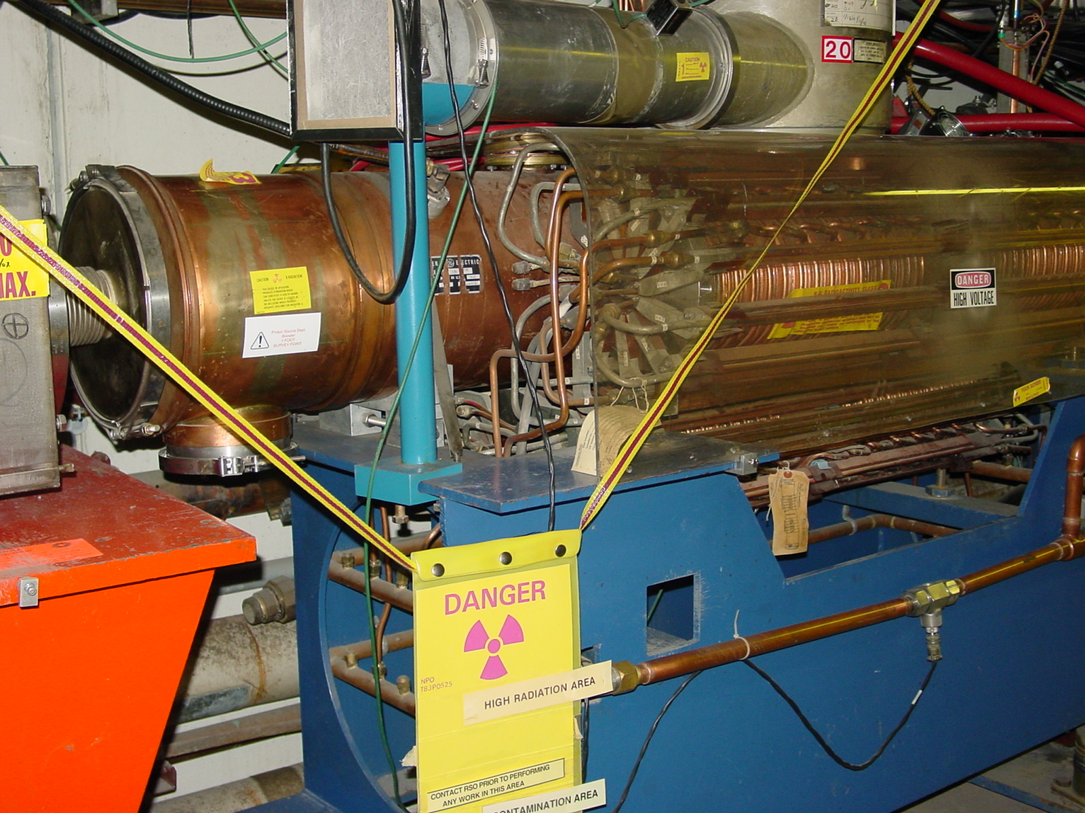
Booster RF System
18 more or less original RF cavities and power supplies.
tunable from 38 to 53 MHz during acceleration.
2 ¼” drift tube one of our primary aperture restrictions; new design being considered.
Existing cavities might overheat at >7.5Hz. Need to re-commission cooling
In-tunnel Power Amplifiers (PA’s) are by far the highest maintenance item in the Booster

Slide 32
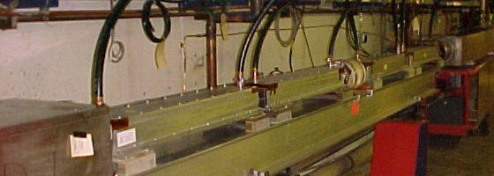
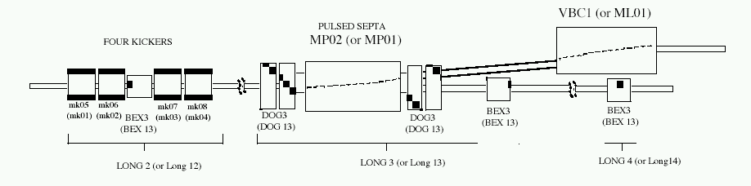
Booster Extraction (Two Extraction Regions)
DC “doglegs” work with ramped 3-bump (BEXBUMP) to maintain 40π aperture below septum
Fast (~40 ns) kickers

Slide 33
Typical Booster Cycle
Various Injected Intensities
Transition
Intensity (E12)
Energy Lost (KJ)
Time (s)

Slide 34
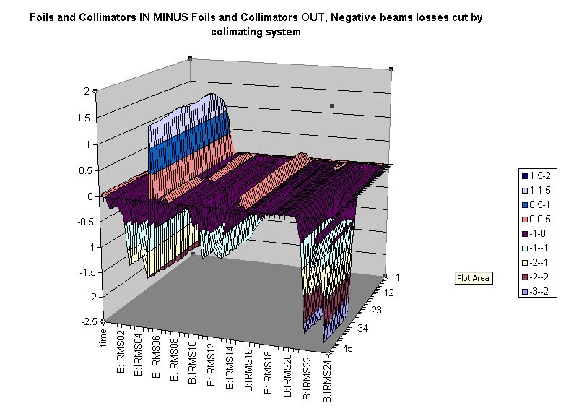
Differential Loss Monitor Example: Collimators in – Collimators Out
Collimator Position
Relative Loss
Time
Position

Slide 35
Dead Dog Studies
Took advantage of recent TeV Magnet failure to raise the Long 13 (dump) septum and turn off the associated dogleg.
Doglegs almost exactly add, so this should reduce the effect by almost half.
The mode of operation prevents short batching, booster study cycles and RDF operation.
Had about 36 hours of study in this mode.
Bottom Line: major improvement.

Slide 36
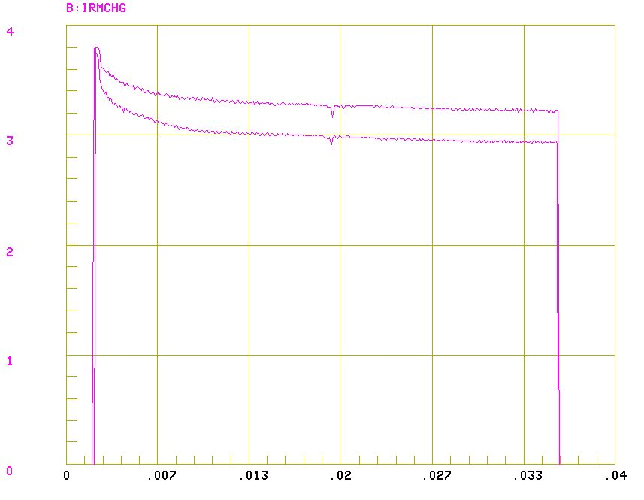
Transmission After Tuning
March 6, 7 turns, 1 dog
March 3, 7 turns, both dogs

Slide 37
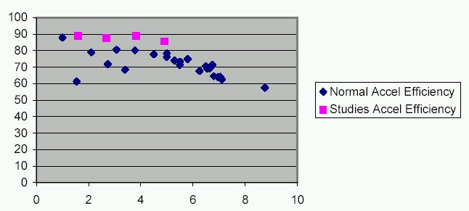
Transmission with One Dogleg
%
Injected Charge (E12)

Slide 38
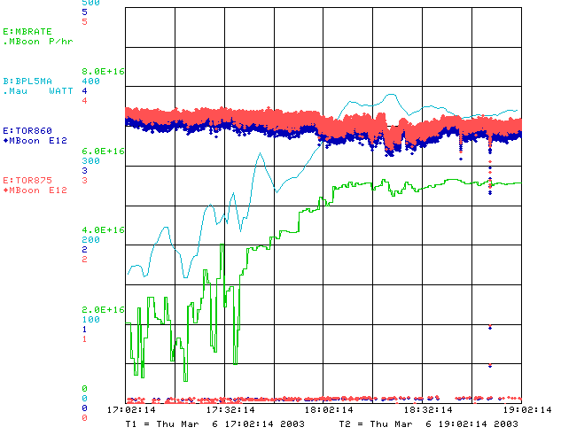
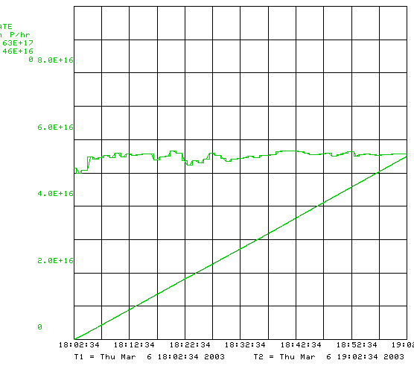
Record Running w/o Dogleg

Slide 39
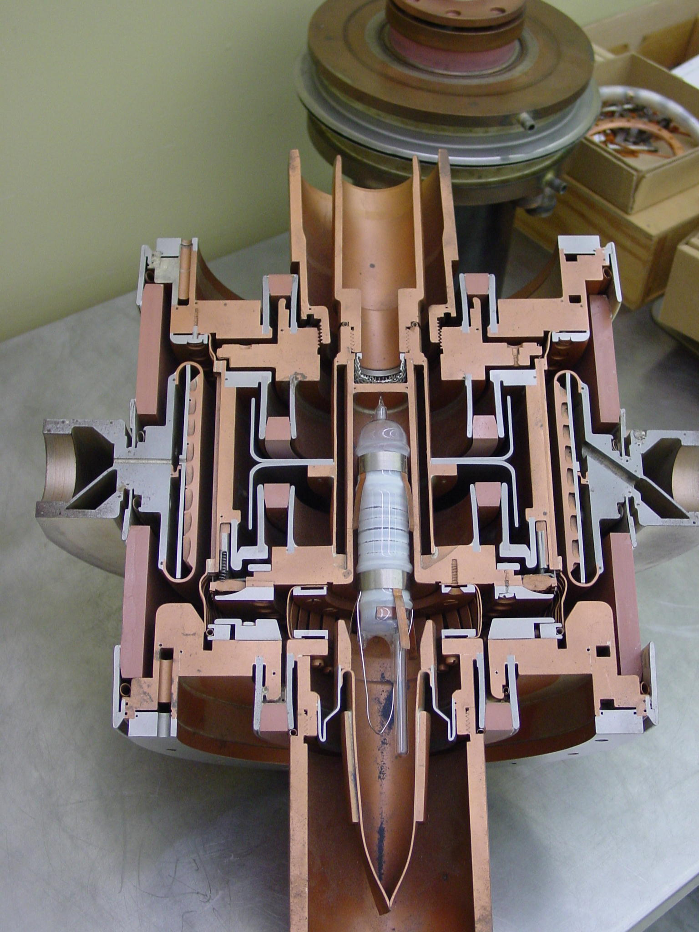
The 7835 Power Triode – Our BIG Worry
Very complex technology
  RF, material science, vacuum, chemistry
Similar to other tubes made by Burle
  4616 & 4617
7835 only used in the scientific community.
  One military user for 4617
Quality varies from decade to decade

Slide 40
Tube Throughput with Burle
Median lifetime: 16 months
  Recent lifetime: Less! (possibly related to vacuum problems)
We need about 3.41 tubes/year to maintain
  Assuming historical median
  With present tubes: twice that.
Burle now can make/rebuild ~20/year
  Critical path: Final bakeout; two stands, 3-5 weeks bakeout
  Also of concern: Supplier delivery time (e.g., ceramics, cathode)
  Recently had four failures for one success!!
Delivery time: ~8 months,
  But, often 12 months!
This is obviously a worry.

Slide 41
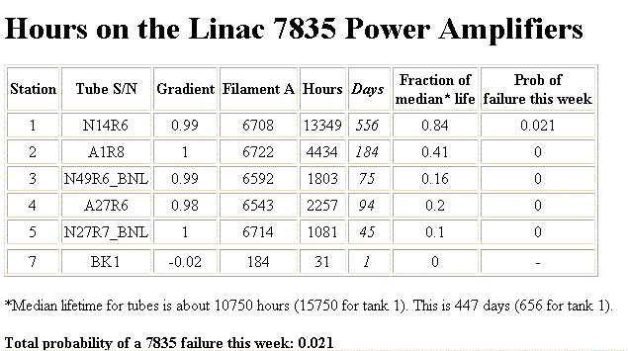
Present 7835 Power Tube Situation
We’ve received 5 tubes since the last review
  Only two delivered from Burle, after numerous failures
  Two borrowed from BNL
  One borrowed from Argonne
  We now have one spare; we have frequently had zero; we have never had two.
  Next one due “in August”.

