Slide 1
Limitations to Total Booster Flux
Total protons per batch: 4E12 with decent beam loss, 5E12 max.
Average rep rate of the machine:
  Injection bump magnets (7.5Hz)
  RF cavities (7.5Hz, maybe 15 w/cooling)
  Kickers (15 Hz)
  Extraction septa (now 4Hz, 7.5 after Jan. shutdown)
Beam loss
  Above ground:
    Shielding
    Occupancy class of Booster towers
  Tunnel losses
    Component damage
    Activiation of high maintenance items (particularly RF cavities)
Of particular interest to NUMI
Our biggest concern

Slide 2
Some Cold Hard Facts for the Proton Source
Running as we are now, the Booster can deliver a little over 1E20 protons per year – this is about a factor of five over typical stacking operations, and gives MiniBooNE about a fifth of their baseline.
NuMI will come on line in 2005, initially wanting about half of MiniBooNE’s rate, but hoping to increase their capacity – through Main Injector Improvements – until it is equal to MiniBooNE.
Whatever the labs official policy, there will be great pressure (and good physics arguments) for running MiniBooNE and NuMI at the same time.
-> By 2006 or so, the Proton Source will be called upon to deliver 10 times what it is delivering now.
At the moment, there is NO PLAN for achieving this, short of a complete replacement!

Slide 3

Typical Booster Cycle
Various Injected Intensities
Transition
Intensity (E12)
Energy Lost (KJ)
Time (s)

Slide 4
Proton Timelines
Everything measured in 15 Hz “clicks”
Minimum Main Injector Ramp = 22 clicks = 1.4 s
MiniBoone batches “sneak in” while the MI is ramping.
Cycle times of interest
  Min. Stack cycle: 1 inj + 22 MI ramp = 23 clicks = 1.5 s
  Min. NuMI cycle: 6 inj + 22 MI ramp = 28 clicks = 1.9 s
  Full “Slipstack” cycle (total 11 batches):
    6 inject
    + 2 capture (6 -> 3)
    + 2 inject
    + 2 capture (2 -> 1)
    + 2 inject
    + 2 capture (2 -> 1)
    + 1 inject
    + 22 M.I. Ramp
    ----------------------
    39 clicks = 2.6 s

Slide 5
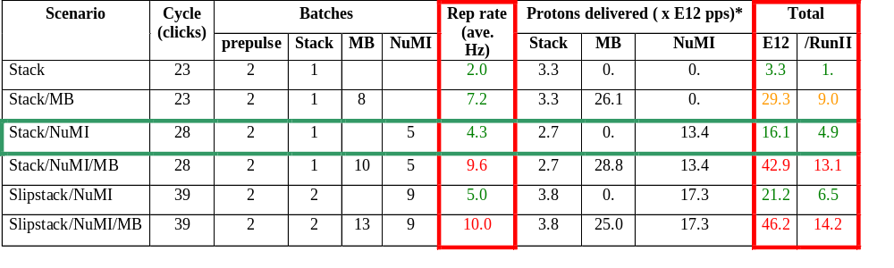
Summary of Proton Ecomomics
MiniBooNE baseline ≈ 5E20 p/year
Booster Hardware Issues
Radiation Issues
NUMI “baseline” = 13.4E12 pps x 2E7 s/year ≈ 2.7E20 p/year
Right now we’re at roughly 1/5 of the MiniBooNE baseline
*assuming 5E12 protons per batch

Slide 6
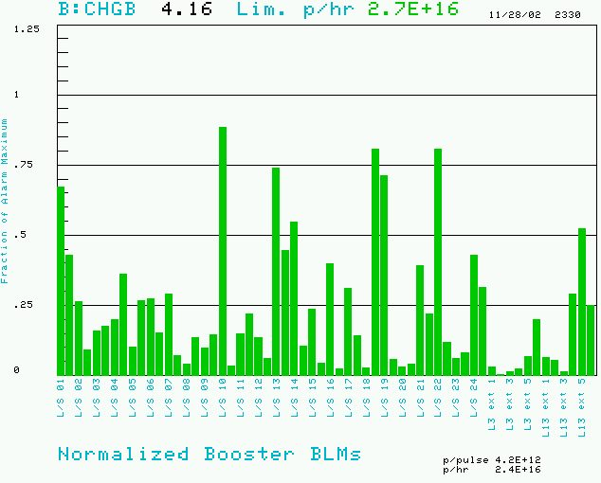
Booster Losses (Normalized to Trip Point)
BRF11: 200 mR/hr @ 1ft
BRF15: 300 mR/hr @ 1ft

Slide 7
Hardware Improvements to Booster
Shielding and reclassification of Booster towers: complete 2001
New extraction septum (MP02) power supply: complete 11/02
New extraction septum: magnet complete. To be installed 1/03
Collimation system: complete, but cannot be used until…
Collimation system shielding: 75 tons of steel to be stacked 1/03
Time line improvements (very important for MiniBooNE operation): more or less complete.
More cables for extraction septum (will allow 15 Hz operation): ??
New injection bump magnets: ??
New RF cavities: ??

Slide 8
Plan
All near term hardware improvements will be complete by end of Jan. shutdown. At the point the Booster will physically be able to run a 7.5 Hz.
Proceed with tuning improvements (C. Ankenbrandt coor.):
  IPM calibration (Tomlin, Spentzouris, Lackey).
  Orbit correctors: complete, working out operational issues (Prebys, Coney).
  Precision lattice measurement: (Lackey, Coney, new grad. Student).
  Transition studies (gamma-t jump??): (Jackson et al.)
  Damping improvements: Pellico + ??

Slide 9
New RF System
The existing RF cavities form the primary aperture restriction (2 ¼” vs. 3 ¼”).
They are high maintenance, so their activation is a worry.
There is a plan for a new RF system with 5” cavities:
  Powered prototype built
  Vacuum prototype ready for summer installation
  Second prototype to be built by university machine shops?
Total cost: $5.5M cavities + $5.5M power supplies (maybe use old ones)
Is it worth it? On of the questions for the study group is how much improvement we might expect.

Slide 10
Of Particular Interest to NuMI (and not to MiniBooNE)
Per batch intensity (MiniBooNE can make it up in rep rate).
Longitudinal emittance (needed for elegant M.I. Loading schemes).
M.I. cogging for multi-batch operation (Webber will discuss).
Operational issues (I.e. running during shot setup). These were a big deal for MiniBooNE. They will be totally different for NuMI.

Slide 11
Bottom Line
The proton source is currently delivering about 1/5 of what MiniBooNE wants.
NuMI would like similar numbers of protons.
It’s very likely that MiniBooNE and NuMI will want to run together, meaning we’d like to increase proton output by a factor of 10.
Our current plan will likely double or triple the present output.
There is a yet no clear path beyond that.

Slide 12
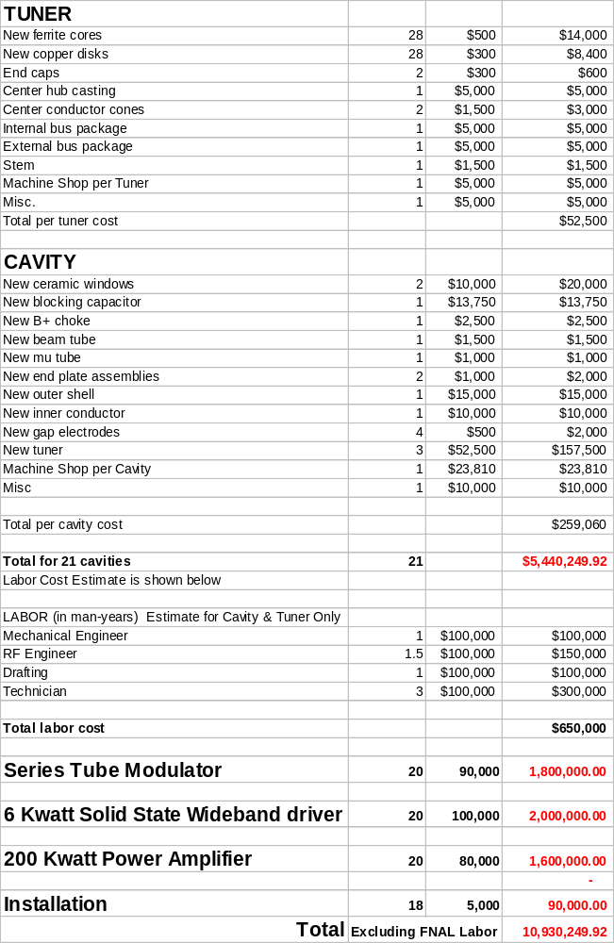
Upgrade Cost Estimate
Summary:
~$260K per cavity, of which $160K goes for the three tuners.
A roughly equal amount for the power supply chain.
About 20 cavities.
-> $11M total

Slide 13
Questions to Answer
Accuracy of the Cost Estimate?
Status:
  First prototype
  Vacuum prototype
  Design
Reasonable timeline.
Ways to save money:
  Use old tuners?
  Use existing power supplies?
Ways in which universities can help:
  Political pressure
  Money
  Fabrication

Slide 14
Some Issues
What is the best stacking procedure? Three in parallel or one at a time?
How much manpower and time will we need?
What are the radiation budget implications? Fields near the collimators are 5-10 mR/hr.
Can we take advantage of help offered by MiniBooNE?
Are there any modifications which should be made to the collimator stands to facilitate later servicing when they’re hot?

