Slide 1

Magnet Circuit
Middle magnet
L = 1 uH
R = .1mOhm
Upstream magnet
Downstream magnet
The central field should be exactly -2x outer field so total integral = 0

Slide 2
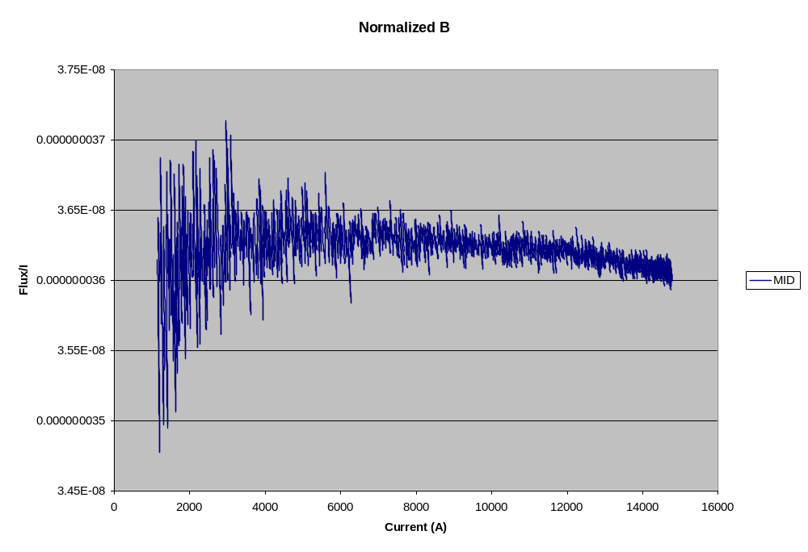
Nonlinearity
1%

Slide 3
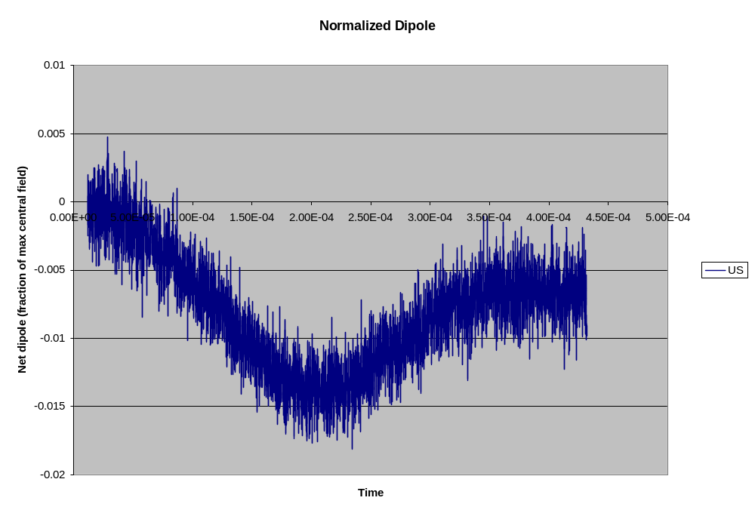
Effect on net dipole
1.2 cm orbit distortion

Slide 4
Shunting
Middle magnet
L = 1 uH
R = .1mOhm
Proposed Shunt
L ~ 100 uH
R ~ 10 mOhm
Upstream magnet
Downstream magnet

Slide 5
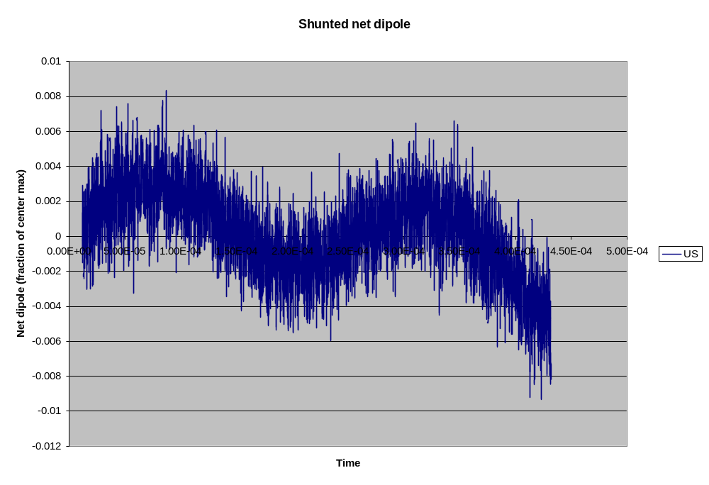
Benefit of 1.2% shunt

