Slide 1
Status of Proton Plan
Eric Prebys

Slide 2
Management Re-organization
Accelerator Projects
Jeff Spalding (Head)
Bruce Baller (Deputy)
Project Support Team
(Bruce Baller), Leader
Ken Domann
Ann Nestander
Jeff Sims
Alan Wehmann
Proton Plan
Eric Prebys, PM
Nancy Grossman (??),
Deputy
Run II Upgrades
Pushpa Bhat, PM
Mike Martens (Deputy)
Project support team:
  Resource-Loaded Schedule (MS Project) – Domann
  Accounting - Cobra interface to Lab’s system - Nestander
  Project management support – Sims
  Web and documentation support - Wehmann

Slide 3
Phased Approach to Neutrino Program
Phase 0 (now):
  Goal: deliver 2.5E13 protons per 2 second MI cycle to NuMI (~2E20 p/yr), limited by MI RF system.
  Deliver 1-2E20 protons per year to Booster Neutrino Beam (currently MiniBooNE)
Phase 1 (~2008):
  A combination of Main Injector RF improvements and operational loading initiatives will increase the NuMI intensity to 4-5E13 protons per 2.2 second cycle to NuMI (~3E20 p/yr).
  This will increase by ~20% as protons currently used for pbar production become available.
  It is hoped we can continue to operate BNB at the 2E20 p/yr level during this period.
Phase 2 (post-collider):
  In this phase, we will consider using the recycler as a preloader to the Main Injector and possibly reducing the Main Injector cycle time.
  The exact scope and potential of these improvements is under study.
Phase 3 (proton driver)
  Main Injector RF must accommodate 1.5E13 protons every 1.5 seconds
  NuMI beamline and target must also be compatible with these intensities.

Slide 4
Implications for Main Injector RF
These phases are largely decouple except for the Main Injector RF.
  Our present system:
    Number of cavities: 18
    Total Power Available: 175 kW/cavity (single PA)
    Total Power dissipated: 58.6 kW/cavity
    Power available for acceleration: 116.4 kW/cavity
    Maximum acceleration rate: 200 GeV/s
  In the absence of beam loading compensation, an RF system is stable until the energy expended in accelerating the beam is equal to the energy dissipated in the cavity.
  Feed forward loops can increase this stability threshold
  For our system
    Maximum guaranteed stable intensity: 3.3E13 protons
    Power limited intensity: 6.5E13 protons
  -> Only guarantee phase 0

Slide 5
MI RF (cont’d)
By adding an additional (175/2 – 58.6 =) 28.9 kW passive load to each cavity, we could ensure 87.5 kW of power for stable acceleration
  ~$2M
  Assure 4.9E13 proton per load limit
  Not guaranteed to be enough for Phase 1/2.
Each cavity has an additional port for a second PA, potentially giving 350 kW of total power.
  ~$12M
  This would insure 9.8E13 protons/load in the most conservative case (175 kW power dissipation)
  Possibly higher with feedback loops
  Definitely enough for Phase 1 and 2
  Unlikely to be enough for a proton driver.

Slide 6
Review: What Limits Total Proton Intensity?
Maximum number of Protons the Booster can stably accelerate: 5E12
Maximum average Booster rep. Rate: currently 7.5 Hz, may have to go to 10 Hz for NuMI+ (full) MiniBooNE
(NUMI only) Maximum number of booster batches the Main Injector can hold: currently 6 in principle, possibly go to 11 with fancy loading schemes in the future
(NUMI only) Minimum Main Injector ramp cycle time (NUMI only): 1.4s+loading time (at least 1/15s*nbatches)
Losses in the Booster:
  Above ground radiation
  Damage and/or activation of tunnel components
Our biggest worry at the moment and probably forever

Slide 7
Initial Plan (BEAMS-DOC-1441, 11/04)
Strategy (highlights)
  Increase maximum repetition rate of Booster:
    ORBUMP magnets and PS
    RF cavities
  Reduce losses in Booster
    New Corrector System
    Gamma-t commissioning
    30 Hz harmonic (reduce max. acceleration rate)
    Extra RF cavity
  Commission multibatch operation in Main Injector
    Mixed mode operation
    Slip stacking
    RF upgrade (??)
    Loss mitigation and monitoring
  Increase reliability
    Old Linac PA tubes (7835)
    Replace Linac pulsed quad power supplies
    Instrumentation upgrade
    Booster RF solid state upgrade

Slide 8
Current Status of Plan
Since the initial release of the plan, we have worked to re-scope it to reflect:
  Funding guidance (pre and post BTeV cancellation)
  Feedback from those knowledgeable and/or responsible for the individual projects.
  Suggested additions.
WBS
  We are working with project support to build a bottoms-up, resource loaded WBS
    All major projects have at least realistic timelines to level 3.
    Good faith M&S and SWF estimates
    Working to refine and baseline project.
  In many cases, we are integrating projects which were already underway prior to The Plan.

Slide 9
Likely Response to Current Budget Guidance
After the cancellation of BTeV, we have the following budget guidance (M&S), compared to our original plan
Most Likely Scenario
  Main Injector RF project and Booster Corrector System get delayed by one year
  Booster RF Solid State PA upgrade deferred indefinitely.
 | FY05 | FY06 | FY07 | FY08 | Subt. | Cont. | Total
Original Plan | 5960 | 8008 | 2546 | 0 | 16514 | 42% | 23450
Present Guidance | 3854 | 5917 | 5016 | 5717 | 20504 |  | 20504

Slide 10
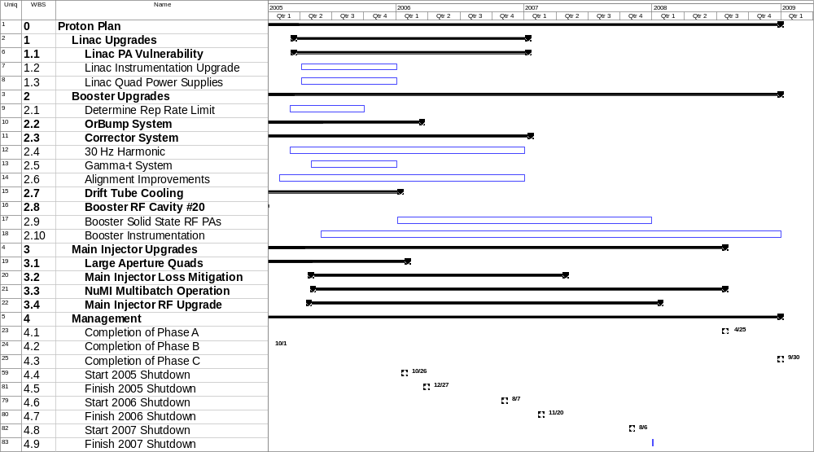
Existing Plan (not fully rescoped)

Slide 11
Status of Major Work
Linac (1)
  (1.1) 7835 Task force (Rich Andrews)
  (1.3) LEL quad power supplies
    Working on prototype, based on HEL supplies
Booster (2)
  (2.2) ORBUMP System
    Magnets:
      First magnet built and tested, proceeding with the rest
    Power Supply
      Procuring and assembling
  (2.3) Corrector System
    Conceptual design complete
    Working on detailed design
    Working on PS specs
  (2.4) 30 Hz
    Work Proceeding on Prototype

Slide 12
Status of Major Work (cont’d)
(3) Main Injector (except RF)
  (3.1) Large Aperture Quads
    In fabrication. Will be ready for 05 shutdown
  (3.2) Loss mitigation/collimator system
    Working group formed
    Identifying collimator candidates for MI-8
    Starting ring collimator system design based on Booster
  (3.3) Multi-batch operation
    Demonstrated maximum of 2.5E13 (6x4.2E12 batches) load to NuMI
    Demonstrated mixed mode (2+5) operation w/ 5x1E12 batches to NuMI

Slide 13
Main Injector RF in FY05 (3.4)
Build prototype cavity
  Passive load:
    Existing port?
    Cut new port?
  Second PA
Carry out a series of studies in the Main Injector
  Determine effectiveness of feed-forward loops
  Determine optimal passive load and predict intensity limit for one- and two- PA scenarios
Refine cost estimate for passive load and PA upgrades.
Use this information to determine longer range plan.

Slide 14
Proton Projections
Phases of Operation
  Phase I
    After this shutdown
    Dogleg problem ameliorated
    Booster limited to 7.5Hz total repetition rate
    Main Injector limited to 4E13 protons (2+5 operation)
  Phase II
    After 2005 shutdown
    ORBUMP replaced
    RF cooling finished
    Booster capable of 9Hz operation
    MI still limited
  Phase III
    After 2006 shutdown
    MI RF upgrade complete
    2+9 operation to NuMI
2007

Slide 15
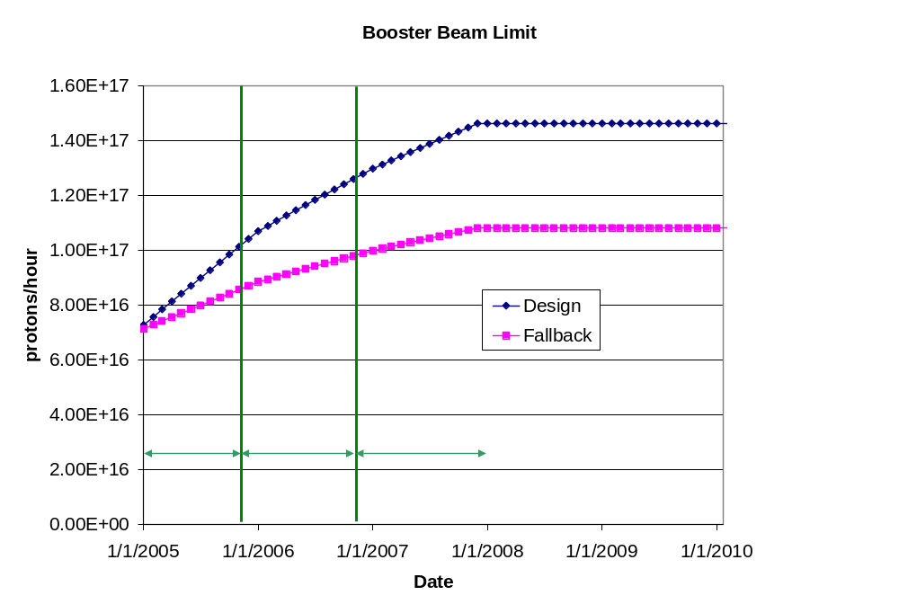
Predicted Proton Intensity Limits

Slide 16
Estimating PoT
Even the fallback proton scenario accommodates NuMI operation.
Total proton output continues to be limited by radiation losses, rather than Booster repetition rate.
We assume:
  NuMI and antiproton production get what they need
  The BNB gets whatever it can beyond that, within the total output limit of the Booster
This is a programmatic decision:
  Protons can be diverted from NuMI to the BNB, but not the other way around.
The BMB PoT estimates are extremely sensitive to the total proton limit, which is uncertain.

Slide 17
Calculating NuMI PoT
Even the fallback scenario accommodates NuMI operation.
Assume the following
  Booster batch intensity rises steadily to 5.5E12 over the next three years.
  Ramp up to full 2+5 operation by April 2005
  Ramp up to full 2+9 batch slipstacked operation a few months after MI RF upgrade.
  90% efficiency for slip stacking.
  10 month operation each year.
  81% total uptime for remainder of year
    based on MiniBooNE. Includes scheduled and unscheduled downtime
  90% avg/peak operating efficiency
  10% down time for shot setup
  5% down time for fast Recycler transfers
  5% down time during 2005 for Ecool accesses.
  Does NOT include SY120

Slide 18
Calculating BNB PoT
Trickier:
  Still limited by beam loss, NOT rep. rate.
  Assume antiproton and NuMI have priority, so
  BNB VERY sensitive to proton limit and its fluctuations.
Use:
(avg pph) = (pph lim.)*η – (NuMI pph) – (pbar pph)
Also assume:
  10 month operation
  81% up time (based on 2004)
  5% downtime in 2005 for ECool access
  BNB gets all the beam during shot setup (10% of the time)
Booster output limit, as discussed
Avg/pk ~ 86% from July 2004 MiniBooNE operation

Slide 19
“Design” PoT
 | Booster Batch Size | Main Injector Load | Cycle Time | MI Intensity | Booster Rate* | Total Proton Rate | Annual Rate at end of Phase
 |  | (AP + NuMI) | (sec) | (protons) | (Hz) | (p/hr) | NuMI | BNB
Actual Operation
July, 04 | 5.0E+12 | 1+0 | 2.0 | 0.5E+13 | 5.1 | 0.8E+17 | 0 | 3.3E+20
Proton Plan
Phase I | 5.10E+12 | 2+1→2+5 | 2.0 | 3.6E+13 | 6.3 | 1.0E+17 | 2.0E+20 | 1.5E+20
Phase II | 5.3E+12 | 2+5 | 2.0 | 3.7E+13 | 7.5 | 1.2E+17 | 2.2E+20 | 2.8E+20
Phase III | 5.50E+12 | 2+9 | 2.2 | 6.0E+13 | 8.3 | 1.5E+17 | 3.4E+20 | 2.2E+20
Beyond Scope of Present Plan
11 Hz | 5.50E+12 | 2+9 | 2.2 | 6.1E+13 | 11.0 | 2.0E+17 | 3.4E+20 | 5.0E+20

Slide 20
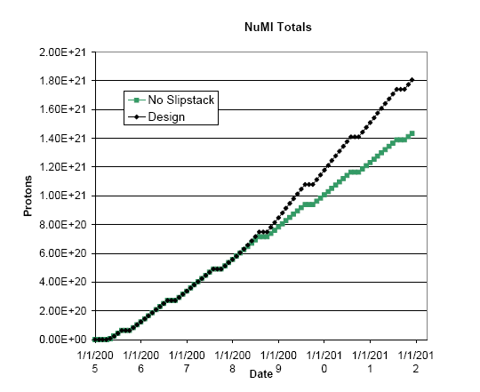
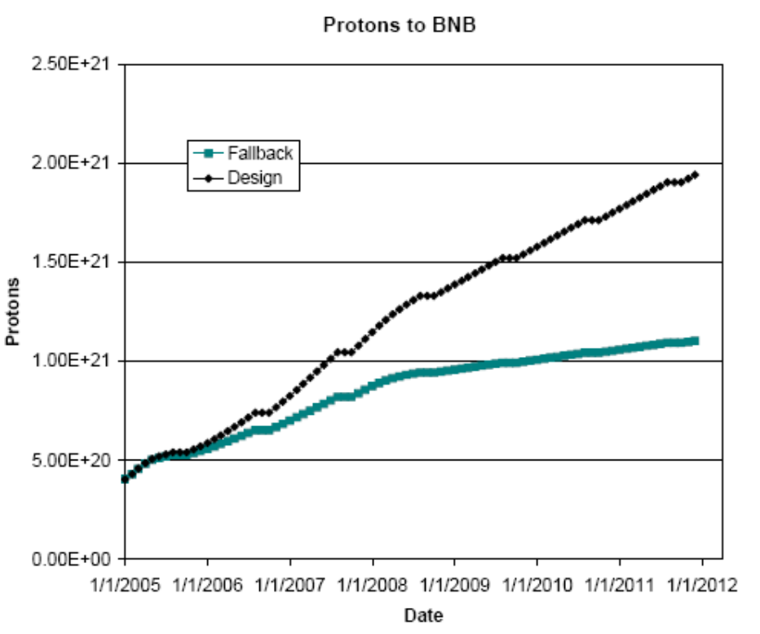
Projections (“delayed” scenario in document)
BNB only runs during shot setup

