Slide 1
Proton Plan
Answers to Questions
Director’s Review
August 2006
Eric Prebys

Slide 2
Questions 1
How many 7835 Amplifier tubes have been tested and meet specs? What is the plan for completing the testing.
  Our testing so far has been keeping pace with our need to replace tubes
  At the moment, we have 20 tubes, of which five have been tested. (Three of the new tubes have already been installed)
  Yield has been extremely good in recent years. Only one new tube was returned for a bad ion pump. It has since been returned and tests fine.
  Testing was slowed by the retirement of a key Technician. We have an offer out to a replacement, and it is believed that will allow us to increase the rate of testing.
  We are also considering assembling a second test stand.

Slide 3
Questions 2
Regarding the Linac RF, is the “feed forward” technology well enough understood to proceed with it now if so decided?
  Defer to RF people

Slide 4
Questions 3
Report (quantitatively) on the benefits of the work accomplished during the Booster
  As we said, we were very methodical in coming up after the shutdown, and we are only now hitting the hourly rates that we were at before the shutdown.
  Nevertheless, there are many indications that we have improved machine operation

Slide 5
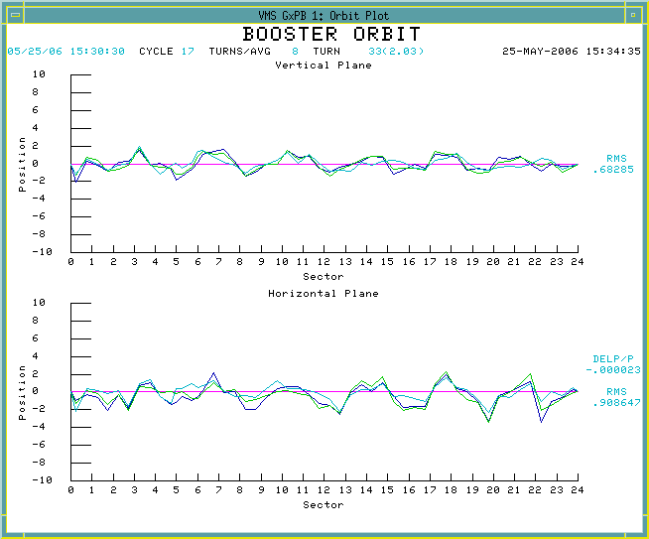
Question 3 (cont’d)
Orbit relative to injection
This was roughly 1 cm prior to shutdown

Slide 6
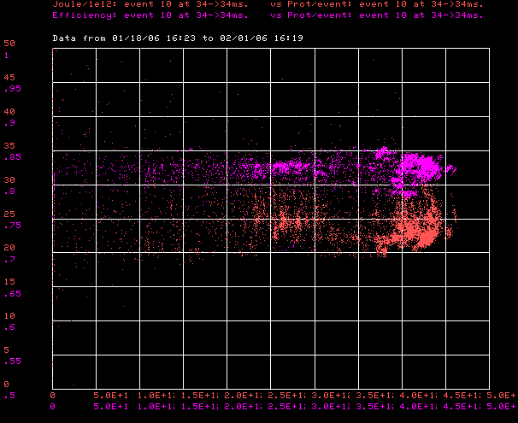
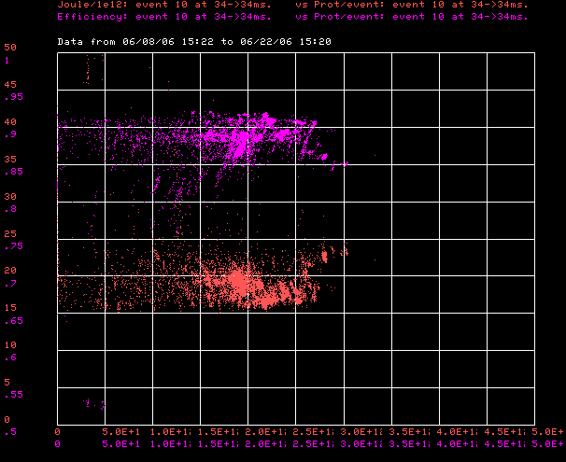
Question 3 (cont’d)
January
June
Efficiency (High is good)
85%
20 J/E12
Normalized Energy Loss
(low is good)
0.
2.5E12
5E12
0.
2.5E12
5E12
Batch size ->

Slide 7
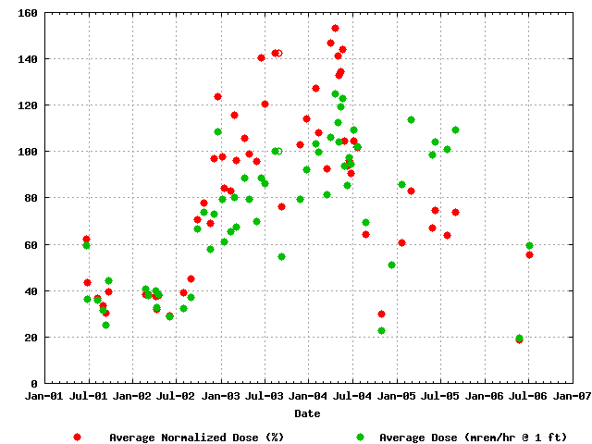
Question 3 (cont’d)
Normalized radiation dose
Factor of ~15 in total proton rate
MiniBooNE
NuMI

Slide 8
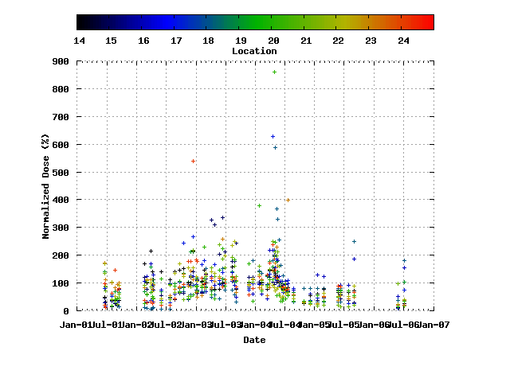
Question 3 (cont’d)
RF Regions

Slide 9
Question 4
Do the test of the Booster corrector prototype magnet show it meets requirements
  So far yes, unless the AC measurements hold unpleasant surprises.

Slide 10
Question 5
Talk to the accelerator physics work that justifies what steps are being taken.
  This is an area we are working to improve
  In the Booster, we have a fairly accurate longitudinal model, which has driven our decision to cancel the 30 Hz harmonic and pursue the gamma-t system, for example
  The transverse model does not quantitatively reproduce beam loss.
  Our assumptions to date are strictly based on reduced scraping due to effectively increasing the aperture by reducing uncontrolled beam motion, which we believe has dominated our losses up until now.
  The suggestions to look at other machines (particularly as to the effects of tune control) are appreciated.

Slide 11
Question 6
Is the gamma-t jump decision ever going to be made?
  Fair question, however…
  More work has gone into understanding the gamma-t system in the last year than in probably the decade before.
  Simulations look very compelling, so at the moment the assumption is that we are proceeding with the system.
  Still some important problems to work out
    Beam position at transition
    Effect on coupled bunch instabilities
    Transition phase jump “subtleties”
  Getting close to definitive test

Slide 12
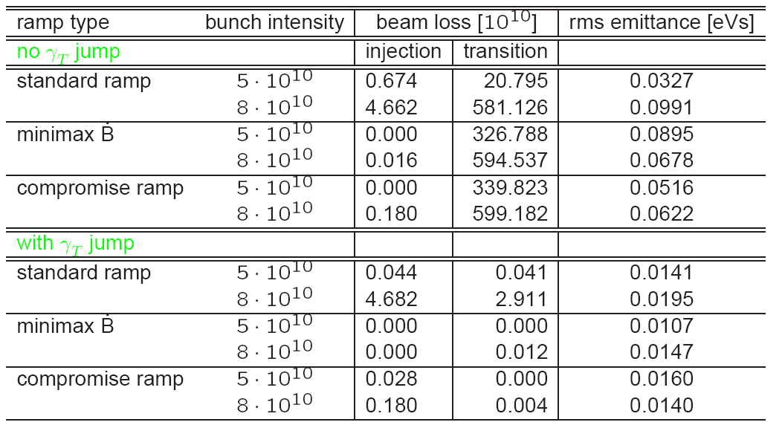
Question 6 (cont’d)
Out of 84 bunches
(.3 unit)
J. Machlachlan, FNAL-BEAMS-DOC-2339-v1

Slide 13
Question 7
Describe MI collimation thoughts…
  Defer to Ioanis
  MI conceptual collimation review talks and committee report available at:
    http://www-ap.fnal.gov/~bcbrown/Sources/Accel_Projects.html

Slide 14
Question 8
Speculate on (or remind us of) any hopes for benefits before the end of the 2007 shutdown
  Our projections for NuMI only assume they will run (with more up time) in 2+5 mode as they were before the shutdown:
    A few percent increase in Booster batch size is projected, but this is small compared to the up time issues.
  It is planned that the MI will have at least demonstrated full 2+9 operation at some intensity. Beam loss will determine whether we use it operationally prior to the collimation system.
  The total Booster output is projected to increase by at least 20% due to the improvements made during the shutdown. This extra beam will go primarily to MiniBooNE.

