Slide 1
Proton Plan
Introduction and Overview
Director’s Review
August 2006
Eric Prebys

Slide 2
Proton Plan Charge
Develop a plan for a reasonable set of improvements and operational initiatives to maximize proton delivery to NuMI and the Booster Neutrino Beam (BNB)
Estimate the budget and timeline for these improvements.
Estimate proton delivery to both beam lines if the Plan proceeds on schedule.
Note:
  This project precedes other work that must be done to support the NoVA program
  This project precedes a proton driver or other significant improvements to the complex that are under discussion.

Slide 3
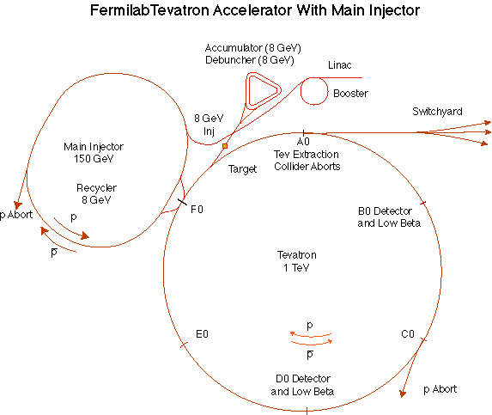
The Fermilab Accelerator Complex
MinBooNE
NUMI
=Proton Plan System
=Proton Plan Customer

Slide 4
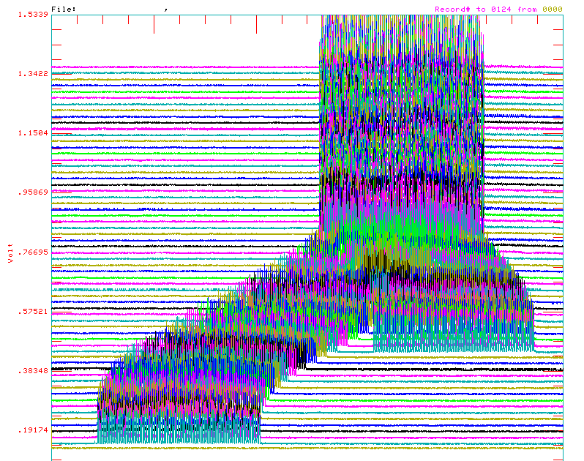
Review: Main Injector Loading
The Main Injector has six usable “slots”, into which Booster batches may be placed.
More batches may be loaded, using “slip stacking”, in which an initial batch in the Main Injector is accelerated such that a subsequent batch will be at a slightly different energy.
The two will then drift together and can be captured as a single batch (with at least twice the longitudinal emittance).

Slide 5
NuMI Operating Modes
Initial NuMI operation (“2+5”):
  Two batches slip stacked for antiproton production.
  Five more batches loaded for NuMI
  All will be accelerated together.
  This is the current standard operation.
Ultimate NuMI operation (“2+9”):
  Five batches will be loaded into the Main Injector, leaving one empty slot.
  Six more batches will be loaded and slipped with the first to make two for antiproton production and 9 for NuMI.
  This is under study, but will probably not result in a net increase in protons until after the next shutdown (see Kourbanis’ talk)

Slide 6
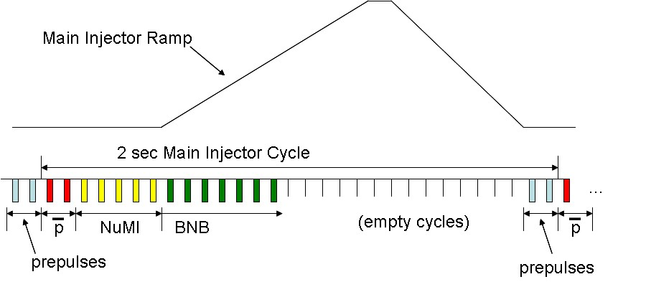
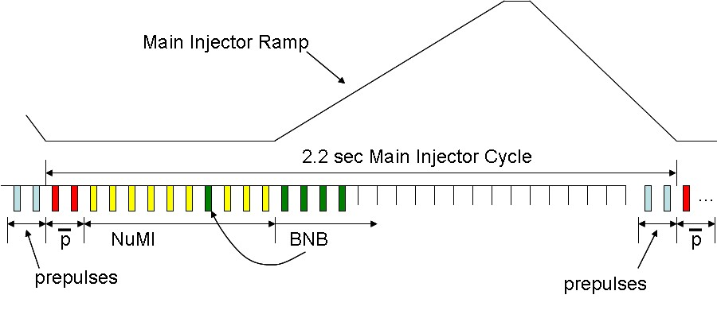
Time Line
“2+5”
“2+9”

Slide 7
Some Ballpark Numbers
At 120 GeV, 100 kW is roughly
  1E20 protons/year
  1 Booster Hz @5E12*
  2E16 peak proton intensity out of Booster
ABSOLUTE limit of this Proton Source:
  5E12 batches @ 15Hz
    ~1.5MW @ 120 GeV
    1.5E21 protons/year
    3E16 pph out of Booster
    This is about ~2x the present proton plan
*not including prepulses.! Add 2Hz/(MI cycle) for total rate

Slide 8
Context: Staged Approach to Neutrino Program
Proton Plan
NuMI era (concurrent with Run II)
  Ramp up to deliver slip stacked protons to both NuMI and antiproton production
  Continue to deliver protons to the 8 GeV line at some level
  Goal:
    ~400 kW to NuMI
    1-2E20 protons to 8 GeV line
S(uper)NuMI era (after collider program)
  Use Recycler as a pre-loader to the Main Injector to eliminate loading time
  Details being worked out. Becoming a formal plan.
  Goal
    ~700 kW to NuMI line
SNuMI 2 (tentative)
  Use Antiproton Accumulator Ring to momentum stack protons
  Boxcar stack these protons into Recycler
  Load into Main Injector
  Goal
    ~1.2 MW to NuMI line
Proton Driver?
  Always a possibility, but not part of our baseline thinking at the moment.

Slide 9
Goals of Plan
120 GeV (NuMI)
  Accelerate 4-5E13 protons per 2.2s cycle
  This alone is within demonstrated performance of the Booster (at least in terms of total protons):
    7.5Hz adequate
    Total proton rate ~OK
  Most of the necessary work is in Main Injector
  Maintaining acceptable longitudinal quality from Booster for slip stacking presents an operational challenge
8 GeV (BNB)
  Maintain ~2e20 p/year to maintain 8 GeV neutrino program
  Requires ~50% increase in total protons
  Requires Booster to go to ~9Hz
Future
  Pave the way for increased beam throughput needed by SNuMI and beyond

Slide 10
Limits to Proton Intensity
Total proton rate from Proton Source (Linac+Booster):
  Booster batch size
    ~4-5E12 protons/batch
  Booster repetition rate
    15 Hz instantaneous
    Prior to 2006 shutdown: 7.5Hz average (injection bump+RF)
    Now: 9 Hz (including conditioning pre-pulses)
  Beam loss
    Damage and/or activation of Booster components
    Above ground radiation
Total protons accelerated in Main Injector:
  Maximum main injector load
    Six “slots” for booster batches (3E13)
    Up to ~11 with slip stacking (4-5E13)
    Possible RF stability limitations (under study)
  Cycle time:
    1.4s + loading time (1/15s per booster batch)
Historically our biggest worry

Slide 11
Plan Strategy
Increase the proton delivery from the Booster (to both NuMI and BNB)
  Increase acceptance by improving orbit control, beam quality, etc
  Increase maximum average Booster repetition rate
Increase the beam intensity in the Main Injector for NuMI
  Main Injector multi-batch operation
    5 single batches to NuMI
    ->9 slip stacked batches to NuMI
  Identify and ameliorate loss and rep. rate issuess
  Might require RF improvements.
Improve operational reliability and stability
  Alleviate Low Energy Linac PA tube (7835) Problem
  Linac quad supplies and Low Level RF
  Booster RF?

Slide 12
Proton Plan Time Line
11/04: First draft of “proton Director’s Review, August 2005
8/05: First Director’s Review
9/05: “Baseline”
Since baseline:
  Plan carefully tracked with monthly PMG meetings
  Change control through formal change request (CR) procedure.
    So far, 19 CR’s of varying magnitude

Slide 13
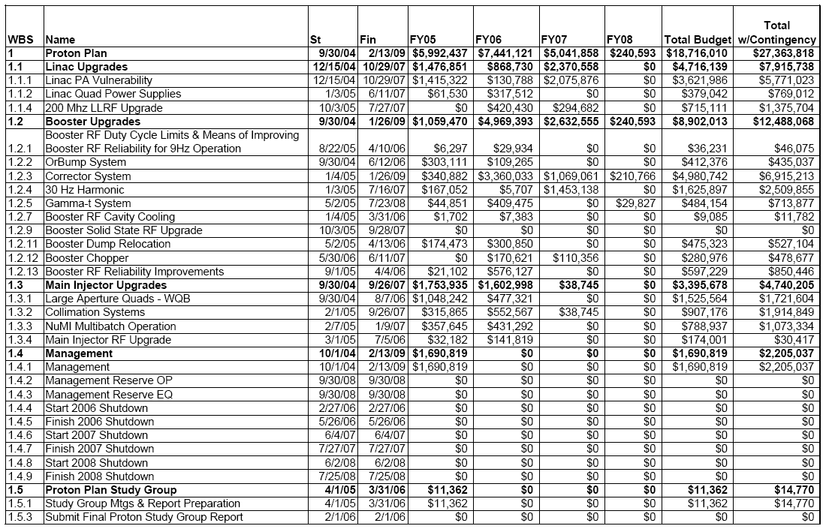
Level 3 Breakdown
See Sims’ talk for budget and schedule details
Expanded and moved to SNuMI project

Slide 14
Significant Elements of Plan
Linac
  Stockpile two year supply of spare 200 MHz power amplifier tubes (7835’s), in the event of an interruption in supply
  Characterize and improve Low Energy Linac Low Level RF
Booster:
  Replace and reconfigure injection bump (ORBUMP) system.
  Relocate 8 GeV dump from Booster tunnel to MI-8 transfer line
  Make Booster robust to 9 Hz, and understand requirements to go to 15 Hz
  Design, build, and install new corrector system
Main Injector:
  Replace seven quadrupoles with increased aperture versions, to reduce injection and extraction losses.
  Operationally develop multi-batch and multi-batch slip stacked operation
  Design and install collimation system, both in the MI-8 line and in the MI ring
  Modify injection kicker to allow multi-batch slip stacked operation
  Characterize and perhaps make improvements to RF system, to support high intensity operation.
Red = completed during shutdown

Slide 15
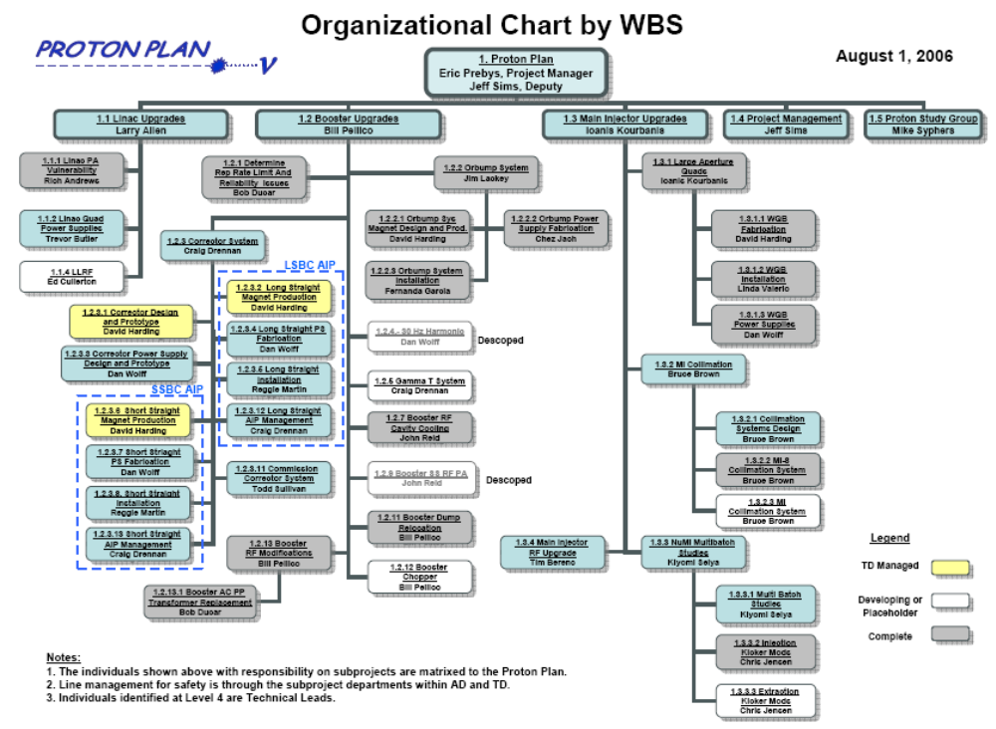

Slide 16
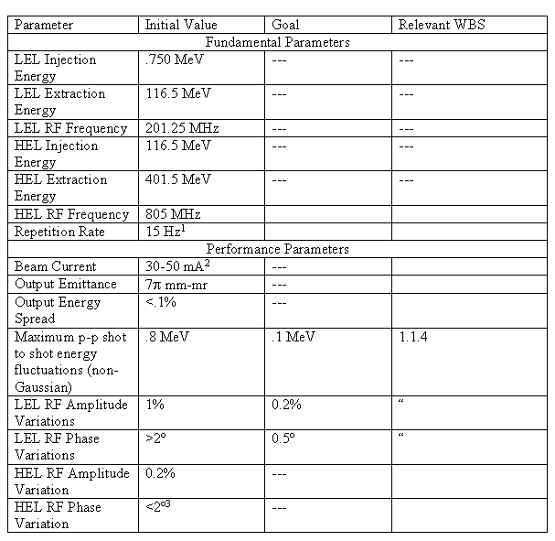
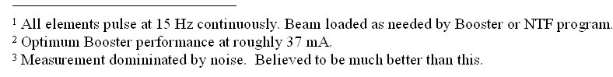
Linac Parameters

Slide 17
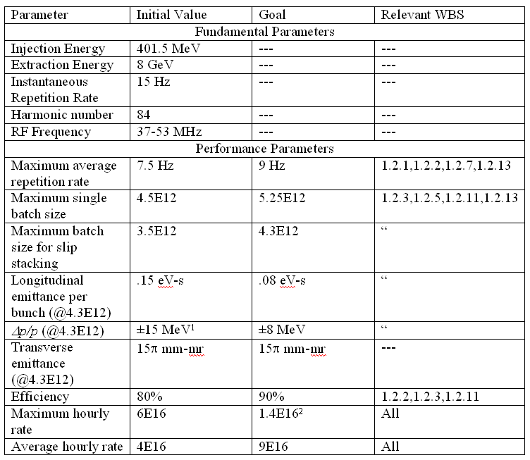
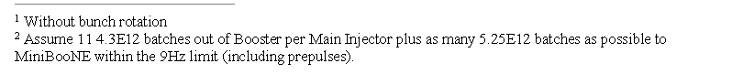
Booster Parameters

Slide 18
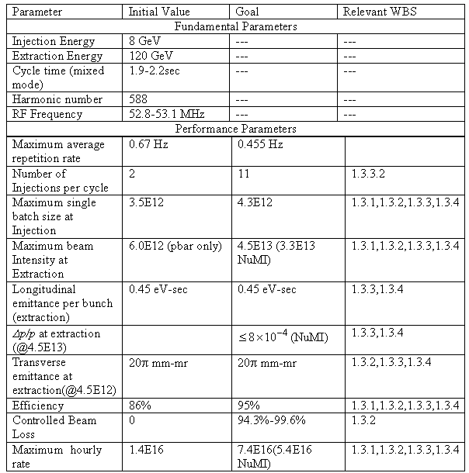
Main Injector Parameters

Slide 19
Since Last Review
Linac
  All 12 strategic spare 7835’s delivered!
    One sent back (bad ion pump)
  Design of pulsed quad supplies ongoing
  LEL LLRF studies well under way
Booster
  Operationally supported slip stacking for pBar production, NuMI, and MiniBooNE
    Required operational cogging
    Longitudinal properties improved with the intervention of Rapid Response Team (RRT)
  Prepared for and completed major shutdown projects (see later talk)
  Finalized specifications and have begun testing prototype for new Booster corrector system.
Main Injector
  Prepared for and completed shutdown projects
  Ramped up to full 2+5 operation
    Rate maximum until slip stacking begins after shutdown
  Did studies related to full slip stacking
    Demonstrated accelerated 2+9 operation at low intensity

Slide 20
Summary at a Glance
= Task completed during shutdown
= Significant element completed during shutdown
= Non-shutdown task completed
= Task descoped
New 13.8 kV transformers and switch gear for Booster RF
MI-8 Collimation Complete
MI-10 kicker upgrade

Slide 21
Future
A significant part of the Proton Plan was completed (or descoped) by the end of the recent shutdown.
This will free up some badly needed expertise to focus on optimizing the system to take advantage of the improvements that have been made.
The most significant remaining tasks are:
  Linac LLRF (1.1.4)
  Booster Corrector System (1.2.3)
    This would be a major project all by itself
  Main Injector Ring Collimation (1.3.2.1.3)
  Main Injector RF Upgrade (1.3.4)
    Scope still being determined

Slide 22
Safety and Risk
The Proton Plan includes major tunnel activity, so safety is always a primary concern
  More about the 2006 shutdown in later talk
A number of future projects are tied to shutdowns
However, there are no significant remaining Run II projects, so this plan will also largely drive the shutdown.
This reduces schedule risk (a bit)

Slide 23
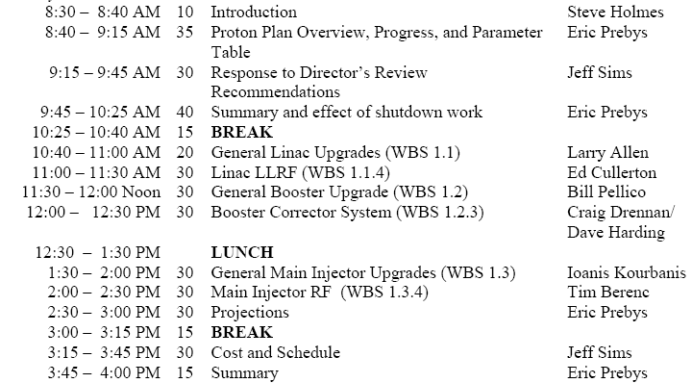
Today’s Agenda
= significant individual task

