Slide 1
Proton Plan
Proton Projections
Eric Prebys

Slide 2
Outline
Projection Procedure
Accuracy to date
Issues and Refinements
Updated Projections
Conclusions

Slide 3
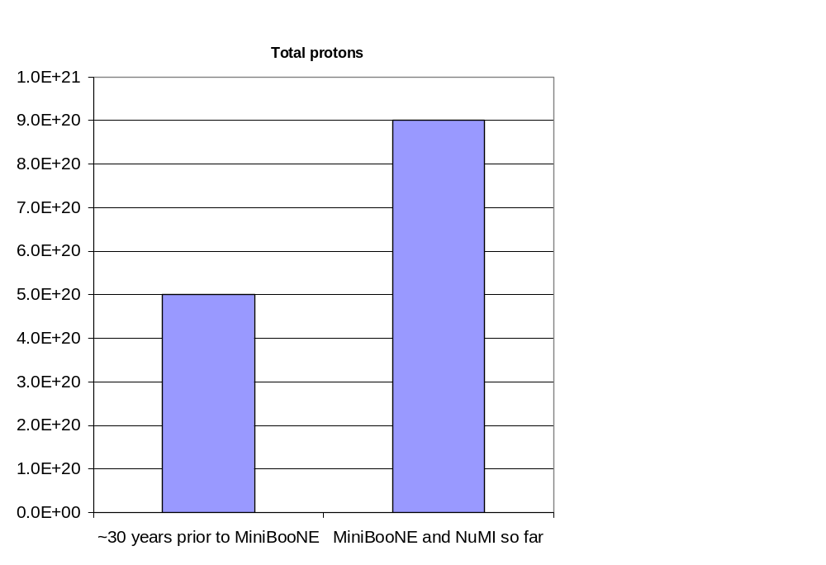
General Comments
Accurate proton delivery projections are one of the most important facets of the proton plan
  Run II has shown that accuracy provides more long term satisfaction than wild optimism.
  Both MINOS and MINIBOONE were conceived under what are now understood to be unrealistic assumptions about proton delivery
Putting things in perspective

Slide 4
Reminder: Modes of Operation
“2+5” Operation
  Two batches are slip stacked together for pBar production.
  5 single batches are loaded for NuMI
  All are accelerated together
  This has been standard operation since shortly after NuMI turned on
“2+9” Operation
  5 single batches are loaded
  6 batches are slipped together with these
    -> five double batches and one single batch
  At flat top, one double batch is extracted for pbar and the rest are extracted to NuMI

Slide 5
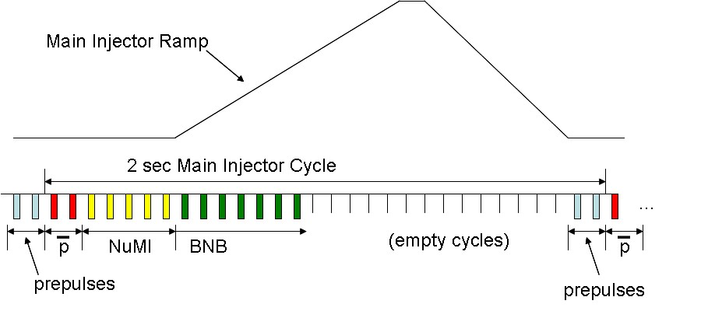
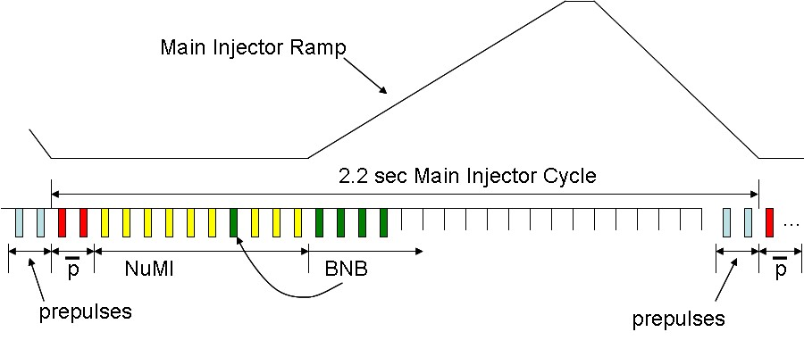
Time Line
“2+5”
“2+9”

Slide 6
Procedure for estimating Proton Delivery
Assume traditional operational priority:
  Protons for pBar production
    Limited by ability to slip stack
    Limited by max cooling rate
  Protons for NuMI
    Limited by max Booster batch size
    Limited by max MI cycle rate
    Limited by max MI proton capacity
    (will be) limited by ability to slip stack NuMI protons in MI
  Protons for BNB (currently MiniBooNE)
    Determined by difference between Booster capacity and maximum MI loading.
    Currently limited by Booster lossesUltimately limited by Booster rep. rate.
    Extremely sensitive to fluctuations in total Booster output

Slide 7
Important Milestones
2006 Shutdown
  Maximum Booster rep. rate increases from 7.5Hz->9Hz
  Main Injector Improvements will allow studies of full 2+9 operation
  Assume beam loss in Main Injector limits us to 2+5 as standard operation.
2007 Shutdown
  Installation of half of Booster correctors will allow increased throughput
  Collimation and RF Improvements in the Main Injector will allow operational slip stacking (2+9) operation to NuMI
2008 Shutdown
  With the installation of last Booster correctors and improved gamma-t magnets, all Proton Plan projects complete.

Slide 8






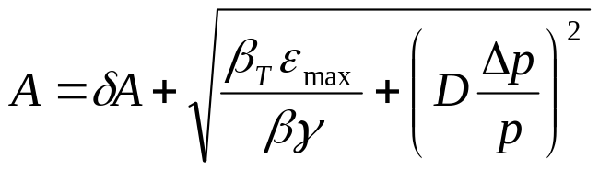
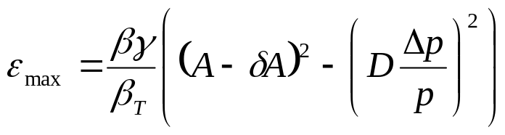
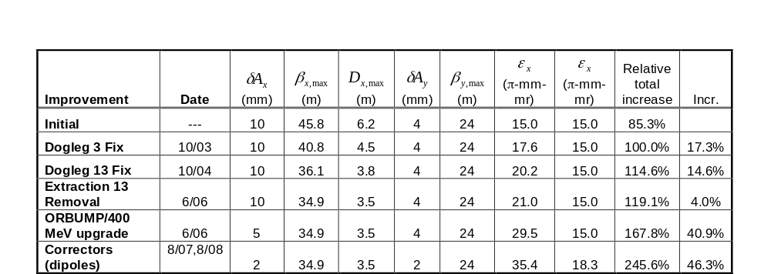
Evaluate Effect of Booster Improvements
Calculate effect of various improvements based on increased acceptance:
Use:
Effective aperture
reduction

Slide 9
Additional Effects
Increased transmission with Long 13 is removed
  3%
  Probably conservative
Effect of sparse sextupole correctors on emmittance
  ~10%
  Does not yet include significantly improved harmonic corrections
Effect of Linac Low Level RF
  ~5% improvement on average beam intensity

Slide 10
Estimating Booster Output
History has shown that the lab tends to overestimate the benefits of particular improvements.
  Tuning and optimization take a long time
  Tend to asymptotically approach the goal, then get distracted by other things.
So we…
  Evaluate the potential of particular improvements based on effective aperture increase or uncontrolled beam loss reduction:
    For example, if something reduces uncontrolled loss by 10%, it has the potential to allow us to send 10% more beam.
  Consider the following scenarios:
    “Design”: After one year of tuning, we realize half of the potential benefit.
    “Fallback”: After one year of tuning, we realize one quarter of the potential benefit.

Slide 11
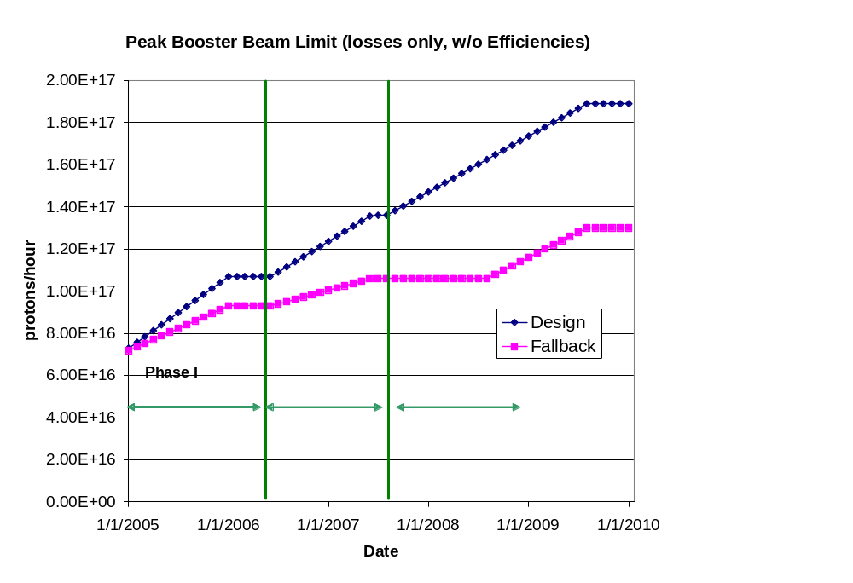
Peak Booster Intensities
These are “peak” numbers
An “average to peak” correction is applied to get average values
These are the numbers from loss limits
The real peak value will be limited by the 9Hz rep rate at about 1E17, depending on batch size.

Slide 12
Design and Base
NuMI
  Design
    Booster delivering nominal batch intensities
    Slip stacking implemented in a few months after the 2007 shutdown
  Base
    Booster batches slightly less
    No slip stacking
MiniBooNE
  Design
    NuMI running at “design”
    Booster achieves nominal throughput
  Base
    NuMI running at “design”, BUT
    Booster throughput at fallback level
    NuMI continues to have priority
Note, there are many other scenarios and operational options which are to numerous to explicitly consider

Slide 13
Factors Considered in FY05, FY06 Projections
Linear ramp-up to see benefit of improvements
Slip stacking efficiency
  Done in a confusing way (more about this later)
Annual shutdowns (assume 2 mo/yr)
Uptimes: based on MiniBooNE 2004
Peak to average corrections
  For BNB, based on MiniBooNE 2004
  For NuMI, used reasonable guess
Effects of shot setup
Implemented as VB routines in Excel spreadsheet
  Easy to modify

Slide 14
How are we doing so far?
Compare NuMI and MiniBooNE to FY05 and FY06 “blue and red” curves
  Approximately equal to Proton Plan projections shown at last review
General comments
  Booster peak intensities have not been quite as high as projected
  NuMI rate has been severely affected by unplanned down times
  MiniBooNE benefited significantly from these downtimes

Slide 15
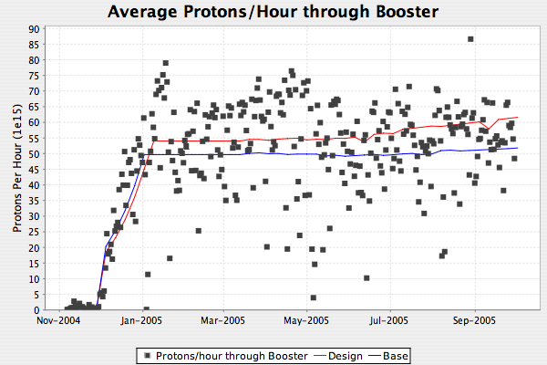
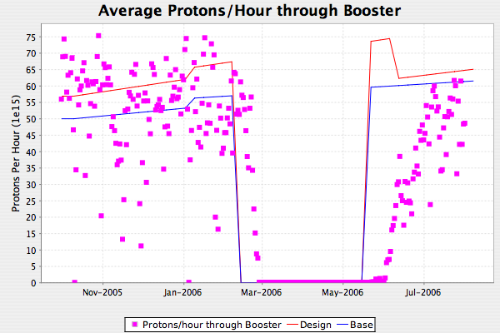
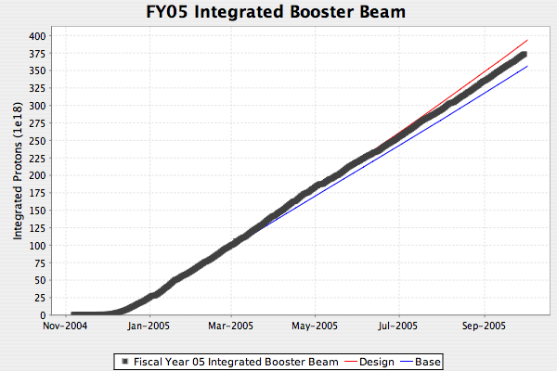
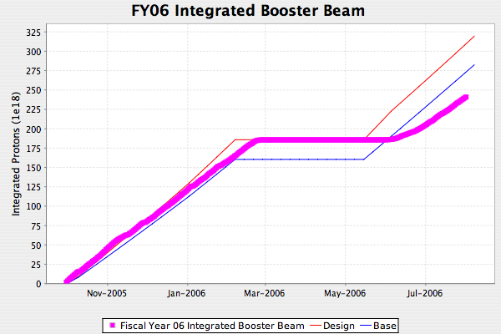
Total Protons Through Booster
Turn on slower than expected

Slide 16
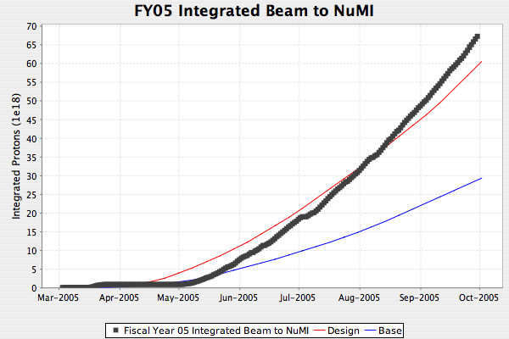
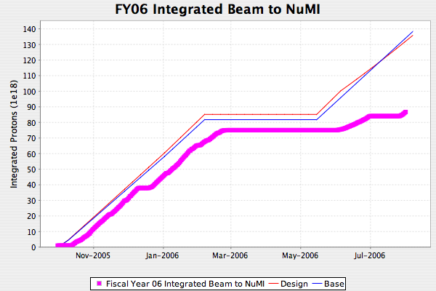
Protons to NuMI
NuMI Beam delivery significantly impacted by unforseen down times
Water in target
Resin beads in water system
Horn ground fault (loose foot)
Tritium in water
Special runs
Note: without slip stacking, NuMI rate set by 5 booster batch limit, so no way to get back to curve by end of FY

Slide 17
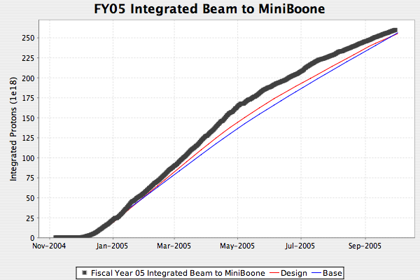
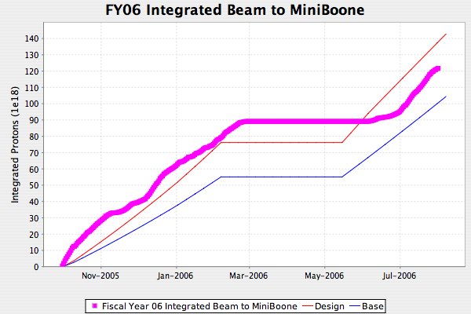
BNB (MiniBooNE)
Generally, NuMI’s problems have allowed MiniBooNE to stay on or close to the curve, although Booster throughput has not been quite what was projected

Slide 18
Revisions to Long Term Projections
Batch size
  Old scheme used one batch size with low “efficiency” for slip stacked batches
    Accurate but confusing
  New scheme has two explicit batch sizes
Slip stacking to NuMI
  Originally believed we could start slip stacking after the 2006 shutdown.
  Now believe slip stacking losses will necessitate collimators, which will not be installed until 2007 shutdown
Uptime
  Major factor in NuMI beam delivery
  Old scheme had only small variation between design and base (~81%)
  New scheme:
    NuMI “base” will be ~uptime from turn-on through shutdown (70%)
    BNB base will budget 1 unscheduled horn replacement every two years (78%)

Slide 19
Revisions (cont’d)
Post shutdown turn-on
  Historically tried to cover this by using a projection shutdown longer than actual shutdown
    Real shutdown always extended to same length
    Still looks bad
  New scheme:
    Post shutdown exponential ramp up with (τ ~2 weeks)
Cogging losses
  Old scheme did not account for the fact that cogged cycles (pbar and NuMI) lose more energy than uncogged cycles.
  Somewhat compensated by the old way we handled slip stacked batch sizes.
  Now include 20% increased energy loss for cogged cycles.

Slide 20
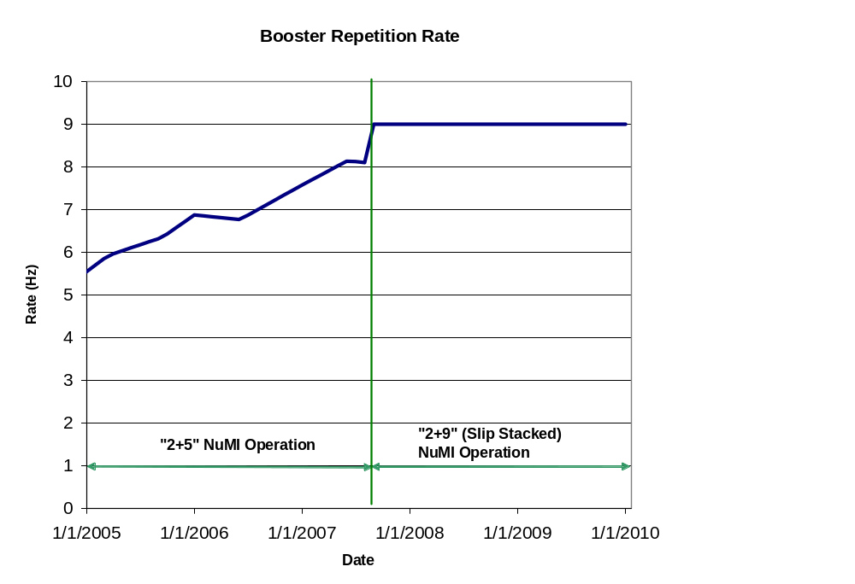
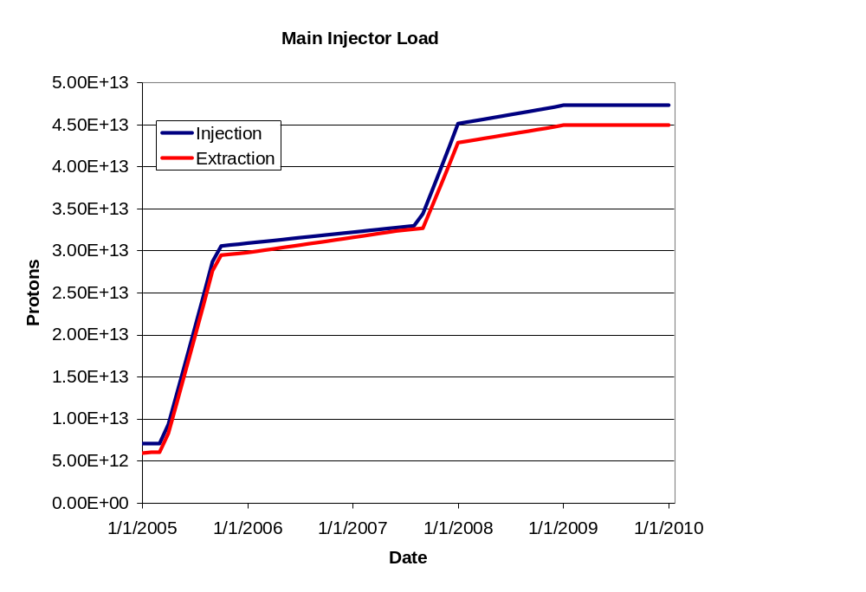
Machine Loading
Assumes model where slip stacking is implemented by going immediately to 2+9, but with reduced batch sizes to NuMI.
Ultimate goal (44 week year)
  NuMI: 3.2E20 p/yr
  BNB: 1.8E20 p/yr

Slide 21
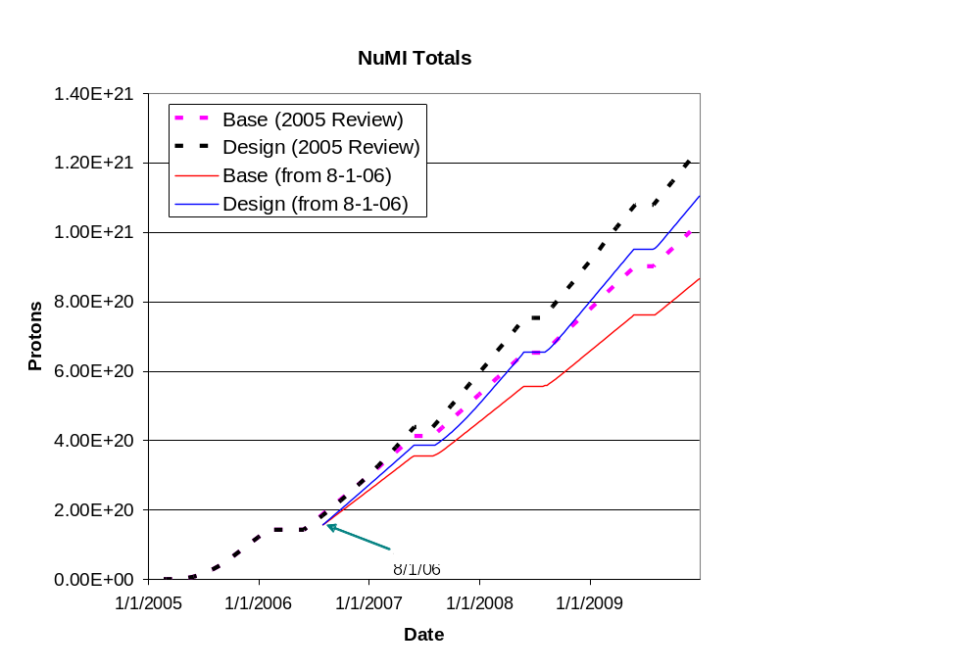
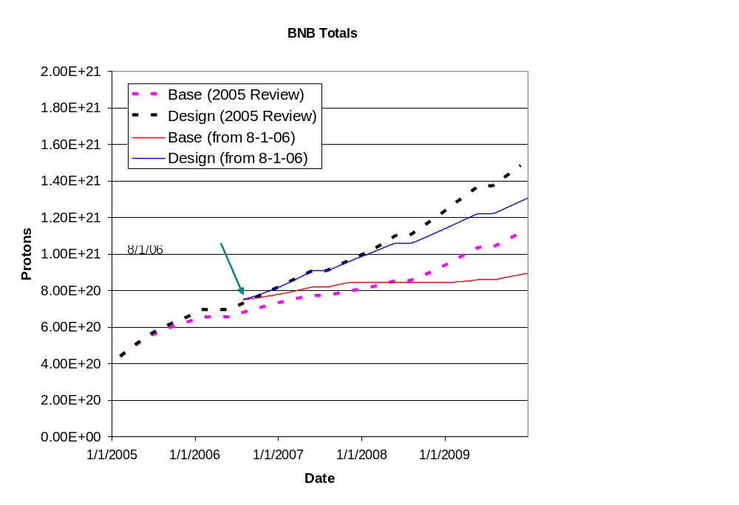
Cumulative Totals

Slide 22
Conclusions
We have attempted to meet the proton delivery goals put in place at the beginning of the proton plan
  Have done pretty well with respect to BNB
  NuMI did well the first FY, but has fallen a bit short this FY
    Plagued by unplanned down times
    Overly optimistic turn on after shutdown.
We are continuing to revise our projections for the future to provide experimenters with the most accurate information we possibly can.

