Slide 1
2006 Shutdown
Eric Prebys, FNAL Accelerator Division

Slide 2
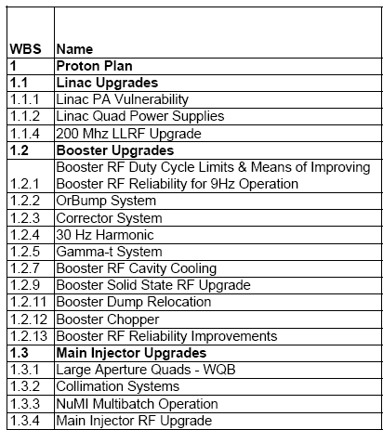
This shutdown was important!!!
= Task completed during shutdown
= Significant element completed during shutdown
= Non-shutdown task completed
= Task descoped
2006 shutdown

Slide 3
Major Shutdown Projects
Linac
  Used shutdown to make characterization measurements needed for LLRF project (1.1.4.1.1)
Booster
  New injection bump (ORBUMP) scheme installed and 400 MeV line reconfigured (1.2.2)
  RF cavity drift tube cooling completed (1.2.7)
  One of the two extraction regions removed from Booster and relocated to the MI-8 transfer line (1.2.11)
  New 13.8 kV tranformers and switch gear installed for Booster RF system (1.2.13.1)
  Significant non-Plan Booster projects:
    400 MeV line LVPS replacement
    Sump water rerouting
Main Injector
  Seven large aperture quad magnets installed to eliminated aperture restriction (1.3.1)
  Collimation system installed in MI-8 line (1.3.2.2)
  MI-10 kicker modified to allow rep. rate needed for slip stacked NuMI operation (1.3.3.2)

Slide 4
ORBUMP/400 MeV Line Project
Since the Run II project started, it was planned to replace the Booster Injection bump (ORBUMP) magnets
  Original magnets not capable of average rep. rates > 7.5Hz
  Not powerful enough to fully match beam at injection
Original plan for “drop in” replacements that were stronger and water cooled.
  Also required new pulsed power supply
During the project, Milorad Popovic proposed an idea to reconfigure injection line
  Good idea, but significantly complicated project

Slide 5
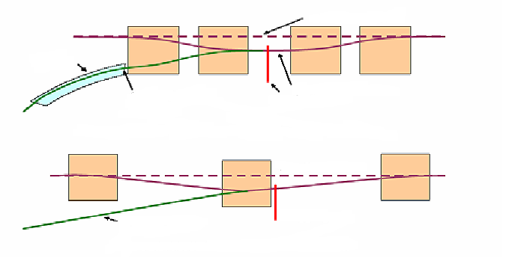
ORBMP/Injection
New Booster Injection - ORBMP Girder & PS
  A simplified 3 bump injection scheme
      Septum magnet not required
      Better lattice match
      Alignment of circulating beam with Injected beam
      Reduced edge focusing effects
      Total power cut in half
Circulating Beam
Septa
Injected Beam
Old Injection Girder
Foil
Circulating Beam
Injected Beam
Foil
New Injection Girder
Provided by Jim Lackey and Fernanda Garcia

Slide 6
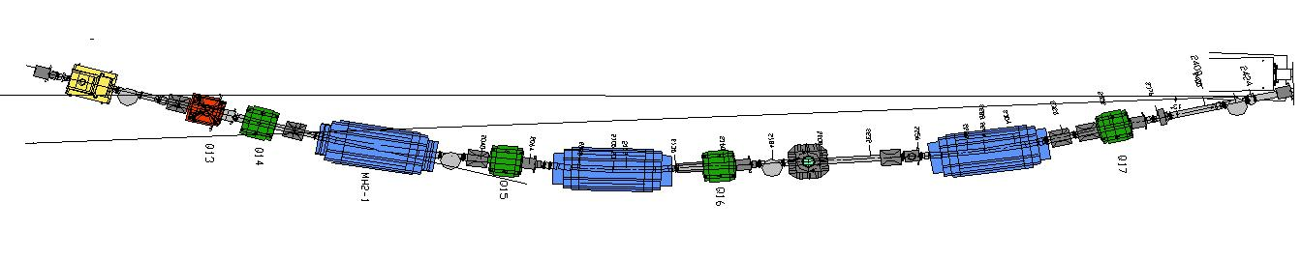
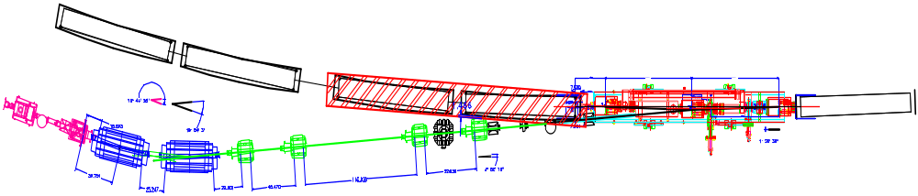
Injection Modifications
Old Scheme
New Scheme
ORBMP Girder
Booster
ORBMP MAGNETS
New 400 MeV Injection Layout
Provided by Jim Lackey and Fernanda Garcia

Slide 7
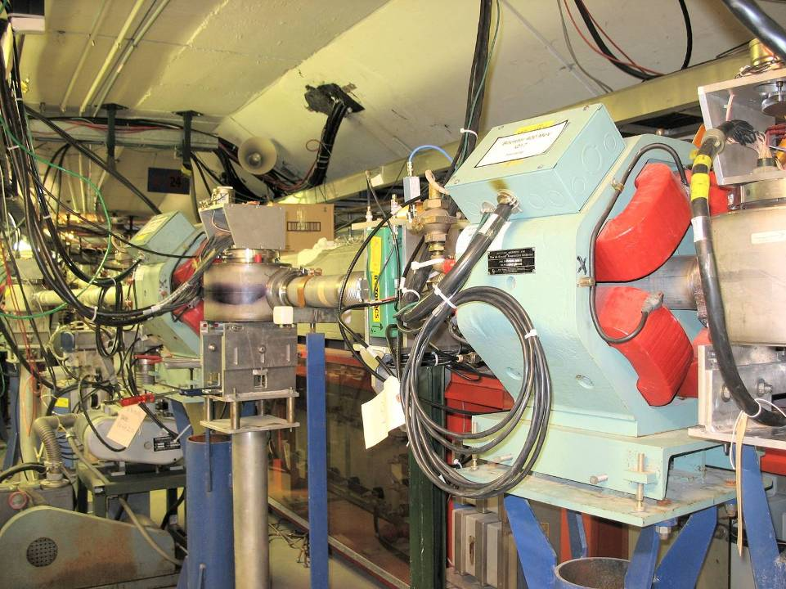
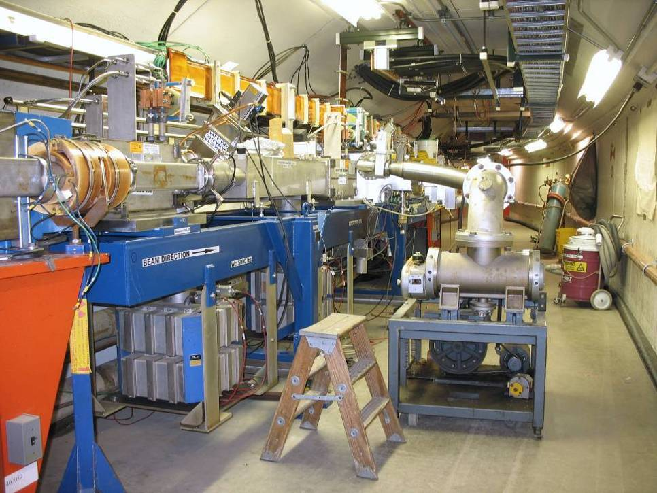
ORBUMP/400 MeV Project
Re-routed 400 MeV Line
Injection Girder

Slide 8
Booster Dump Relocation
For some time, the Booster had two extraction regions
  Long 13, which originally went to the Main Ring, was used for
    Test pulses
    The unused part of “short batches”
    The Radiation Damage Facility
  Long 3, which was installed at the beginning of the pBar program is now the primary extraction, which goes, via the MI-8 line, to
    The Main Injector
    MiniBooNE (BNB)
Problems
  The “doglegs”, which steer the beam around the extraction septa during acceleration, cause lattice distortions due to edge focusing effects
    Although these were significantly ameliorated during previous shutdowns, they were still non-zero
  Steering the beam around both extraction regions during accleration proved problematic.
    Significant beam loss seen at the Long 13 regions
  The aperture restriction at Long 13 complicated the operation of the collimation system

Slide 9
Dump Relocation (cont’d)
For these reasons, it was decided to remove the Long 13 extraction region, and install an equivalent extraction in the MI-8 line.
  The only capability that has been lost is the RDF, which was virtually never used, and has been at least partially replaced by the Switchyard 120 program.
Project required little fabrication
  Spare septum
  Spare kickers
  Existing power supplies relocated
  Dump originally used for MI-8 and BNB commissioning

Slide 10
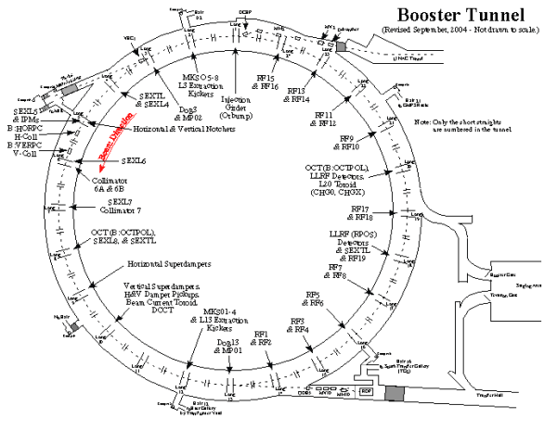
Booster Dump Relocation
Left alone
L3 Extraction to MI
L13 Extraction Dump
relocated to the MI-8 transfer line

Slide 11
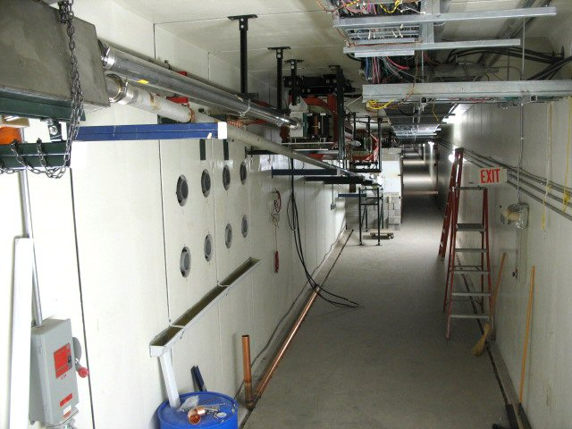
MI-8 Dump Line
Relocated Septum
Dump
New Dump Line

Slide 12
MI-8 Collimation
First turn beam loss in the Main Injector is a significant issue that will get worse as we begin to slip stack
At least part of the problem comes from tails coming out of Booster (possibly due to field issues in the extraction septum).
For this reason, a collimation system was designed and installed over the shutdown

Slide 13
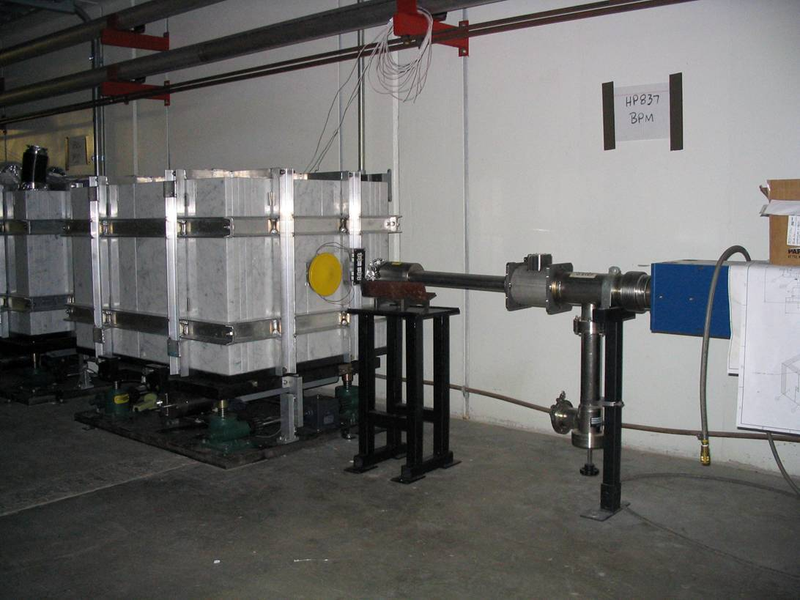
MI-8 Collimator
Note marble cladding

Slide 14
Main Injector Large Aperture Quads
Seven quads in the Main Injector, in conjunction with nearby Lambertsons, resulted in aperture restrictions.
These produced hot spots when NuMI began to ramp up.
Luckily, the problem was recognized some time ago, and production of large aperture quads (WQB’s) was begun even before the Proton Plan
These were installed during the shutdown.

Slide 15
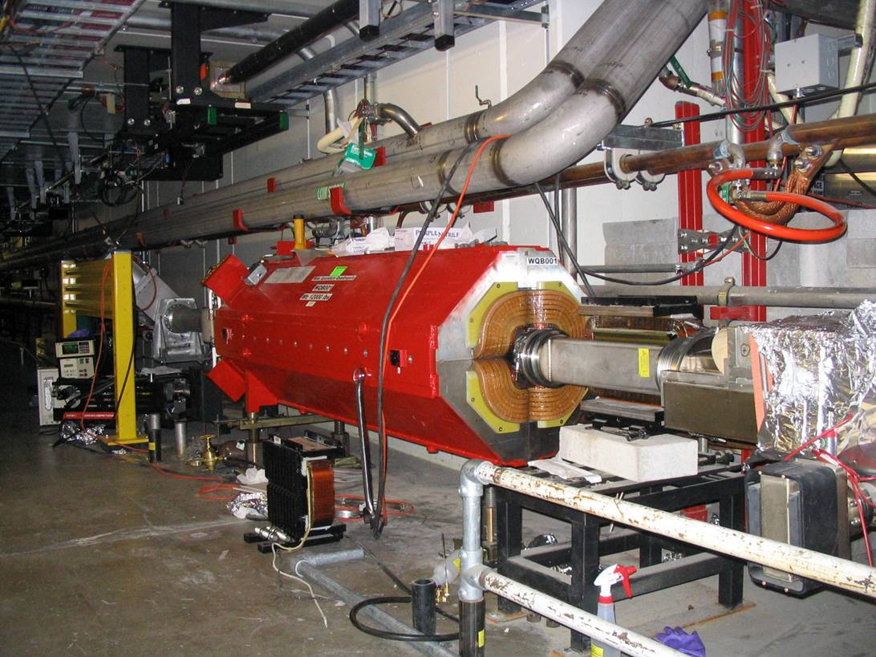
Main injector large aperture quads (7)

Slide 16
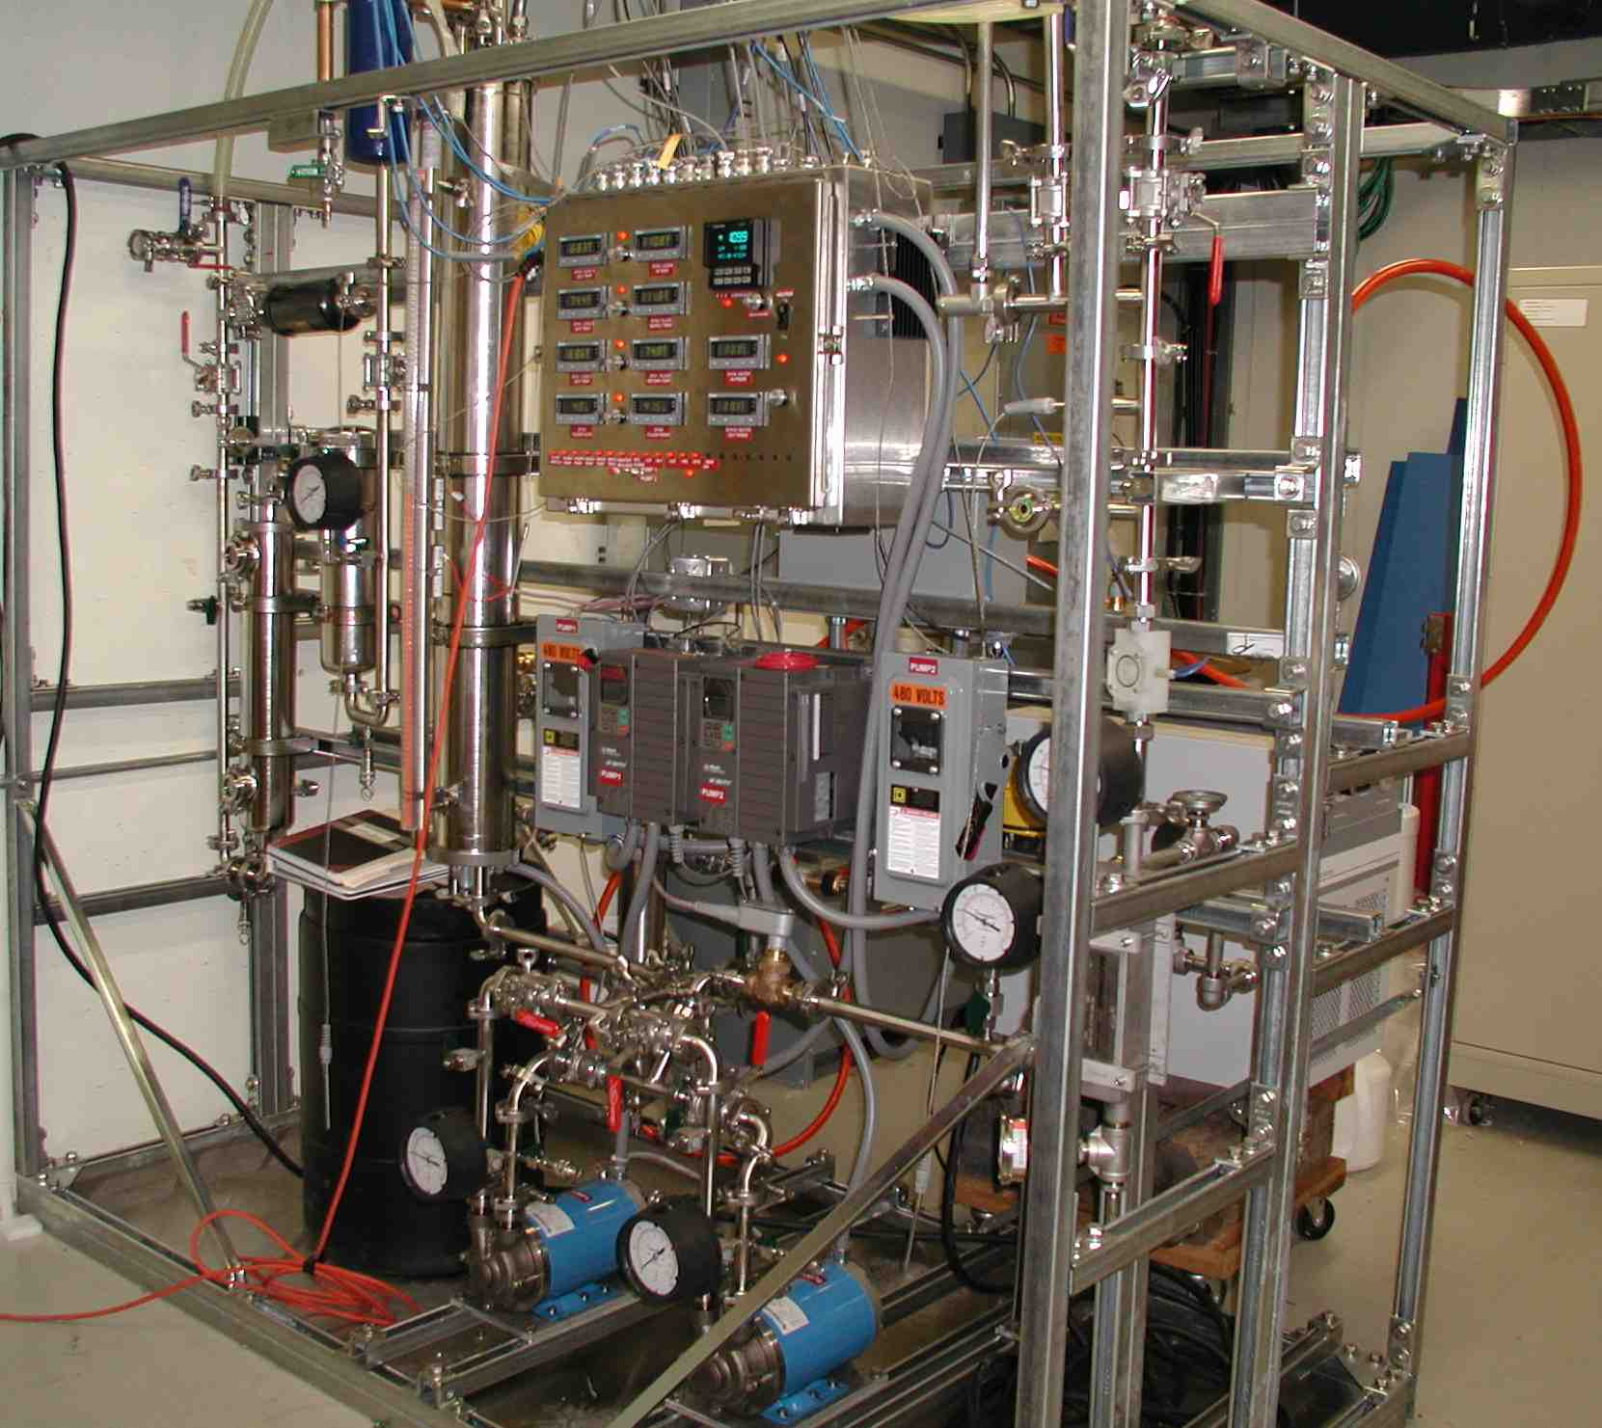
MI-10 Kicker
Until this shutdown, the MI-10 injection kicker was not capable of extended operation at the average rep. rate needed for full slip stacked NuMI operation.
A new cooled load and associated cooling skid were installed during the shutdown.

Slide 17
Shutdown Planning and Coordination
These were BIG projects
  For the Booster, this was the biggest project since the
  200->400 MeV upgrade
Required lots of coordination of resources
  Much work went into schedule planning between L2,L3 managers and support departments
  As always, worker safety was our top concern!!
  Appointed overall shutdown coordinator (Rich Andrews)
    Responsible for overall schedule
    Held daily 7:00 AM meetings of all working groups
  Also appointed “floor manager” (Todd Sullivan)
    Responsible for monitoring daily activity
    Watched for safety, conflicts, etc
    Provided important feedback for daily meeting
Ran like clockwork
  All projects were completed on schedule
  We stayed within our contingency budget
  One reportable injury
    Improperly mounted beam pipe cutter, resulted in sutures
    Word went out, and situation was rectified.

Slide 18
Quality Control
These projects involved a great deal of reconfiguration of beam lines
  i.e. disconnecting and reconnecting things
In addition, LVPS’s in the 400 MeV line were replaced at this time.
Lots of opportunity for wiring mistakes!!
Polarity check teams checked and double-checked all wiring

Slide 19
Startup Summary
Booster (note, we worked around significant daytime tunnel work):
  Friday 5/12, 19:00
    First attempt to send beam to Booster
  Sunday 5/14, 02:00
    DC Beam
  Tuesday 5/16, 19:00
    Beam accelrated and extracted
  Wednesday 5/17, 15:00
    Beam to MI-8 line and new dump
    19:00 - First attempt at 400 MeV beam
Main Injector
  Monday 5/22, 16:30
    Beam circulates in Main Injector on first shot
  Tuesday 5/23, 14:00
    Beam to 120 GeV
  Wednesday 5/24, 22:00
    Beam to 150 GeV

Slide 20
Startup Problems
The quality control paid off. Mistakes were kept to a minimum
Problems found
  Miscalculation of required MI-8 dump septum strength (forgot to account for quad between septum and dump)
  One miswired magnet shunt in MI-8 line
  Small regulation problem with new quads in Main Injector.
That’s about it.

Slide 21
Effect of Shutdown work
ORBUMP
  New injection scheme works well
  Injection orbit slewing reduced from ~1cm to about 2mm
  Removed rate issue
Booster dump relocation
  New dump works fine
  Now able to maintain a more stable orbit during acceleration in Booster
MI-8 collimation
  Not yet commissioned
Main Injector Large Aperture Quads
  Significantly increased aperture (see Kourbanis’ talk)
MI-10 kicker
  Now capable of full slip stacked operation
  Better pulse quality

Slide 22
Where we stand
Booster should now be capable of extended running at an average rep. rate of 9Hz, as required by the proton plan.
The aperture improvements in the Booster should allow us to significantly increase our total beam throughput.
The MI-10 kicker improvements and MI-8 collimation should allow us to at least test full “2+9” NuMI operation.
More about what remains to be done in the system talks…

