Slide 1
Proton Plan
Summary
Director’s Review
August 2006
Eric Prebys

Slide 2
Year in Review
Plan Development
  Plan officially baselined in 9/05
  Change control and monthly PMG’s
  No significant remaining scope uncertainties
    Remember, plan started with ~$12M uncertainty and lots of “placeholders”
Linac
  Twelve strategic spares delivered as recommended
    Together with ordinary spares, will allow for 2-3 years of operation, if supply interrupted.
    Would have seemed unbelievable just a few years ago
    Based on the success of this effort, the Thales test facility was DESCOPED
  Significant modeling of LEL LLRF
    Prep for LLRF upgrade
  Quad control card supply replacement under way

Slide 3
Year in Review (cont’d)
Booster
  Major shutdown projects completed
    ORBUMP/400 MeV Line
    Booster Dump Relocation
  Corrector project well under way
    Prototype being tested
    Installation plan being finalized
    On track for power supply decision
  RF upgrades to 9Hz
    Linac drift tube cooling
    13.8 kV transformer replacement
  Some important descoping
    After literally decades of discussion, a detailed study showed conclusively that the 30 Hz harmonic upgrade was not justified
    The solid state RF upgrade was moved to an operational maintenance project under the control of the RF Department

Slide 4
Year in Review (cont’d)
Main Injector
  Significant shutdown projects
    Large aperture quads
    Upgraded MI-10 kicker
    MI-8 collimation
  Lots of progress on beam stability and RF issues
  Conceptual MI collimation complete and reviewed
    Involved impressive modeling effort, both of the beam and of the collimation
  Slip stacking studies
    Demonstrated 2+9 operation at low intensities
Proton Study
  Final report submitted to Director
  Has now evolved into the SNuMI project

Slide 5
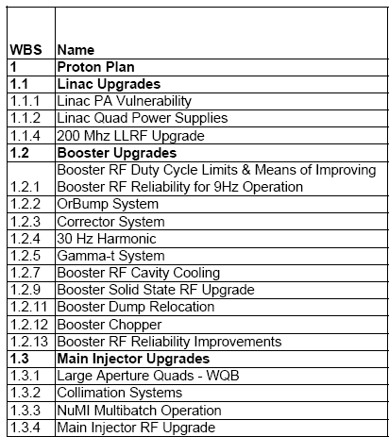
Summary at a Glance
= Task completed during shutdown
= Significant element completed during shutdown
= Non-shutdown task completed
= Task descoped
New 13.8 kV transformers and switch gear for Booster RF
MI-8 Collimation Complete
MI-10 kicker upgrade

Slide 6
Where we stand
A significant part of the Proton Plan was completed (or descoped) by the end of the recent shutdown.
  The shutdown itself was a major success
  Booster should now operate at the 9Hz required by the Plan
  The improvements which are in place should allow us to increase total delivered beam dramatically
  The Main Injector can now at least begin to test full slip stacking.
Dramatic increase in model and our physical understanding.
  Linac LLRF
  Booster gamma-t/30 Hz
  Main Injector ring collimation
  Main injector beam and RF effects.
The biggest remaining tasks are:
  Linac LLRF (1.1.4)
  Booster Corrector System (1.2.3)
  Main Injector Ring Collimation (1.3.2.1.3)
  Main Injector RF Upgrade (1.3.4)

Slide 7
Acknowledgements
Thanks to everyone who has worked hard on the Proton Plan and who has worked to prepare for this review.
Thanks to both this committee and last year’s committee for their time and useful feedback.

