Slide 1
Proton Plan Status
March Report
Eric Prebys
Jeff Sims

Slide 2
Agenda
Operations Report – E. Prebys
Technical Progress – E. Prebys
NuMI Target Status – D. Bogert
Project Status and Cost Report – J. Sims

Slide 3
Operations Report

Slide 4
Proton Delivery
In light of the NuMI target failure, it’s not meaningful to analyze separate NuMI and BNB progress separately.
After summarizing initial NuMI performance, we will concentrate on total proton delivery:
  Hourly rates: compare actual total rate to pbar+BNB+NuMI projections.
  Integrated total: compare MiniBooNE actual to BNB+NuMI projections.
Except for shutdown dates, these have not changed for 2005 since the November document.

Slide 5
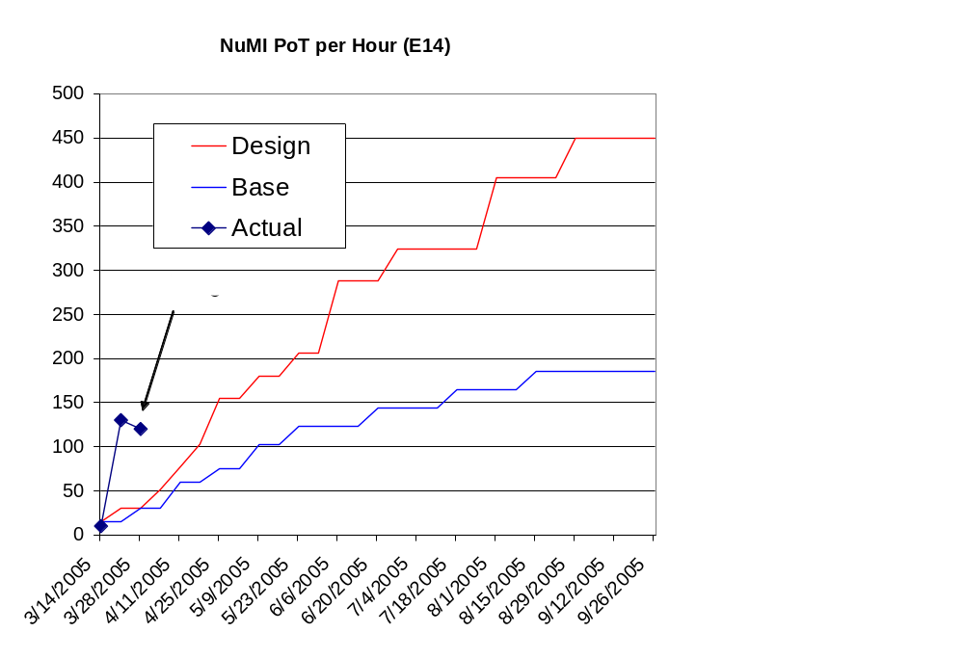
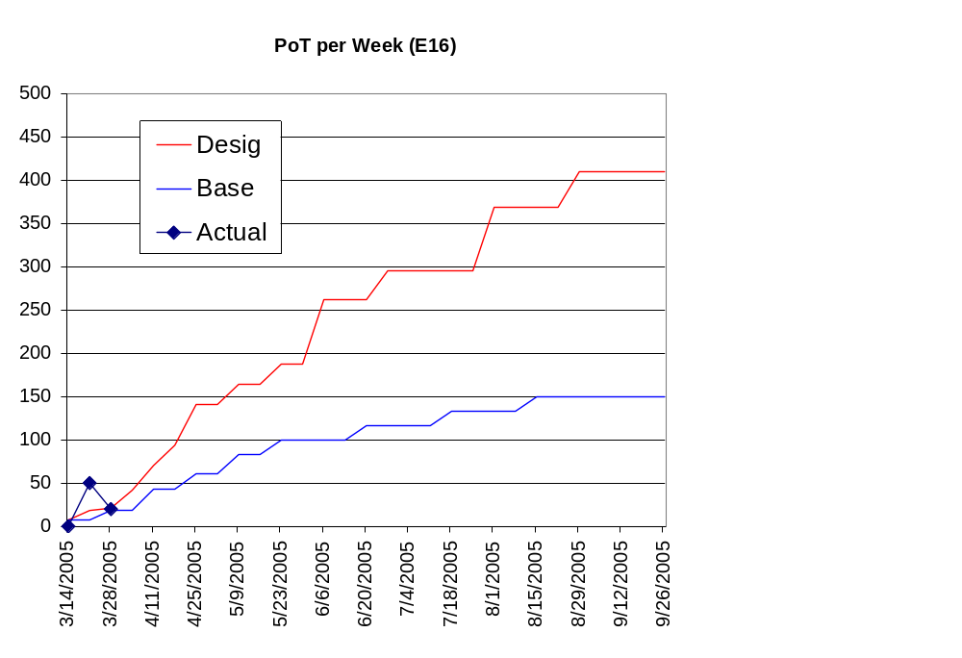
Initial NuMI Progress

Slide 6
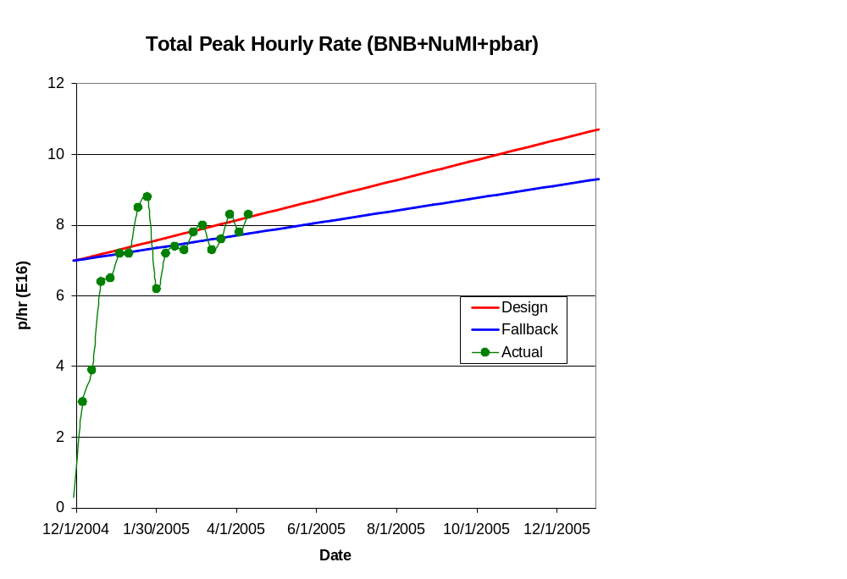
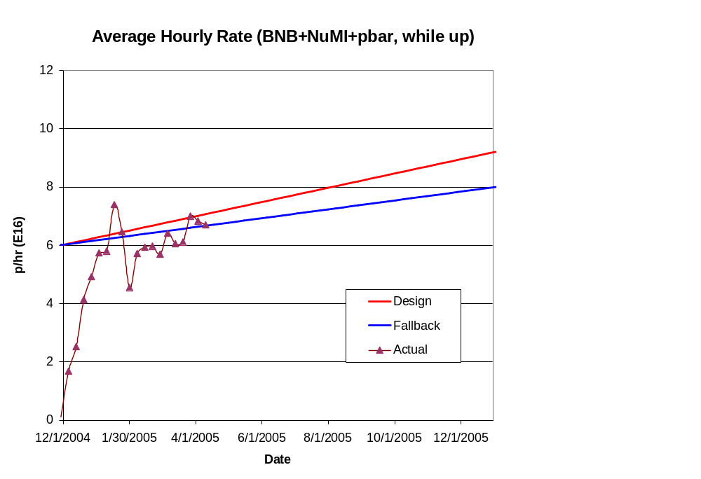
Hourly Proton Rate

Slide 7
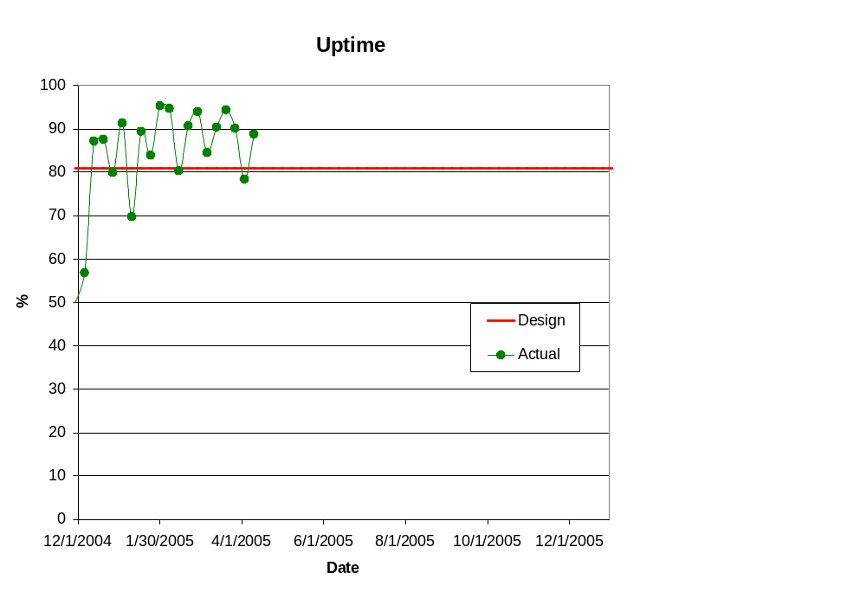
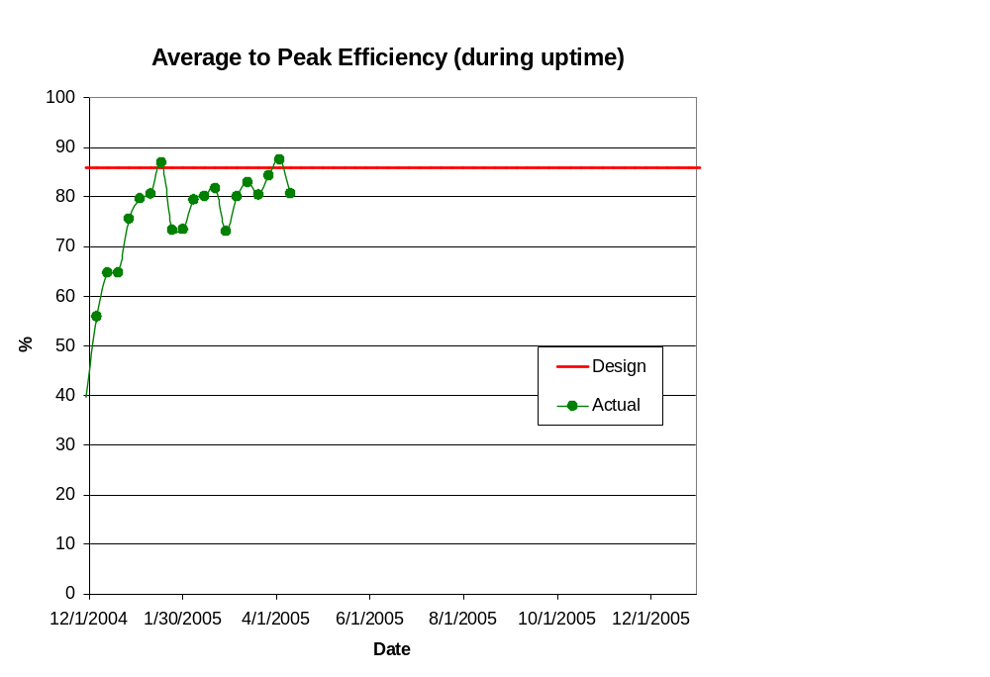
Efficiencies

Slide 8
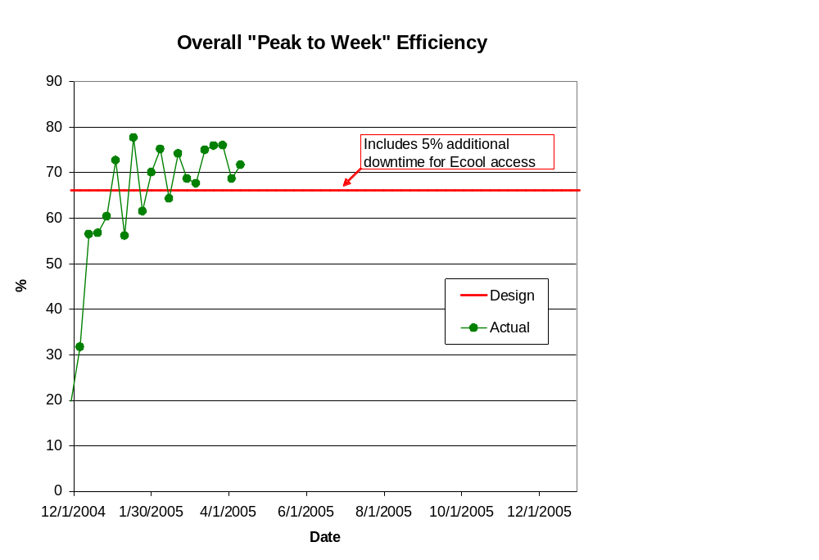
Overall “Peak to Week” Efficiency

Slide 9
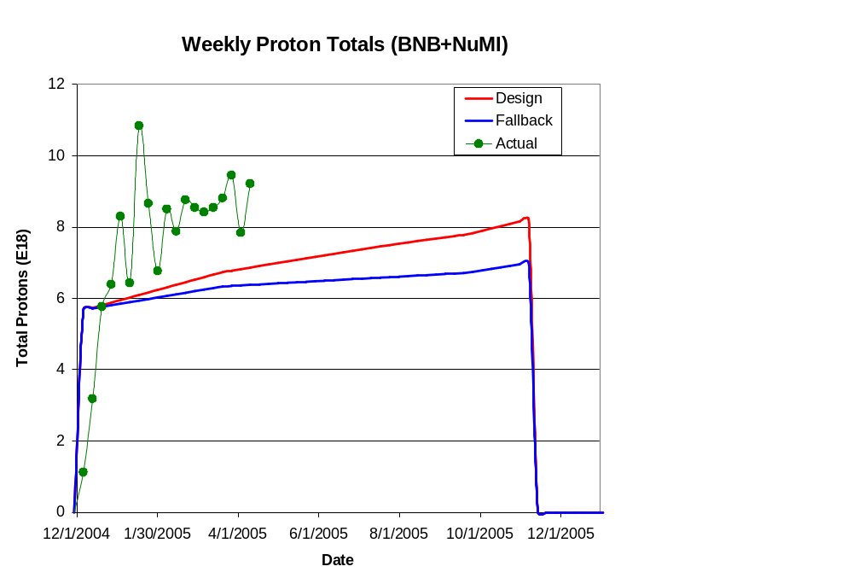
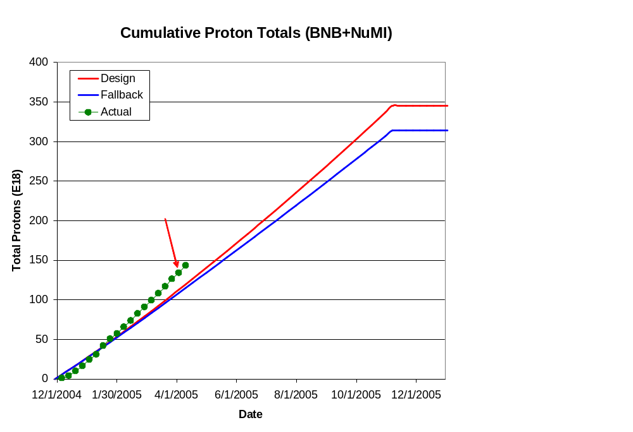
Integrated Delivery (BNB)

Slide 10
Technical Progress

Slide 11
Scope Changes
Criteria to be in plan (one of following):
  Critical path to plan goals.
  Expensive (>$200K)
  Requires significant coordination across departments
Descoped:
  Instrumentation upgrades
  Booster solid state RF
Added (proposed):
  Booster dump relocation
  New booster notcher
  Main Injector injection kicker mods
  Pbar extraction kicker mods
  Stage II working group

Slide 12
Progress
Baseline plan
  The majority of scheduled tasks have been assigned dates and populated with resources based on information provided by level 3 managers.
Technical Progress
  Linac
  1.01.01 PA Vulnerability –
    AD Effort - 7835 tubes have been ordered
    Sale of Burle – discussed shortly
  1.01.02 Quad PS –
    Proceeding with 300 A prototype test and specifications
  1.01.03 Instrumentation – (descoped)
  Booster
  1.02.01 Determine Rep Rate Limit –
    Ducar beginning to investigatge
  1.02.02 Orbump –
    TD Effort - First Magnet is complete. 15% complete with the assembly of the remaining magnets (costs collected in Run II)
    AD Effort - Power supply specification and simulations are complete. Procurement is now underway.

Slide 13
Progress
  Booster
  1.02.03 Correctors –
    TD Effort – Design and Early Procurements are beginning.
  1.02.04 30 Hz Harmonic –
    Procurement proceeding for prototype test
  1.02.05 Gamma T –
    Studies continue
  1.02.06 Alignment Improvements –
    Put BPM offsets into databse
  1.02.07 Drift Tube Cooling – (no significant progress)
  1.02.08 Cavity #20 – (no significant progress)
  1.02.09 SS RF PA’s – Descoped
  1.02.10 Instrumentation Upgrade - Descoped
  1.02.11 Booster Dump Relocation – NEW SCOPE
    Discussed shortly
  1.02.12 Booster Chopper - NEW SCOPE
    Working on specifications

Slide 14
Progress
  Main Injector
  1.03.01 Large Aperture Quads –
    TD Effort – Design and Procurement are nearly complete. Fabrication of the first unit is 30% complete.
  1.03.02 Collimation –
    AD Effort - Beam loss studies in MI and MI-8 are ongoing. Residual Radiation measurements and simulations will begin soon.
  1.03.03 NuMI MultiBatch Operations –
    Barrier Bucket Procurement , Mixed Mode Operations
    NEW SCOPE- Injection Kicker Replacement, Extraction Kicker Modifications
  1.03.04 RF Upgrade –
    Discussed shortly
Studies
  1.05 Proton Study Group–
    NEW SCOPE – Discussed shortly

Slide 15
Burle Status
Burle has been sold:
  Buyer still confidential, but “foreign”, so must be approved by the government
  Rumored to “sort of” have “something to do” with “tubes” already
    might mean test tubes, tube socks, tube tops, etc.
  Must continue to support coaxitron for the Navy until ~2020
  In light of that, it is claimed that we are still profitable.
Current delivery schedule (21 total):
  APR-05: 1
  MAY-05: 3
  JUN-05: 3
  JUL-05: 2
  AUG-05: 0
  SEP-05: 2
  OCT-05: 2
  NOV-05: 2
  DEC-05: 2
  JAN-06: 2
  FEB-06: 2
Standard order (mostly rebuilds)
Proton Plan order
(all new)

Slide 16
NEW SCOPE - Long 13 Relocation (1.02.11)
Even after the lattice improvements of recent years ( “dogleg fix”), the original extraction at Long 13 remains a major source of loss in the Booster.
This extraction region is needed for
  Short batches
  Study cycles
  RDF
It is relatively straightforward and inexpensive (few hundred K$) to move this dump to the MI-8 line.
  Move kickers from Long 12
  Install spare extraction septum
  Move power supplies
  Use MiniBooNE test dump
Loses RDF, but SY120 a better option for radiation studies.
Working on detailed plan.
Will do it in the 2005 shutdown.

Slide 17
Main Injector RF (1.03.04)
The Main Injector Upgrade path remains the single largest uncertainty in the Proton Plan
  Might be possible to reach intensities of the current Plan without upgrades of any kind.
Towards a decision
  Proceed with two/PA prototype
  Proceed with systematic studies in the Main Injector
  Organize a workshop this summer
    Will consider the following
      Potential of feed forward system
      Potential and concerns with two PA solution
      New RF system proposals.
    Will coordinate needs of current plan, Stage II Plan, and Proton Driver
    Generate a perfomance/price table
  Goal: reach a decision for Stage I by end of FY05

Slide 18
NEW SCOPE - Proton Plan Stage II (1.05)
In the wake of the BTeV cancellation, a committee formed to study options for maximizing proton delivery after the end of the collider program (~2009):
  Mike Syphers (chair)
  Paul Derwent
  Jim Hylen
  Sergei Nagaitsev
  Ralph Pasquinelli
  Eric Prebys
Committee has met several times and is actively soliciting ideas from any interested parties.
Report to Division Head June 1, 2005.
NOTE: The actual implementation of the recommendations of this commitee is beyond the scope of the present plan.

