Slide 1
Proton Plan
Cost and Schedule Status
March 2005
Eric Prebys
Jeff Sims

Slide 2
Proton Plan Development Progress
This is a “Work in Progress”
The intent of the following is to present that we have developed the plan sufficiently to begin understanding the resources and timeframe required to meet the Proton Plan goals.
We are working toward a baseline resource loaded schedule. Our goal is to present the nearly baselined version at the next PMG.
A Director’s review will be organized as soon as we are ready for baseline. Note that MIRF and MI Collimators may not be fully developed at that time.
For reference there are ~290 lines in the current Proton Plan schedule.

Slide 3
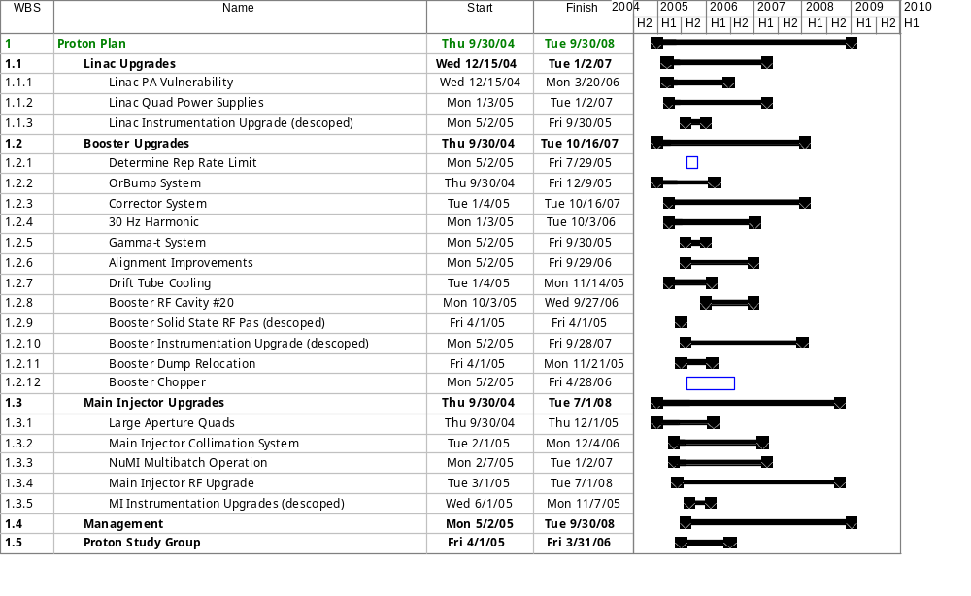
Proton Plan Schedule - Level 3 Summary
PP Inception 10/1/05

Slide 4
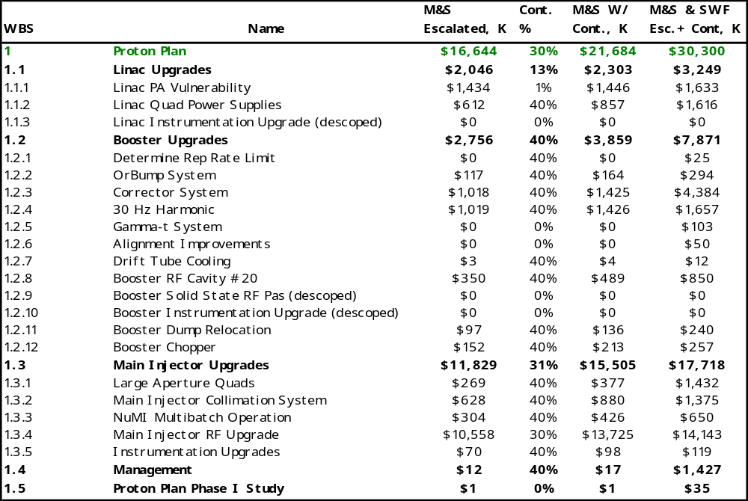
Proton Plan Costs - Level 3 Summary
Estimate
Type
Bottom Up
Bottom Up
Top Down
Bottom Up
*
Bottom Up
AIP Candidate FY05
Bottom Up
AIP Candidate FY06
Bottom Up
Top Down
Bottom Up
Bottom Up
Top Down
Top Down
Bottom Up
Top Down
AIP Candidate FY06
Top Down
Bottom Up
MIE Candidate FY07
Bottom Up
* Orbump Magnet costs are collected in Run II

Slide 5
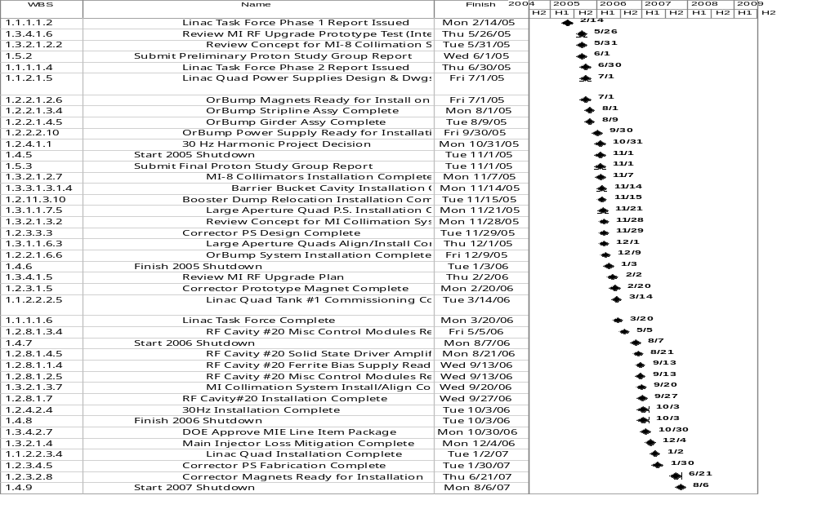

All Milestones

Slide 6
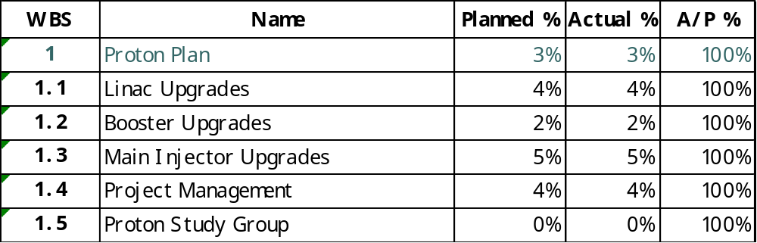
Progress as of March 31, ‘05

Slide 7
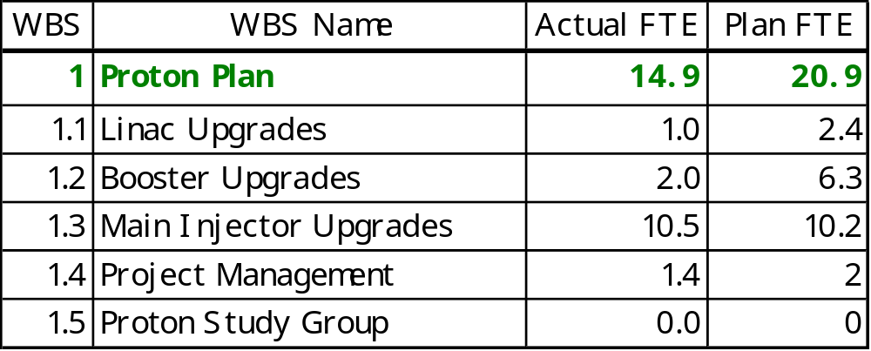
Effort for March ‘05
*
*
*Likely not reporting to new cost codes….Project Management will review monthly Division effort reports and work with level 3 managers to ensure everyone charges to the proper Proton Plan tasks

Slide 8
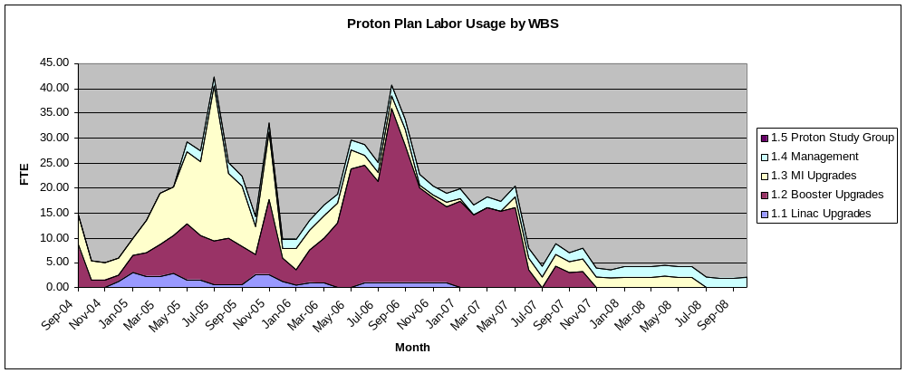
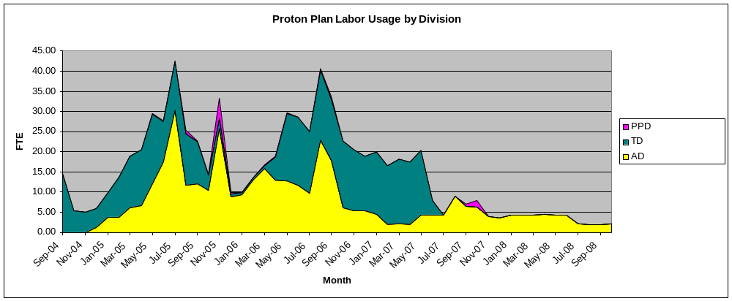
Proton Plan SWF Planned Usage
FY05
FY06
FY07
FY08

Slide 9
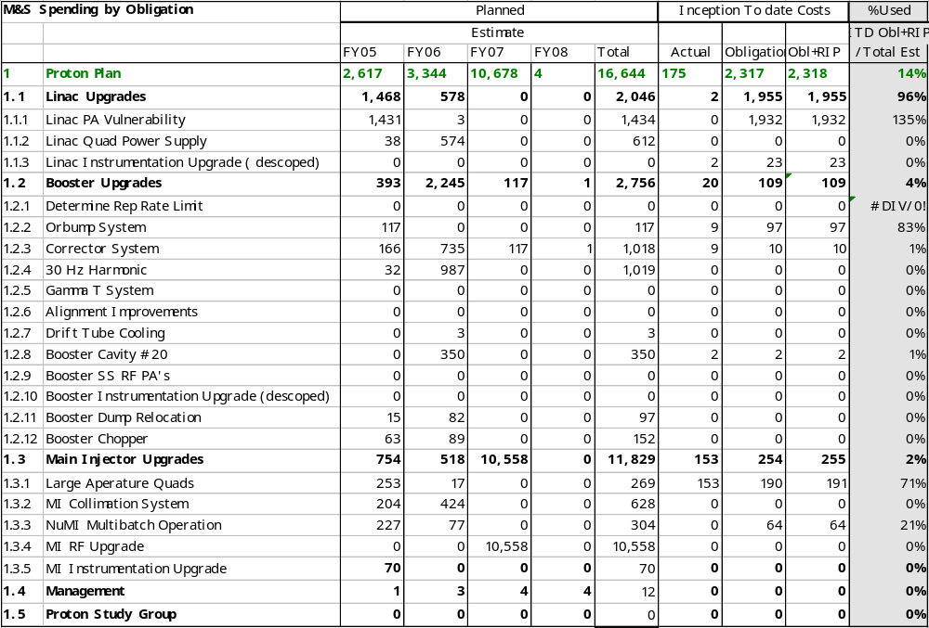
M&S Spending– Direct, No Contingency
7835 Tubes*
In $K
* 500K will be covered by Run II

Slide 10
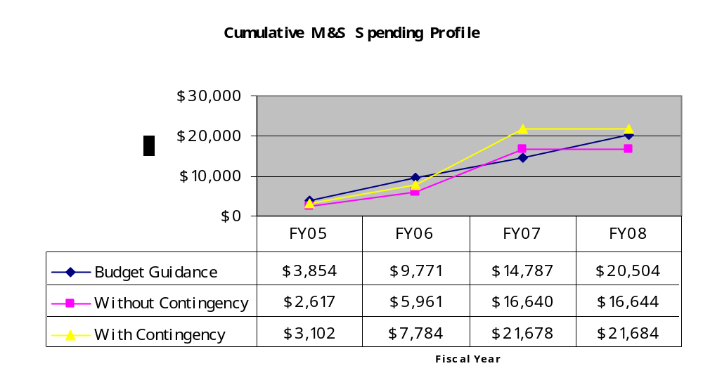
M&S Spending Profile
MI RF Upgrade
Plan exceeds initial guidance by $1million

Slide 11
M&S Estimate Increases/New Scope
Why are we currently exceeding the initial budget guidance of $20.5 million by $1.1 million?
  Estimates have increased from the January PP estimates in the following areas:
    Booster Correctors up by $400k in M&S
    MI Collimators up by $400k in M&S
  New Scope
    MI Injection and Extraction Kicker Modifications adds $227k of M&S
    Booster Chopper Adds $150k of M&S
    Booster Dump Relocation Adds $100k of M&S

Slide 12
Status Summary
Upcoming Project Management effort for the Proton Plan :
  Schedule
    Continue to improve estimates of top down sections with input from Level 3 managers.
    Compile estimate back up information within the plan via hyperlinks.
    Prioritize the scope of the current Proton Plan. We want to be prepared to identify the lower priority areas in case additional descoping is necessary to stay within the initial budget guidance.
    Review and revise contingency to more accurately reflect the current level of estimate for each section based on the level 3 managers input.
    We will have a near baseline plan with the above improvements at the next PMG.
  Reporting
    In the near future earned value and obligation reporting will be done via COBRA.
  MIE/AIP
    Develop Plant/Line Item projects within the Proton Plan as requested by the Division Head and Directorate… Project Execution Plan, Davis Bacon Justification, Etc.

