Slide 1
Proton RF Issues
 | MI Load | Booster Rate | Proton Rate | Annual Proton Totals
Scenario | (protons) | (Hz) | (p/hr) | pBar | NuMI | MiniBooNE
pBar+ baseline NuMI | 3.5E+13 | 4.0 | 6.3E+16 | 1.0E+20 | 2.5E+20 | 0.0E+00
pBar + baseline NuMI + limited MiniBooNE | 3.5E+13 | 7.5 | 1.3E+17 | 1.0E+20 | 2.5E+20 | 3.5E+20
pBar + baseline NuMI + full MiniBooNE | 3.5E+13 | 9.0 | 1.5E+17 | 1.0E+20 | 2.5E+20 | 5.0E+20
pBar + slipstacked NuMI | 5.5E+13 | 6.1 | 8.7E+16 | 8.8E+19 | 4.0E+20 | 0.0E+00
pBar + slipstacked NuMI + limited MiniBooNE | 5.5E+13 | 7.5 | 1.1E+17 | 8.8E+19 | 4.0E+20 | 1.3E+20
pBar + slipstacked NuMI + full MiniBooNE | 5.5E+13 | 11.2 | 1.8E+17 | 8.8E+19 | 4.0E+20 | 5.0E+20
Demonstrated Performance | 3.0E13 | 7.5Hz | 8.0E16 | -- | -- | --
By summer 05
By end 05

Slide 2
MI RF Power Calculation (courtesy W. Chou)
Cavity Q = 3000 (at max ramp rate), R/Q = 104 Ω, R = 3.1 x 10⁵ Ω
17 cavities, each delivering 175 kW (max 200 kW) for a total of 3.0 MW
Wall/tuner loss: V(gap) = 240 kV ⇒ P = 92 kW each, total of 1.57 MW for 17 cavities
Beam intensity: 3.3 x 10¹³, 4.0 x 10¹³ and 6.0 x 10¹³
Ramp rate (GeV/s) | Beam intensity | Power to the beam (MW) | Wall/tuner loss (MW) | Total power (MW)
240 | 3.3 x 10¹³ | 1.27 | 1.57 | 2.84 (o.k.)
240 | 4.0 x 10¹³ | 1.54 | 1.57 | 3.11
240 | 6.0 x 10¹³ | 2.30 | 1.57 | 3.87
280 | 3.3 x 10¹³ | 1.48 | 1.57 | 3.05
280 | 4.0 x 10¹³ | 1.79 | 1.57 | 3.36
280 | 6.0 x 10¹³ | 2.69 | 1.57 | 4.26
    Need second PA for either higher beam intensity or fast ramp!

Slide 3
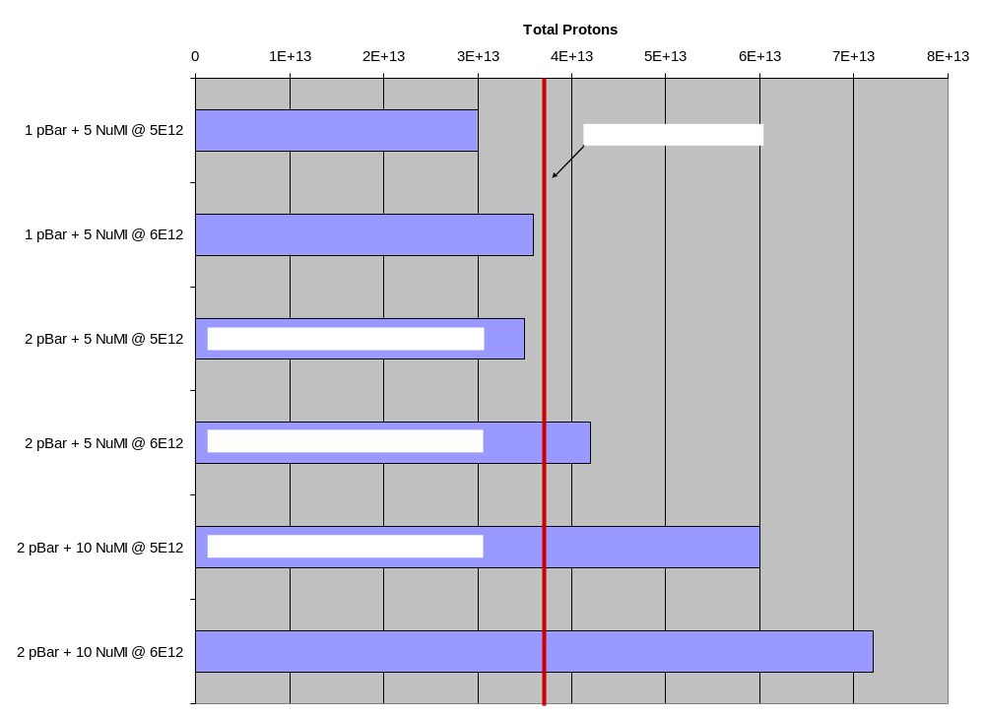
Main Injector RF Power Issues

Slide 4
Key Issues
Booster
  repetition rate limit with and without drift tube cooling.
  Scale of addressing main power issue (not answered here).
Main Injector
  Present RF limit
  Increasing this
  How quickly to spend large $$$

