Slide 1
Motivation for Booster RF Upgrade
To support the neutrino program at Fermilab (MiniBooNE, NUMI + ? ) , the Booster will have to deliver somewhere between 5 and 10 times the rate of protons that it can deliver now. If MiniBooNE and NUMI run together, peak demand will occur some time in 2005.
The total Booster intensity is limited by losses in the tunnel which already lead to disturbing levels of activation.
The existing RF cavities are problematic for two reasons
  They are a primary aperture restriction (2 ¼” vs. 3 ¼” beam pipe).
  They are fairly high maintenance, so their activation is a concern.
In order for this to happen in a timely manner, we must:
  Present it as a concrete plan to the Fermilab management.
  Get lots of support (and maybe even $$) from physics community and universities.

Slide 2
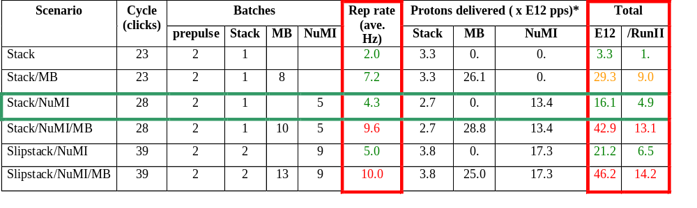
Summary of Proton Ecomomics
MiniBooNE baseline ≈ 5E20 p/year
Booster Hardware Issues
Radiation Issues
NUMI “baseline” = 13.4E12 pps x 2E7 s/year ≈ 2.7E20 p/year
Right now we’re at roughly 1/5 of the MiniBooNE baseline
*assuming 5E12 protons per batch

Slide 3
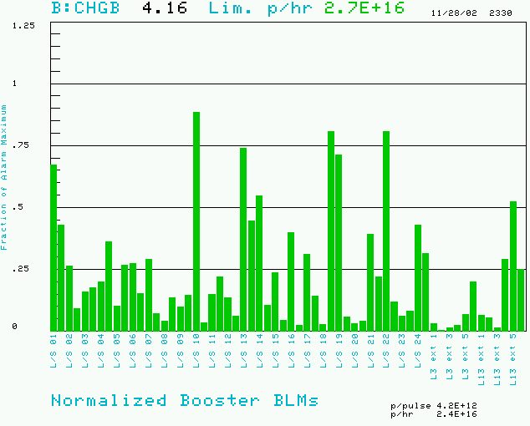
Booster Losses (Normalized to Trip Point)
BRF11: 200 mR/hr @ 1ft
BRF15: 300 mR/hr @ 1ft

Slide 4
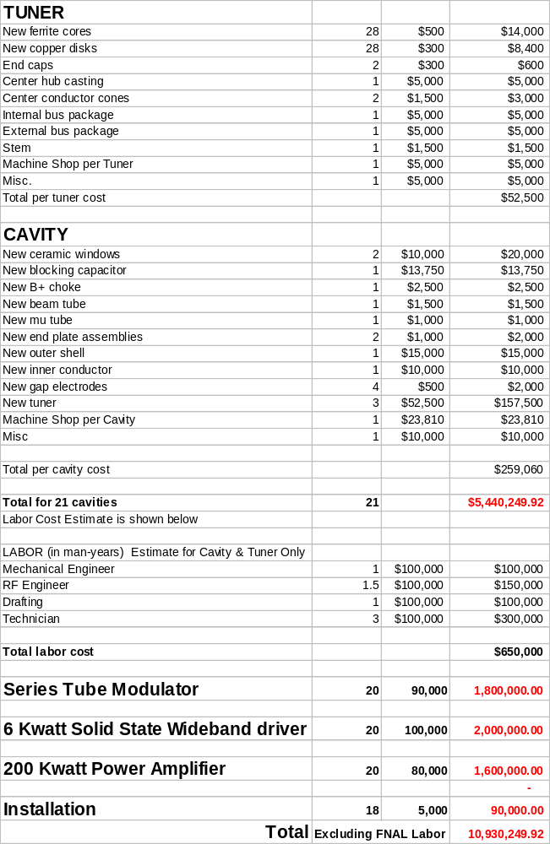
Upgrade Cost Estimate
Summary:
~$260K per cavity, of which $160K goes for the three tuners.
A roughly equal amount for the power supply chain.
About 20 cavities.
-> $11M total

Slide 5
Questions to Answer
Accuracy of the Cost Estimate?
Status:
  First prototype
  Vacuum prototype
  Design
Reasonable timeline.
Ways to save money:
  Use old tuners?
  Use existing power supplies?
Ways in which universities can help:
  Political pressure
  Money
  Fabrication

Slide 6
Some Issues
What is the best stacking procedure? Three in parallel or one at a time?
How much manpower and time will we need?
What are the radiation budget implications? Fields near the collimators are 5-10 mR/hr.
Can we take advantage of help offered by MiniBooNE?
Are there any modifications which should be made to the collimator stands to facilitate later servicing when they’re hot?

