Slide 1
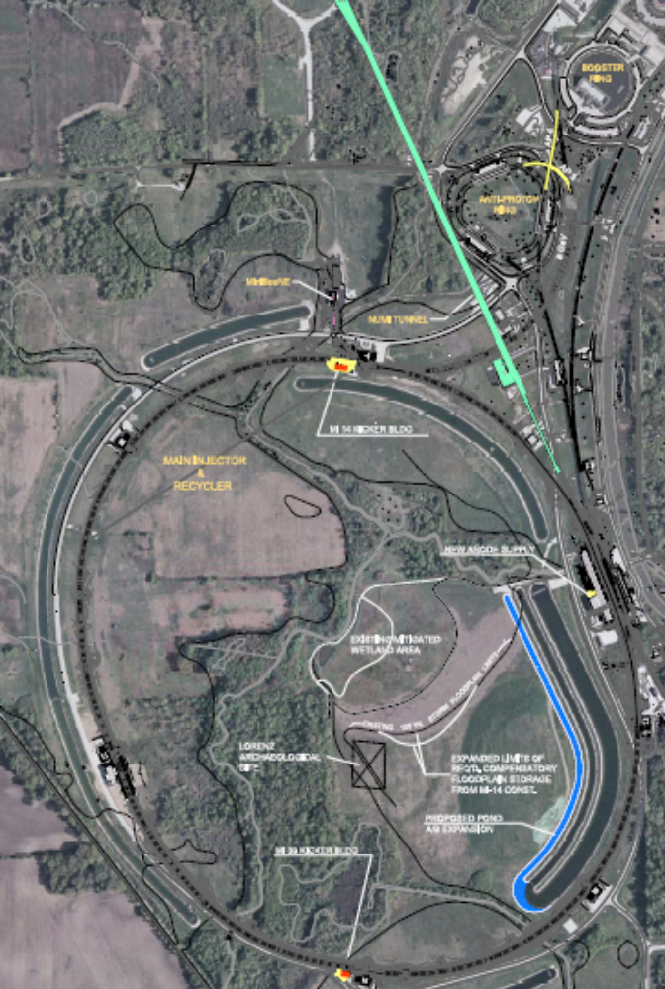
SNuMI:
WBS 1.1 Booster Upgrades
LINAC
NuMI Tunnel
Booster Ring
Eric Prebys
$675K FY06$
(no contingency, no G&A)
30% contingency
Accumulator Ring (phase II)
BNB
Main Injector & Recycler
Pond Expansion (phase II)

Slide 2
Overview
Introduction/Proton Plan
WBS Organization and Interfaces
Performance Specifications
Major Elements
Value Engineering & Risk Management
Costs
Schedule & Milestones
Summary and Conclusions

Slide 3
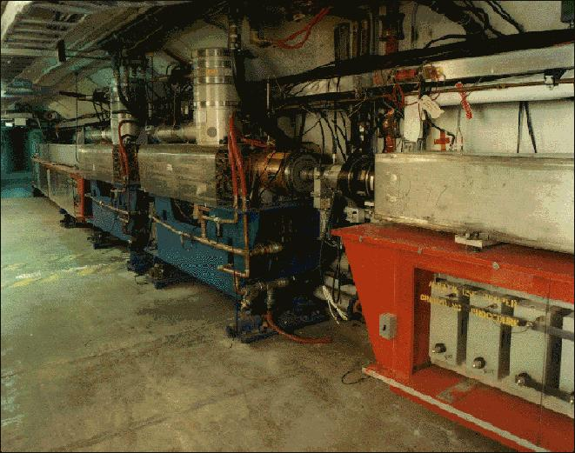
The Booster
The Booster is a rapid cycling synchrotron which takes beam from the 400 MeV Linac and accelerates it to 8 GeV for injection into the Main Injector.
It has not changed significantly since it was built ~35 years ago.
The magnets are run in a15 Hz resonant circuit, which sets a fundamental clock for the entire accelerator complex.
The Booster delivers beam at an instantaneous rate of 15 Hz, but pulsed elements limit the average rate to about 9 Hz.
Notes:
Cartoon of the detector: walk through from inside

Slide 4
Proton Plan
The Proton Plan is the current campaign to maximize proton delivery to NuMI and MiniBooNE during the collider era:
  Hardware projects complete in 2008 shutdown
  Plan complete in 2009
  SNuMI assumes success of Proton Plan
The Main Goals of the Proton Plan are:
  Increase overall reliability of Linac/Booster
  Increase Booster efficiency to reduce uncontrolled beam loss in Booster tunnel (currently the limiting factor in beam delivery)
    Total beam throughput limit 18E16 protons per hour
  Achieve Booster beam quality necessary for slip stacking in the Main Injector
    Longitudinal emittance=.08 eV-s, δp = ±8 MeV
  Increase average Booster repetition rate to at least 9 Hz
If the first three goals are met, they will satisfy the needs of SNuMI
Repetition rate remains an issue

Slide 5
WBS Organization
No explicit predecessors to Booster Upgrade task
Section 1.1.2 implicitly depends on success of Proton Plan, and will increase in scope if Proton Plan goals are not met.
Also implicitly depends on performance of 400 MeV Linac.
Booster beam quality tied to slip stacking in Recycler (1.2).
1. SNuMI Plan
Nancy Grossman
Project Mgr
1.1 Booster Upgrades
Eric Prebys
1.1.1 Booster RF
System
15Hz Upgrade
Rich Andrews
1.1.2 Booster Beam
Quality Improvements
William Pellico
1.1.3 Booster
Radiation Safety
Anthony Leveling

Slide 6
Performance Specifications
Parameter | Proton Plan | SNuMI I |  | Unit
Extracted Batch Intensity | 4.3E+12 | 4.3E+12 |  | protons
Average Pulse Rate* | 5.9 | 10.5 |  | Hz
Average Beam Rate | 5.0 | 9.0 |  | Hz
Norm. Trans. Emittance at Extr. | 15 | 15 |  | π mm·mrad @ 95%
Long. Emittance per Bunch at Extr. | 0.08 | 0.08 |  | eV·sec @ 95%
δp (After Bunch Rotation) | 8 | 8 |  | (±) MeV/c @ 95%
*for NuMI only operation. Current proton plan is 9Hz, including 8 GeV (BNB) operation.
Notes:
Cartoon of the detector: walk through from inside

Slide 7
Repetition Rate (1.1.1)
After the Proton Plan, the Booster should be able to run at 9 Hz.
It’s possible it could run at the 10.5 Hz needed by SNuMI, although there might be reliability issues.
  Would need to go to 15 Hz if we want to continue BNB program
In general, if we determine that we need upgrades to run reliably 10.5 Hz, we will do what is necessary to get to 15 Hz.
We have budgeted the things we feel are the most important:
  RF tuner cooling (1.1.1.1)
  RF Anode supplies (1.1.1.2)
  RF Bias supplies (1.1.1.3)
We are evaluating other things that might be issues:
  Feeder capacity (1.1.1.5)
  480V distribution system (1.1.1.6)

Slide 8
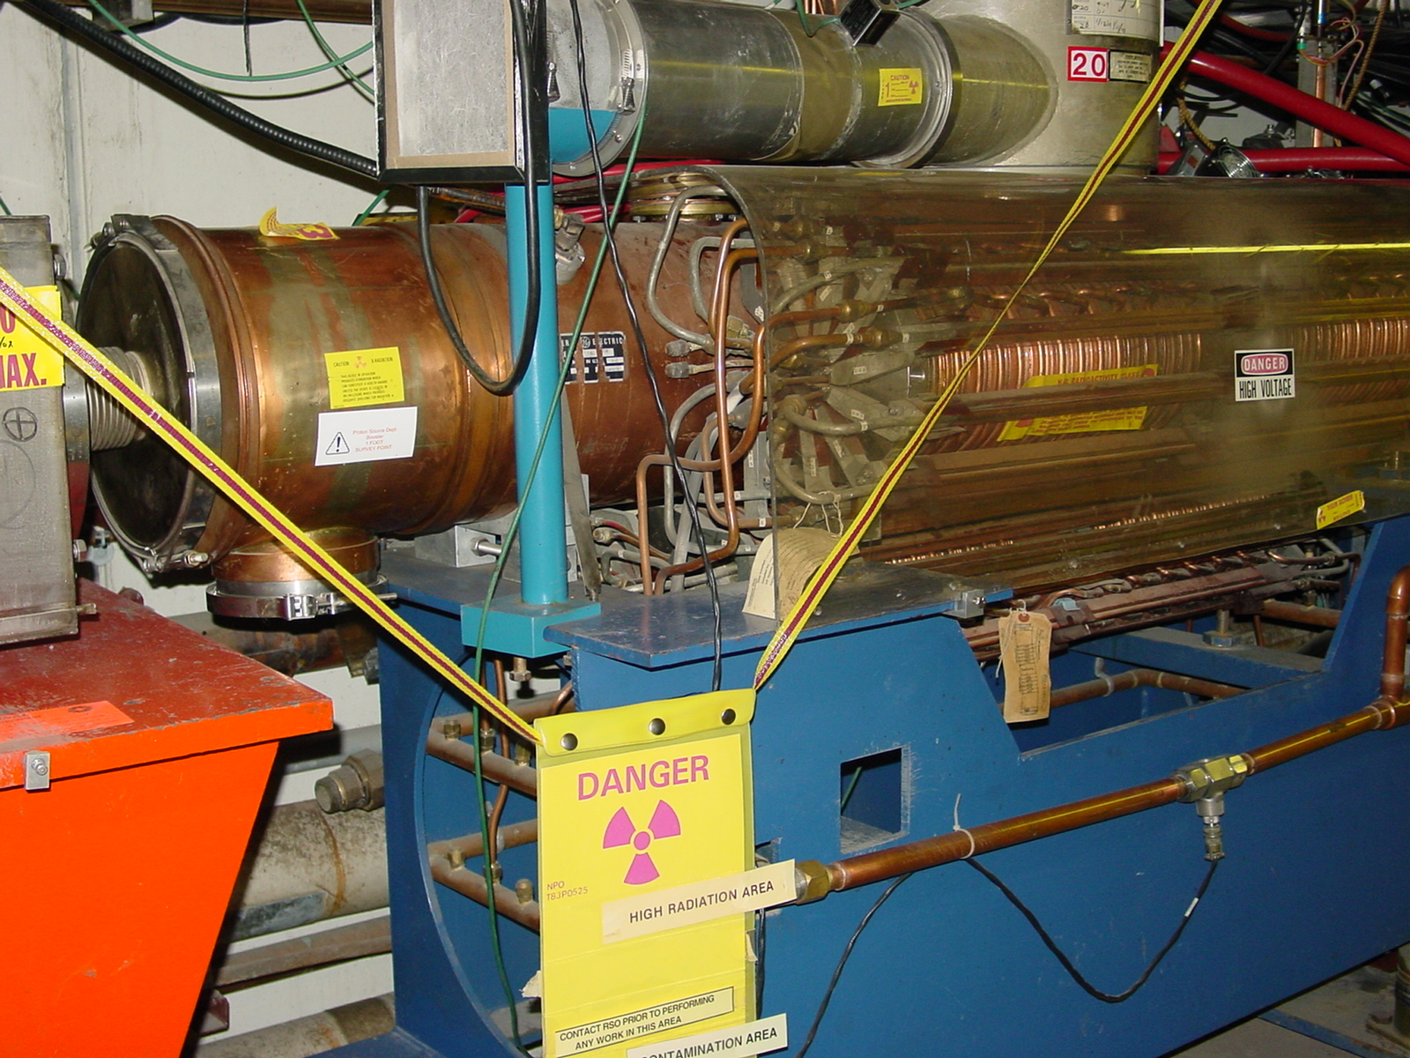
RF Tuner Cooling (1.1.1.1)
Tuner (1 of 3)
Each of the 19 RF cavities in the Booster has three biased ferrite tuners which sweep the frequency from 37 to 53 MHz as the Booster accelerates.
The end cones of these tuners could overheat at high repetition rates and become damaged.
There is a cooling channel in these end cones, which is not currently used.
Doesn’t drive shutdowns
We will inspect these and repair if necessary
  $10K M&S
  $71K Labor

Slide 9
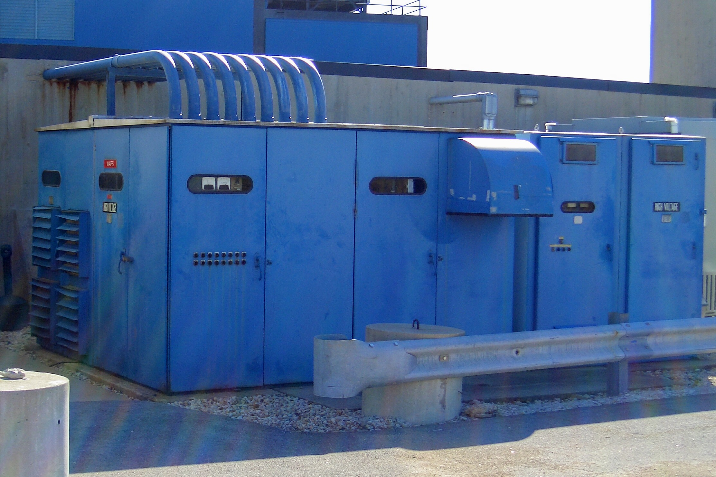
Anode Power Supplies (1.1.1.2)
Supply power to the anodes of the power amplifier tubes in the Booster
Two of them: East and West
Pulsed power of 30 kV @ 50 A
Original to the lab.
  Probably OK to 10.5 Hz
  Problematic at 15 Hz
Plan to refurbish with new transformers
  $258K M&S
  $5K Labor

Slide 10
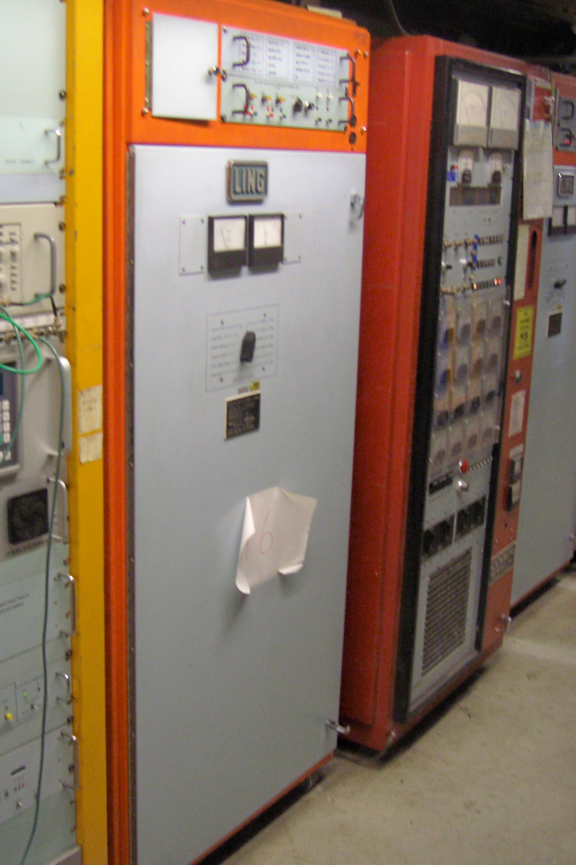
RF Bias Supplies (1.1.1.3)
Bias Supply
These supplies provide the current to the ferrite loaded tuners described in 1.1.1.1
Half of these were built with transformers that are not capable of 15 Hz operation.
Must verify reliable 10.5 Hz operation.
To go to 15 Hz, need to replace internal transformer, which requires some minor rework of the chassis
  $250K M&S
  $44K Labor
Modulator

Slide 11
Other Elements (not related to repetition rate)
Must verify that Booster has met its Proton Plan goals in terms of beam quality and efficiency
  These currently appear as milestones
    1.1.2.1.1 Verify Booster meets beam loss requirements
    1.1.2.2.1 Verify Beam quality requirements
Need to address radiation safety (1.1.3)
  Booster shielding assessment limits beam to 1.35E17 protons/hour, but warning limit lower.
  Booster protected by interlocked radiation monitors, so updating shielding assessment primarily paperwork

Slide 12
Value Engineering/Risk Management
The bulk of the elements in the Booster section of SNuMI involve increasing the repetition rate of pulsed elements and power supplies through straightforward refurbishment of existing systems.
In the matter of the repetition rate, the biggest risks are
  Refurbishment of the anode supply determined to be inadequate
    Would require $2-3M anode supply replacement
  480V network and/or feeder determined to be inadequate
    Not costed out yet, but on the order of hundreds of $K.
SNuMI relies on Proton Plan meeting its goals
  Proton Plan carefully tracked and reviewed to establish that it is meeting its goals
  At the end of the plan, the Booster will have a very sophisticated correction system, so further improvements will likely come from addressing beam physics problems through study and understanding, rather than major hardware projects
    i.e. time not money

Slide 13
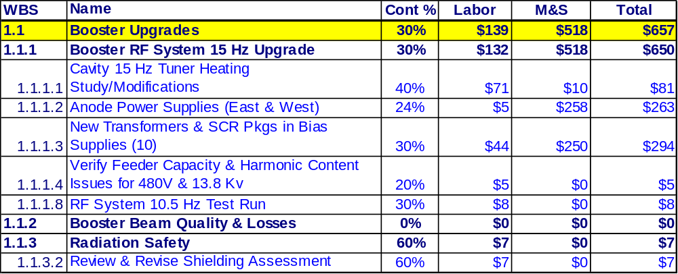
Booster Upgrades
Cost Overview
(no G&A or contingency, FY06K$)
The cost is driven by the upgrades that are required to increase the average repetition rate of the Booster RF system
  Tuner cooling
  Bias supply improvement
  Anode supply refurbishment

Slide 14
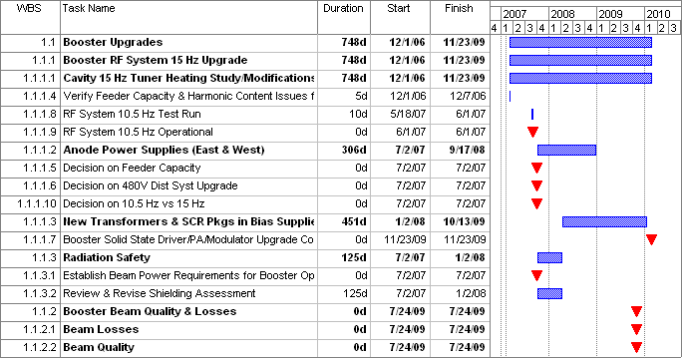
Booster Upgrades
Schedule Overview

Slide 15
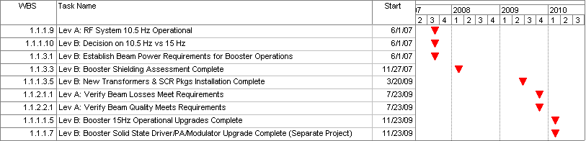
Booster Upgrades
Milestones
Very important to establish beam power requirements (1.1.3.1)
  At what level will we continue to run 8 GeV program, if at all?
  This will drive the 15Hz vs. 10.5 Hz decision
Potential scope increases:
  If we decide the 480V system and/or the feeder are inadequate for 15 Hz operation (1.1.1.5, 1.1.1.6).

Slide 16
Conclusions
SNuMI relies on the success Proton Plan
  At the end of the Plan, the Booster should meet the SNuMI needs in terms of beam quality and total proton rate
Majority of Booster activities aimed at increasing repetition rate, to full 15 Hz where possible
  RF cooling
  Anode power supplies
  Cavity bias supplies
Overall Cost (base cost of $675 K)
  Total contingency for system 30%
  Cost driven by the repetition rate items
  Currently based on engineering estimates
Schedule
  Driven design and the delivery of transformers to refurbish anode supplies
  Not a critical path item in the overall project

