Slide 1
Proton Plan Expectations
Eric Prebys
AD/Proton Source

Slide 2
Overview
Overview of Proton Plan
Status
Remaining Projects
Projections
Conclusions

Slide 3
Proton Plan
The Proton Plan is the current campaign to maximize proton delivery to NuMI and MiniBooNE during the collider era:
  Hardware projects complete in 2008 shutdown
  Plan complete in 2009
  SNuMI assumes success of Proton Plan
The Main Goals of the Proton Plan are:
  Increase overall reliability of Linac/Booster
  Increase Booster efficiency to reduce uncontrolled beam loss in Booster tunnel (currently the limiting factor in beam delivery)
    Total beam throughput limit 18E16 protons per hour
  Achieve Booster beam quality necessary for slip stacking in the Main Injector
    Longitudinal emittance=.08 eV-s, δp = ±8 MeV
  Increase average Booster repetition rate to at least 9 Hz
If the first three goals are met, they will satisfy the needs of SNuMI
Repetition rate remains an issue
  This is the only scope currently in SNuMI!

Slide 4
Limits to Proton Intensity
Total proton rate from Proton Source (Linac+Booster):
  Booster batch size
    ~4-5E12 protons/batch
  Booster repetition rate
    15 Hz instantaneous
    Prior to 2006 shutdown: 7.5Hz average (injection bump+RF)
    Now: 9 Hz (including conditioning pre-pulses)
  Beam loss
    Damage and/or activation of Booster components
    Above ground radiation
Total protons accelerated in Main Injector:
  Maximum main injector load
    Six “slots” for booster batches (3E13)
    Up to ~11 with slip stacking (4-5E13)
    Some RF issues (see Kourbanis talk)
  Cycle time:
    1.4s + loading time (1/15s per booster batch)
Historically our biggest worry

Slide 5
Goals of Proton Plan
120 GeV (NuMI)
  Accelerate 4-5E13 protons per 2.2s cycle
  This alone is within demonstrated performance of the Booster (at least in terms of total protons):
    7.5Hz adequate
    Total proton rate ~OK
  Most of the necessary work is in Main Injector
  Maintaining acceptable longitudinal quality from Booster for slip stacking presents an operational challenge
8 GeV (BNB)
  Maintain ~2e20 p/year to maintain 8 GeV neutrino program
  Requires ~50% increase in total protons
  Requires Booster to go to ~9Hz
Future
  Pave the way for increased beam throughput needed by SNuMI and beyond
    e.g. Booster corrector upgrade

Slide 6
Context: Staged Approach to
Neutrino Program
NuMI era (concurrent with Run II)
  Ramp up to deliver slip stacked protons to both NuMI and antiproton production
  Continue to deliver protons to the 8 GeV line at some level
  Goal:
    ~380 kW to NuMI
    1-2E20 protons to 8 GeV line
S(uper)NuMI era (after collider program)
  Use Recycler as a pre-loader to the Main Injector to eliminate loading time
  Becoming a formal plan.
  Goal
    ~700 kW to NuMI line
SNuMI 2 (tentative)
  Use Antiproton Accumulator Ring to momentum stack protons
  Boxcar stack these protons into Recycler
  Load into Main Injector
  Goal
    ~1.2 MW to NuMI line
HINS (formerly known as “Proton Driver”)?
  Always a possibility, but not part of our baseline thinking at the moment.
Proton Plan
This Review

Slide 7
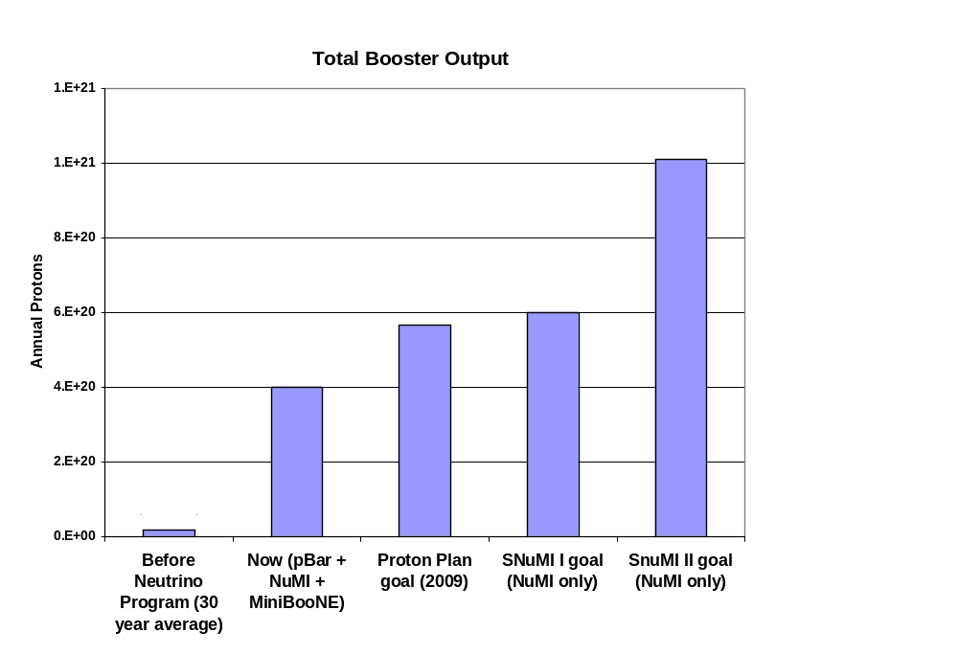
Total Protons
Present

Slide 8
Significant Elements of Plan
  Major achievement!!!!
Linac
  Stockpile two year supply of spare 200 MHz power amplifier tubes (7835’s), in the event of an interruption in supply
  Characterize and improve Low Energy Linac Low Level RF
Booster:
  Replace and reconfigure injection bump (ORBUMP) system.
  Relocate 8 GeV dump from Booster tunnel to MI-8 transfer line
  Make Booster robust to 9 Hz, and understand requirements to go to 15 Hz
  Design, build, and install new corrector system
Main Injector:
  Replace seven quadrupoles with increased aperture versions, to reduce injection and extraction losses.
  Operationally develop multi-batch and multi-batch slip stacked operation
  Design and install collimation system, both in the MI-8 line and in the MI ring
  Modify injection kicker to allow multi-batch slip stacked operation
  Characterize and make improvements to RF system to support high intensity operation.
Red = completed

Slide 9
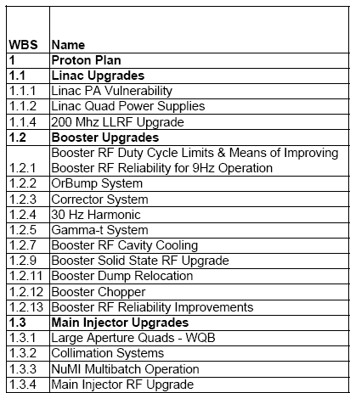
Status Summary
= Task completed
= Significant element(s) completed
= Task descoped
New 13.8 kV transformers and switch gear for Booster RF
MI-8 Collimation Complete
MI-10 kicker upgrade

Slide 10
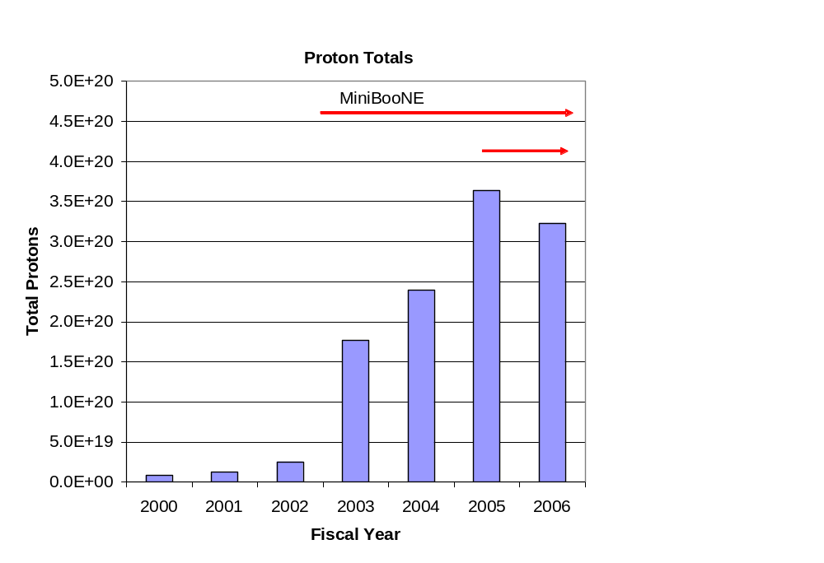
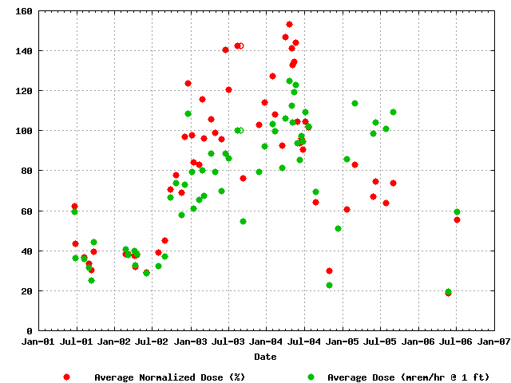
Success of Plan
Total Protons Delivered
Average Booster Activation
MiniBooNE
NuMI
Factor of 15 increase in protons

Slide 11
Future
A significant part of the Proton Plan was completed (or descoped) by the end of the last shutdown.
This will free up some badly needed expertise to focus on optimizing the system to take advantage of the improvements that have been made.
The most significant remaining tasks are:
  Linac LLRF (1.1.4)
  Booster Corrector System (1.2.3)
    This would be a major project all by itself
    Last (?) major Booster project
  Main Injector Ring Collimation (1.3.2.1.3)
  Main Injector RF Upgrade (1.3.4)
    Series tube modulator power dissipation
    Anode power supply rectifier transformer
    Solid State Driver power supplies
See Kourbanis Talk

Slide 12
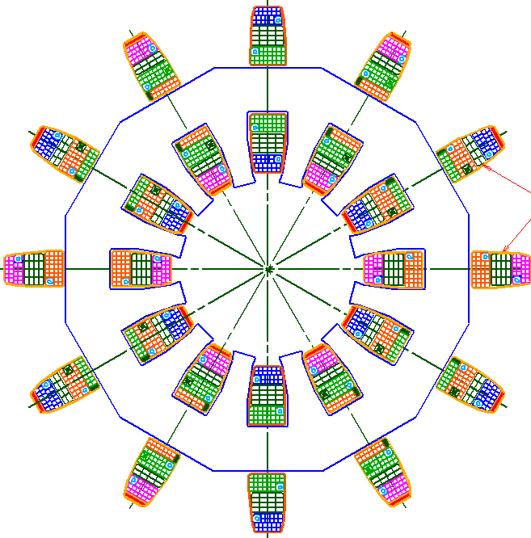
Booster Corrector System
Replace all 48 (original) Booster corrector packages.
  Unique new design
Six independent multipoles
  Stronger H and V dipoles
    ±1cm beam motion throughout cycle
  Stronger quad
    Arbitrary tune working point throughout cycle
  Skew quad
    Coupling, same strength as before.
  Sextupole and skew sextupole at every period.
    Less emittance blowup
    More control of harmonic resonances.
Integrated BPM
  Saves space
Total Cost
  $3.6M M&S
  $2.6M SWF
~16”

Slide 13
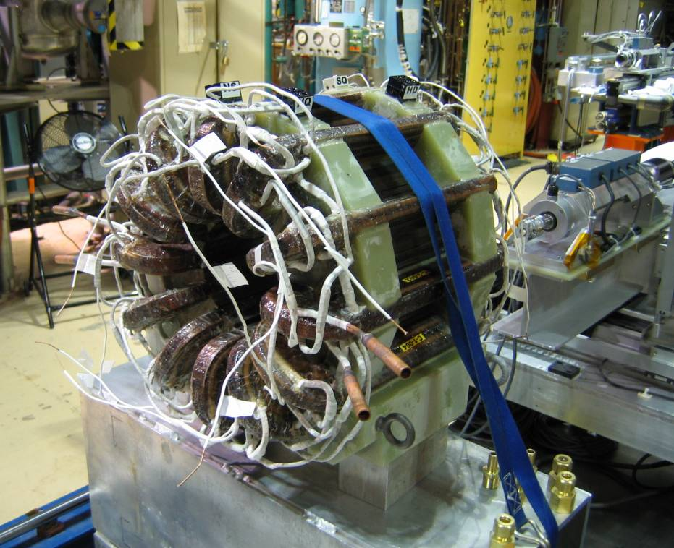
Correctors: Status
Testing first prototype
  Looks good
Just passed internal technical review
  New corrector system “badly overdue”
Aggressive schedule
Half of correctors in stalled in 2007 shutdown.
Second half in 2008 shutdown.
Done with Booster?

Slide 14
Proton Plan Timeline
Now
  Proton Plan ~half complete (in terms of total $)
2007 Shutdown (June 2007)
  Install half of Booster correctors
  Complete Main Injector collimation and RF projects
    Main Injector “done”, in terms of hardware projects
2008 Shutdown (June 2008)
  Install remaining Booster correctors
  All Proton Plan hardware projects complete
Mid-2009
  All tuning and commissioning complete
  End of Proton Plan

Slide 15
Proton Plan Projections
Proton Plan represents the first ever attempt to accurately predict total proton output from Booster.
History has shown that the lab tends to overestimate the benefits of particular improvements.
  Tuning and optimization take a long time
  Tend to asymptotically approach the goal, then get distracted by other things.
So we…
  Evaluate the potential of particular improvements based on effective aperture increase or uncontrolled beam loss reduction:
    For example, if something reduces uncontrolled loss by 10%, it has the potential to allow us to send 10% more beam.
  Consider the following scenarios:
    “Design”: After one year of tuning, we realize half of the potential benefit.
    “Fallback”: After one year of tuning, we realize one quarter of the potential benefit.

Slide 16
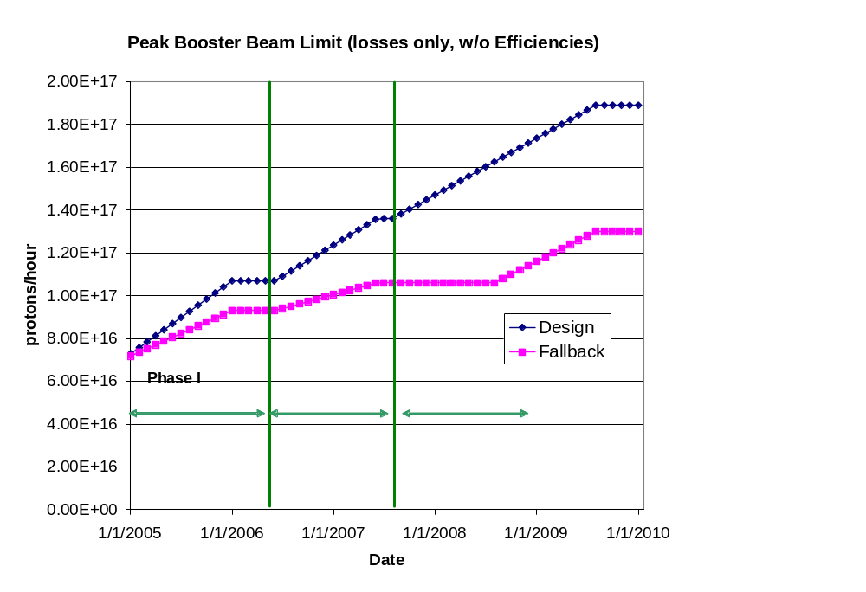
Peak Booster Intensities
These are “peak” numbers
An “average to peak” correction is applied to get average values
These are the numbers from loss limits
The real peak value will be limited by the 9Hz rep rate at about 1E17, depending on batch size.
Present

Slide 17
Factors Considered in Projections
Linear ramp-up to see benefit of improvements
Slip stacking efficiency
Different Booster efficiency for cogged (pBar+NuMI) cycles and uncogged (BNB) cycles.
Annual shutdowns (assume 2 mo/yr)
  Overall asymptotic ramp-up after shutdown (improved for FY06)
Uptimes: based on MiniBooNE 2004 and NuMI 2005
Peak to average corrections
  For BNB, based on MiniBooNE 2004
  For NuMI, used reasonable guess

Slide 18
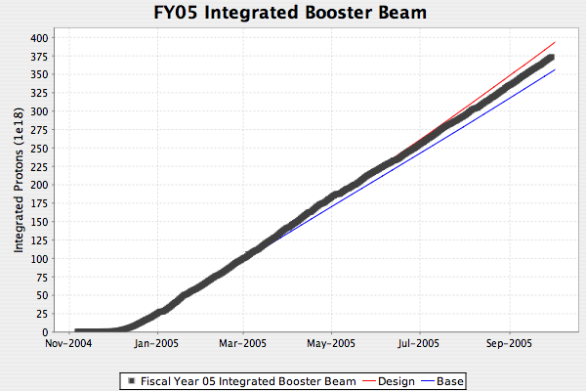
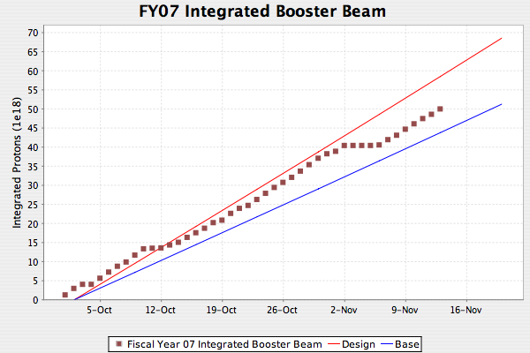
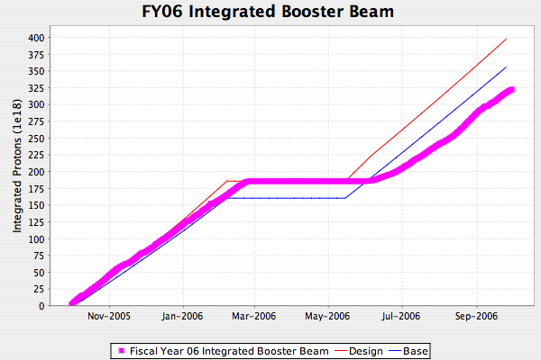
Proton Projections: Total
Turn on slower than expected
Overall
  “Good” running in line with plan
  Overly optimistic on turn-on after shutdowns
  Improved for future projections

Slide 19
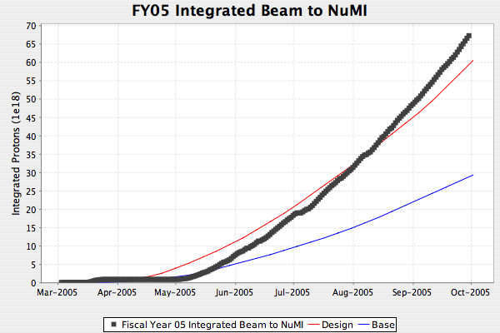
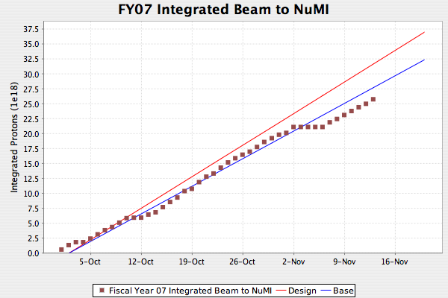
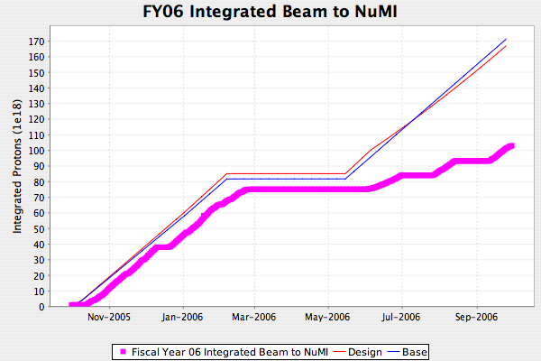
Projections: NuMI
Water in target
Water in target
Horn ground fault
RAW Problem
Resin beads in water system
Overall
  Projections accurate when up
  Lower uptime than expected
  Revised for future projections and SNuMI
Special runs
Tritium in water

Slide 20
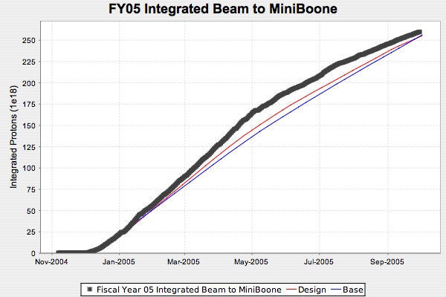
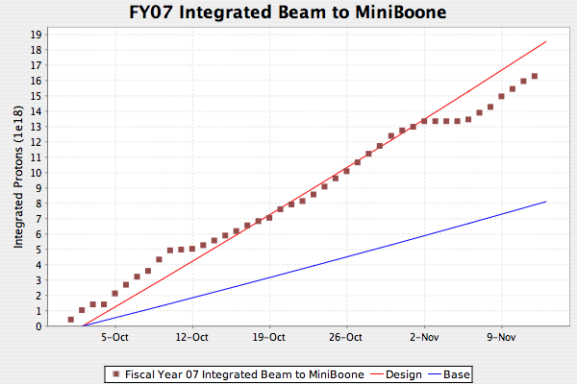
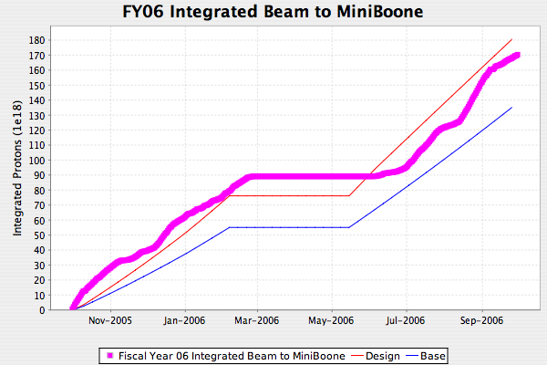
Proton Projections: BNB
Overall
  BNB has benefitted from NuMI problems
  Total delivery pretty close to projections

Slide 21
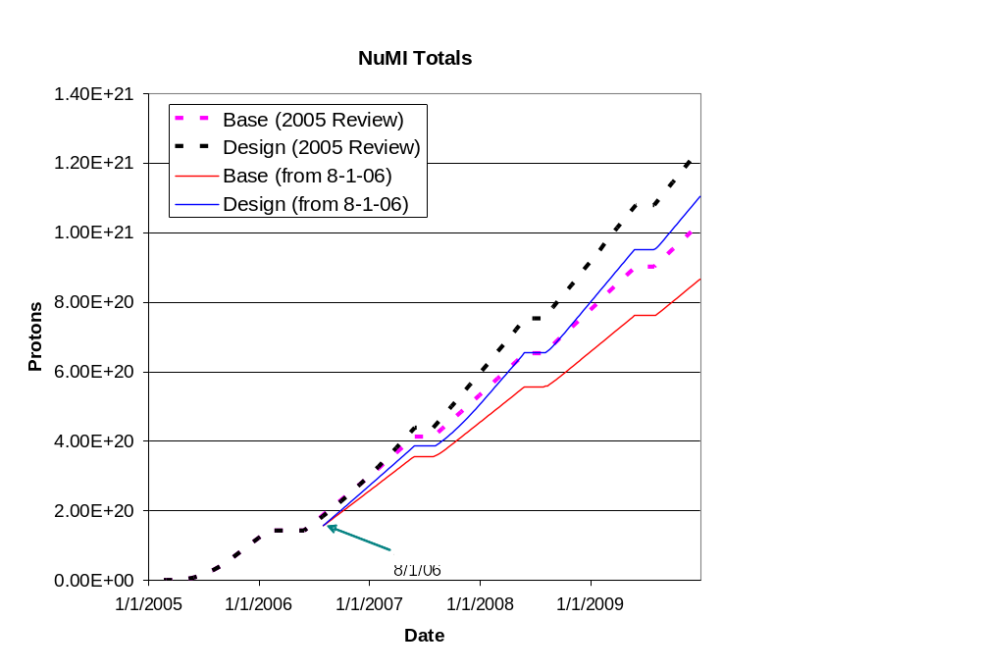
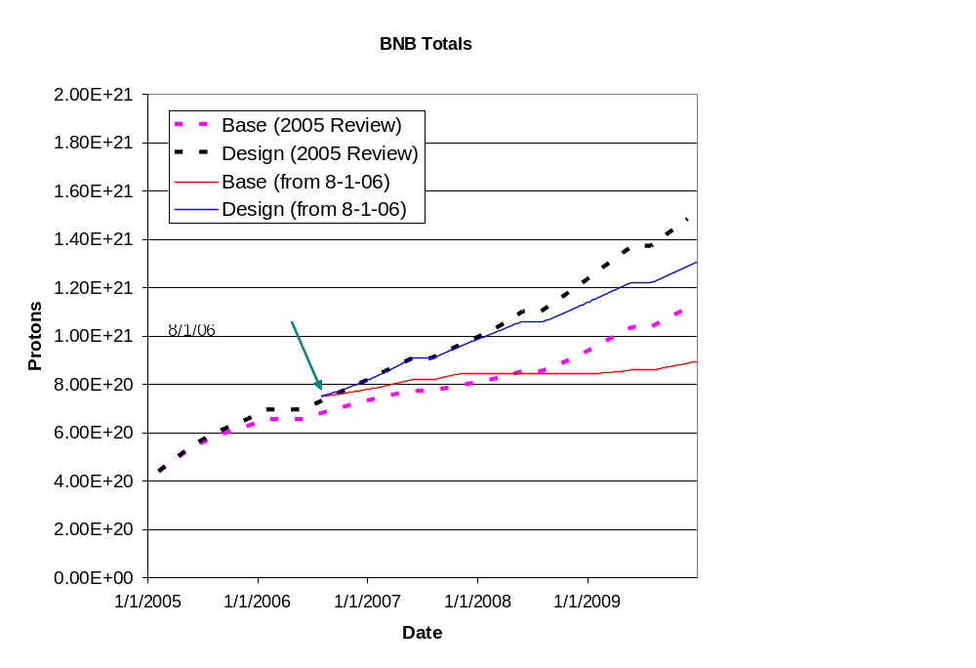
Long Term Cumulative Totals
Projections as revised at last Director’s Review
Compared to first Director’s Review

Slide 22
Conclusions
SNuMI relies on the success Proton Plan
  So far, the Proton plan has done a good job of tracking major projects and proton delivery
  At the end of the Plan, the Booster should meet the SNuMI needs in terms of beam quality and total proton rate
If the Proton Plan is successful, the only remaining projects needed for SNuMI will involve repetition rate issues
  RF cooling
  Anode power supplies
  Cavity bias supplies
Important for SNuMI to keep track of Proton Plan over next several years
  e.g. SNuMI milestones
    1.1.2.1.1 – verify that Booster meets beam loss requirements
    1.1.2.2.1 – verify that Booster meets beam quality requirements

