Slide 1

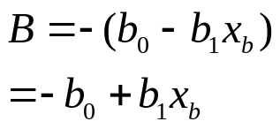
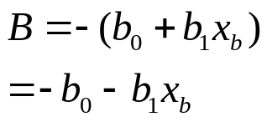

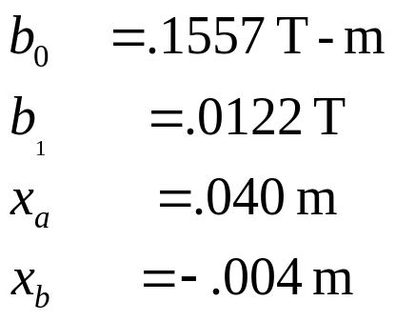
ORBUMP: Net dipole error
Present configuration
+I
-I
-I
+I
Orientation
Net dipole ≈ 0

Slide 2
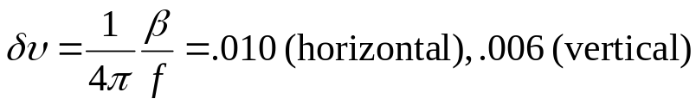
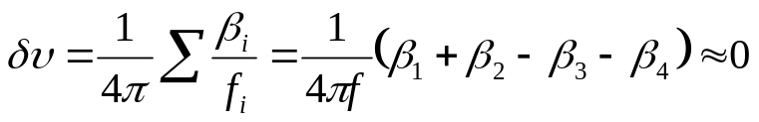
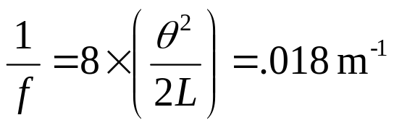
Effect on optics
Quadrupole moment: ~.0122 T (from Jim’s figure)
  For one magnet: 1/f=.0038m⁻¹ @ 400 MeV
  Tuneshift
    For one magnet
    For set
  Compare to dogleg effect
Conclusion: effect of quadrupole moment negligible
Δψ ≈ 3/20 = .15

Slide 3
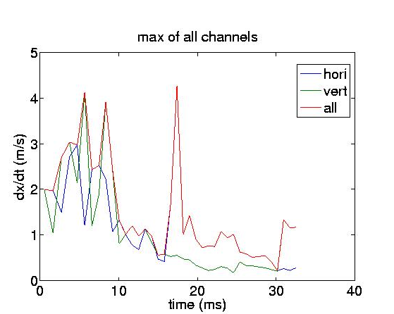
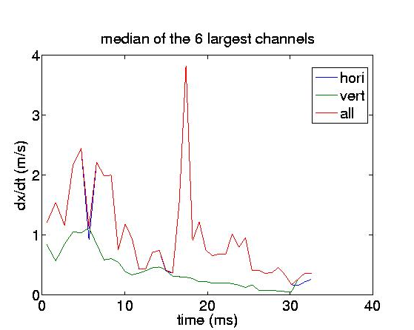
Position slew rates

