Slide 1
Proton Planning – Demands and Issues
Eric Prebys
FNAL Accelerator Division

Slide 2
Background
The details of proton demand and issues can be found in an official report to the director at:
www.fnal.gov/directorate/program_planning/studies/ProtonReport.pdf
Working assumptions:
  Existing proton source must last at least another 10 years or so in more or less it’s current configuration.
  During that time, a new “proton driver” will be built, which will ultimately replace the existing proton source.
  Proton source improvements should require no significant downtimes beyond those needed for other reasons.
  The maximum total funding for proton source improvements will be of the order of $18M over the next few years.

Slide 3
Scope of Improvements
The level of funding precludes some things which have been discussed:
  Replacement or major upgrade of 200 MHz linac
    Official policy on 7835 PA’s: keep fingers crossed.
  Decrease of Main Injector ramp time
    Unless it is done as part of Proton Driver
For this reason, the proton plan focuses primarily on the Booster
  Decreasing uncontrolled losses.
  Increasing reliable average repetition rate.
  Biggest decisions involve plan for RF system.

Slide 4
General Comments about Linac
The linac is not currently a performance bottleneck for the complex when it is running stably.
There are ongoing longevity and reliability concerns in the linac
  General state of instrumentation is inadequate to characterize linac behavior
  The 7835 tubes from Burle continue to be a major concern, although the situation is better than it was a year ago.
  There are some other longevity issues, if we expect the linac to last another ~10 years.

Slide 5
What Limits Total Proton Intensity?
Maximum number of Protons the Booster can stably accelerate: 5E12
Maximum average Booster rep. Rate: currently 7.5 Hz, may have to go to 10 Hz for NuMI+ (full) MiniBooNE
(NUMI only) Maximum number of booster batches the Main Injector can hold: currently 6 in principle, possibly go to 11 with fancy loading schemes in the future
(NUMI only) Minimum Main Injector ramp cycle time (NUMI only): 1.4s+loading time (at least 1/15s*nbatches)
Losses in the Booster:
  Above ground radiation
  Damage and/or activation of tunnel components
Our biggest worry at the moment!!!!

Slide 6
Operating Scenario
Run II gets what it needs:
  Only pBar production is a significant user of protons.
MiniBooNE get’s whatever it can on top of that, within the current local and total loss limits
  Presently, MiniBooNE gets about 9 times the protons of stacking
Lab policy:
  When NuMI turns on in 2005, it will get whatever protons it can after stacking.
  MiniBooNE will continue to run if there are more protons available.
  (more about this later…)

Slide 7
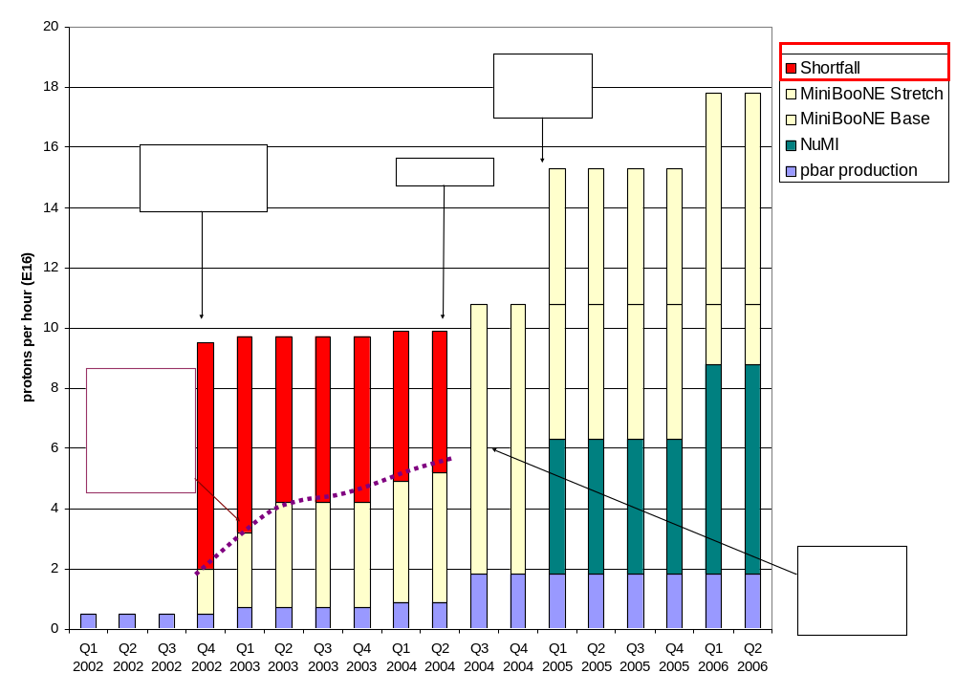
Proton Demand
We'll come back to this plot later

Slide 8
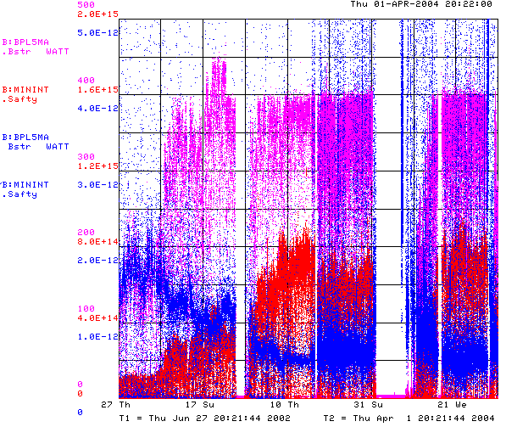
How are We Doing?
Power loss (W)
Protons (p/min)
Energy Lost (W-min/p)
Record Performance
BooNE turn-on (Sept. 2002)
“Mysterious”
Performance Problems
Big Shutdown

Slide 9

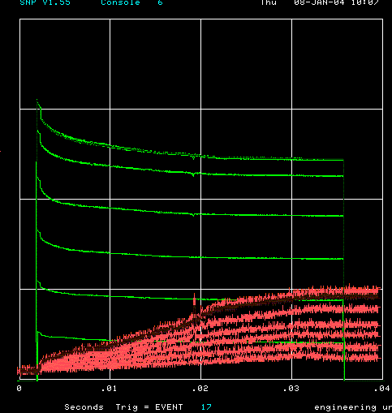
How far have we come?
Before MiniBooNE
Now (same scale!!)
Charge through Booster cycle
Time (s)
Energy Lost
Note less pronounced injection and transition losses

Slide 10
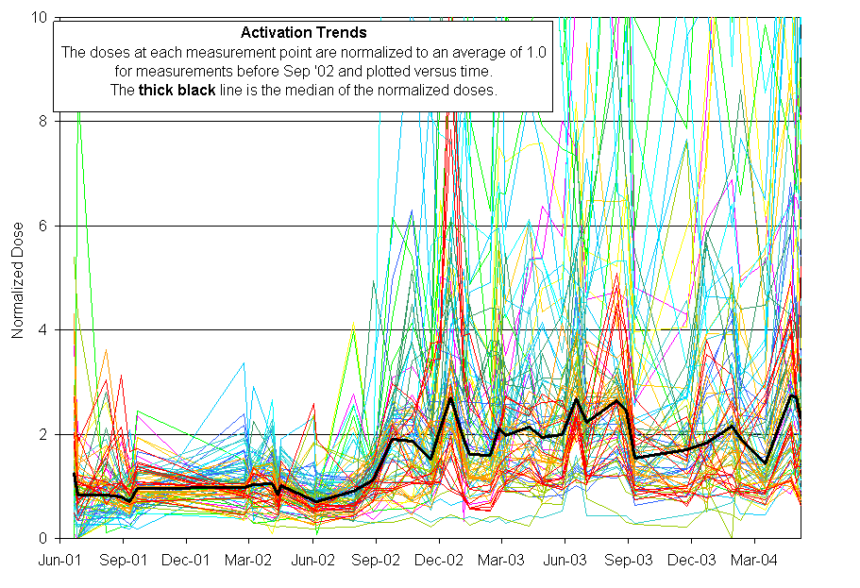
Activation History
MiniBooNE
Protons increased x10
Activation increased by ~3

Slide 11
Near Term Priorities (through early 2005)
Collimator Commissioning
Beam Cogging (synchronizing multiple batches to the Main Injector)
Alignment
L13 modifications
Add two RF cavities to the Booster, increasing the total number to 20.
Injection Bump (ORBUMP)
  Power supply
  Magnets

Slide 12
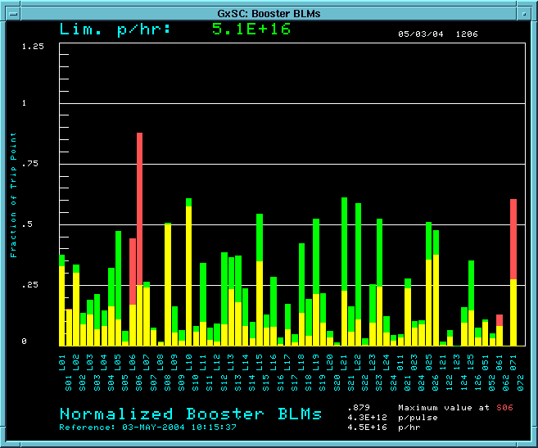
Collimator Commissioning
We have begun to use the collimators in normal operation:
Not (yet) as good as expected, but encouraging.
RF Region
Losses w/o collimators
Losses with collimators

Slide 13
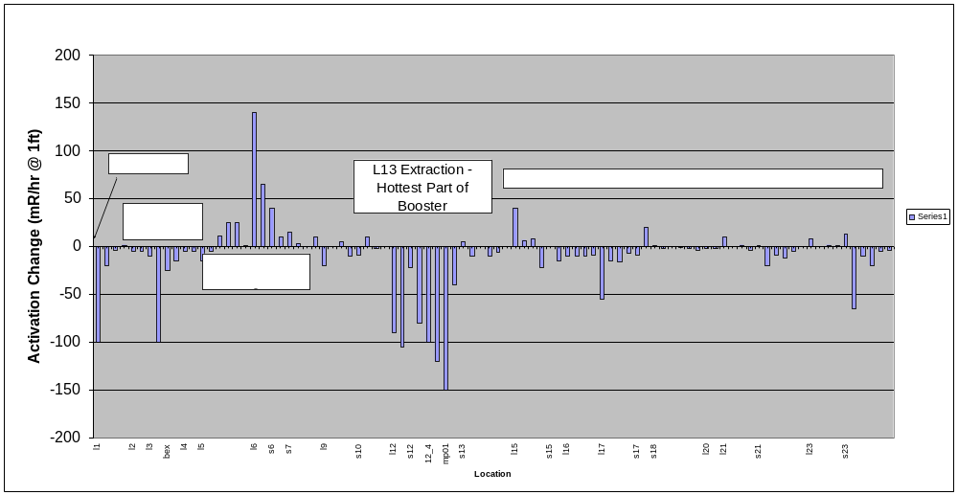
Effect of Collimators on Activation
One week of continuous collimator operation….
  Difference from previous week measurement (mr/hr @ 1ft)

Slide 14
Plan for collimator commissioning
Complete commissioning of feedback positioning system
  Move collimators in until losses observed on selected loss monitors
Find optimum position of primary and secondary collimators
Modify booster orbit to move losses from period 13 to collimators

Slide 15
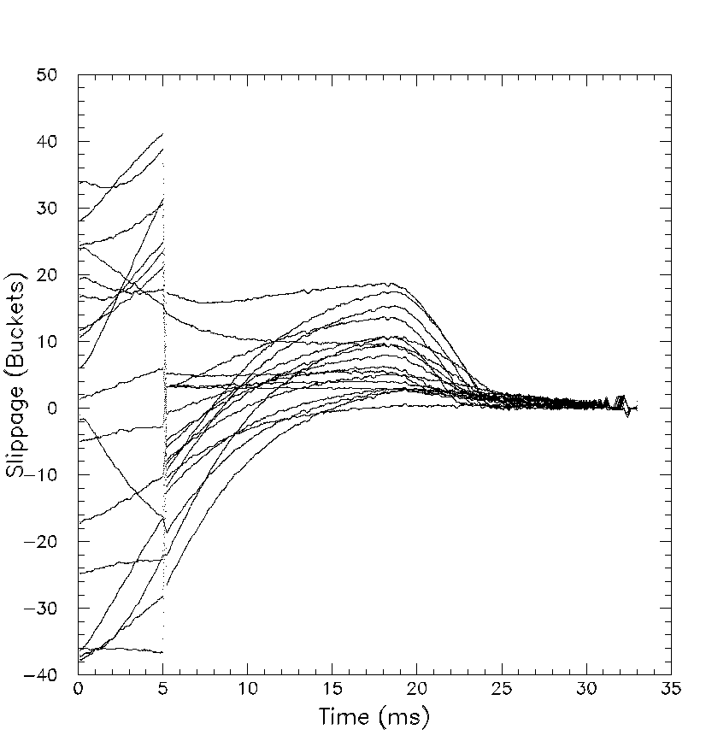
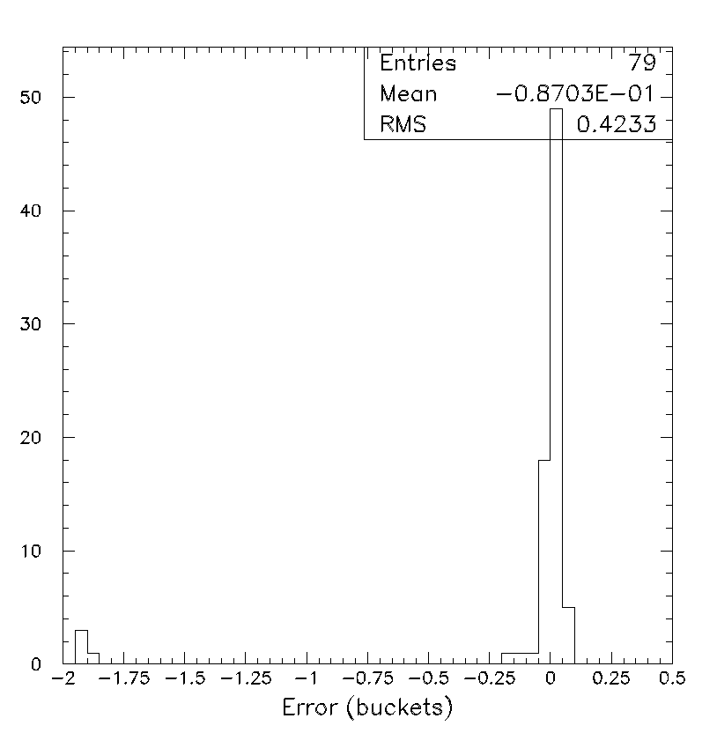
Progress in Beam Cogging
Vital to multibatch operation
  Slipstacked pBar production – SOON
  Multibatch to NuMI – assume 1/05
Cogging principle demonstrated
  Use measured phase error to place notch
  Use radial feedback to correct total acceleration time
Now being commissioned to Main Injector

Slide 16
Alignment
We will continue to improve vertical and cavity alignment as opportunities arise
Throughout the year, we will introduce a full laser-tracker network with the goal of having a complete 3D as-found, by the end of the Summer shutdown.
Will focus on a horizontal plan next year.

Slide 17
Increasing Number of RF cavities
Thanks to recent modeling and RF study progress, we now understand that our existing RF system is marginal for getting beam through transition
  Can get 6.5E12 to transition, but it falls out
  Performance significantly degraded when we lose one cavity (out of 18).
We have two large aperture prototype cavities which were built with significant help from universities.
We would like to use these to increase the total number of cavities
  At least one in by the end of Summer shutdown
  Second some time in 2005

Slide 18
Other Projects (Jim Lackey will discuss in Detail)
L13 Modifications:
  Modify like L3 to reduce the overall “dogleg effect” by ~80% relative to when it was discovered (factor of 2.5 better than now).
ORBUMP magnet and power supply replacements:
  Enable reliable high repetition rates.
  Increase bending power to correct injection mismatch.

