Slide 1
Proton Planning – Major Projects, Schedule, Decisions, and Projections
Eric Prebys
FNAL Accelerator Division

Slide 2
Major Features of Long Term Plan
Linac
  Primarily maintenance and reliability upgrades
Booster
  RF System: biggest issue
  Corrector system (dipoles+quads)
  Higher harmonic
Main Injector
  See A. Marchionni’s talk

Slide 3
Major Linac Projects
Quad power supplies
  Very old technology, reliability concern
  Major source of PCB’s
  About $1M to replace
7835 filament current stability
  Believed to be a source of linac instability
  Investigating 480 isolation
  Plan to implement on all stations ASAP
  Cost ~100K

Slide 4
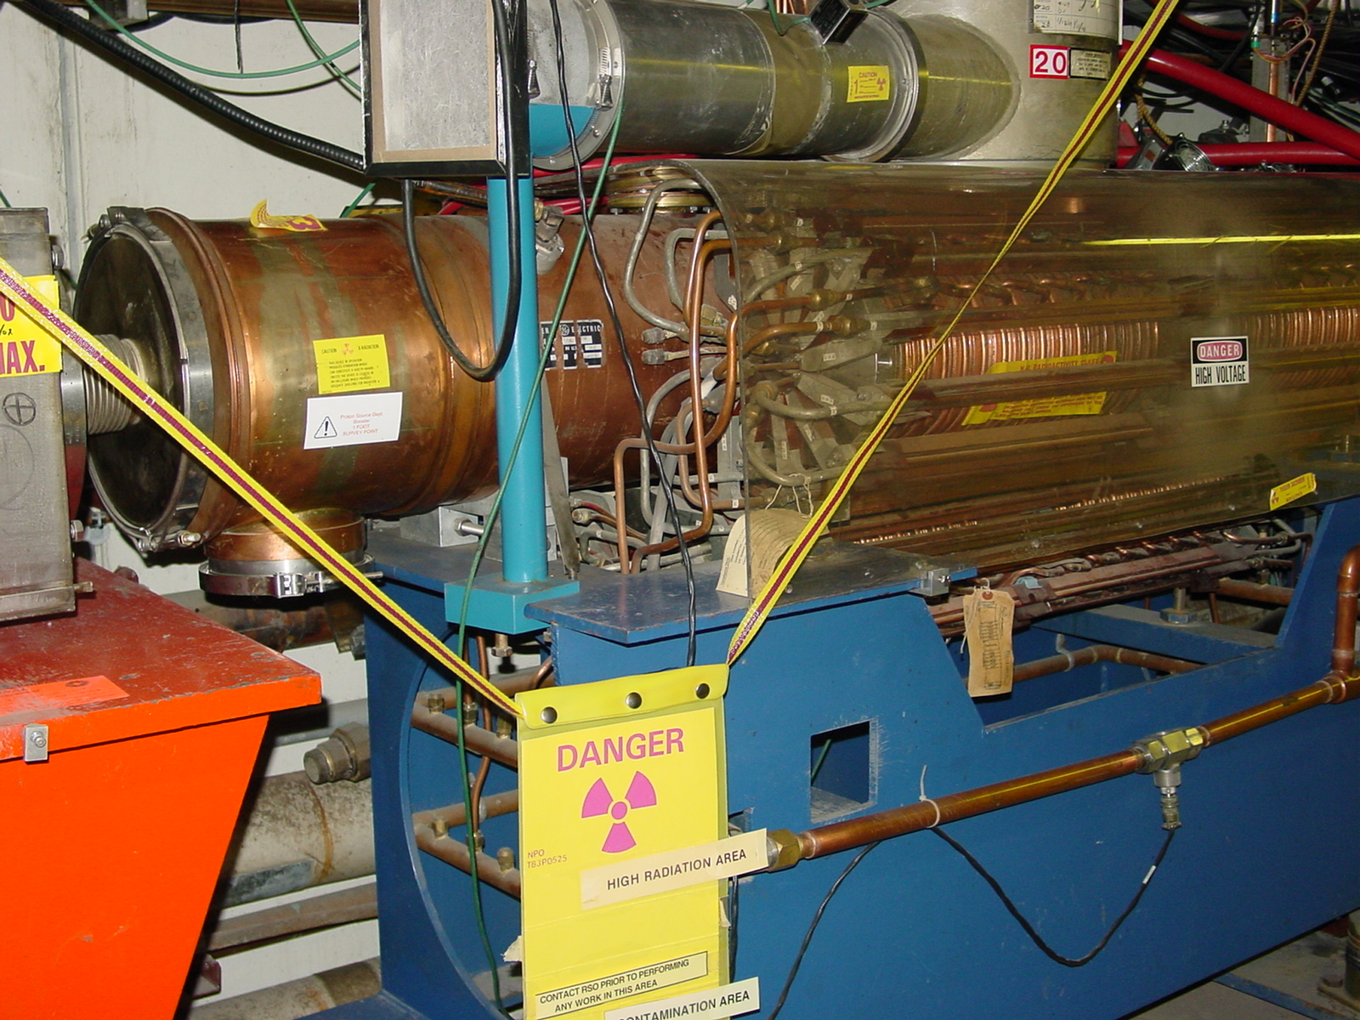
Booster RF Issues
The existing RF cavities are an aperture restriction
They are a high maintenance item (primarily the PA), so their activation is a worry.
There is a possibility that heating could be a worry beyond 7.5 Hz.
The RFSUM of the existing 18-cavity system is a limitation to the maximum proton batch size.
Decisions about the RF system are the most significant part of the plan, at least from the finance/resource point of view.

Slide 5
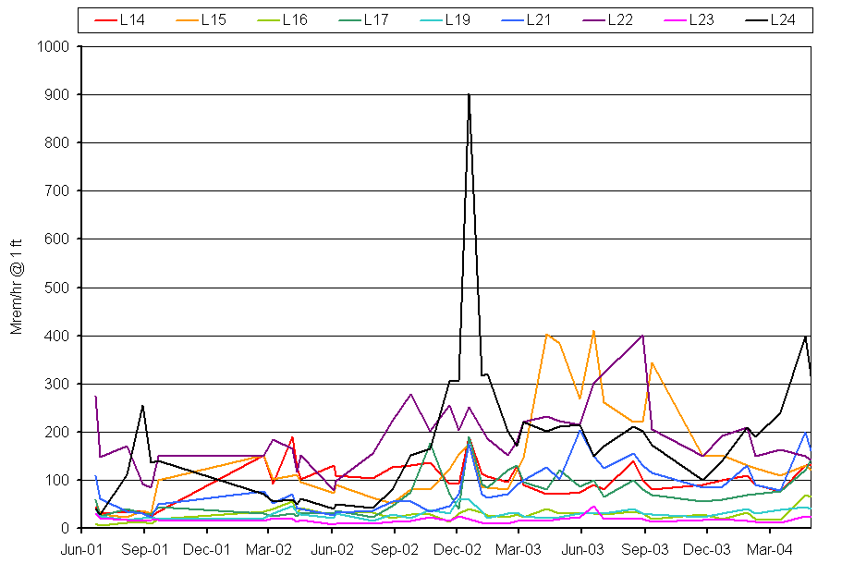
Why not Commit to a new RF System?
Activation at RF Cavities
10x more protons
MBooNETurn on
Always been hot cavities
Some hot
Some cool
Date
It’s hoped that a combination of alignment and collimators can keep activation under control (initial data very encouraging).
A new RF system would use all of the money forseen for the proton plan.

Slide 6
Booster RF Options
New, solid state PA’s
  Dramatically reduce maintenance
  Similar to Main Injector design
  One being used already.
  Total cost: ~$7M
  Definitely part of the plan
Increase number of RF cavities:
  Can use the two large aperture prototypes built with help from MiniBooNE and NuMI/Minos universities
  Hope to have at least one in by end of Summer shutdown.
  Second in during 2005.
  Could potentially increase Booster batch size to 6.5E12 or higher.

Slide 7
RF Cavity Replacement Options
Control losses with alignment and collimators?
  Don’t replace
  Should know by ~8/04
Move forward with 5” prototype design?
  Design complete and tested
  Could begin procurement and construction immediately in FY05.
  Aggressive schedule could have cavities in place by 2007
  Cost: ~6M
Completely new design?
  Could be designed with higher GE voltage and reduced HOM.
  Frequency range a challenge
  Could have design by end of 2005, cavities in place by 2008
Plan to decide on preliminary recommendation by 8/04

Slide 8
Corrector Packages
The Booster contains corrector packages at each of the 48 sub-periods.
  Horizontal trim
  Vertical trim
  Quad
  Skew quad
The trims are not powerful enough to control the orbit throughout the cycle
The quads are not powerful enough to fully control the tune/coupling throughout the cycle
We would like to replace the corrector system with one with roughly 3-4 times the strenght.
Working with TD on the specifications.
Could have in place in ~2 years
Cost ~3M.

Slide 9
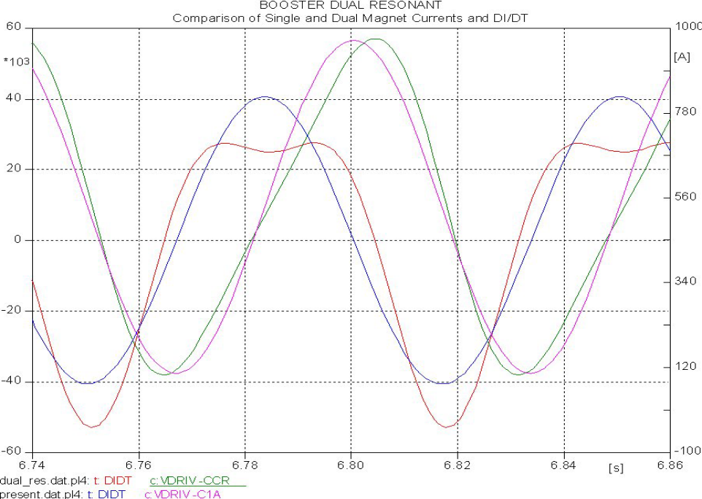
Higher Harmonic Operation
By adding a 30 Hz compononent to the Booster magnetic lattice, we could reduce the maximum dp/dt by ~35%, effectively increasing the RF power.
Pursue prototype in 2005
If successful, implement in 2006
Cost ~$1M

Slide 10
Proton Projections – Basic Assumptions
Based on stated policies of Directorate…
  Run II (pBar production) will continue to have priority.
  One NuMI comes on line, it will be given protons up to the lower of:
    The Main Injector loading/ramp time limit
    The Booster loss limit
  IF the Main Injector loading limit is reached with significant Booster loss headroom, we will continue to run the 8 GeV line (MiniBooNE, FiNESSE, etc) up to the Booster loss limit.
Even with fairly conservative projectsion, we should be able to satisfy the needs of RunII and NuMI
Unfortunately, under this scenario, it is very difficult to make projections wrt MiniBooNE’s future.

Slide 11
Increasing intensity with collimators
Currently, our most accurate measure of Booster activation is the power loss, which is calculated from lost protons.
This will cease to be a good measure once the collimators are implemented.
Our plan is to measure activation at a set of chosen locations on a weekly basis
  Impact ~2 hrs/wk
As activation is observed to decrease, we will increase intensity to keep it roughly constant.

Slide 12
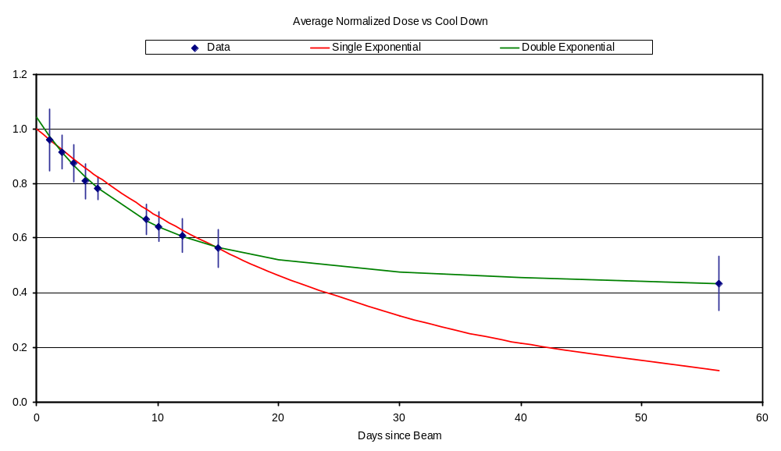
Predicting Rate Based on Cooldown
Best fit with two roughly equal components:
  Half-life 5.6 days
  Half-life 282 days (⁵⁷Co)
Predict effect of increase method based on this model.

Slide 13
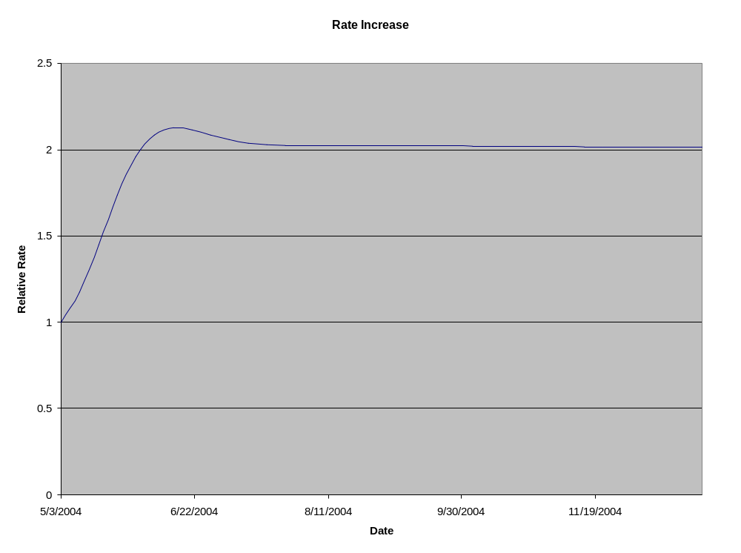
Rate Increase
Assuming 50% loss reduction

Slide 14
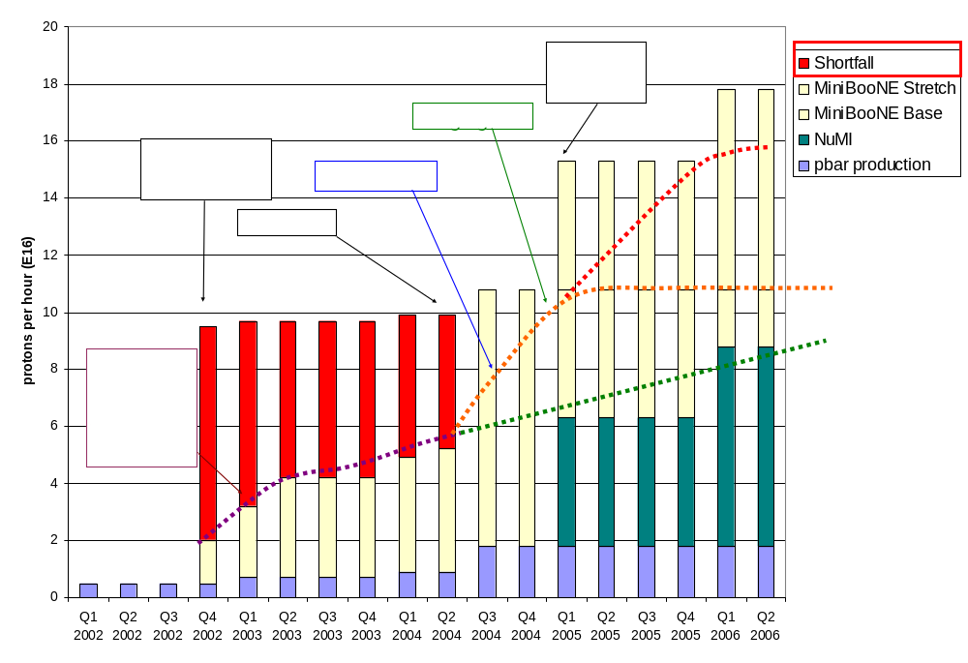
Making Projections
Stretch
Optimistic
Conservative

Slide 15
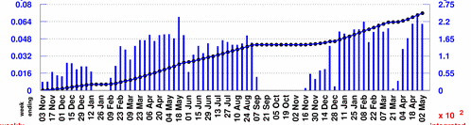
Projecting to MiniBooNE
Rather than use the instantaneous rate, will scale from typical weekly MiniBooNE totals:
Baseline Scenario:
  Improvements compensate for increased protons to pBar -> Continue to average 5.5E18/wk
  MBooNE shuts OFF 1/05
Optimistic Scenario:
  MBooNE rate increases more or less linearly to 10E18/wk at 1/05
  5.5E18/wk after NuMI turns on.
Stretch Scenario:
  MBooNE rate increases linearly to 10E18/wk at 1/05
  5.5E18/wk after NuMI turns on.
  Linearly to 10E18/wk on 1/06
Typically 5.5E18/wk

Slide 16
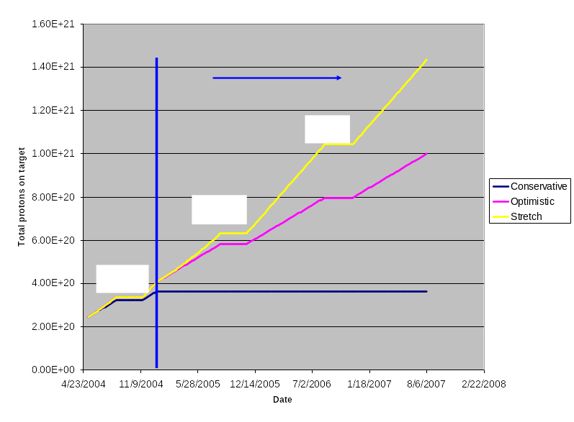
Protons to MiniBooNE

Slide 17
Approximate Timeline
2004
  Collimators commissioned and fully operational
  L13 Modification
  Vertical and RF cavity alignment
  Complete alignment network and as-found
  19th RF cavity added to Booster
2005
  New ORBUMP magnets and Power supplies.
  Horizontal alignment proceeds
  Procurement for solid state PA’s
  Either design or procurement of new RF cavities, if recommended
  Design and procurement for new corrector system
  New quad supplies in Linac
2006
  Complete installation of solid state PA’s
  Install new corrector system
  Continue with RF cavity design/procurement.
  Install 30 Hz harmonic, if recommended
2007
  Complete installation of 5” RF cavities, if recommended.
2008
  Complete installation of new RF system, if recommended.

