Slide 1
Answers to Committee Questions
Eric Prebys
FNAL Accelerator Division

Slide 2
1. Any Information on Measured vs. Theoretical Collimator Performance?
Details of the collimator design can be found in Fermilab Beams document:
  N.V. Mokhov, et al, “Fermilab Booster Beam Collimation and Shielding” (BEAMS-DOC-622-v1).
Predicts average of .1 W/m @ 60 kW operation
Prior to Collimators, saw 1W/m @ 20 kW operation
-> Expect factor of ~30 reduction.
Initial data indicate factor of ~2-3 reduction so far.
Things to consider:
  Model does not adequately account for beam loss at L13 region.
  We do not yet effectively collimate horizontally, due to beam motion.

Slide 3
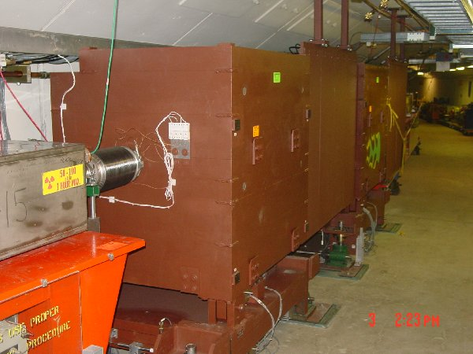
2. Collimator Activation Limits and Maintenance Strategy
The collimators were designed so that all potentially high maintenance components (i.e. motors and LVDT’s) are well away from the beam and should remain quite cool (<50 mR/hr @1 ft) even at the highest intensity.
The hottest areas will be the beam pipe in the region of the collimators.
This region is shielded from the aisle by an “iron curtain”.
Biggest worry would be replacing a BPM or corrector package behind this wall, but we feel that with proper planning, we could do this even with activation > 1R/hr @ 1ft.
This is a concern and we will continue to monitor it.

Slide 4
3a - RF Voltage vs. Intensity
We have gotten as many as 6.7E12 protons to transition, but can only get about ~5.5E12 through transition.
  We believe that at least part of the problem getting through transition is RF voltage.
Some details of measurements and calculation can be found in FERMILAB-TM-2238 (J. Maclachlan, X. Yang).
Primary effect seems to be real impedance, so to first order, expect linear scaling with RFSUM
  1 or 2 cavities would be a 5% or 10% increase in beam.
  This is ~consistent with the effect of losing a cavity.
Beam loss at a particular intensity more difficult to model.
  Efficiency seen to rise up to the highest RFSUM we can achieve.
Increased reliability also a factor in decision to add RF stations.

Slide 5
3b Gamma-t Jump
We have implemented hardware improvements needed to operate system at high rep. Rate.
Have demonstrated operation at moderate intensity
Issues:
  Alignment of pulsed quads: beam kicked at transition
  Effect on coupled-bunch modes.
Studies increased recently:
  X. Yang, J. Maclachlan working together with Argonne people (K. Harkay, J. Dooling, J. Norem).
  Expect more definitive statements soon.

Slide 6
4. Heating/Rad damage in ORBUMP magnets
Heating has been well modeled and should not be an issue at all in the ferrite, even at the highest rate.
The copper conductor will be water-cooled.
All mechanical parts of the magnet (feed-thrus, etc) are placed and designed to minimize radiation damage.
There are no good data on the rad-hardness of this particular ferrite:
  Based on experience with other ferrite, we believe it is not an issue.
  We will irradiate a sample to investigate the potential for damage.

Slide 7
5. MI Losses with NuMI Running. A worry?
Activation has not been an issue in the Main Injector up until now.
  Vast majority of the ring < 20 mR/hr @ 1ft
  A few (~2-3) points ~50 mR/hr near small aperture quadrupoles
  Max 100 mR/hr near some Lambertsons
Max NuMI+slipstacking ~10x current beam.
Simple scaling would indicate activation would become “an issue”, but not a major worry.
More studies needed on how losses scale with multi-batches and slipstacking.
Obviously needs more attention in a Proton Driver scenario.

