Slide 1
Proton Source
Eric Prebys
FNAL Accelerator Division/Proton Source

Slide 2
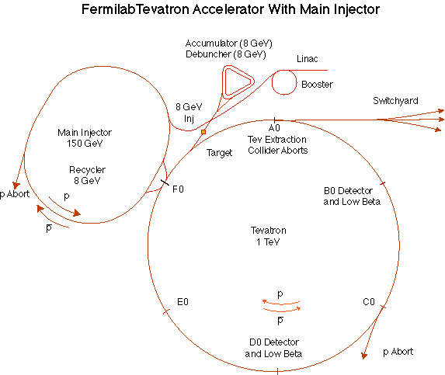
The Fermilab Accelerator Complex
Proton Source
MinBooNE
NUMI
MI-8 line

Slide 3
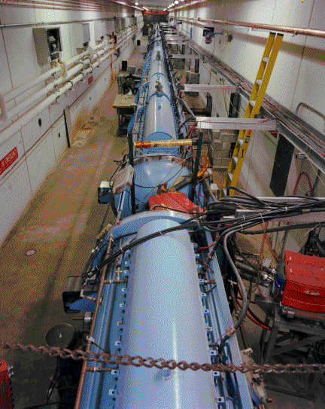
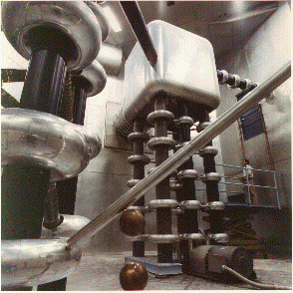
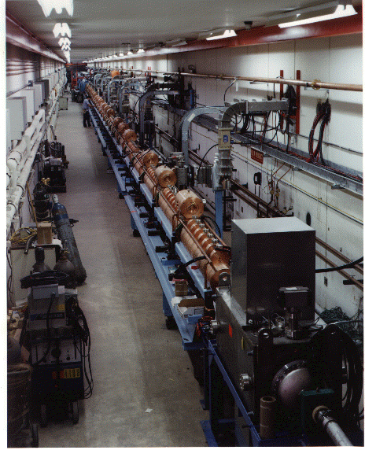
Preac(cellerator) and Linac
“New linac” (HEL)- Accelerate H- ions from 116 MeV to 400 MeV
“Preac” - Static Cockroft-Walton generator accelerates H- ions from 0 to 750 KeV.
“Old linac”(LEL)- accelerate H- ions from 750 keV to 116 MeV

Slide 4
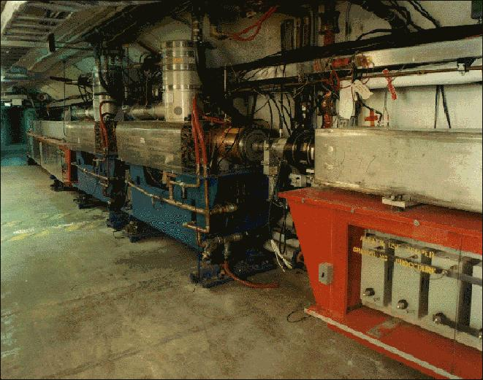
Booster
Accelerates the 400 MeV beam from the Linac to 8 GeV
  Operates in a 15 Hz offset resonant circuit
  Sets fundamental clock of accelerator complex
From the Booster, beam can be directed to
  The Main Injector
  MiniBooNE (switch occurs in the MI-8 transfer line)
  A dump.
More or less original equipment

Slide 5
Extracted Beam Structure
Single turn extraction:
80 bunches = 1.6 μsec
19 ns
~9 ns (FW)
…
5-6 x 10¹⁰ protons/bunch x 80 bunches = 4-5 x 10¹² protons/”batch”
(instantaneous) batch rep rate = 15 Hz

Slide 6
Limits to Proton Intensity
Total proton rate from Proton Source (Linac+Booster):
  Booster batch size
    ~4-5E12 protons/batch, depending on beam quality required.
  Booster repetition rate
    15 Hz instantaneous
    Currently ~9Hz, limited by RF system.
  Beam loss
    Damage and/or activation of Booster components
    Above ground radiation
Present performance
  Maximum ~10¹⁷ p/hr @ 4.5x10¹² p/batch
Historically our biggest worry

Slide 7
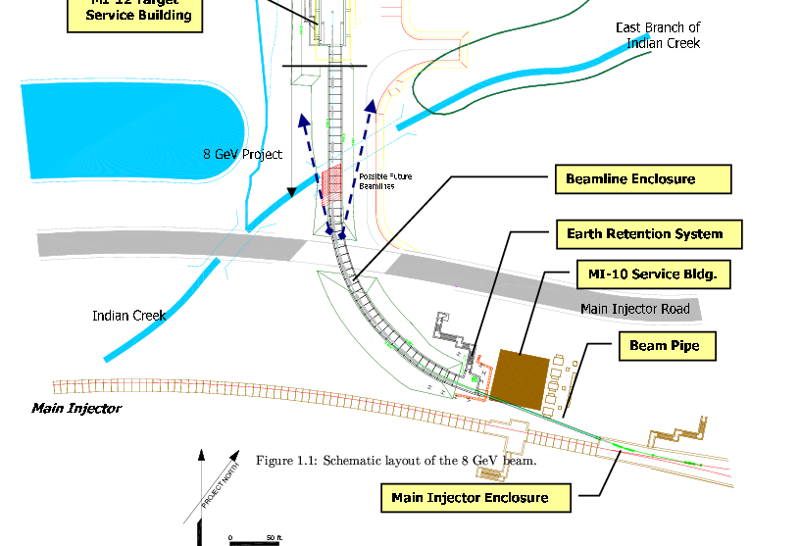
8 GeV Targetry Possibility: Booster Neutrino Beam
Could locate target somewhere in MI-12B beam line
Would compete with running experiments for beam

Slide 8
Variable Energy??
The specification says “1-5 GeV”
The Booster Accelerates resonantly to 8 GeV
It cannot be changed on a cycle by cycle basis
It can (and has) accelerated to different energies during dedicated running periods, HOWEVER
The MI-8 transfer line consists largely of permanent magnets design for 8 GeV beam.
  Cannot transport <8 GeV beam to Main Injector or BNB

Slide 9
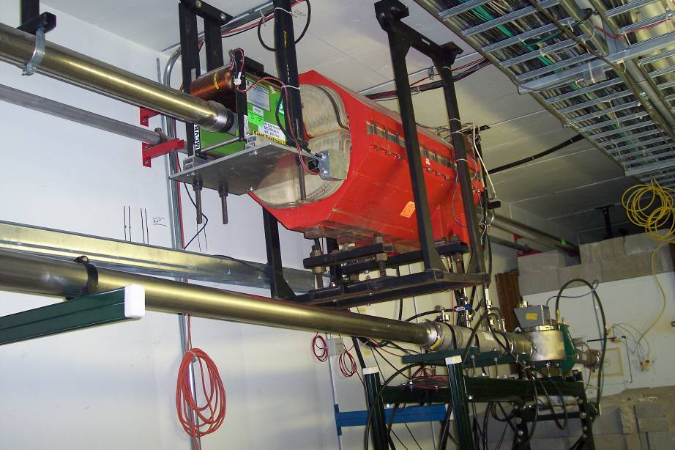
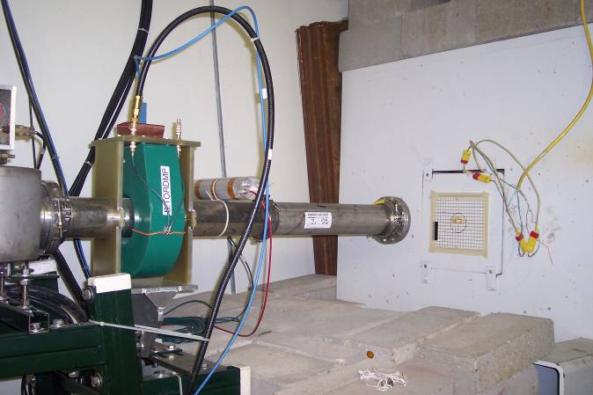
Possibility: Booster Dump
Used for study cycles and “short batches”
Can run to here with Main Injector in access
No permanent magnets before dump.
Could be retuned for alternate energies during special running periods.
Limited space for apparatus.
Maximum beam flux 6.8 x 10¹⁸ protons per year
  And we need a lot of that for normal operation.
MI-8 Line
Dump line

Slide 10
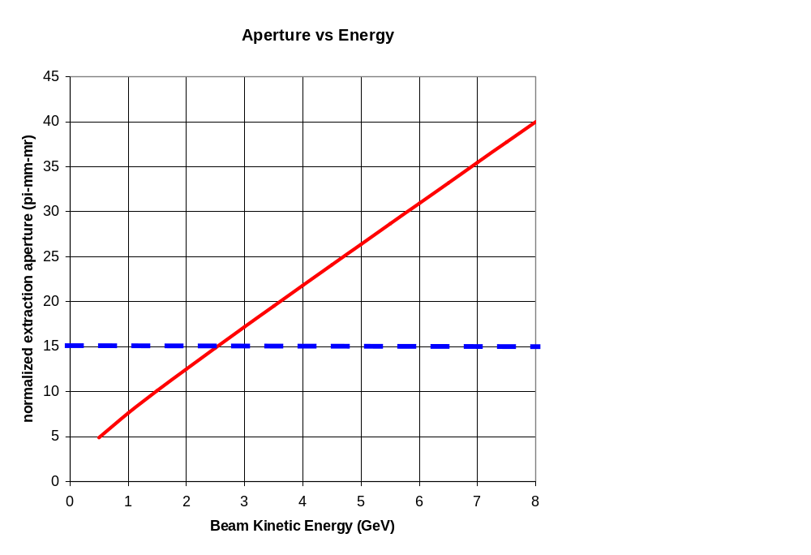
Extraction Aperture
Probably can’t go below ~4 GeV without big losses

Slide 11




A Few Comments on Proposed Parameters
Proton energy 1 GeV - 5 GeV
Protons per macro-pulse ≤ 10¹⁷
  ~20000 times Booster capacity
  ~ 1000 times SNS or (proposed) JPARC storage rings
  -> Slow spill not an option here or anywhere
Nominal macro-pulse lengths < 1 msec
  If linac, then 16 Amps ~100-1000 times practical linacs
Variable macro-pulse spacing up to ~250 sec
  10¹⁷ proton @ 5GeV every 250 sec = 320 kW
    ~1/4 design SNS
    About 10 times TOTAL Fermilab proton capacity

