Slide 1
Pre-shutdown Proton Source Status
The proton source typically delivers about 5.2E18 protons per week
  .7E18 (13%) for Run II (pbar production)
  4.5E18 (87%) for MiniBooNE
  This is about 40% of the MiniBooNE request
This number is limited by uncontrolled losses in the Booster.
The initial NuMI request (~1/05) will be about half the MiniBooNE request, and will rise somewhat of the next few years.
-> To run MiniBooNE and NuMI together, the Proton Source must deliver about four times what it delivers now.
So, what are we going to do about it??

Slide 2
Major Proton Source Shutdown Projects (with total time)
New Linac Lambertson (2.5 weeks)
  Will improve 400 MeV line optics and reduce losses.
  Status: in place; aligned today; being reconnected.
New Collimation System (2.5 weeks)
  Will reduce uncontrolled losses.
  Status: Collimators in place and cabled. Working on vacuum pipe.
Rearrange Long 3 extraction region (1 week)
  Will significantly reduce lattice “dogleg problem”.
  Status: waiting as long as possible for cooldown.
New wide aperture (EDWA) magnets at beginning of MI-8 line (4 weeks)
  Will reduce above-ground radiation.
  Status: wires and beam pipe disconnected. Begin magnet removal tomorrow.

Slide 3
Shutdown Projects (cont’d)
2 (of 18) prototype wide aperture RF cavities (2 days)
  Aperture goes from 2 ¼” -> 5”. Should reduce losses and activation.
  Status: Hopefully be ready for installation during the week of October 27th.
New Long 13 septum power supply
  Preparation for new septum & dogleg fix
  Status: Power supply in place. Cable pull soon.
Booster vertical alignment (1 week + 1 week)
  Hopefully solve known alignment problems.
  Status: trying to complete vertical network.
Radiation exposure a major worry on almost all jobs!!

Slide 4
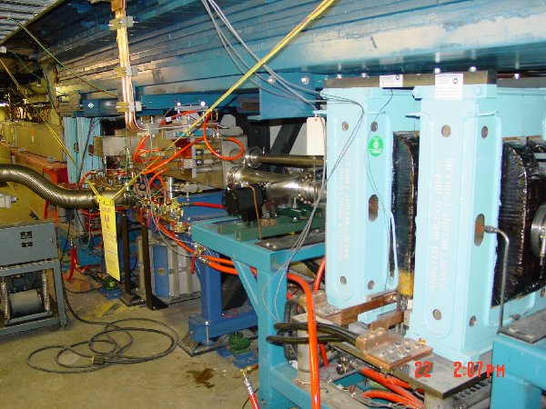
Long 3 Dogleg Work
Stretch out dogleg pairs
Move Septum
Should dramatically reduce lattice distortions caused by doglegs

Slide 5
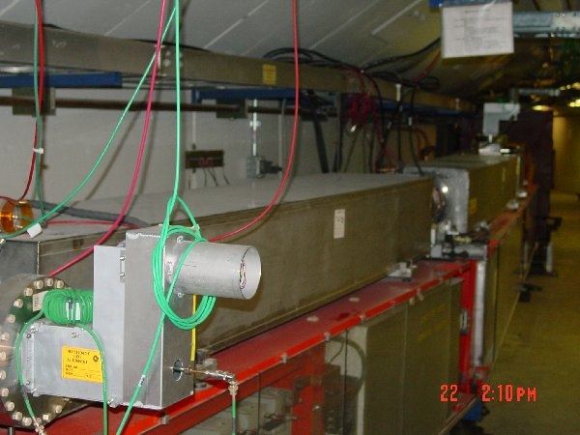
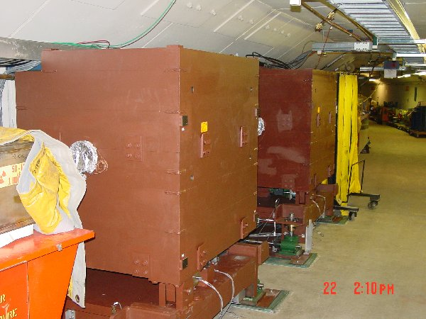
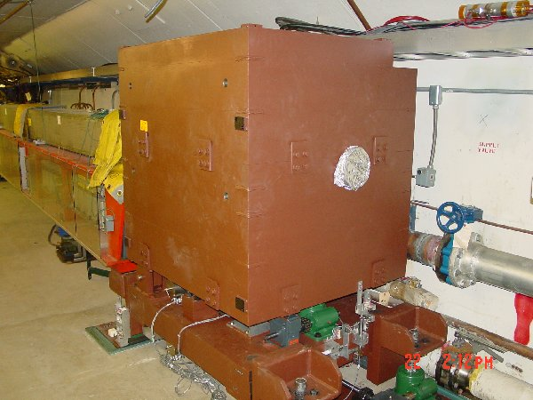
Collimation System
Primary Collimation foils
Secondary absorbers w/shielding
Tertiary absorber

Slide 6
Proton Source Shutdown Schedule
Sun | Mon | Tue | Wed | Thu | Fri | Sat
Sept. 7 | 8 | 9 | 10 | 11 | 12 | 13
14 | 15 | 16 | 17 | 18 | 19 | 20
21 | 22 | 23 | 24 | 25 | 26 | 27
28 | 29 | 30 | Oct. 1 | 2 | 3 | 4
5 | 6 | 7 | 8 | 9 | 10 | 11
12 | 13 | 14 | 15 | 16 | 17 | 18
Prep L6 and L3 for collimator placement
BOOSTER OFF- Cool down and miscellaneous prep work
Collimators (with ironworkers) – Assumes collimators have been assembled in access bay!
Lambertson (LInac Tunnel)
EDWA Installation
Collimators (ironworkers move to EDWA installation)
Lambertson (LInac Tunnel)
EDWA Installation
Lambertson (LInac Tunnel)
Dogleg Modification at Long 3
EDWA Installation
Linac up
EDWA Installation

Slide 7
Shutdown Schedule (cont’d)
Sun | Mon | Tue | Wed | Thu | Fri | Sat
Oct. 19 | 20 | 21 | 22 | 23 | 24 | 25
26 | 27 | 28 | 29 | 30 | 31 | Nov 1
2 | 3 | 4 | 5 | 6 | 7 | 8
9 | 10 | 11 | 12 | 13 | 14 | 15
16 | 17 | 18 | 19 | 20 | 21 | 22
Test MI-8
Extraction
Commissioning and Studies..
Install Prototype RF Cavities
Vertically align Booster
Commissioning and Studies. Possible weekend extraction tests.
Return to normal operation

Slide 8
Startup Plan and Projections
The current plan has two full weeks of studies and commissioning prior to the startup of the complex.
  New Long 3 arrangement should be similar to studies done in February -> we achieved record performance with 36 hours of tuning.
  Saw improvements from prototype collimation system during limited tests.
Expect to come out of shutdown “better” than we were before the shutdown.
We project 2-3 months to fully optimize new lattice and commission collimators.
  Learn optimum operating modes
  Establish new beam loss protocols (current system invovles counting lost protons -> won’t work with collimators)

Slide 9
Extraction Commissioning
Plan to secure the MI and extract beam to MiniBooNE weekend of October 25th-26th (end of week 7)
Based on the success of that weekend, reserve option to test extraction on subsequent weekends.
Plan to come out of shutdown with the new extraction more or less fully operational.

Slide 10
Collimator Commissioning
General procedure
  move the three secondary collimators in until they begin to attenuate the beam
  back them out slightly.
  Adjust the positions of primary collimators to minimize uncontrolled loss per proton.
Safety considerations
  One of our current limits (power loss), works by counting lost protons and weighting by energy.
  This will not work with collimators.
  We will need to establish much tighter limits on individual loss monitors.

