Slide 1
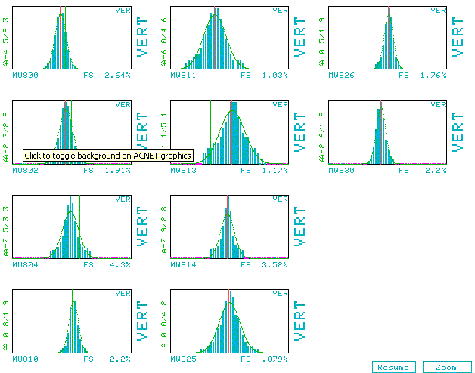
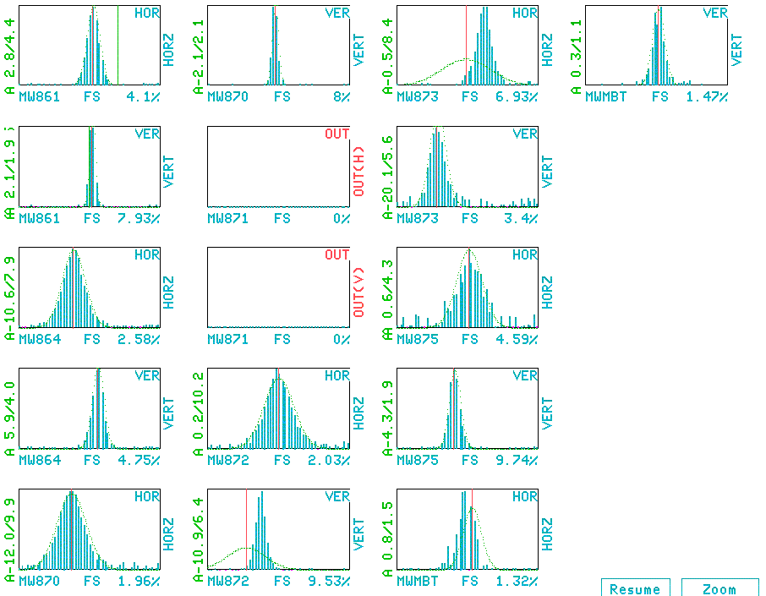
Beam Extracted to MiniBooNE
Started extraction tests Saturday owl.
Discovered MP02 septum was installed .8” too high -> moved.
After that, quickly established beam to MiniBooNE.
Waiting on optics analysis, but losses, alignment, and apertures look very good.
Target
MW
MI-8 Line
MiniBooNE Line

