Slide 1
Experimenter Contributions to Booster Improvements
Eric Prebys
FNAL Accelerator Division

Slide 2
General
The Booster has exceeded the Run II handbook specification for protons to the pBar target
  Slip-stacking the only thing left for Run II
  Challenges come from neutrino program
The present MiniBooNE and near future NuMI experiments depend critically on the performance of the Booster.
When these experiments were initially approved, there was no evidence whatsoever that the Booster could meet the need.
Luckily, the experiments came to understand this, and have provided and continue to provide valuable help:
  People (studies, calculations, general help)
  Fabrication (hardware, machine shop time)
  Money (well, yeah)
  “Advocacy” (very important)

Slide 3
Challenges in the Booster
Repetition Rate
  Injection system
  Extraction septum
  RF system
Peak Intensity (batch size):
  RF
  Tuning
  Transition
  damping
Beam loss
  Tuning
  Lattice Improvements
  Beam control
  Collimation
Above-ground radiation
  Calculation
  Shielding
  Work area re-classification
Multi-batch issues
  Beam cogging
Reliability and Basic Understanding
  Monitoring
  Analysis

Slide 4
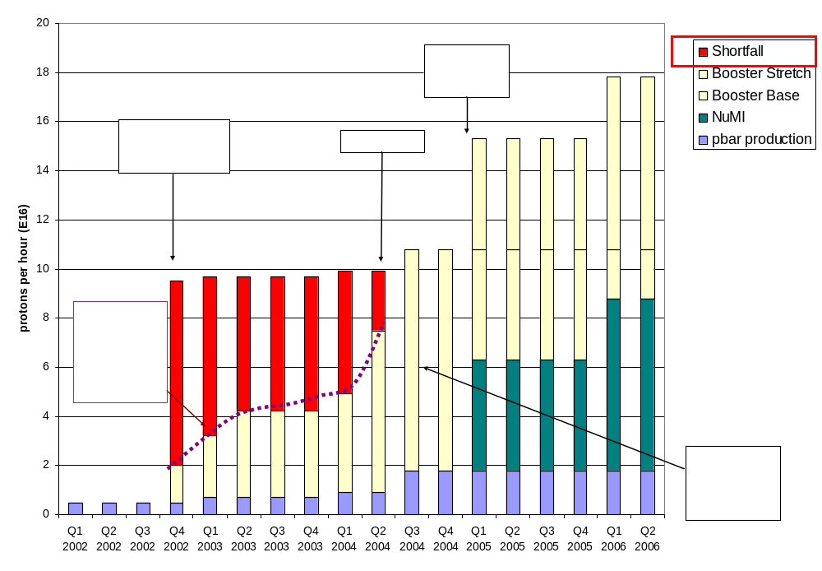
Proton Demand

Slide 5
Early Contributions from MiniBooNE
Shielding and Loss Calculations:
  Eric Zimmerman (Colorado U)
  Randy Johnson (U. Cincinnati)
  Goeff Mills (LANL)
Dipole Corrector Studies:
  Jocelyn Monroe (Columbia)
  Morgan Wascoe (LSU)
  Linda Coney (Columbia)
General Booster Studies
  Adam Malik (LSU)
  Linday Coney (Columbia)
  Jocelyn Monroe (Columbia)
Total loss monitors
  Yan Liu (U. Michigan)

Slide 6
RF Prototype Cavities – it takes a village
Originally planned to build one large-aperture RF cavity based on a proton driver R&D proposal
With the help of university machine shops, we were able to build two at a much lower price that one would have cost:
  Princeton (MiniBooNE)
  CalTech (NuMI)
  Columbia (MiniBooNE)
  Tufts (NuMI)
  Indiana (MiniBooNE)
  U. Texas, Austin (NuMI)
University Coordination:
  Doug Michael (CalTech)
  Chris Smith (CalTech)
  Bill Sands (Princeton)
Construction an unmitigated success
  All parts delivered on time
  NO mistakes.
One cavity will go in this fall and another in 2005 (as 19th and 20th cavities)

Slide 7
Fall 2003 Shutdown Work
Collimator System
  Initial collimator design abandoned as unworkable in late 2002
  Aggressive new design in 2003
    Larry Bartoszek, chief mechanical engineer (MiniBooNE)
  Installation originally cancelled for 2003 shutdown
    Columbia rescued it with a $300K loan.
Dogleg modifications
  Indiana provided a $100K loan to complete some of the miscellaneous installation and magnet work.

Slide 8
Current Projects
Booster Cogging
  Needed for both NuMI and pBar multi-batch operation
  B. Zwaska (NuMI, U. Texas, Austin/FNAL Accel. PhD)
Booster Ramp Monitoring
  Monitor and alarm ramped devices
  Ami Choi (MiniBooNE, Columbia)
Booster Rad Robot
  Use a robot to monitor both real time loss and activation in the Booster
  $35K NSF grant through Columbia
  Dave Schmidt (Columbia) working on software

Slide 9
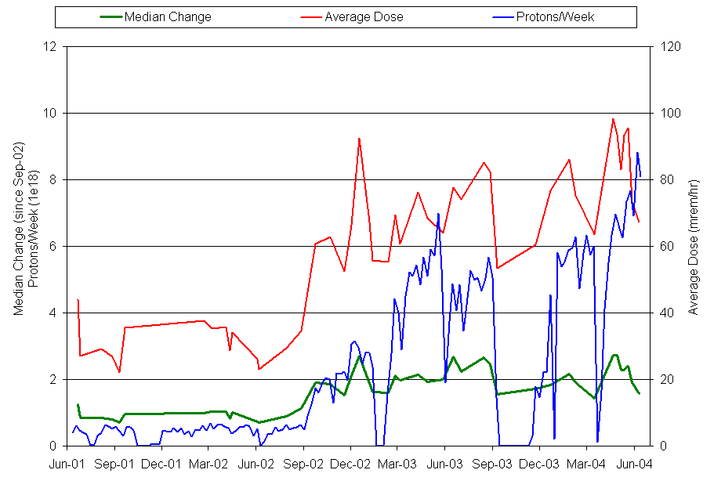
Successes
MiniBooNE (15x protons)
Raw Activation
protons
Normalized activation
collimators

Slide 10
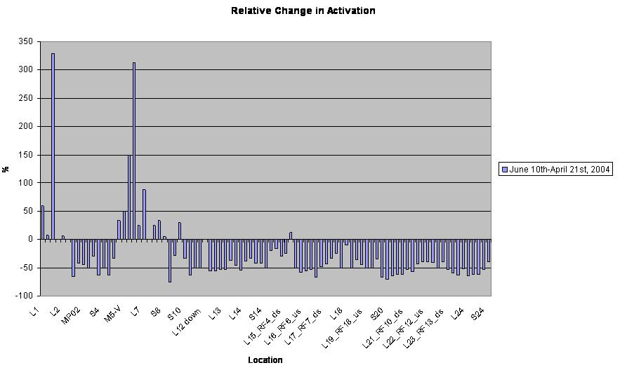
Activation (since collimators)

Slide 11
Recent Records
Protons per pulse: 6.06E12 (Run II=5E12)
Protons per hr to MiniBooNE: 7.5E16 (80% MiniBooNE goal)

Slide 12
Some Comments
If experiments depend critically on accelerator performance, it’s vital that experimentors get involved.
The contributions from MiniBooNE and NuMI have been very important to the Booster, but…
Most of the work has come from the lab, both from the proton source department and other departments, who have not been thanked here.
While on the topic of “outside help”, I should mention Argonne (Jim Norem, Kathy Harkay, Jeff Dooling):
  Transition work
  $$ for dogleg modification.

