Slide 1
Booster Activities
Eric Prebys
AD/PS

Slide 2
Major Proton Source Shutdown Projects
New injection bump (ORBUMP) scheme installed and 400 MeV line reconfigured
  Will allow higher rep rate
  Improves injection orbit matching and reduces losses
RF cavity drift tube cooling completed
  Will allow higher rep. rate
One of the two extraction regions removed from Booster and relocated to the MI-8 transfer line
  Reduces losses during acceleration cycle
New 13.8 kV transformers and switch gear installed for Booster RF system
  Improved reliability at high rep. rate
400 MeV line LVPS replacement
  Better reliability and stability of Booster injection
Sump water rerouting
  preventive maintenance for Tritium issue

Slide 3
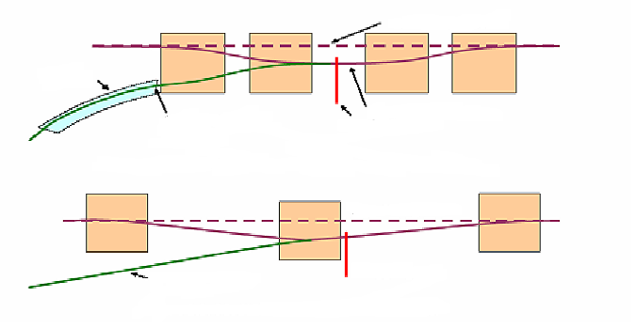
ORBMP/Injection
New Booster Injection - ORBMP Girder & PS
  A simplified 3 bump injection scheme
      Septum magnet not required
      Better lattice match
      Alignment of circulating beam with Injected beam
      Reduced edge focusing effects
      Total power cut in half
Circulating Beam
Septa
Injected Beam
Old Injection Girder
Foil
Circulating Beam
Injected Beam
Foil
New Injection Girder
Provided by Jim Lackey and Fernanda Garcia

Slide 4
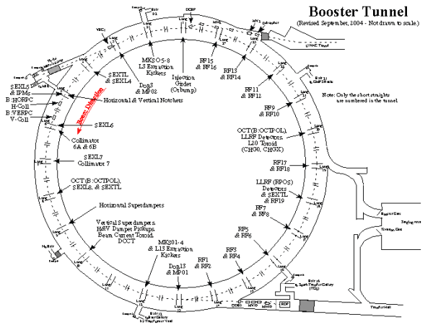
Booster Dump Relocation
Left alone
L3 Extraction to MI
L13 Extraction Dump
relocated to the MI-8 transfer line

Slide 5
Effects of Shutdown Work
Better Injection matching
  Beam motion reduced from 1 cm to ~2mm
Record efficiency -> Record performance
  Hourly rates
    9E16 pph MiniBooNE
    1E17 pph total
  Weekly totals
    1.08E19 to MiniBooNE
    1.2E19 total
Note: nothing that was done in this shutdown was expected to significantly increase beam to NuMI. That will come from
  Increased up time
  Reduced average MI cycle time
  Slip stacking (fully operational after next shutdown)

Slide 6
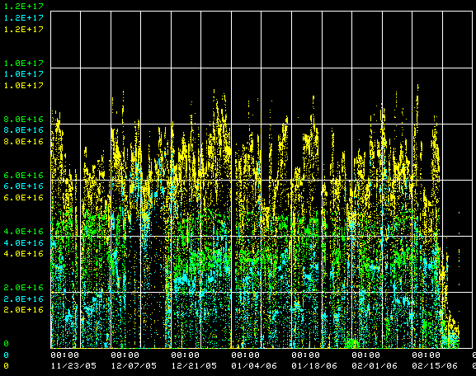
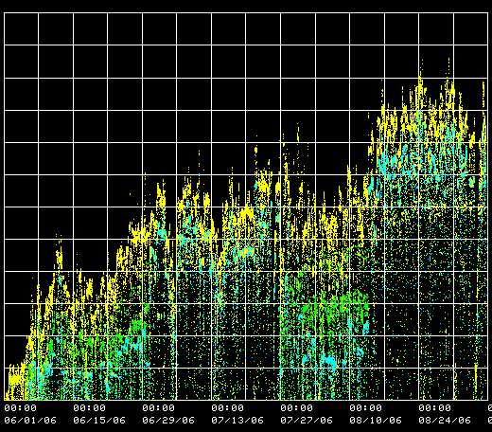
Hourly Rates
protons/hr (NuMI)
protons/hr (MiniBooNE)
protons/hr (total)
1E17
Before Shutdown
After Shutdown

Slide 7
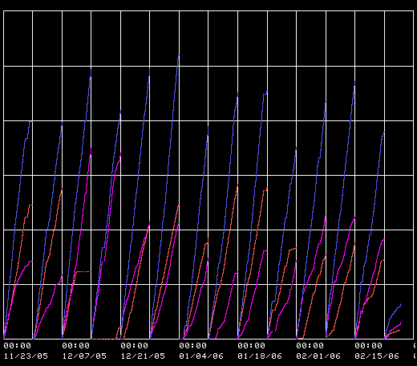
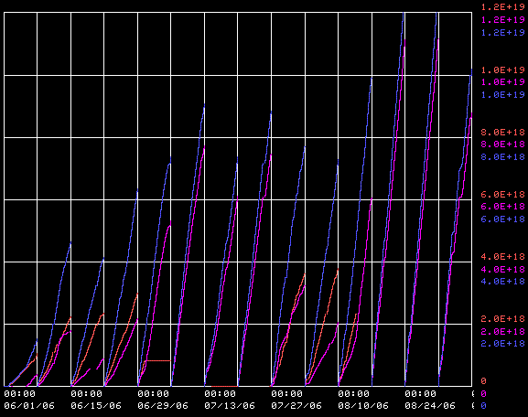
Hourly Rates
weekly sum (NuMI)
weekly sum (MiniBooNE)
weekly sum (total)
1E19
Before Shutdown
After Shutdown

Slide 8
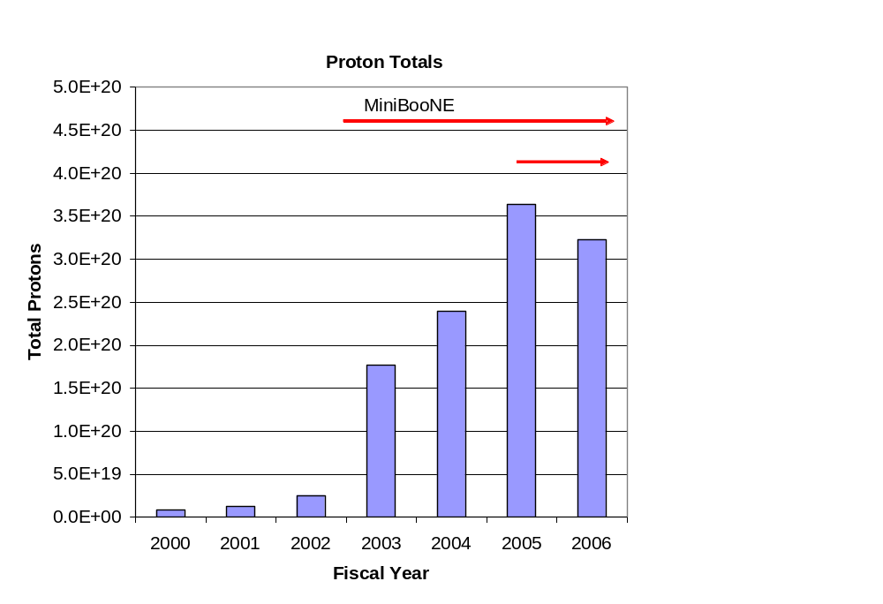
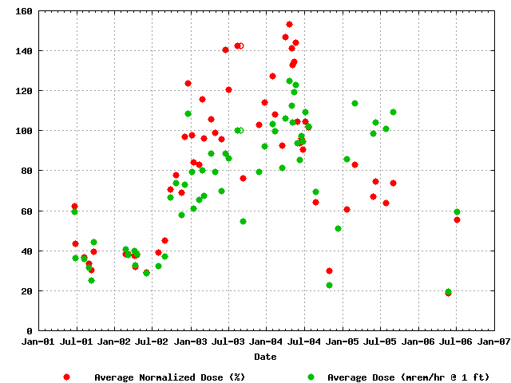
Bottom Line
Average Activation
MiniBooNE
NuMI
Factor of 15 increase in protons

Slide 9
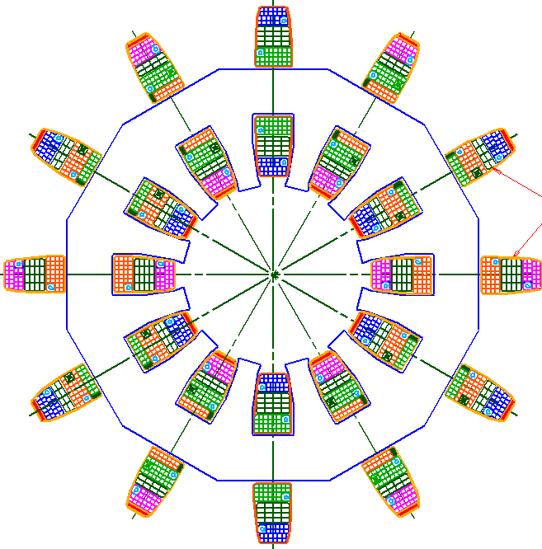
Next (Last??) Big Thing: New Correctors
Replace all 48 (original) Booster corrector packages.
Six independent multipoles
  Stronger H and V dipoles
    ±1cm beam motion throughout cycle
  Stronger quad
    Arbitrary tune working point throughout cycle
  Skew quad
    Coupling, same strength as before.
  Sextupole and skew sextupole at every period.
    Less emittance blowup
    More control of harmonic resonances.

Slide 10
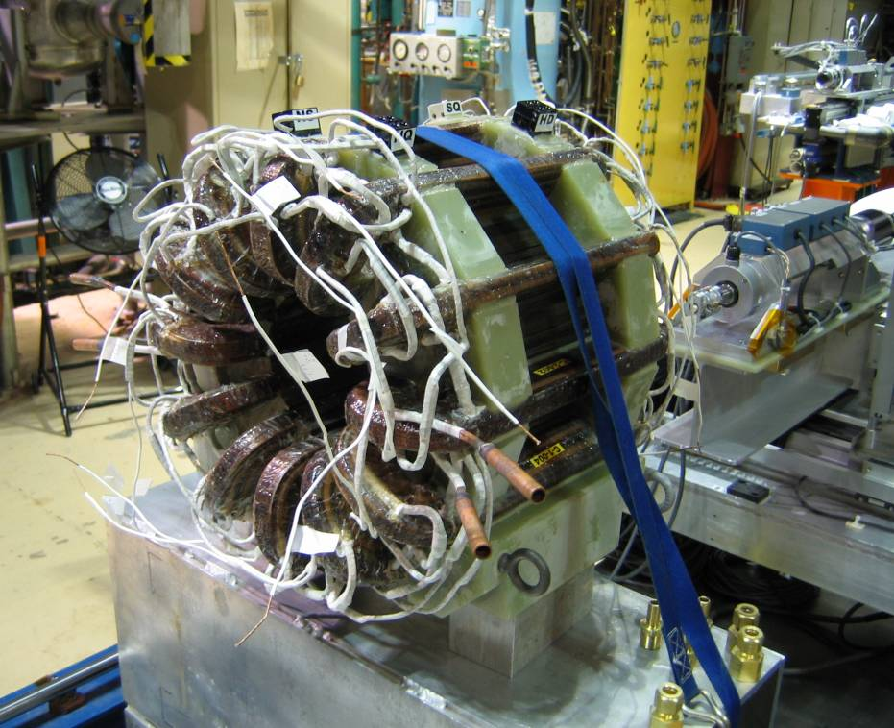
Correctors: Status
Testing first prototype
  Looks good
Just passed internal technical review
Aggressive schedule
Half of correctors in stalled in 2007 shutdown.
Second half in 2008 shutdown.
Done with Booster?

