Slide 1
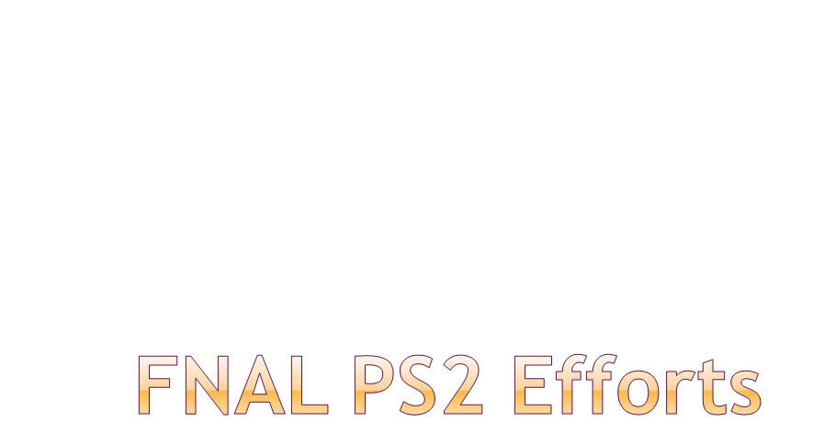
Eric Prebys

Slide 2
There is a great deal of synergy between PS2 and the Fermilab Main Injector during the Project X era.
  High energy ion transport, injection, and stripping.
  High intensity stability issues
  RF
Will try to build on this synergy and exploit ongoing efforts and available manpower at the lab
  Accelerator Physics Center: (ILC) Beam Physics
  SciDAC computing effort
  Relationship with Muons, Inc.

