Slide 1
PowerPoint Basics
Eric Prebys

Slide 2


Why?
Q: Do computers make our life easier?
A: I don’t know, but PowerPoint does.
  Powerful
  Easy to use
  Versatile
  Great for the “organizationally challenged”

Slide 3
Getting Started
Launch Program:
  Usually “Start->Programs->Microsoft PowerPoint”
You will be given options (varies slightly by version):
  “Open existing document”
  “Blank Presentation” (starting from scratch)
  “From Template” (some pre-defined styles)
  “From content wizard” (I avoid this one).
You will start with the title slide:
  Add title
  Add author

Slide 4
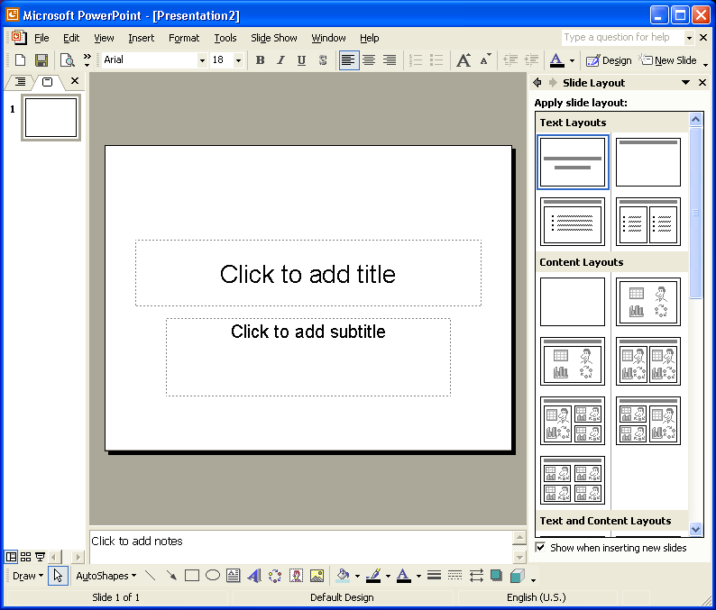
PowerPoint Desktop (newest versions)
Menus
Layouts
Slide Organizer
(use to rearrange slides)
Content Shortcuts

Slide 5
Turning off Annoying Features
On newer versions (XP or 2003):
  Go to “Tools->Autocorrect Options”.
  Select “Autoformat as you type” tab.
  UNCHECK “Automatic layout for inserted objects”.
  This will eliminate a lot of annoyances.

Slide 6

Inserting Slides
Select “Insert->New Slide”
  You will be prompted for the new slide layout.
    Some combination of text, images, and other objects
    You can modify this after you have created the basics.
Fill in title and text by clicking in the appropriate field and typing
  Promote or demote lists with indent buttons near upper right (or tab and shift-tab)
Add other content by clicking on the appropriate field in the content window
  Can also use “Insert” Menu
chart
spreadsheet
clipart
Image from file
Media clip
Org chart

Slide 7
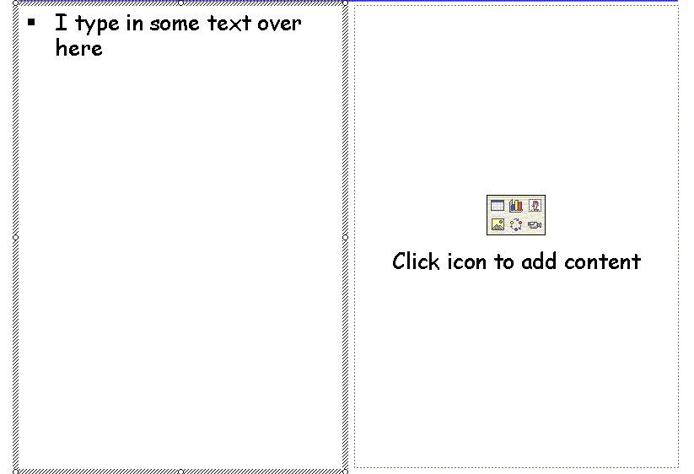
Example

Slide 8

Inserting Objects and other Files
Use “Insert” menu.
“Insert->Object” can create a variety of file types, or import them from existing files.
Can insert movie or sound files with “Insert->Movies and Sounds” menu:

Slide 9

Modifying Slides
Use textbox tool to add lines of text
You can move and resize text windows
  Click on edge and resize with mouse
Can also move and resize pictures
Draw simple things like arrows with the bottom menu items (or AutoShapes menu)

Slide 10
Useful Options in “Drawing” Menu
If you don’t see this, select “View->Toolbars” and check “Drawing”.
Generally, double-click or right-click on objects to set their colors, attributes, etc.
Word Art
Font
text
graphics

Slide 11
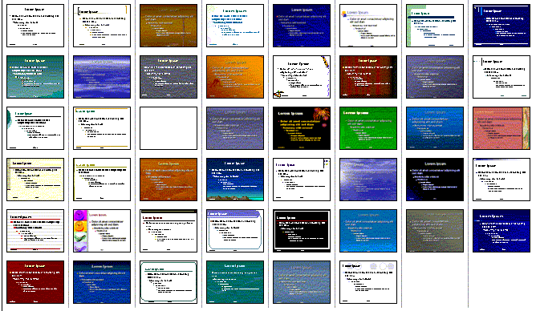
Modified Slide Layout
Can select from standard templates at file creation time:
Can also modify template with the “View->Master->Slide” menu
  This is where you set the title at the bottom of the page, for example.
Can save a favorite template with “Save as…” type “PowerPoint template (.pot)”

Slide 12
“Borrowing” Web Content
To use an image from a web page:
  Right-click on it and select “copy”, then “Edit->Paste” into PowerPoint, OR
  Right-click and select “Save image as…”, save to file, then insert with “Insert->Picture->From file”.
To copy an entire web page:
  Hit <ALT>-<PRINT SCREEN> to copy to the paste buffer
  “Edit->Paste” into page.
  Double click and select “Picture” tab to crop to desired size OR
  Consider pasting into an intermediate program like Office Photo Editor to crop and process before including.

Slide 13
Some Fancy Tricks (only for projector display)
Select “Slide Show-> Slide Transition”
  This will control how one slide transitions to the next
  Select style from list
  Click “Apply to all slides” to apply to whole presentation.
Select “Slide Show->Animation Schemes”
  This will allow you to animate the individual objects on a slide.

Slide 14
Example Animations
Can animate in one element
Then the next
Can modify with “Slide Show->Custom Animations”

Slide 15
Saving and Presenting
Save with “File->Save as…”
To display on a projector:
  Open file.
  Select “View->Slide Show”
  Click to advance
  Right click to navigate
To print out
  “File->Print”
    Select “slides” or “handouts” (several to a page).
To export to a webpage
  Select “File->Save as…”
  Select “Type” “Web page”
  Make sure to click “Publish” and select “All web browsers”.
  This will create one file with the name of the document and a directory with all the supporting files.
  The whole tree can be copied to a web server.

Slide 16
Tips and tricks (in no particular order)
Most programs (and all Microsoft programs) have compatible clipboards.
  You can “Edit->copy” from one program and “Edit->Paste” into a PowerPoint Slide.
When in doubt, right-click or double-click on a field to see what options appear.
For content from other applications, it’s usually better to create them separately, then include them as files, rather than create them directly in PowerPoint.

Slide 17
Versions and Options
Power Point has been around a long time.
Major improvements up until Office ’97.
Since then, most cosmetic and bells and whistles.
  All versions since then have been compatible.
  I’ve tried to be generic, but you may encounter some minor differences.
Getting software:
  Not all versions of Office have PowerPoint (e.g. “Small Business Edition”).
  If you are getting a new computer, make sure it’s bundled with PowerPoint (“Student” or “Standard” edition).
  If Office is a bit pricy (or if you believe Bill Gates is the Antichrist), consider OpenOffice
    http://www.openoffice.org/
    FREE!!!!!!!
    Emulates (and imports) major Office products, including PowerPoint
    Runs on other platforms (e.g. Linux).

Slide 18
Some Closing Remarks
Remember, the idea is to convey information:
  Are the colors visible?
  Are the fonts large enough?
  Have you overused features?
If you’re printing out slides:
  Don’t rely on animations, links, multimedia, etc.
  Don’t waste ink on backgrounds.

