Slide 1
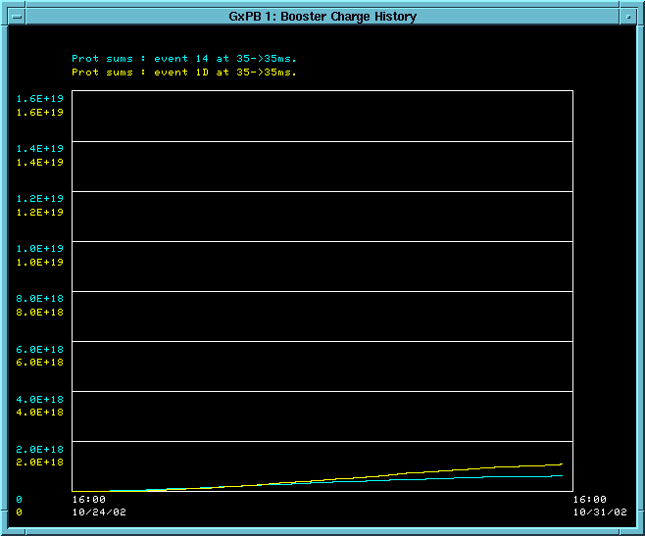
Protons Delivered in One Week (ending 10/31)
Base Line: 1.2E19
(5E20/year)
MiniBooNE: 1.1E18
Stacking: 6E17

Slide 2
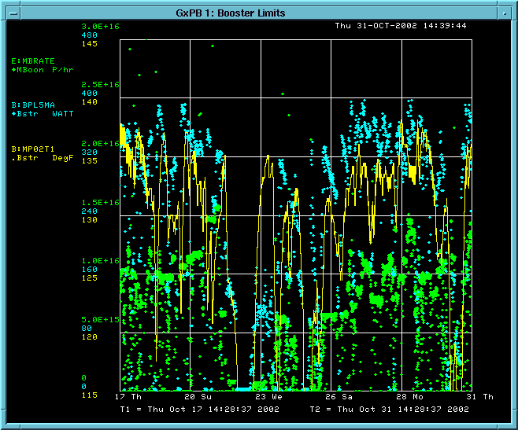
Limiting Factors
Limit
Booster Power Loss (will raise limit this week)
MP02 Temp
MiniBooNE rate (p/hr)
Wrong Magnet Move
Right Magnet Move

Slide 3
Plan to Increase Intensity
Near Term
  New extraction septum power supply: reduce heating (next week or so)
  Raise Booster power loss administrative limit 400->500W (this week)
  Integrate Booster orbit correction into MiniBooNE operation (this week)
  Minor shot-setup related operational improvements (next 2 weeks)
  ⇒ 50-100% increase.
“January” shutdown
  Shield collimators and begin to use.
  Install new extraction septum.
  Another factor of ~2.
Longer term:
  ???: lots of ideas, no magic bullet.

