Slide 1
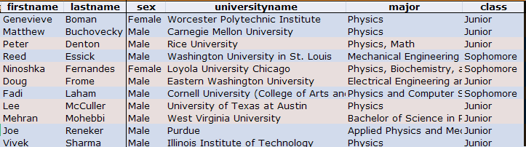
 | FNAL
 | ANL
 | 2008 | 2009
Total Applicants | 35 | 45
Total Slots | 11 | 11
Argonne | 6 | 6
FNAL | 5 | 5
Total offers | 13 | 14
Rejections | 2 | 3
Males | 10 | 9
Females | 1 | 2
non-US | 3 | 2
Illinois schools | 5 | 2
Sophomores | 1 | 3
Juniors | 10 | 8
3/240/09

